Slide 1
2022 HSC monitoring ​advice
Principals

Slide 2
What is the context for HSC Monitoring?​
Rules and regulations – underpinned by Education Act 1990​
Effective and efficient processes​
NESA​
Rules & regulations​ ACE Manual online​
Schools Online​
NESA​
Syllabuses
Stronger HSC
Standards
NESA​
Registration for government school system
Department​
Curriculum Policy Standards
Prioritise teaching time​
Reduce administrative burden​
Importance of consultation ‘to develop whole school negotiated processes and procedures’
Notes:
The information required for schools to successfully implement the HSC for all students comes from a range of sources, with multiple stakeholders (NESA, DoE, NSWTF) is underpinned by legislation (see Appendix 1).
The requirements of these multiple sources have been synthesised in the HSC monitoring advice, with links to the source documents where necessary.
The HSC monitoring advice was written with a view to identifying essential processes, but with a sensitivity to teacher and NSWTF concerns about excess administrative burden.
References:
Education Act: https://www.legislation.nsw.gov.au/#/view/act/1990/8/whole#%2Fpart8%2Fdiv2%2Fsec95
Educational Services Review: https://education.nsw.gov.au/about-us/strategies-and-reports/our-reports-and-reviews/educational-services-review

Slide 3
2022 HSC monitoring advice
SPaRO​
for principal confirmation and ​ DEL endorsement of the ​ HSC monitoring declaration ​
to input and confirm the HSC teacher support data collection for inexperienced and unsupervised teachers.
NESA COVID advice​
Principals have authority to determine the number, type and weighting of tasks for HSC and Year 11 school-based assessment​
informed by components in the syllabus assessment and reporting documents​
ACE manual COVID Changes for 2022 : https://ace.nesa.nsw.edu.au/covid-changes-for-2022
Notes:
The School Planning and Reporting Online (SPaRO) tool is used to collect data. Principals and DELs electronically sign off confirmation (Principal) and endorsement (DEL) for everything listed in Appendix 2 of the HSC monitoring document.
HSC teacher support data is collected at the same time. SPaRO is opening in Term 4 2021 so Principals can enter teacher support data. SPaRO entries and sign-offs must be done by 8 April 2022.
The expectation of the department and NESA is that you adhere to relevant assessment and reporting documents and requirements for each syllabus taught in your school.
If your school is affected by COVID closures, however, then variations to assessment may ensue. The ACE rule allows principals to have discretion over the number, type and weighting of tasks this year.
You can learn more in the ACE manual, COVID changes for 2022 – the link is on the slide. This ACE rule applies until 31 December 2022 or until it is revoked.
Reference:
ACE manual https://ace.nesa.nsw.edu.au/covid-changes-for-2022.

Slide 4
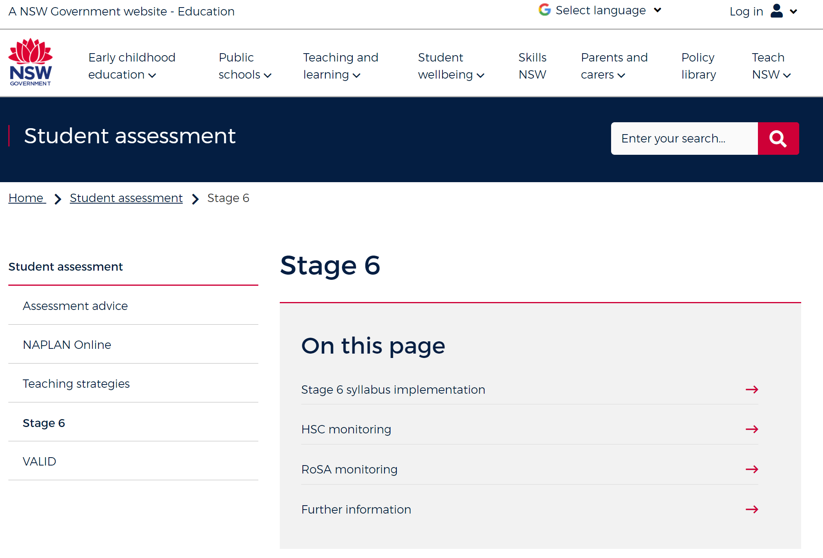
Department’s HSC monitoring advice
https://education.nsw.gov.au/teaching-and-learning/student-assessment/stage6
Notes:
You can find a copy of the advice at the URL shown on the slide

Slide 5
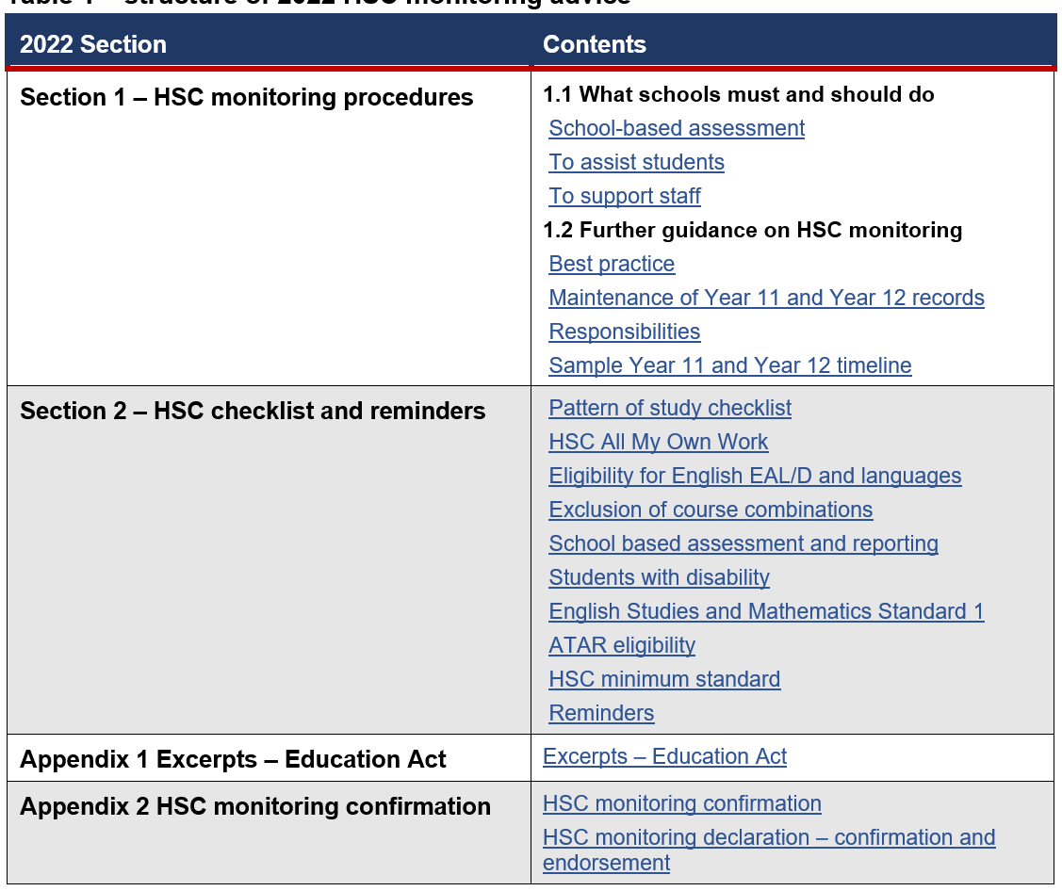
Structure of HSC monitoring advice​
Links provided for quick access to information​
Emailed to principals ​
Published in Staff Noticeboard ​
On Stage 6 web page​

Slide 6
Section 1 – HSC monitoring procedures
What schools must and should do – and further guidance
the advice is intended to assist senior executive, head teachers and teachers
when consulting to develop whole school negotiated processes and procedures
to monitor the requirements for Year 11 and Year 12
school processes should be time efficient and managed to support teachers, students and families.
1.1 … must and should do
School based assessment
To assist students
To support staff
1.2 Further guidance …
Best practice
Maintenance of records
Responsibilities
Sample timeline Year 11-12
Notes:
Maintenance of records
There is NO requirement to keep paper based records.
Efficient use of electronic systems is encouraged.

Slide 7
Section 2 – HSC checklist and reminders
Reminders
Pattern of study checklist​
HSC: All My Own Work​
Eligibility for English EAL/D and languages​
Exclusion of course combinations​
School-based assessment and reporting ​
key compliance issue​
stronger HSC reforms from 2018
Students with disability​
English Studies and Mathematics Standard 1​
awarded grade for HSC​
estimated mark if doing optional exam​
ATAR eligibility​
HSC minimum standard​
Reminders
wellbeing of students
Notes:
Remember to consider the wellbeing of students when developing assessment schedules. Wherever possible, schools should avoid multiple assessment tasks being due within a short timeframe. This is part of the whole school negotiated process.

Slide 8
Appendix 1 – Education Act excerpts
For all staff and students
The Education Act (1990) underpins NESA as ‘the authority’ in terms of rules and regulations for curriculum and the Higher School Certificate examinations​
The basis for the importance of external examinations
Notes:
As noted at the start of this presentation, the information required for schools to successfully implement the HSC is underpinned by legislation.
Appendix 1 of the HSC monitoring advice contains the relevant excerpts from the Education Act 1990
the legislation underpins the role of NESA as the authority implementing the education act
the numbers 95 and 12 refer to the sections of the legislation specific to the HSC

Slide 9
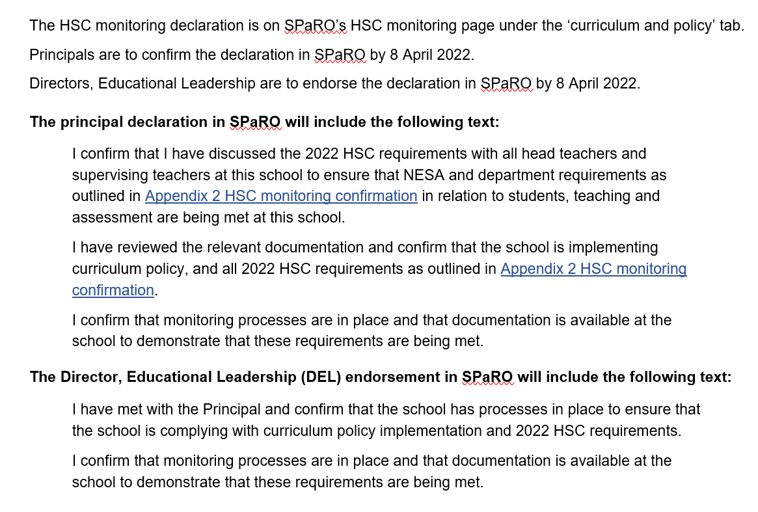
Appendix 2 – HSC monitoring declaration
Confirmation and endorsement
Check box confirmation in SPaRO​
principal declaration​
DEL confirmation
Nil return for schools that don’t have a Year 12 cohort in 2022.
Notes:
By then end of Term 1 2022, principals are requested to check off Appendix 2 in SPaRO, to confirm that the necessary information has been disseminated and that satisfactory monitoring procedures are in place.
​
This includes teaching and assessing, using 2022 syllabuses and prescribed texts, meeting requirements for patterns of study and school-based assessment requirements, and fulfilling obligations to students with regard to the HSC minimum standard of literacy and numeracy.

Slide 10
Further information
Kate Thompson, Stage 6 Advisor Email: kate.donnelly@det.nsw.edu.au
Telephone: 0467 962 300

