Slide 1
Stage 1 One unit of work – sample B All K-6 key learning areas
Notes:
Guiding questions

Slide 2
How to use this resource
Each Key Learning Area has sequential activities linked to outcomes. Choose the activities you wish to use and cut and paste them into your weekly class timetable with the resource links.
English
This resource includes 5 sequential tasks, with outcomes, from various English objectives.
Each task has a duration between 45 minutes and 1 hour.
Links to the online resources are included with tasks.
Mathematics
This resource includes 5 sequential tasks, with outcomes, from a Mathematics strand and sub strand.
Each task has a duration between 45 minutes and 1 hour.
Links to the online resources are included with tasks.
Science and Technology
HSIE
PDHPE
Creative Arts
This resource includes 3 sequential tasks, with outcomes, for each Key Learning Area. Each task has a duration between 30 minutes and 1 hour. Links to the online resources are included with tasks.

Slide 3
Support for assessment and feedback
Advice and resources
The department’s Curriculum planning and programming, assessing and reporting to parents K-12 policy informs school-based decisions about assessment and reporting processes.
A collection of ready-to-use assessment tasks, assessment activity templates and tools have been developed to support assessment and feedback. These resources could be used in both face-to-face and online classroom settings.
Professional learning
The strategies for assessment and feedback for K-6 professional learning provides a guide for K-6 teachers about how to assess and provide feedback online to students. It also provides advice to support parents and carers of K-6 students with assessment and feedback. Access the MyPL link to this professional learning under the primary curriculum section of the website.

Slide 4
English – overview of tasks
Objective A
Reading and Viewing– Connotation video
Writing and Representing – The Beach (worksheet provided)
Speaking and Listening – Good, bad or neither? (worksheet provided)
Reading and Viewing – Happily Haunted (worksheet provided)
Reading and Viewing – Onomatopoeia (worksheet provided)

Slide 5
English Task 1 – 45 minutes
Objective A Reading and Viewing 1 – EN1-4A – Connotation video
What do to: Watch the connotation, imagery and symbol video. After viewing, write or draw what you have learnt from this video. You can write in dot points.
Notes:
Teacher notes:
Formative Assessment ideas:
Resources: Y-chart graphic organiser – Digital Learning Selector

Slide 6
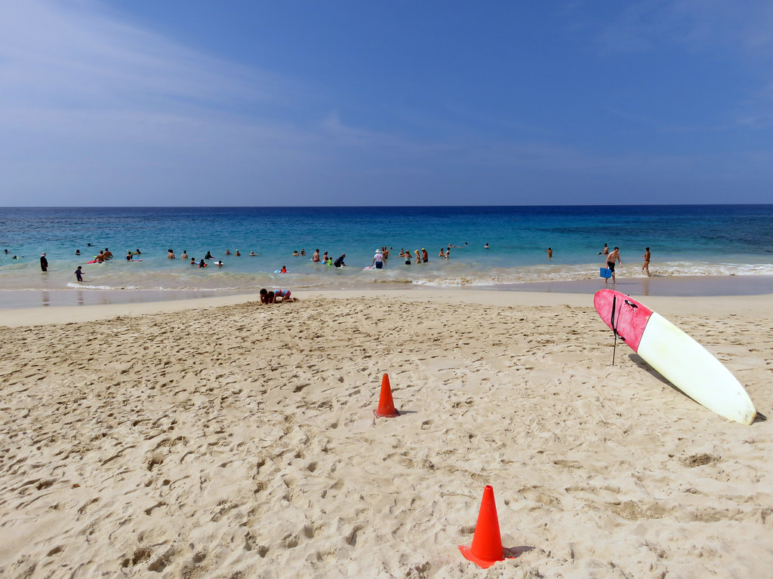
English Task 2 – 45 minutes
Objective A Writing and Representing 1 – EN1-2A – The Beach
What to do: Write a paragraph about how this image makes you feel (connotations of this image). Answer the questions in sentences (see next slide).
"Magic beach" by pfly is licensed under CC BY-SA 2.0
Notes:
Teacher notes:
Formative Assessment ideas:
Resources:

Slide 7
English Task 2 continued
How does the sun, sand and water make you feel? Does it make you feel relaxed and happy or scared and uncertain?
________________________________________________________________________________________________________________________________________________________________________________________________________________________________________________________________________________________________________________________________________________________________________________________
Why do authors sometimes use images in texts? What purpose can they serve?
________________________________________________________________________________________________________________________________________________________________________________________________________________________________________________________________________________________________________________________________________________________________________________________
Notes:
Teacher notes:
Formative Assessment ideas:
Resources:

Slide 8
English Task 3 – 45 minutes
Objective A Speaking and Listening 1 – Good, bad or neither
What to do: Place the listed words into the categories of positive (good), negative (bad) or neutral (neither good or bad) depending on the feelings and moods they make you feel. Explain to an adult why these words were placed in certain columns. Write these words into the table (see next slide) and add 3 more descriptive words of your own for each column.
relaxed | bossy | fit | loud
lazy | curious | energetic | talkative
nosy | interested | healthy | quiet
Notes:
Teacher notes:
Formative Assessment ideas:
Resources:

Slide 9
English Task 3 continued
Connotations
Negative | Neutral | Positive
Notes:
Teacher notes:
Formative Assessment ideas:
Resources:

Slide 10
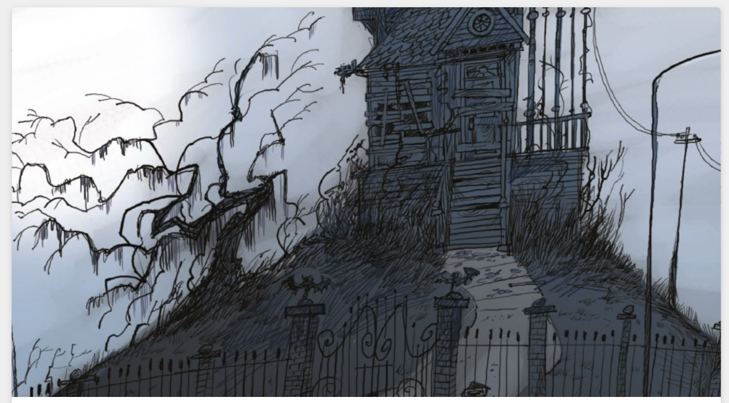
English Task 4 – 45 minutes
Objective A Reading and Viewing – EN1-4A – ‘Happily Haunted’ by Suzy Levison
What to do: Look at the image by illustrator Peter Sheehan from The School Magazine and answer the following questions (see next slide). After you complete the questions, read or listen to ‘Happily Haunted’ by Suzy Levison from The School Magazine.
Notes:
Teacher notes:
Formative Assessment ideas:
Resources:

Slide 11
English Task 4 continued
What colours feature in this illustration?______________________________________________________
Why do you think the illustrator uses these colours?
____________________________________________________________________________________________________________________________________________________________________________________________
How do these colours make you feel?
____________________________________________________________________________________________________________________________________________________________________________________________ Looking at the image, what do you think this poem is going to be about? ____________________________________________________________________________________________________________________________________________________________________________________________ This poem is called Happily Haunted. What do you feel when you hear the word: happily? ______________________________________________________________________________________________
What do you feel when you hear the word: haunted?
______________________________________________________________________________________________
Notes:
Teacher notes:
Formative Assessment ideas:
Resources:

Slide 12
English Task 5 – 1 hour
Objective A Reading and Viewing 1 – EN1-4A – Onomatopoeia
What to do: Onomatopoeia is when a word describes a sound and mimics the sound of the object or action it refers to when it is spoken. For example, screech, woof, bang, moo, whoosh Record the onomatopoeic words from Happily Haunted, by Suzy Levison : 1. 2. Write a sentence using these words and draw an example of what these words would look like or what objects make these sounds (see next slide)
Notes:
Teacher notes:
Formative Assessment ideas:
Resources:

Slide 13
English Task 5 continued
Onomatopoeia
Word | Sentence | Drawing
Notes:
Teacher notes:
Formative Assessment ideas:
Resources:

Slide 14
Mathematics – overview of tasks
Measurement and Geometry – Order! Order!
Measurement and Geometry – Length/ Pentominoes 2
Number and Algebra – Whole Numbers/ ‘Hit It’
Measurement and Geometry – Two dimensional space/ Tangrams 1
Measurement and Geometry – Area, Number and Algebra – Fractions and Decimals / Tangrams 2

Slide 15
Mathematics Task 1 – 45 minutes
Number and Algebra – Whole numbers 1 – MA1-4NA – Order! Order! Working Mathematically outcomes: MA1-1WM, MA1-2WM, MA1-3WM
(From Mike Askew) What to do: View video Order! Order! Write these numbers on post-it-notes or paper and place them in this order. Help Michelle and Barbara order these numbers from largest to smallest. Record how many moves it takes to order them. Remember you are aiming to use the fewest moves possible! Play Order! Order!

Slide 16
Mathematics Task 2 - 45 minutes
Measurement and Geometry – Mass 1 – MA1-12MG – Balancing Numbers 1 Working Mathematically outcomes: MA1-1WM, MA1-2WM, MA1-3WM
(Inspired by the work of Dan Meyer) What to do: View video Balancing numbers 1 – part 1 What do you notice? What do you wonder? View video Balancing numbers 1 – part 2 How many more bears are needed to make the scale balance? (How many bears are equivalent in mass to The Hulk?) What’s an estimate that’s way too high? What’s an estimate that’s way too low? What’s an estimate that you think is reasonable? View video Balancing numbers 1 – part 3 Create a drawing to represent the problem: How many bears are equivalent in mass to the Hulk?
Notes:
Teacher notes:
Formative Assessment ideas:
Resources:

Slide 17
Mathematics Task 3 – 45 minutes
Measurement and Geometry – Mass – MA1-12MG – Balancing Numbers 2 Working Mathematically outcomes: MA1-1WM, MA1-2WM, MA1-3WM
What to do: View video Balancing numbers 2 – part 1 What’s an estimate that’s way too high? What’s an estimate that’s way too low? What’s a reasonable estimate? View video Balancing numbers 2– part 2 What would you do to solve this problem? Share your thinking with a fellow mathematician or write down your ideas. Revise your estimate: how many paddle pop sticks are needed to balance the mass of The Hulk? View video Balancing numbers 2– part 3 What do you think will happen to the balance scale? Draw a picture to communicate your thinking. View video Balancing numbers 2– part 4 What can we say about the mass of The Hulk, the collection of bears and the collection of paddle pop sticks?
Notes:
Teacher notes:
Formative Assessment ideas:
Resources:

Slide 18
Mathematics Task 4 – 45 minutes
Number and Algebra – Whole Numbers 2 – MA1-4NA – Mastermind Working Mathematically outcomes: MA1-1WM, MA1-2WM, MA1-3WM
What to do: View video Mastermind Play mastermind! How to play: Each player writes down a 3-digit number (with no repeating digits). Each player draws up their game board (a table with 3 columns: 'guess', 'digits', 'places'). Players take turns to guess a 3-digit number. Their opponent tells them how many digits are correct and how many are in the correct place. Players record their guess, the number of digits that are correct and the number of digits that are in the right place. Players then use this information to refine their guesses. The first player to correctly guess their opponents' number is the winner! Players can choose to play using 4-digit numbers, 5-digit numbers, 2-digit numbers. etc.
Notes:
Teacher notes:
Formative Assessment ideas:
Resources:

Slide 19
Mathematics Task 5 – 45 minutes
Number and Algebra – Multiplication and Division – MA1-6NA – Circles and Stars Working Mathematically outcomes: MA1-1WM, MA1-2WM, MA1 – 3WM
(From Marilyn Burns) What to do: View video Circles and stars Collect your resources and play Circles and stars from Marilyn Burns. Remember you only need to draw enough stars to help you work out the product. How to play: Divide your paper into eighths Roll a dice to determine how many circles (groups) you need to make Turn over a playing card (or roll the dice again) to determine how many stars to add into each circle. Determine how many stars there are in total. You can draw all or some of the stars in each circle - you only need to draw what you need to help you work out the product. Continue taking turns until each player has had 6 turns each. Work together to work out who has the most stars altogether.
Notes:
Teacher notes:
Formative Assessment ideas:
Resources:

Slide 20
Science and Technology – overview of tasks
Material World
Man-made or natural? (worksheet provided)
Properties of materials (worksheet provided)
Properties Venn (worksheet provided)

Slide 21
Science and Technology Task 1 – 45 minutes
Material World – ST1-7MW-T – Man - made or natural? Focus question: How do properties of materials determine their use?
What to do: Man-made materials are formed by human technology, tools and resources. Natural materials are formed by nature and have not been changed in anyway. Cut out the man-made and natural materials (see next slide). Sort and paste them into the T-chart under the correct heading.

Slide 22
Science and Technology Task 1 continued
Natural materials | Man-made materials
Natural and man-made materials. Cut, sort and paste them into the table.
glass | tree bark | stone | plastic
paper | cotton | steel | polyester
sand | wood | concrete | wool

Slide 23
Science and Technology Task 2 – 45 minutes
Material World – ST1-7MW-T – Properties of materials Focus question: How do properties of materials determine their use?
What to do: Properties of materials can describe how that material looks and feels. For example, the properties of natural chalk could be white, dry, crumbly and light. We use the senses of touch and sight to describe the material. Choose 4 natural materials from the previous activity and add them to the table headings (see next slide). Find and write 4 properties that describe each material.

Slide 24
Science and Technology Task 2 continued
Properties of natural materials
Material 1: | Material 2:
Material 3: | Material 4:

Slide 25
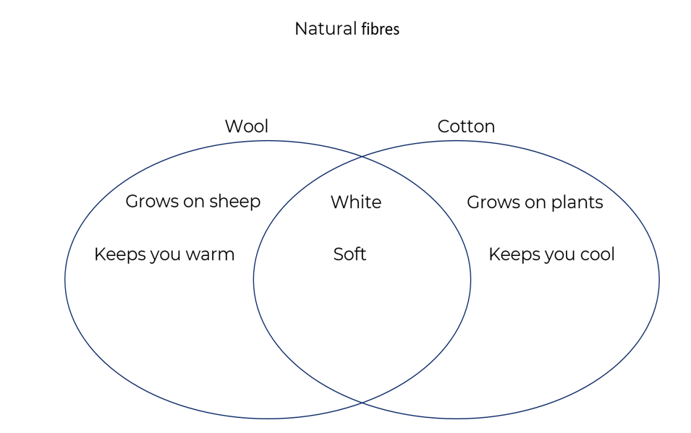
Science and Technology Task 3 – 1 hour
Material World – ST1-7MW-T – Properties Venn Focus question: How do properties of materials determine their use?
What to do: Properties of materials can be both similar and different to each other. We can use Venn diagrams to compare what material properties are the same as each other and which ones are different. For example, the Venn diagram below is comparing the materials of wool and cotton. The circles show the differences while the space in the centre shows the similarities. It’s your turn now to compare the properties of rock and wood. Put the properties that are the same as each other in the centre space. Put the properties that are unique into each side as appropriate.

Slide 26
Science and Technology Task 3 continued
Natural materials
Rock
Wood

Slide 27
HSIE History – overview of tasks
Present and past family life
My family
Life in the past
Changed or stayed the same?
Notes:
The definition of ‘immediate family’ varies with individual circumstances. Be aware and sensitive to the social and cultural backgrounds of the students and their concept of their immediate family. In particular, be aware of the family structures and kinship system in Aboriginal and Torres Strait Islander families (as described in Tom Tom, by Rosemary Sullivan and Dee Huxley).

Slide 28
HSIE History Task 1 – 1 hour
Present and past family life – HT1-1, HT1-4 – My family Key inquiry question – How has family life changed or remained the same over time?
What to do: Think about the members of your family. They might live in the same home as you or they might live somewhere else. Find photos of your family or the people in your family. Tell an adult about your family and the members of your family. Draw a picture of the members of your family. Label each person. Think about what you do each day. What activities do you do? Are the activities the same every day or do they change? Think about what each family member does each day. What activities do they do? Are the activities the same each day or do they change? Ask the members of your family what they do each day. (This is called an interview). Try to find out at least three activities they do. Do they enjoy what they do? Would they like to do something else? You could use a digital device to record their responses.

Slide 29
HSIE History Task 2 – 45 minutes
Present and past family life – HT1-1, HT1-4 – Life in the past Key Inquiry Question – How has family life changed or remained the same over time?
What to do: Interview your family members again to find out what life was like for them when they were children. Ask them if they have any photos of when they were children. Try to ask one of your grandparents what life was like when they were a child. You could use a digital device to record their responses. Think of some questions you could ask them. You could also ask them some of these questions: What games did they play? What was their favourite toy? How did they get from one place to another? Did their family use a car? A bicycle? A horse? Where did they go for holidays? What food did they eat at home? Did they ever eat takeaway food? What clothes did they wear?
Notes:
State Library of NSW – holidays past and present
State Library of NSW – games children play

Slide 30
HSIE History Task 3 – 45 minutes
Present and past family life – HT1-1, HT1-4 – Changed or stayed the same? Key inquiry question – How has family life changed or remained the same over time?
What to do: Look at these photos of games and holidays of children in the past. Holidays past and present Games children play Think about what you learnt about your family members' life when they were children. How was their life the same as your life each day? How was their life different to your life each day? Draw a picture comparing your life to the life of a member of your family when they were a child. Label the people and objects in your drawings. OR Use a digital device to talk about how your life is similar and different to the life of a member of your family when they were a child.
Notes:
State Library of NSW – holidays past and present
State Library of NSW – games children play

Slide 31
PDHPE – overview of tasks
Health, Wellbeing and Relationships
We all belong
Inclusion and exclusion
Movement Skill and Performance
Over-arm throw (worksheet provided)

Slide 32
PDHPE Task 1 – 45 minutes
Health, Wellbeing and Relationships – PD1-10 – We all belong Key Inquiry Question – How can we be inclusive and respectful?
What to do: Discuss with your teacher or parent/caregiver the following questions. What groups do you belong to? Why is it important to belong to a group? Inside a box, write or draw all the groups you belong to. For example, your class, school house, sports team. Around the outside of box, write or draw why it is important to belong to a group. For example, make new friends, learn new skills, learn to cooperate, support. List at least 2 other members of the same group and explain how you could make them feel included. For example, I shared pencils with my friend in class, I passed the ball to everyone in my soccer team or I cheered for my house mates at the swimming carnival.

Slide 33
PDHPE Task 2 – 45 minutes
Health, Wellbeing and Relationships – PD1-10 – Inclusion and exclusion Key Inquiry Question - How can we be inclusive and respectful?
What to do: ‘To be included means to invite another person to be part of something.’ ‘To be excluded means to intentionally not include someone.’ Read the scenario. Laura is a new student in your Stage 1 class. She has just moved to Australia from Japan. She doesn’t know anyone and is still learning to speak English. At lunch time Laura sits alone and looks upset. You return to class and she sits alone again at the back of the room. Discuss with your teacher or parent/caregiver. How do you think Laura feels whilst sitting at the back of the room? How do you think you would feel if you were excluded? What could you do to make Laura feel included? Think of 10 ways to make Laura feel welcome and cared for. Write them down in a list 1-10.

Slide 34
PDHPE Task 3 – 45 minutes
Movement Skill and Performance – PD1-4 – Over-arm throw Key Inquiry Question – What are the different ways we can move our body?
What to do: What types of throw have you used? Which type of throw did you prefer to use? Why? Choose a safe playing area where you can throw a number of soft objects. Create a target that you can safely throw a soft object towards. If possible, create two larger rings around the centre target to create a ‘bullseye’. Use the scoring system and table on the next slides.

Slide 35
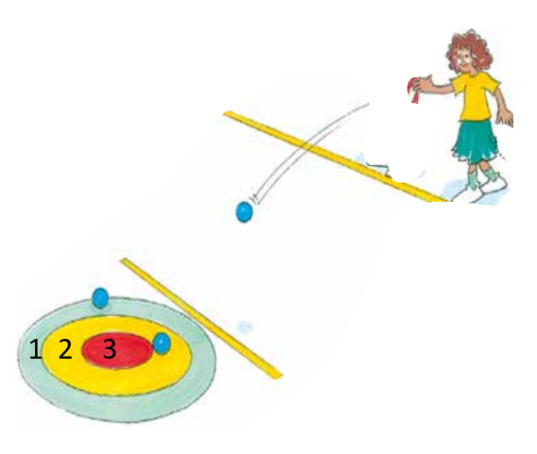
PDHPE Task 3 - continued
Bullseye
‘Starting point’ may be about 3-5 metres from the target for the first attempt.
Before beginning each attempt, discuss the questions with your teacher or parent/caregiver:
Which throwing style do you think will score most points? Why?
If you’re unable to create a target with three rings as shown below, a sample scoring system may be:
5 points if the object hits or lands on the target
3 points if the object lands within one step of the target
2 points if the object lands within two steps of the target.
Adapted from Sport Australia 2019 © Playing for life

Slide 36
PDHPE Task 3 – scoring system
Use the scoring system and record the amount of points you score on each attempt. After 5 attempts move the target, or line, so that the throwing distance has changed.
Target | Attempt 1 | Attempt 2 | Attempt 3 | Attempt 4 | Attempt 5
Target 1
Target 2
Target 3
Target 4
Target 5
EYES (Eyes focused on target area throughout the throw.)
SIDE-ON (Stand side-on to target area.)
STEP FORWARD (Step towards target area with opposite foot to throwing arm.)
FOLLOW-THROUGH (Throwing arm follows through, down and across the body.)

Slide 37
Creative Arts – overview of tasks
Music – Characters in music
Insy Winsy Spider.
Little Miss Muffett.
Characters in the arts.

Slide 38
Creative Arts Task 1 – 45 minutes
Music – MUS1.1, MUS1.2, MUS1.4 – Insy Winsy Spider
What to do: Sing the song ‘‘Insy Winsy (Bitsy) Spider’ Start by doing the finger play then change this to movement Move around the room like a spider Start by being a slow old spider, then a young small and very fast spider, then a jumping spider Change the mood of the spider to grumpy or happy and so on.

Slide 39
Creative Arts Task 2 – 30 minutes
Music – MUS1.1, MUS1.2, MUS1.4 – Little Miss Muffett
What to do: Learn to sing ‘Little Miss Muffett’. Keep the beat on knees using spider fingers. Move this to one accent slapping knees and then gentle spider touches on the remaining 2 pulses in each beat (strong, weak, weak, strong, weak, weak) Experiment with different tempos accompanying this song. Slow (‘lento’) then fast (‘allegro’) whilst keeping the beat. Then combine the two tempos with an ‘accelerando’ (getting faster) in the middle when Miss Muffett finds the spider. Highlight how music can explore a character and changing musical concepts (such as changing the tempo) can effect the way that we think about that character Move hands up and down to indicate the direction of the pitch contour (the melody). Identify the patterns, steps and jumps in the pitch.

Slide 40
Creative Arts Task 3 – 45 minutes
Visual Arts and Music – MUS1.1, MUS1.2, VAS1.1, VAS1.2 – Characters in the arts
What to do: Watch the lesson footage of ‘Little Miss Muffett’ and participate in the activities in the video Create the melodic contour line map with assistance of the footage then practise humming ‘Little Miss Muffett’. Reflect on the quote by Paul Klee that ‘A line is a dot that went for a walk’ and discuss what this line map looks like Create an artwork based upon the melodic contour drawing that was made during the video. This should be a line drawing and can be realistic or abstract. It may feature a spider web or anything else it reminds the students of. Exploring a character either real or imagined would be ideal for this activity.

