Slide 1
Principal network meeting – presentation
Notes:
Purpose: to provide DELs with a presentation they can adapt/deliver to their principal network meetings. The presentation will last for roughly 10-15 mins.
This section of the Curriculum and Reform communication pack includes agenda and acknowledgement of country – the idea is to provide DELs with a complete deck (with notes) that they can deliver or adapt for their Principal network meetings.

Slide 2
Acknowledgement of Country
I would like to acknowledge the traditional custodians of the various lands on which we are meeting today and pay respect to Elders past, present and emerging and extend that respect to any Aboriginal and Torres Strait Islander people joining us today.

Slide 3
Agenda
# | Item | Slide
1
2
3
4
5
Notes:
Notes: DELs to personalise

Slide 4
Summary
What’s in the pipeline?
Sample units for K-2 English and K-2 mathematics are now available for all schools
Schools must register Department Approved Electives (DAE) for 2023 via the link on the webpage. Professional learning will be available during Term 4 in the Teaching and Learning 7-12 Statewide Staffroom
New resources available for all schools on the Leading curriculum K-12 webpage
Week 4 – Curriculum and reform information for schools to use at staff meetings, stage/faculty meetings and School Development Days on the Keep up to date – Curriculum K-12 webpage
Week 4 and 5 – Primary and Secondary principal drop-in sessions (Primary MyPL NR36829, Secondary MyPL NR36830)
Notes:
Purpose: this slide will summarise the information from the following slides and provide an overview of future projects from CandR that are relevant to schools. Key points, high-level of rest of the presentation (single slide takeaway)

Slide 5
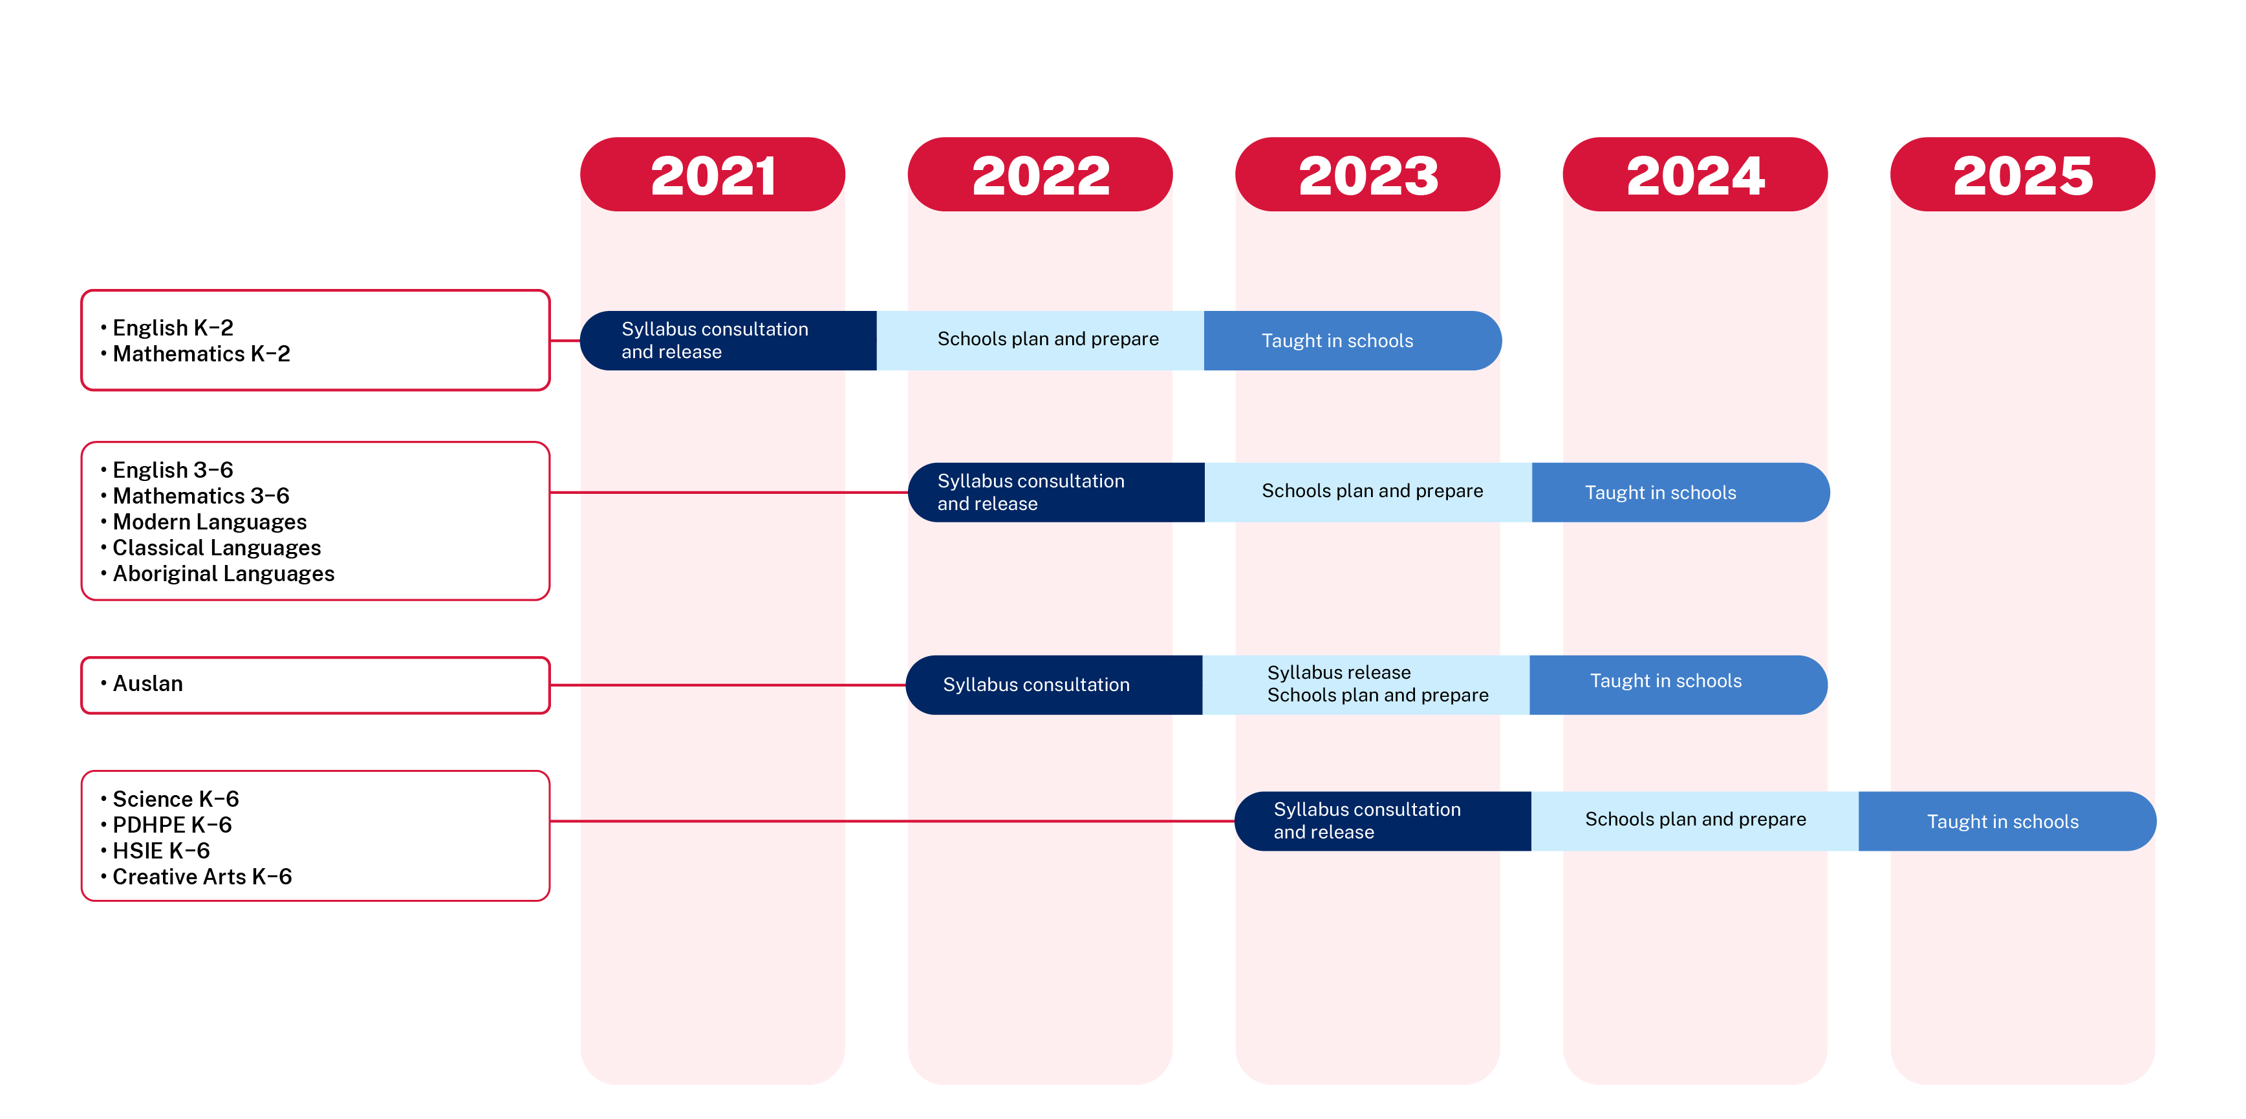
NESA syllabus timeline
Primary – Kindergarten to Year 6
NESA Curriculum Reform timeline
Notes:
Purpose: This slide will also include NESA updates – may not be any content, dependent on NESA timelines and information release (if nothing new, repeat old info to ensure consistent messaging).

Slide 6
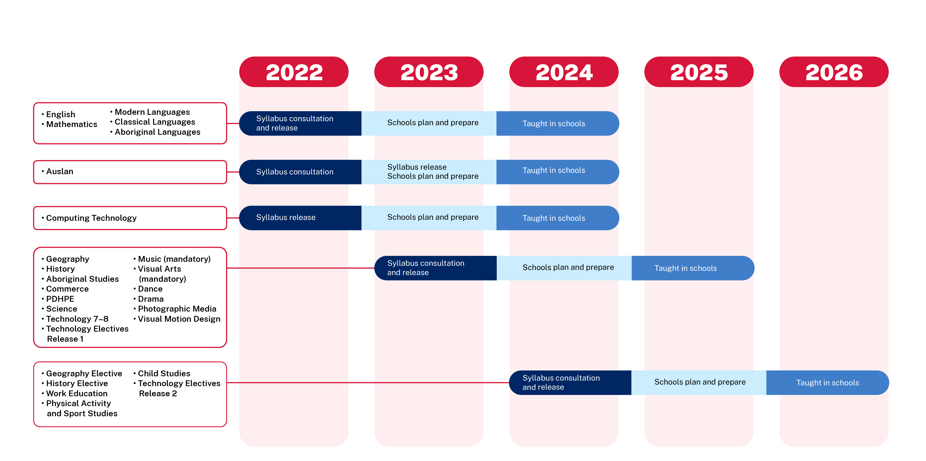
NESA syllabus timeline
Secondary – Years 7 to 10
NESA Curriculum Reform timeline
Notes:
Purpose: This slide will also include NESA updates – may not be any content, dependent on NESA timelines and information release (if nothing new, repeat old info to ensure consistent messaging).

Slide 7
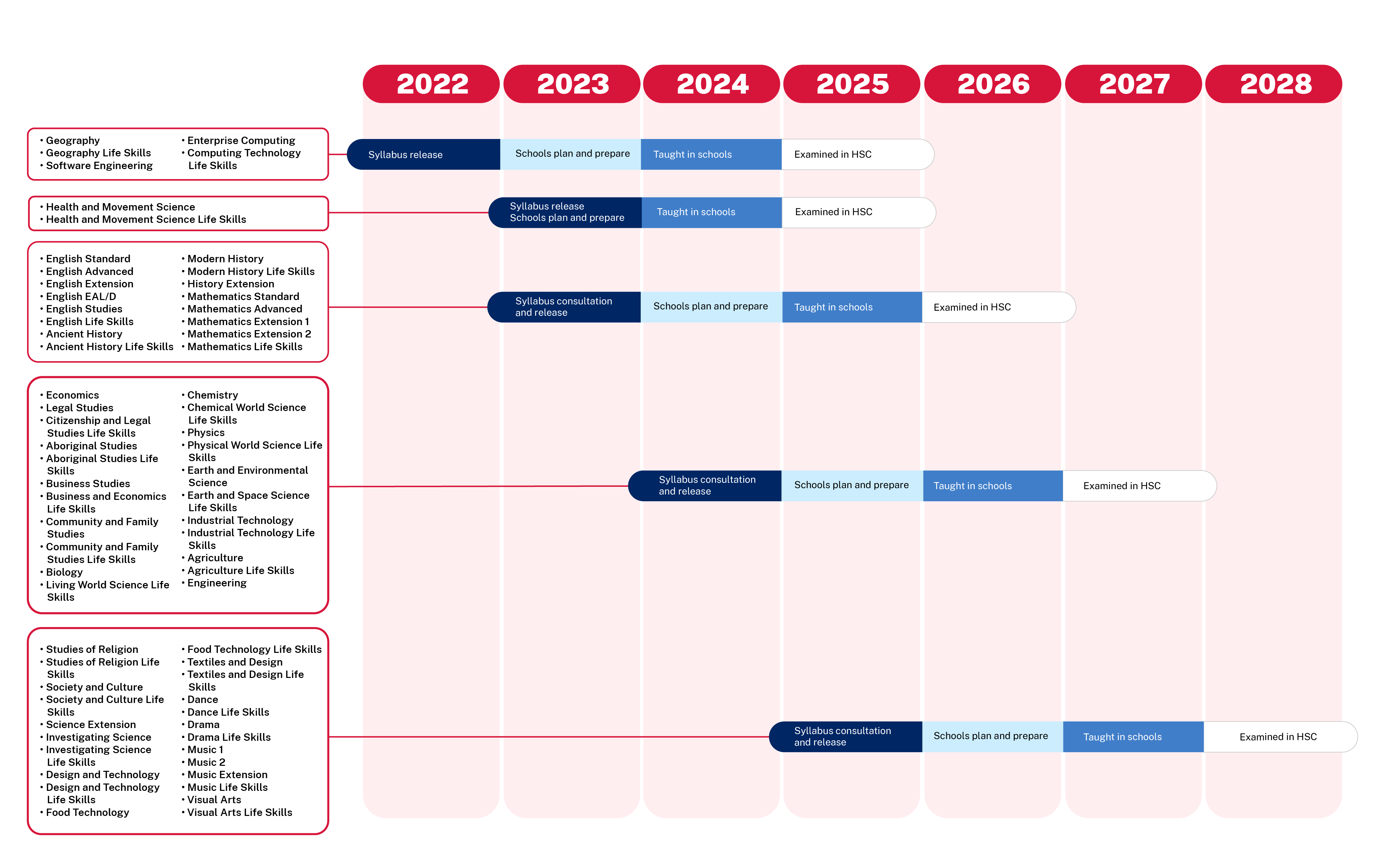
NESA syllabus timeline
Senior Secondary – Years 11 to 12
NESA Curriculum Reform timeline
Notes:
Purpose: This slide will also include NESA updates – may not be any content, dependent on NESA timelines and information release (if nothing new, repeat old info to ensure consistent messaging).

Slide 8
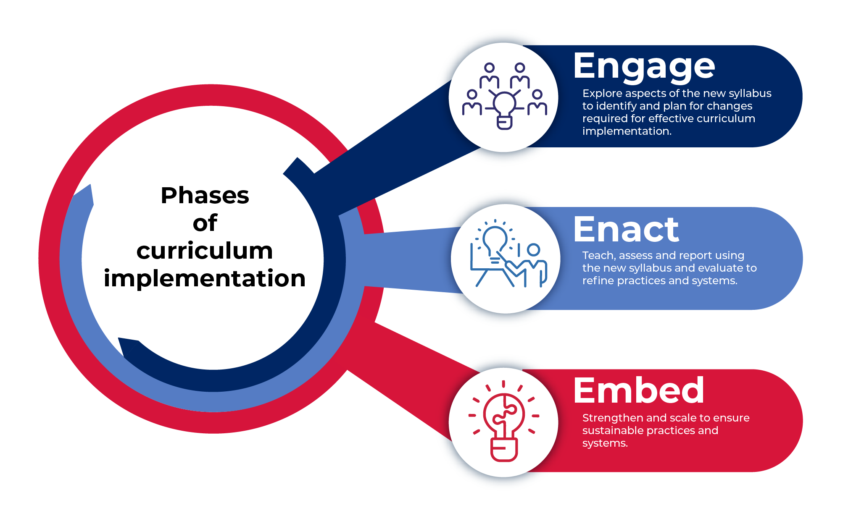
Department of Education updates
K-12 resources
Information related to the Engage, Enact, Embed phases of curriculum implementation including:
Animated videos
Posters
Role-specific information for
Principals
Assistant principals
Assistant principal, curriculum and instruction
Head teacher
Teacher
School planning for curriculum implementation support
Leading collaboration for school improvement toolkit chapters (Engage, Enact, Embed)
Leading curriculum implementation research toolkit
Notes:
Purpose: new resources.

Slide 9
Department of Education updates
Primary resources
English and mathematics K – 2
First 30 sample units released
Optional resources forming part of the Curriculum Reform Support Package for teachers.
Sample units must be reviewed for suitability prior to use. They are designed to be adapted by teachers to meet the needs of their students.
The sample units are available on the department's website
English K-2 units
Mathematics K-2 units
K-6 CHPS (Creative arts, HSIE, PDHPE and Science and technology)
NESA will take a K-6 approach to CHPS syllabuses (not K-2 and 3-6 as for English and mathematics).
Notes:
Purpose: new resources.

Slide 10
Department of Education updates
General resources
Quality curriculum implementation 7-10
A course overview and links to MyPL can be found here
Curriculum planning for every student in every classroom
A course overview and links to MyPL can be found here. New modules include
Aboriginal learners, English as an Additional Language or Dialect (EAL/D) learners, High potential and gifted learners, Learners with disability
What’s coming?
Principal drop-in sessions unpacking the phases of curriculum implementation resources – Weeks 4 and 5
Primary (MyPL NR36829)
Secondary (MyPL NR36830)
Curriculum and reform information for staff meetings, stage/faculty meetings and School Development Days will be available on the Keep up to date – Curriculum K-12 webpage – Week 4
Primary 3 x 15 minute sessions (Phases of curriculum implementation, K-2 English, K-2 Maths)
Secondary 2 x 15 minute sessions (Phases of curriculum implementation, 7-12 syllabus implementation and support packages)
Notes:
Purpose: new resources.

Slide 11
Lessons learnt
…from early adopter schools
The following information has been collated from focus groups:
Schools with strong internal collaboration feel more confident to implement new syllabuses
Leadership teams play a critical role in supporting teachers to effectively implement new syllabuses
Scope and sequences are helpful in planning and organising teaching and learning
Units are being used flexibly and adapted to suit student needs
Time is still a barrier for teachers to learn about new syllabuses.
‘Our school has worked collaboratively and this has been a big support, listening and guiding one another with our varying levels of understandings has ultimately benefited our students. We have found ways to adjust the units to suit our context and needs enabling us to build our understandings.’
– AA focus group participant
Notes:
Purpose: this slide is designed to leverage the lessons learnt from AA and SS schools + CRC news.

Slide 12
Lessons learnt
… from Curriculum Reform Communities
Nominate to join a Curriculum Reform Community (CRC)
The benefits of belonging to a CRC
accurate and consistent information to ensure curriculum changes and expectations are clear for schools
timely updates on the status of curriculum reform
support that includes quick links to the latest resources
professional learning that builds teacher capacity to lead curriculum change
collaborate with teachers from other schools to learn and share practice.
How to join
Fill out the school coordinator nomination form. After principal endorsement, nominated staff members will be assigned to a CRC. From 2023, funding is available for one school coordinator per school.
You can locate your closest CRC on the CRC map. If there is no CRC in your area, you can join the virtual CRC.
For more information, including what is involved and how to nominate, please visit the CRC webpages.
Notes:
Purpose: this slide is designed to leverage the lessons learnt from AA and SS schools + CRC news.

Slide 13
Problem of practice
How do principals establish processes and practices that support effective curriculum implementation?
Phase of curriculum implementation – Engage
Explore aspects of the new syllabus to identify and plan for changes required for effective curriculum implementation.
Stimulus
Viviane Robinson, ‘The impact of leadership on student outcomes, making sense of the evidence’ (10 min read)
Reflective questions
What school practices and systems are in place to support teacher professional learning? How are these evaluated to maximise support for teachers?
How has the principal ensured there is clarity among the school leadership team about their specific responsibilities for curriculum implementation?
What structures are in place for tailored professional support for all staff to strengthen curriculum implementation? What else might be required for this syllabus?
What resources are required to commence syllabus implementation and meet planning, programming, assessing, and reporting requirements? How is this embedded into the Strategic Improvement Plan?
Notes:
Purpose: The 'problem of practice' slide is included for information purposes only. This part of the presentation is designed to stimulate conversation and surface key thinking and research with schools. The topics and stimuli have been agreed on by the DEL IWG and chosen to illustrate system thinking around leading curriculum reform and implementation.

Slide 14
Problem of practice
How do principals establish processes and practices that support effective curriculum implementation?
Suggested protocol for engaging with the stimulus – challenging assumptions
Prior knowledge – jot down initial thoughts around the question using a T-chart (‘I think… is…, I think… is not)
Partner discussion – discuss ideas on T-chart in pairs
Expand the discussion – join with another group to discuss ideas on T-chart
Summarise – partner pairs create a group T-chart
Debrief – share back to wider group, identify commonalities, outline next steps to embed learnings into practice
Notes:
Purpose: The 'problem of practice' slide is included for information purposes only. This part of the presentation is designed to stimulate conversation and surface key thinking and research with schools. The topics and stimuli have been agreed on by the DEL IWG and chosen to illustrate system thinking around leading curriculum reform and implementation.

