Slide 1

Curriculum Reform update – DELs and principals
Term 3, Week 8, 2023

Slide 2
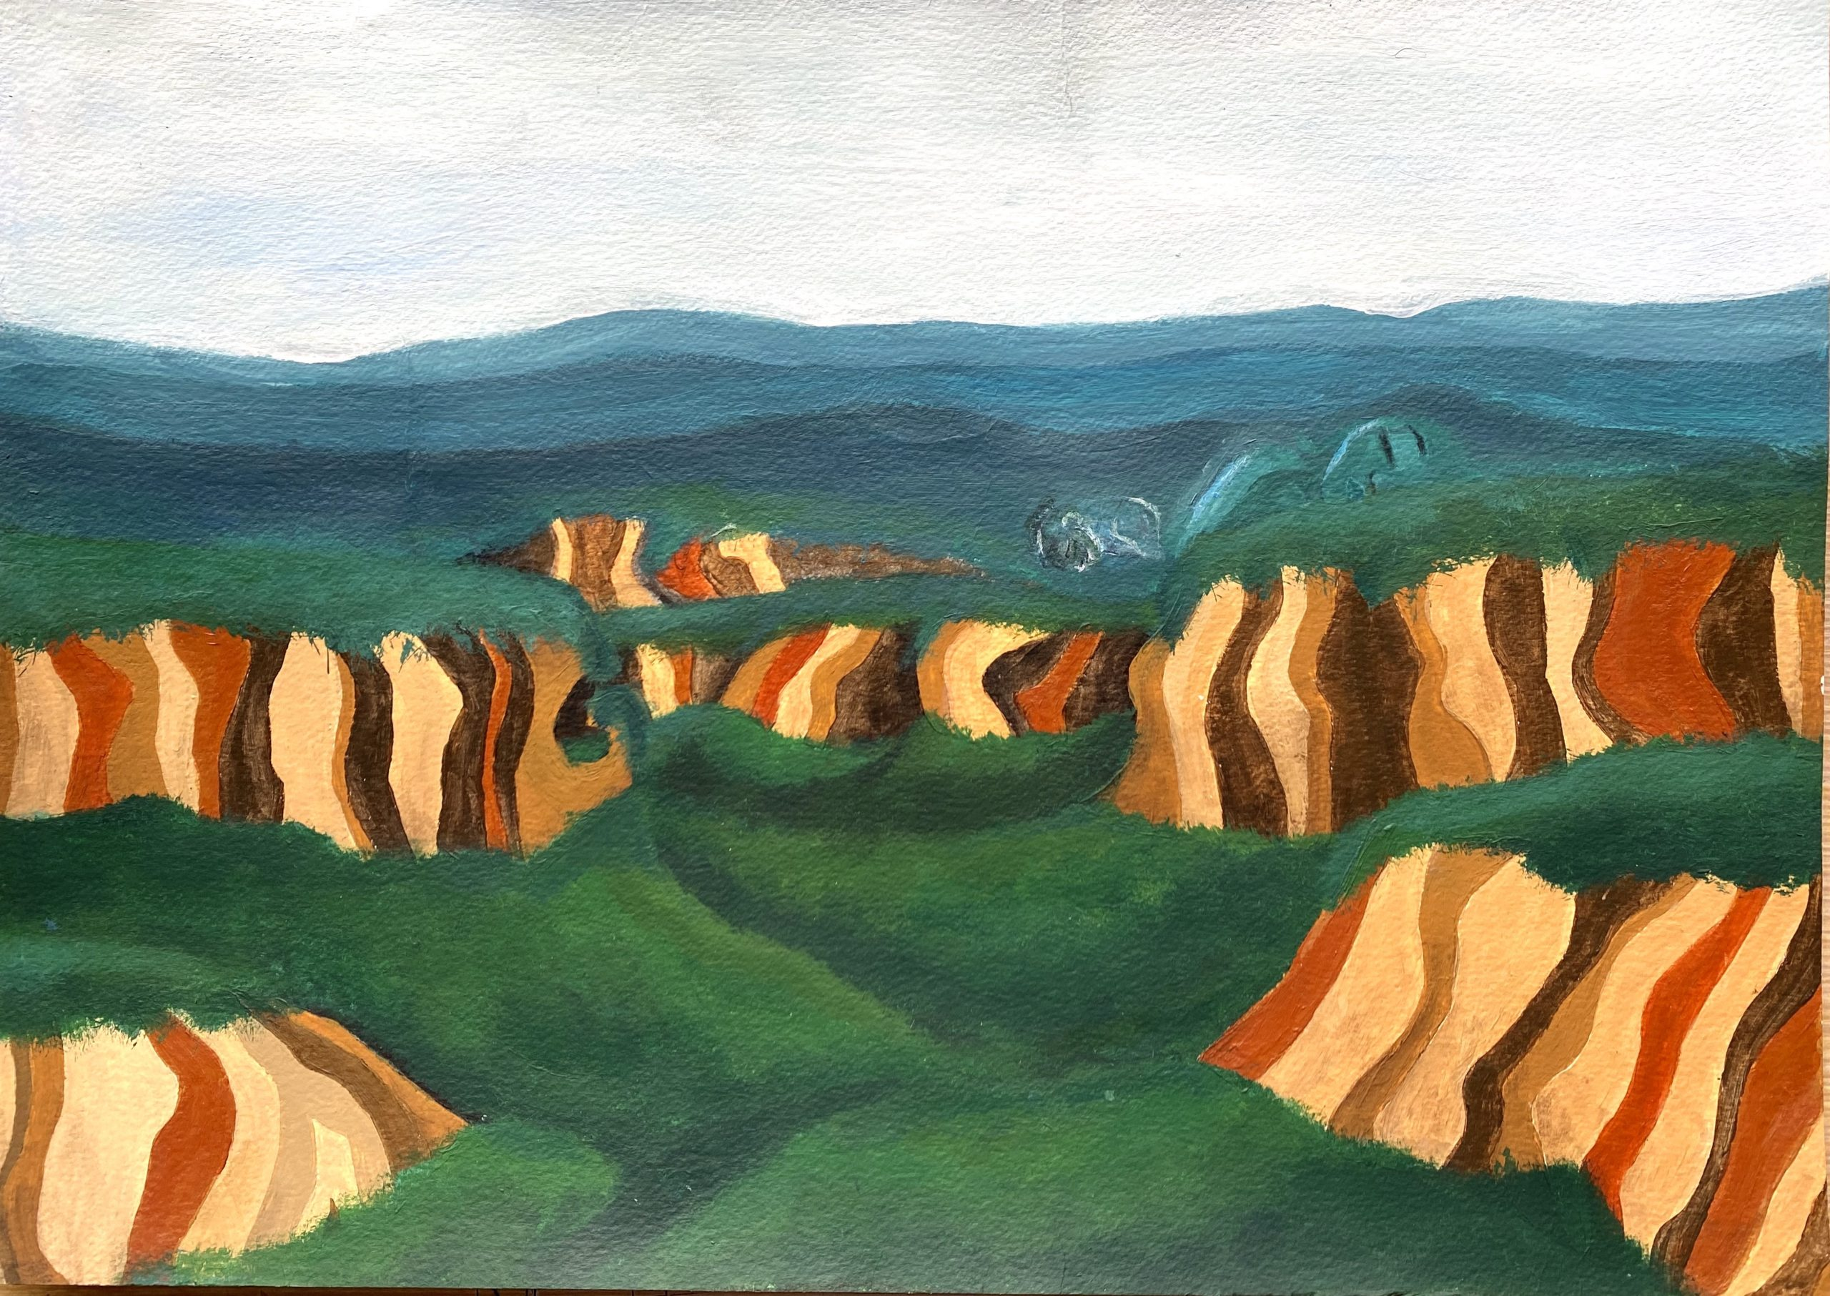
Acknowledgement of Country
We recognise the Ongoing Custodians of the lands and waterways where we work and live. We pay respect to Elders past and present as ongoing teachers of knowledge, songlines and stories.
We strive to ensure every Aboriginal and Torres Strait Islander learner in NSW achieves their potential through education.
‘Sleeping Giant’ created by Benjamin Lilly – Year 9, from Blaxland High School on Ngurra Country of the Dharug and Gundungurra peoples, as part of 2020 Schools Reconciliation Challenge

Slide 3





Summary
CHECK OUT
DOWNLOAD
ENROL
EXPLORE
WATCH
the new 3-6 English and mathematics resources that are now available (including scope and sequences and syllabus mapping tools to support Stage 2, Stage 3 and multi-age)
the Health and Movement Science 11-12 scope and sequences
in Leading effective curriculum implementation (LECI) Module 6 – Embedding curriculum to drive school improvement
the data analysis resources that have been published on the school planning for curriculum implementation webpage
the CRC illustration of practice video 'What are Curriculum Reform Communities (CRC)?' (4:18) to see how other schools are implementing new curriculum

Slide 4



Primary curriculum update
New resources
Download the following resources for the 3-6 component of the K-10 English and mathematics syllabuses. These include scope and sequences and syllabus mapping tools to support Stage 2, Stage 3 and multi-age are now available:
        English 3-6 scope and sequences
        English 3-6 syllabus mapping tools
        mathematics 3-6 scope and sequences
        mathematics 3-6 syllabus mapping tools

Slide 5
Primary curriculum update (2)
Keep an eye out for the following 3-6 English and mathematics resources due to be published later in Term 3 (W9 & 10):
        Sample units to support teaching in Term 1, 2024
        3 microlearning modules
        (2 x mathematics and 1 x English)
Check out the planning, programming and assessing languages K-6 webpage for sample units for the languages below (if your school runs a language program):
Arabic (ES1)
Greek (S1)
Hindi (S2)
Italian (S3)

Slide 6



Secondary curriculum update
DOWNLOAD
REGISTER
Health and Movement Science 11-12 scope and sequences
Schools can plan and prepare to teach the new syllabuses in 2023 and 2024. Schools will start teaching the new syllabuses from 2025.
Health and Movement Science 11–12 will be examined in the HSC for the first time in 2026.
      to attend the Mathematics Head Teacher Conference (9 – 10 November 2023).
      Attendees can expect keynote speeches from leading researchers and teacher-educators, interactive workshops run by curriculum experts, and panel discussions with experienced Head Teachers.
      Register now
      https://regodirect.com.au/headteachermathsconference

Slide 7
Secondary curriculum update (2)
Download the following resources for secondary syllabuses due to be implemented in 2024:
Download the following resources for secondary syllabuses due to be implemented in 2024:
English 7-10 programs of learning, teacher resources and support materials.
Modern languages K-10 micro
learning.
Mathematics 7-10 units of learning, teacher resources and support materials
Geography 11-12 programs of learning, learning sequences, teacher resources and support materials
Department approved elective courses – additional iSTEM resources
Enterprise Computing 11-12 programs of learning, teacher resources and support materials
Software Engineering 11-12
programs of learning, teacher resources and support materials
Regular Statewide staffroom events for new syllabuses are available for teachers and leaders.

Slide 8


Curriculum implementation
Illustrations of practice and case studies
Engage with the following illustration of practice videos to see how other schools are preparing for curriculum implementation.
        Effective preparation for curriculum implementation
        What are Curriculum Reform Communities?
        Curriculum planning for every student
        Engage phase
        Enact phase
        Lessons learnt
      Read CESE’s curriculum implementation case studies to see how early adopter schools have engaged with the new syllabuses and approached curriculum implementation in their context.

Slide 9


Leading effective curriculum implementation
Middle leader professional learning
Monday 16 October, 3:45pm – 4:45pm (Term 4, Week 2)
Module 6: Embedding curriculum change to drive school improvement
6
Tuesday 17 October, 3:45pm – 4:45pm (Term 4, Week 2)
Module 5 – Using data to effectively evaluated the curriculum was held in Week 7, Term 3.
'Meet the experts' session with Viviane Robinson was also held in Term 3, Week 8, Term 3.
The recording of previous sessions can be accessed in the LECI Teams space. To find out more access the LECI professional learning webpage.
“
This course helped me lead a whole-school review of our assessment and reporting practices. The templates were a great resource in leading professional discussions and helped with directed questions and focus areas.
“
LECI participant, Module 4, 2023

Slide 10

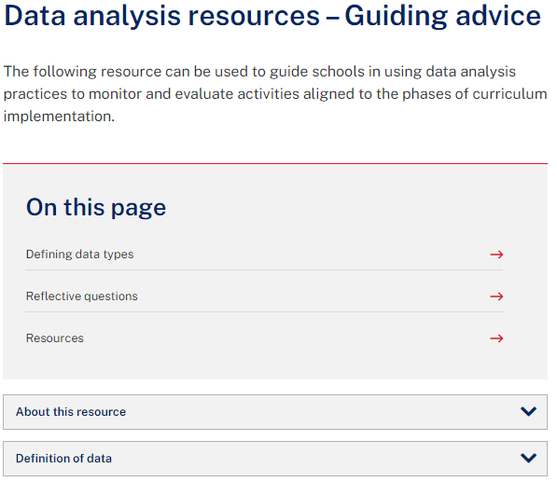
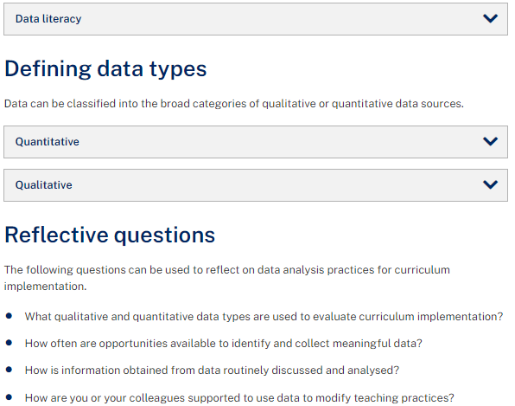
School planning for curriculum implementation
New resources available
DOWNLOAD
EXPLORE
evaluation support resources from the school planning for curriculum implementation webpage. QDAI templates, checklists and modelled examples have been updated.
      the data analysis resources that have been published on the school planning for curriculum implementation webpage. These include advice and resources on:
        Data literacy
        Defining data types
        Planning for curriculum change template
        Triangulation template
        Focus questions – IPM for
        curriculum implementation

Slide 11


NESA update
Have your say closes on 11 September 2023 for:
        Creative Arts K-6
        HSIE K-6
        PDHPE K-6
        Science and Technology K-6
        Geography 7-10
        History 7-10
        PDHPE 7-10
        Visual Arts 7-10
        Draft syllabuses are available on the NESA Consultations webpage.
        Visit the Have your say webpage for more information.
Have your say has closed for music 7-10, science 7-10 and technology 7-8.

Slide 12




Curriculum Reform Communities (CRC)
Curriculum Reform Communities (CRC) support schools with the implementation of new syllabuses and build the capability of teachers to lead curriculum change.
There are currently over 70 CRC across NSW, including a virtual network.
CRC illustration of practice video 'What are Curriculum Reform Communities (CRC)?' (4:18) has been released to showcase how CRC support schools to implement new syllabuses and develop curriculum contextualised to school needs.
Visit the Curriculum Reform Communities webpage to access reflection questions that support engagement with the illustration of practice.

Slide 13

Literacy and numeracy (1)
The Literacy and Numeracy Learning Progressions and PLAN2
New feature released in PLAN2
The Indicator progress analysis (BETA) allows teachers to evaluate the learning of a group of students, in selected indicators, between 2 points in time, as recorded by all existing observation sources. Features include:
graph of updates to the statuses of selected progression indicators
visual display of the week, term and year an indicator status was updated
display of the duration of each status, before it was updated to a new status
a summary of the ‘movement’ of observations between the starting status and ending status
a view of all existing observation sources on screen at once to evaluate progress across the curriculum.
Visit the ALAN Indicator progress analysis support web page to learn more.

Slide 14



Literacy and numeracy (2)
Join the PLAN2 Bitesize Team for ongoing professional learning and support with PLAN2. Sessions are held every Monday from 3:30-4:00pm.
Visit the Literacy Statewide staffroom or the Numeracy Statewide staffroom to engage with live and recorded professional learning sessions, resources and advice.
For more information on the update to v3, visit the department’s Literacy and Numeracy Learning Progressions webpage and About PLAN2 webpage.

Slide 15


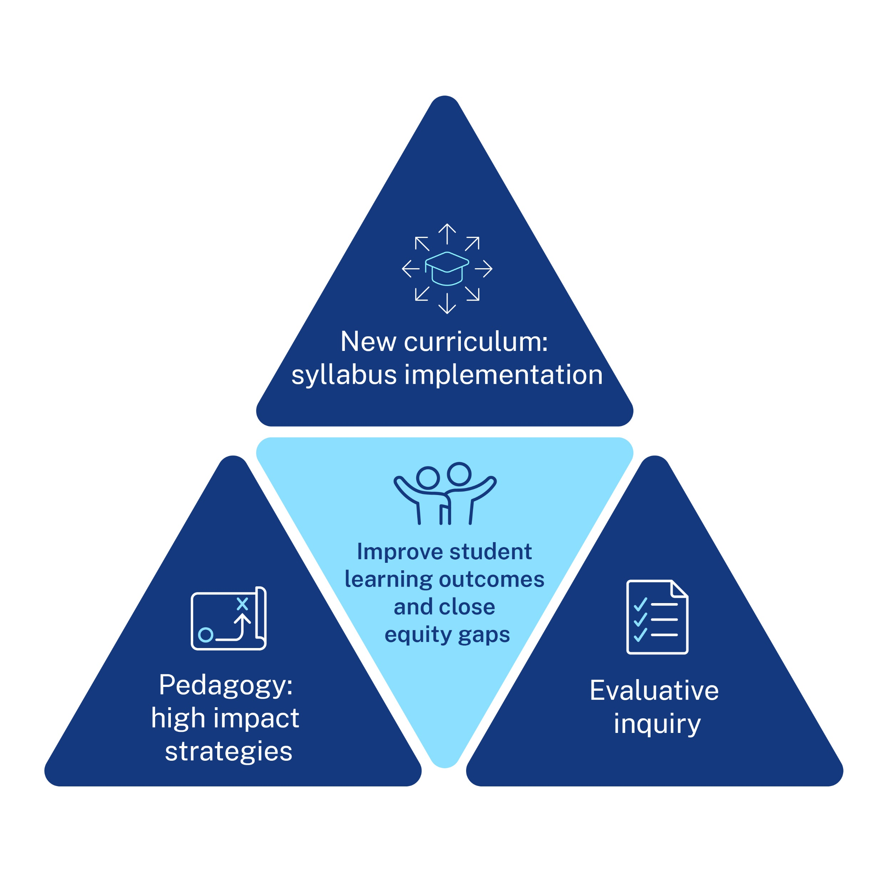
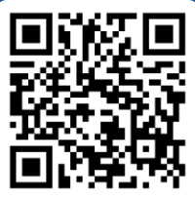

Secondary Professional Learning – Model of support
State-wide professional learning
Subject-specific full day statewide PL facilitated online each term
Evaluative inquiry focus workshops facilitated online between PL rounds
Benefits
Available Term 1 2024
Underpinned by ‘equity roadmap’ to set a statewide standard, desegregate the profession and address equity gaps
Online model has been tested and evaluated via HSC Strategy and K-2 CIPL
Focuses on improved learning outcomes via intersection between syllabus content and pedagogy, and assessment practices and inquiry approach
Increased access for challenging contexts via online delivery (per HSC Strategy)
6hrs
accredited
2hrs
accredited
Teacher stream
Teacher stream
Improving student learning outcomes through embedding high impact teaching and assessment strategies using an evaluative inquiry cycle to support new syllabus implementation.
Applying an evaluative inquiry approach to implement high impact strategies and strengthen teaching in the classroom.
Curriculum leader stream
Curriculum leader stream
Improving student learning outcomes through leading processes to support staff embedding high impact teaching and assessment strategies using an evaluative inquiry cycle to support new syllabus information.
Applying an evaluative inquiry approach to implement high impact strategies and strengthen teaching practice at stage or KLA level.
Scan me
Click here to register your interest for 2024

Slide 16



Head teachers and teachers working together
English and mathematics professional learning
New Term 4 dates:
Register through MyPL:
AC00550 Workshop 1: Utilising the new syllabus
AC00403 Workshop 2: Designing scope and sequences
AC00404 Workshop 3: Programming for the new English syllabus
AC00552 Workshop 3: Programming for the new Mathematics syllabus
Workshop 1 – 25 October
Navigating the new syllabus. Exploring the key pedagogy and research underpinning the new syllabus and implications for teaching practice.
6 hours of accredited
professional learning in total
Workshop 2 – 17 and 26 October, 15 November
Developing a faculty-based implementation plan.
Assessment schedules and scope and sequences.
Benefits
Subject specific
Underpinned by responsive evaluation​
Opportunity to engage with subject colleagues
For more information, contact curriculum.portfolio@det.nsw.edu.au.
Workshop 3 – 18 October, 13 and 22 November
Planning, programming, resourcing and assessment. Contextualisation of department resources.

