Slide 1

Curriculum Reform update – DELs and principals
Term 2, Week 8, 2023

Slide 2

Acknowledgement of Country
We recognise the Ongoing Custodians of the lands and waterways where we work and live. We pay respect to Elders past and present as ongoing teachers of knowledge, songlines and stories. ​​
We strive to ensure every Aboriginal and Torres Strait Islander learner in NSW achieves their potential through education.
‘Connections’ created by the Sista Speak Group (Year 3-6 girls) from Glendore Public School as part of the 2023 Calendar for Cultural Diversity.

Slide 3
Summary
Microlearning and 200 units are now available to support Early Stage 1 (ES1), Stage 1 (S1) and multi-age classes in K-2 English and mathematics. Stage 2 (S2), Stage 3 (S3) and multi-age scope sequences are now available for 3-6 English and mathematics with the production of 3-6 English and mathematics units underway.
New resources and professional learning for English 7-10, mathematics 7-10, modern languages K-10, computing technology 7-10, enterprise computing 11-12, software engineering 11-12, geography 11-12 and iSTEM are now available.
New website now live for Assessment practices – consistent teacher judgement.
Six case studies on the experience of early adopter schools have been published with a discussion guide on CESE’s webpage.
NESA parent and carer guides for a range of the new syllabus are available on the NSW Curriculum website using the Teaching resources tab.

Slide 4

Primary curriculum update
New primary resources are available on the curriculum webpage, including:
All 200 units to support ES1, S1 and multi-age for the English and mathematics K-2 component of the K-10 syllabuses.
The full suite of English and mathematics K-2 microlearning.
Scope and sequences for S2, S3 and multi-age for the English and mathematics 3-6 component of the K-10 syllabuses.
The ‘Collaborative Partnership Schools' project has commenced with round 1 schools beginning the writing process for 3-6 English and mathematics units. Initial briefing sessions for round 2 will occur in Week 9 this term. Expressions of interest for rounds 3 and 4 close on Friday 23 June

Slide 5
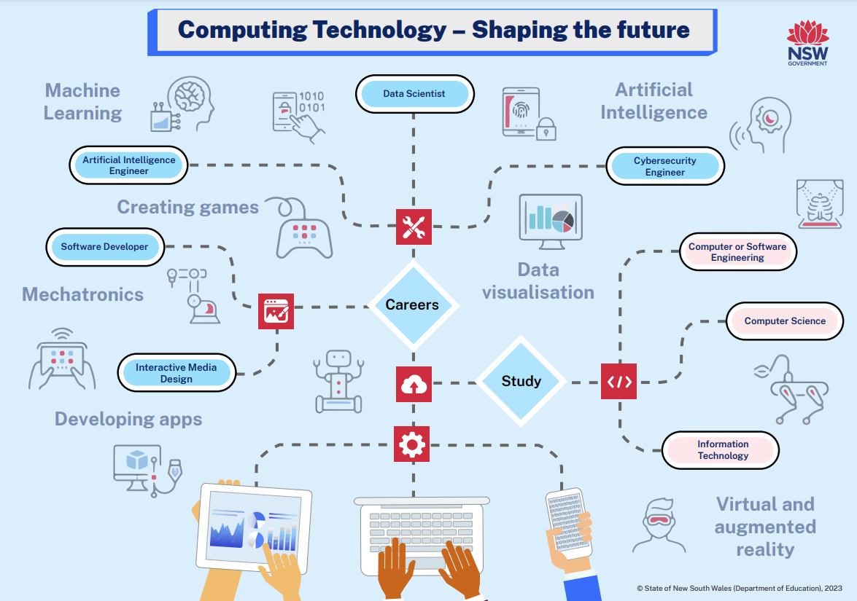
Secondary curriculum update
Ahead of the implementation of the Computing Technology 7-10 syllabus in 2024, the department is delivering a special campaign to:
promote this exciting new syllabus to stage 4 students, their parents and carers and explain why they should enrol in this course.
encourage schools and teachers to offer this engaging elective subject.
Read more about the range of resources available to schools.
Save the Date
Head Teacher English Conference – 4-5 September 2023.
Head Teacher Mathematics Conference – Term 4 TBA

Slide 6
Secondary curriculum resources
New secondary resources are available on the curriculum webpage, including:
English 7-10 – programs of learning, teacher resources and support materials.
Modern languages K-10 – NESA accredited microlearning ‘from planning to practice 7-10’ available in MyPL.
Mathematics 7-10 – units of learning, teacher resources and support.
Geography 11-12 – assessment schedule, sample scope and sequence and microlearning available in MyPL.
Department approved electives – additional iSTEM resources
Computing technology 7-10 – scope and sequences, assessment schedules, units of learning and microlearning available in MyPL.
TAS – Enterprise Computing 11-12 – teacher resources and support
TAS – Software Engineering 11-12 – teacher resources and support
Regular statewide staffroom events for new syllabuses are available for teachers and leaders.

Slide 7

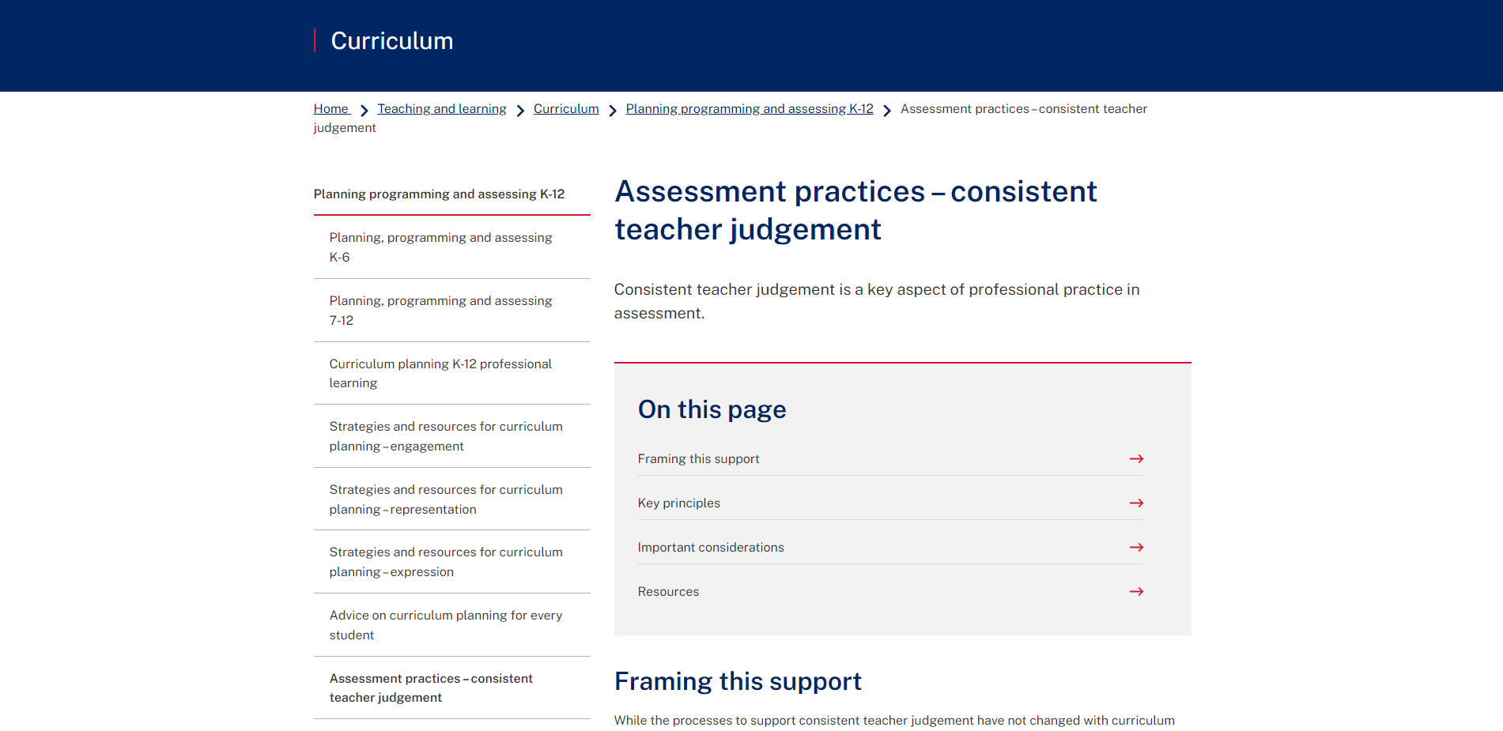

Assessment resources
Assessment practices – consistent teacher judgement
Assessment practices – consistent teacher judgement webpage is now live. It includes:
        advice to effectively lead assessment processes across the school
        an evidence-based approach for designing, marking and moderating school based assessment
        strategies for developing effective consistent teacher judgement practices to support curriculum implementation
        reflection points for school leaders and teachers to review their consistent teacher judgement and moderation practices.
Notes:
Slide: Assessment Practices – consistent teacher judgement
Script:
Consistent teacher judgement is a key aspect of professional practice in assessment.
While the processes to support consistent teacher judgement have not changed with curriculum reform, assessment should reflect the key intentions of the new curriculum, with a focus on ensuring every student:
learns with understanding
builds skills in applying knowledge, and
makes excellent ongoing progress. Masters (2020)
The Assessment practices – consistent teacher judgement webpage provides advice for school leaders and teachers in designing, marking and moderating school-based assessment.
Advice includes strategies for developing effective consistent teacher judgement practices to support curriculum implementation.
The release of syllabuses provide schools with an opportunity to reflect on the effectiveness of existing school-based assessment practices. This advice can be used by schools to support assessment processes to enhance curriculum implementation.
Key considerations are highlighted for schools to reflect on their consistent teacher judgement and moderation practices. Please note: This is general assessment advice that applies to all KLAs.

Slide 8

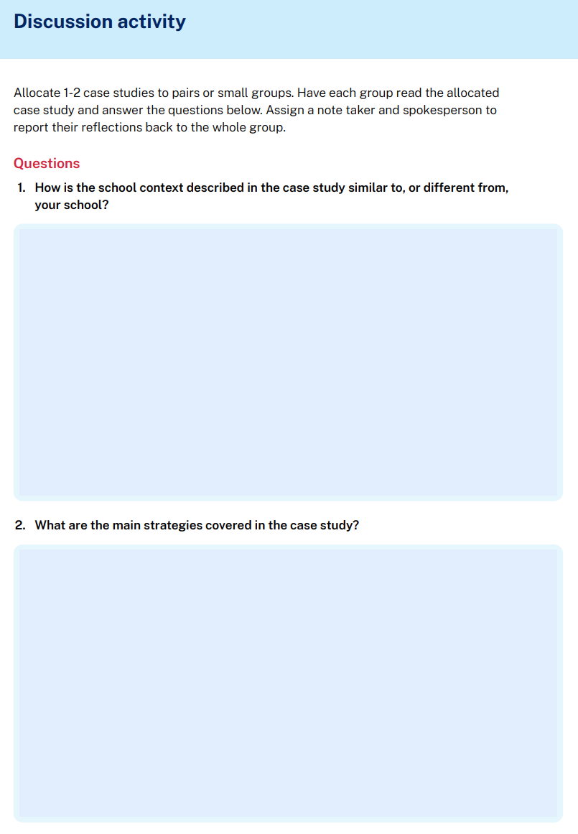
Curriculum implementation
The Centre for Education Statistics and Evaluation (CESE) case studies
Across these 6 case studies, school leaders and teachers share strategies that helped them effectively implement the new curriculum in their school’s context. These strategies are grouped into four themes:
using effective leadership and change management approaches
creating a school culture receptive to the new curriculum
adapting school structures and processes
developing quality classroom-based practices
The case studies come with a discussion guide with reflection activities. You can find the case studies on CESE’s webpage.

Slide 9

Leading effective curriculum implementation
Middle leader professional learning
Module 3 – Curriculum and the teaching and learning cycle is NESA accredited PD and was held in Week 7, Term 2.
If you missed the session, the recording can be accessed in the LECI Teams space. Complete this short form for access.
Next up:
'Meet the experts' session with Jordana Hunter and Amy Haywood from the Grattan Institute.
Tuesday 22 May, 3.45-4.45pm (Term 2, Week 10)
Module 4 – Effective assessment and reporting practices
Monday 24 July, 3:45pm-4:45pm (Term 3, Week 2)
Tuesday 25 July, 3:45pm-4:45pm (Term 3, Week 2)
LECI provided me with an opportunity to work collaboratively with the leadership team to develop a plan that was part of our real work and a priority for the school.
(LECI participant, Module 2, 2023)

Slide 10

Latest news from NESA
Primary and Secondary
NESA is currently updating the Curriculum Reform timeline.
New: 'Supporting your Child' parent and carer guides are on the NSW Curriculum website (NESA's digital curriculum). Available through the Teaching resources tab, as downloadable documents.
Supporting your child: Parent and carer guide – English Kindergarten
Supporting your child: Parent and carer guide – English 1- 2
Supporting your child: Parent and carer guide – English 3-6
Supporting your child: Parent and carer guide – Mathematics Kindergarten
Supporting your child: Parent and carer guide – Mathematics 1-2
Supporting your child: Parent and carer guide – Mathematics 3-6
Supporting your child: Parent and carer guide – Aboriginal Languages K-10
Notes:
Search 'Supporting your child' to locate the guides.

Slide 11
Curriculum Reform Communities (CRC)
The CRC are supporting schools with the implementation of new syllabuses and the development of school contextualised curriculum.
There are 71 CRC locations across the state. Over 1500 schools are a part of a CRC and there are over 1700 members in the CRC MS Team space.
Each CRC has a school-based leader and a curriculum advisor who acts as a mentor to support the CRC leader.
Simon Breakspear is leading professional learning for all school coordinators to enhance curriculum leadership.
Share the CRC school coordinator nomination form with school leaders or nominate a school coordinator to represent a school.
Notes:
Speaker notes:
The aim of the CRC is to provide consistent and equitable information and support to schools during curriculum reform. There is a local meeting once a term that is led by a school-based leader and supported by a mentor from the Curriculum and Reform Directorate and the Curriculum Advisor from Strategic Delivery.
Simon Breakspear is leading online professional learning once a term for all school coordinators to enhance curriculum leadership. Term 2 presentation discussed 'leadership of curriculum change'. Term 3 is on Wednesday 2 August 3:45-4:45pm and Term 4 presentation on Tuesday 31 October.
There is a CRC Microsoft Teams space that provides updates and resources for school coordinators.
Please share the CRC school coordinator nomination form with your school leaders or if you would like to nominate a school coordinator to represent a school.

Slide 12

Literacy and numeracy – support available
National Literacy and Numeracy Learning Progressions and PLAN2
The Term 2 Literacy and Numeracy newsletter will be released to subscribers in Week 8. Subscribe to the newsletter.
Join the PLAN2 Bitesize Team for ongoing professional learning and support with PLAN2. Sessions are held every Monday from 3:30-4:00pm. Session topics for this term will include:
        creating areas of focus for the new curriculum
        creating high school subject classes and custom groups
        using DoE Areas of focus templates
        measuring progress using the progressions
Visit the Literacy Statewide staffroom or the Numeracy Statewide staffroom to engage with live and recorded professional learning sessions, resources and advice.
For more information on the update to v3, visit the department’s Literacy and Numeracy Learning Progressions webpage and About PLAN2 webpage.

Slide 13

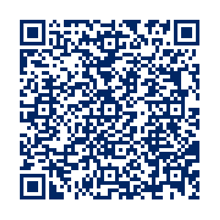
Strategic Delivery:
Curriculum Implementation Professional Learning
Upcoming sessions for Semester 2 of Curriculum Implementation Professional Learning for K-2 English and Mathematics are now available:
Fourteen hours of professional learning focusing on improving student learning outcomes by:
unpacking new elements of the syllabus
embedding a different high impact teaching and assessment strategy each cycle
implementing an inquiry cycle
Register your interest in attending Curriculum Implementation Professional Learning
Session 1
Session 2
Session 3
State-wide online full day facilitated professional learning
2-hour afternoon workshop in
local offices face-to-face or online
State-wide online full day facilitated professional learning
or scan the QR code
Term 3
Weeks 4, 5, 6 or 7
Term 3
Weeks 6, 7 or 9
Term 4
Weeks 4, 5, 6 or 7
Here is some feedback from our most recent Session 3 participants:
Fabulous PL. Professional, efficient and informative.
I enjoyed all aspects of the sessions each introducing us to new people, strategies and ideas.
The ability to work through the inquiry cycle in a meaningful way was extremely beneficial as one could engage with each component in a real-world context.
“
“
“

Slide 14

Strategic Delivery:
Support for syllabus implementation local network support
Secondary support
Primary support
More coming up in Term 3
Principal/Deputy sessions
Curriculum Leader sessions
7 workshops available
Focus on collaboration around syllabus implementation and evaluation of school implementation. Principals are supported to enable the effective implementation of the syllabuses across curriculum areas.
Focus on engagement with the syllabus, implementation of scope and sequences as well as programming, including effective assessment practices. Designed for Head Teachers and Deputy Principals leading curriculum implementation for 7-10 English and Mathematics syllabuses.
Current workshops available to support implementation of the
K-2 English and Mathematics syllabuses:
K-2 Syllabus Implementation Support English
K-2 Syllabus Implementation Support Mathematics
K-2 Mathematics Adapting Units workshop
K-2 Mathematics Adapting Units workshop for small schools
K- 2 English Contextualising Component A workshop
K-2 English Adapting Component B workshop
K-2 English Adapting Component B workshop for small schools
3-6 Syllabus engagement workshops available from Term 3
How to enrol
Speak with your local Learning,
Teaching and Leading Coordinator
Email
curriculum.portfolio@det.nsw.edu.au
or
Now
live on the website
Information about curriculum implementation professional learning is now live on the website.
Here you can find details about topics including:
Access the
website here
https://bit.ly/3Olf9f7
Dates of Curriculum Implementation
Professional Learning sessions (1, 2 and 3)
How to register your interest
Local network support for curriculum implementation
How to book a network workshop

Slide 15
Problem of practice
How can principals support equitable outcomes for all students when leading the design of assessment tasks for the new curriculum?
    Phase of curriculum implementation – Enact
Teach, assess and report using the new syllabus and evaluate to refine new practices and systems.
Stimulus​: Dobrescu, Holden, Motta, Piccoli, Roberts & Walker (2021), Cultural context in standardized tests
    Reflective questions
    What structures and professional learning support staff to gain deep knowledge to optimise learning for every student (including EAL/D learners, Aboriginal learners, HPG learners or learners with disability)? How is evidence of this being enacted in the classroom collected and evaluated?
    What formative and summative assessment practices have been included in teaching and learning programs to support the monitoring of student progress? How is the data analysed to inform teaching?
    When optimising learning for all students, what whole school strengths and opportunities have been identified? How is this reflected in school planning?

Slide 16
Problem of practice – protocols
How can principals support equitable outcomes for all students when leading the design of assessment tasks for the new curriculum?
Suggested protocol for engaging with the stimulus – challenging assumptions
Prior knowledge – read the article and complete a T-chart.
        ‘I think cultural bias is …’
        'I think cultural bias is not…’
Partner discussion – in pairs, discuss the ideas on each other's T-chart.
Expand the discussion – share thoughts with the whole group.
Summarise group learnings.
Debrief – comment on the ways your school can refine assessment tasks to support equitable outcomes for all students when enacting new curriculum.

