Slide 1
Finding missing sides
Explicit teaching

Slide 2
Finding missing sides – part 1
Visible learning
Learning intentions
To be able to find a missing side in a right-angled triangle, given an angle and a side.
Success criteria
I can label the sides of a right-angled triangle as opposite, adjacent and hypotenuse.
I can select an appropriate trigonometric ratio based on given information in a right-angled triangle.
I can write an equation based on a trigonometric ratio.
I can solve an equation to find a missing side in a right-angled triangle.

Slide 3
Warm up
Solving equations involving one step

Slide 4
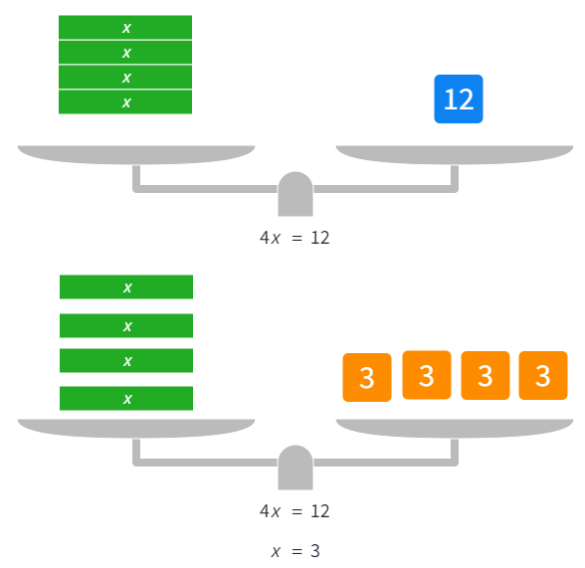


Solving equations involving one step – part 1
Worked example
Solve $4x=12$
Why do we divide when the original equation contains multiplication?
Method 1
Method 2
$$4x=12 \\ \frac{4x}{4}=\frac{12}{4}$$
$$12÷4=3$$
$∴x=3$, because $4×3=12$
Why was 12 replaced with four 3’s?
Why is the final sentence important?
Which method do you prefer?
Notes:
Worked example:
Reveal the question and its solution
Students read in silence
Students explain to themselves what is happening in the examples
Thumb up when finished reading
Explain to a partner
Answer self-explanation questions
Share answers with whole class

Slide 5
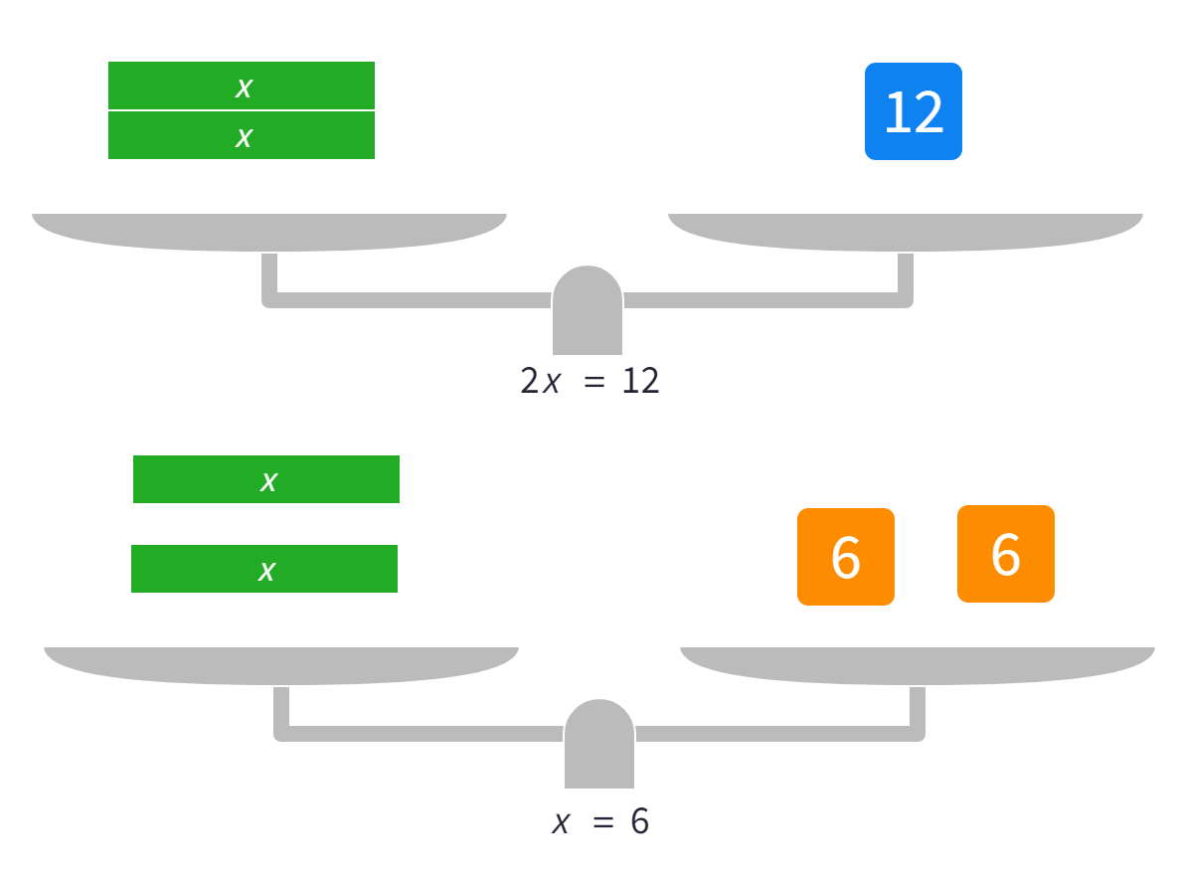


Solving equations involving one step – part 2
Your turn
Solve $2x=12$
Method 1
Method 2
$$2x=12 \\ \frac{2x}{2}=\frac{12}{2}$$
$$12÷2=6$$
$∴x=6$, because $2×6=12$
Notes:
Your turn:
Students now try this example on their own.
Give them time before revealing the answers.

Slide 6
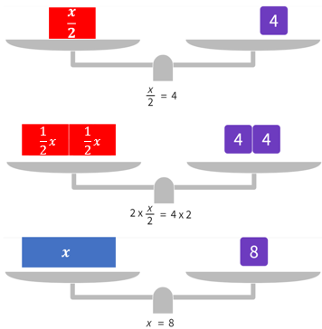


Solving equations involving one step – part 3
Worked example
Solve $\frac{x}{2}=4$
Why do we multiply when the original equation contains division?
Method 1
Method 2
$$\frac{x}{2}=4$$
$$\frac{x}{2}×2=4×2 \\ 4×2=8$$
$∴x=8$, because $\frac{8}{2}=4$
What might have happened in this step?
Why is the final sentence important?
Where did this $x$ come from?
What would you do if the equation had of been $\frac{x}{3}=4$?
Which method do you prefer?
Notes:
Worked example:
Reveal the question and its solution
Students read in silence
Students explain to themselves what is happening in the examples
Thumb up when finished reading
Explain to a partner
Answer self-explanation questions
Share answers with whole class

Slide 7
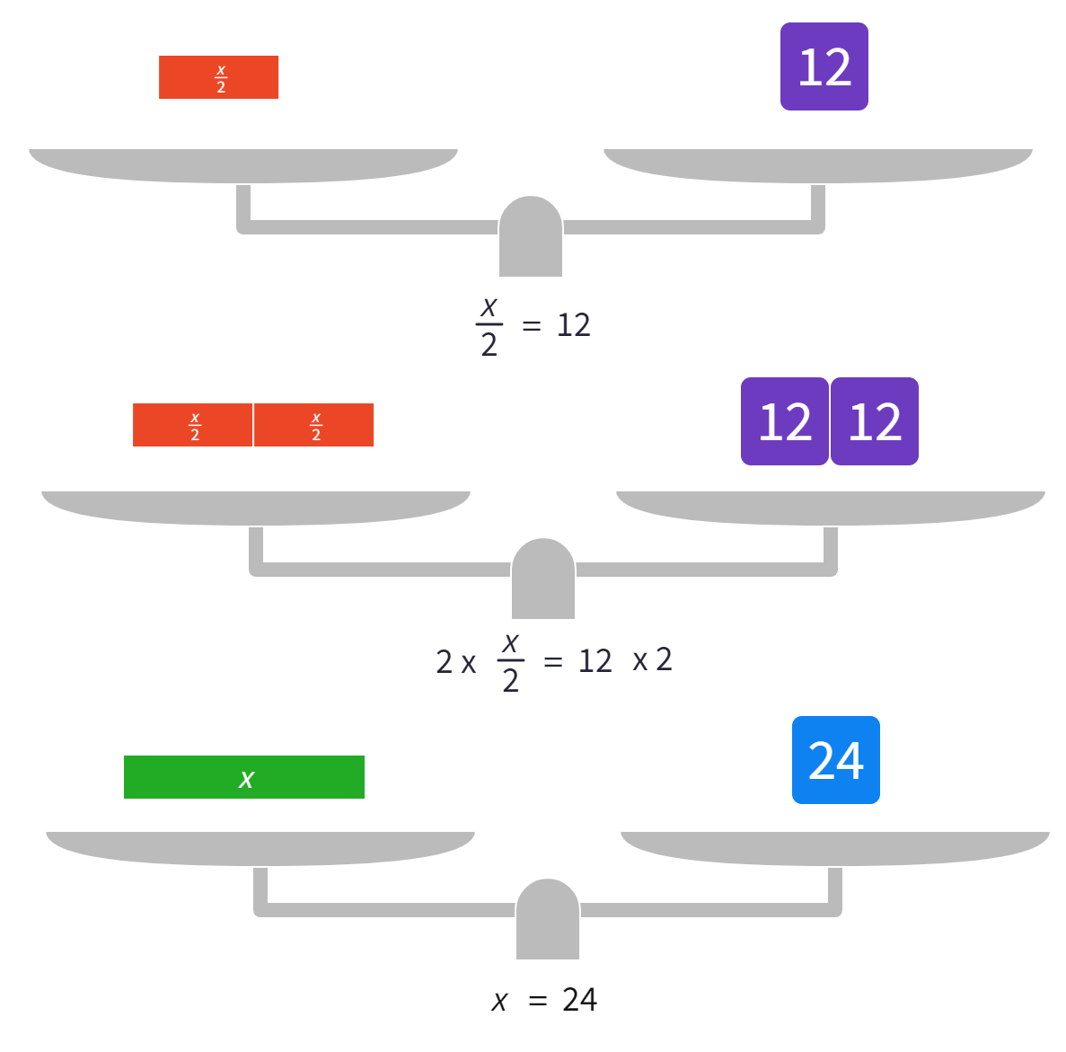


Solving equations involving one step – part 4
Your turn
Solve $\frac{x}{2}=12$
Method 1
Method 2
$$\frac{x}{2}=12$$
$$\frac{x}{2}×2=12×2 \\ 12×2=24$$
$∴x=24$, because $\frac{24}{2}=12$
Notes:
Your turn:
Students now try this example on their own.
Give them time before revealing the answers.

Slide 8

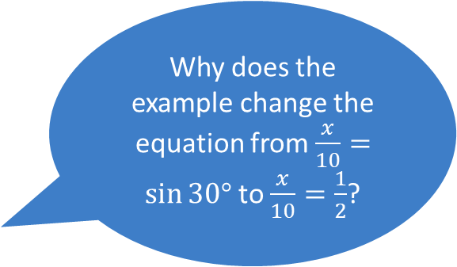


Solving equations involving one step – part 5
Worked example
Solve $\frac{x}{10}=sin 30°$
Why do we multiply when the original equation contains division?
Method 1
Method 2
$$\frac{x}{10}=sin 30°$$
$$\frac{x}{10}×10=sin 30°×10 \\ sin 30°×10=\frac{1}{2}×10=5$$
$∴x=5$, because $\frac{5}{10}=\frac{1}{2}=sin30°$
$$\frac{x}{10}=sin 30°$$
$$\sin{30°=\frac{1}{2}} \\ \frac{x}{10}=\frac{1}{2}$$
$$\frac{1}{2}×10=5$$
$∴x=5$, because $\frac{5}{10}=\frac{1}{2}=sin 30°$
Why does the example change the equation from $\frac{x}{10}=\sin{30°}$ to $\frac{x}{10}=\frac{1}{2}$?
Which method do you prefer?
Notes:
Worked example:
Reveal the question and its solution
Students read in silence
Students explain to themselves what is happening in the examples
Thumb up when finished reading
Explain to a partner
Answer self-explanation questions
Share answers with whole class

Slide 9



Solving equations involving one step – part 6
Your turn
Solve $\frac{x}{8}=cos 60°$
Method 1
Method 2
$$\frac{x}{8}=cos 60°$$
$$\frac{x}{8}×8=cos 60°×8 \\ x=cos 60°×8$$
$$x=\frac{1}{2}×8=4$$
$∴x=\text{4}$, because $\frac{4}{8}=\frac{1}{2}=cos 60°$
$$\frac{x}{8}=cos 60°$$
and $\cos{60°=\frac{1}{2}}$ $$∴\frac{x}{8}=\frac{1}{2}$$
$$x=\frac{1}{2}×8=4$$
$∴x=4$, because $\frac{4}{8}=\frac{1}{2}=cos 60°$
Notes:
Your turn:
Students now try this example on their own.
Give them time before revealing the answers.

Slide 10
Solving equations involving one step – part 7
Your turn – additional questions to try
Solve $2x=1$
Solve $\frac{x}{3}=6$
Solve $\frac{x}{4}=7$
Solve $\tan{45°=\frac{x}{10}}$
Notes:
Your turn:
Students now try this example on their own.
Give them time before revealing the answers.

Slide 11
Launch
Finding missing sides

Slide 12
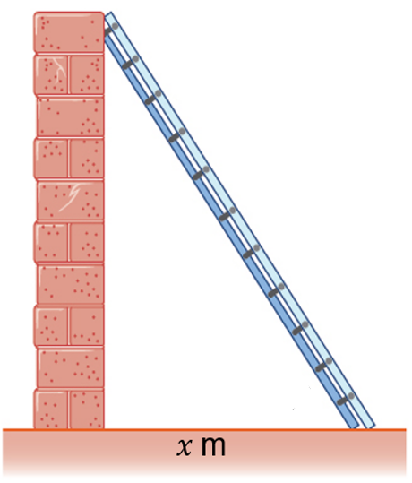
Finding missing sides – part 1
Think pair share
We have a 6 metre ladder and have been advised that it is safest if the angle from the ground is $60°$.
We want to know how far out from the wall the ladder should be to achieve this.
What information do we know in this situation?
Notes:
Students are to engage in a think pair share on how they might find the required distance from the wall

Slide 13
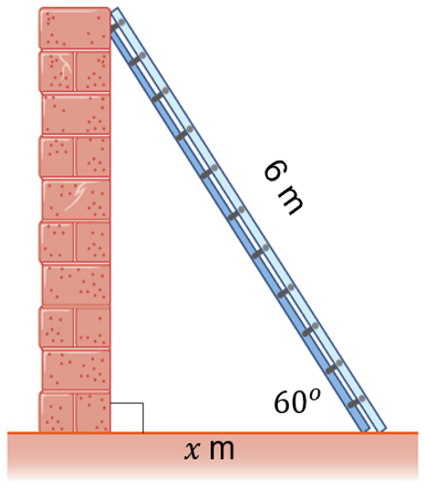
Finding missing sides – part 2
Think pair share
The ladder is 6 metres.
The angle between the ladder and the ground if ${60}^{o}$.
The angle between the wall and the floor is ${90}^{o}$.
How might you find the required distance from the wall, $x$?
Notes:
Students are to engage in a think pair share on how they might find the required distance from the wall

Slide 14
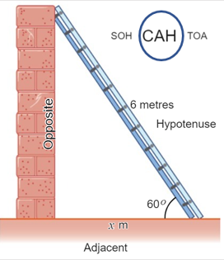
Finding missing sides – part 3
Worked example
After reading the example, explain it to your partner and answer the self explanation prompts.
Which strategies may have been used to label the sides
How were each of the sides labelled?
Why was CAH circled in SOH CAH TOA?
Notes:
Worked example:
Reveal the question and its solution
Students read in silence
Students explain to themselves what is happening in the examples
Thumb up when finished reading
Explain to a partner
Answer self-explanation questions
Share answers with whole class

Slide 15

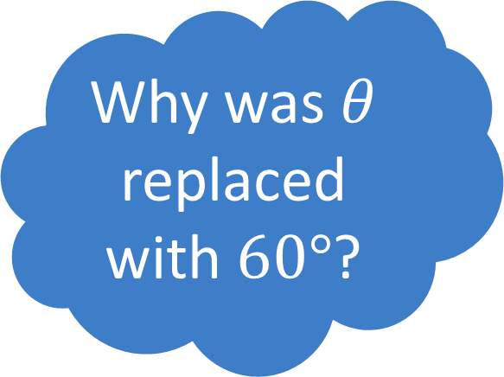
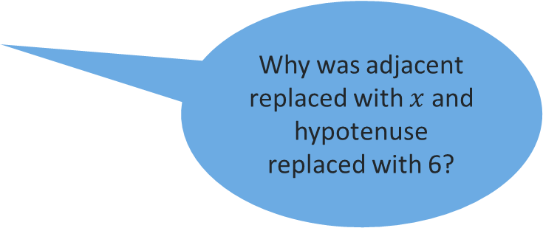
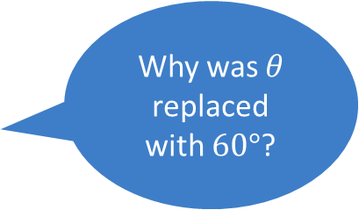
Finding missing sides – part 4
Worked example
Why was $θ$ replaced with $60°$?
$$\cos{θ}=\frac{\text{adjacent}}{\text{hypotenuse}}$$
$$\cos{60°}=\frac{x}{6}$$
$$\frac{1}{2}=\frac{x}{6}$$
$$∴x=3$$
Why was $θ$ replaced with $60°$?
Why was adjacent replaced with $x$ and hypotenuse replaced with 6?
How might this equation have been solved differently?
Notes:
Worked example:
Reveal the question and its solution
Students read in silence
Students explain to themselves what is happening in the examples
Thumb up when finished reading
Explain to a partner
Answer self-explanation questions
Share answers with whole class

Slide 16
Success criteria
I can label the sides of a right-angled triangle as opposite, adjacent and hypotenuse.
I can select an appropriate trigonometric ratio based on given information in a right-angled triangle.
I can write an equation based on a trigonometric ratio.
I can solve an equation to find a missing side in a right-angled triangle.

