Slide 1
Maps and scale
Explicit teaching
Notes:
Presentation to accompany Stage 5 – unit 1 – lesson 9

Slide 2
Visible learning
Learning intentions
To explore the similarities and differences of various graphical representations.
To apply scale in context.
Success criteria
I can read various graphical displays, including maps and floorplans.
I can solve problems involving a scale.

Slide 3
Warm up
Which one doesn’t belong?

Slide 4
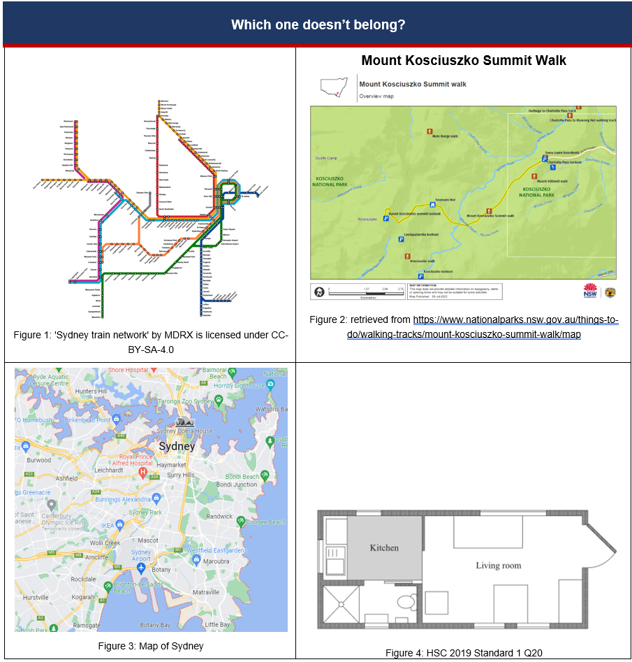
Which one doesn’t belong?
Warm up
Notes:
Have students perform a think / pair / share (bit.ly/thinkpairsharestrategy) to justify which image doesn’t belong.
Encourage discussion of similarities and differences between graphical representations.

Slide 5
Launch
Mount Kosciuszko summit walk

Slide 6
Mount Kosciuszko Summit walk
Launch
Notes:
Have students create a notice / wonder list (bit.ly/noticewonderstrategy) about Figure 2.
Important points for discussion:
What does the bar in the bottom left corner mean?
Where does the track start and finish?
Could you figure out the distance from Seamans hut to Mount Kosciuszko summit lookout?
Who would use this map and why?
Why are some sections darker/lighter?
Demonstrate how to use the scale bar to show the distance between two points on the map.
Ask students to estimate, then calculate (approximately) the distance from:
Snow gums boardwalk to Seamans Hut
Seamans Hut to Mount Kosciuszko summit lookout

Slide 7
Summarise
Floor plan

Slide 8
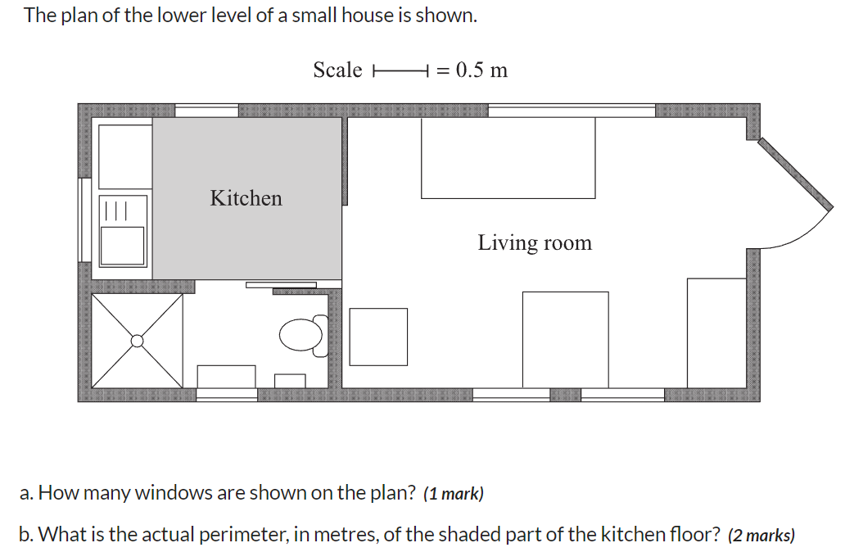
Floor plan
Summarise
Figure 5: HSC 2019 Standard 1 Q20
Notes:
Ask students to share similarities and differences between the maps observed this lesson and the floor plan presented in Figure 5.
Summarise that scales are used in a variety of graphical representations, however the mathematics involved is often very similar.

Slide 9
Success criteria
I can read various graphical displays, including maps and floorplans.
I can solve problems involving a scale.

