Slide 1
Movie magic
Explicit teaching
Notes:
Presentation to accompany Stage 5 – unit 1 – lesson 8

Slide 2
Visible learning
Learning intentions
To develop students’ understanding of scale.
To solve problems involving ratios and scales.
Success criteria
I can describe how scale is used in real life situations.
I can solve scale problems using ratios.

Slide 3
Warm up
Butterfly scale

Slide 4
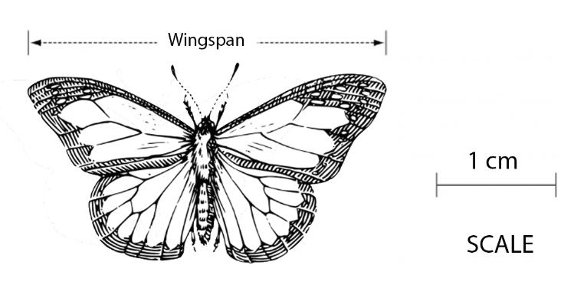
Butterfly scale
Warm up
Predict what questions might be asked about this image.
Pair up and answer their partner’s question.
Notes:
Ask students to:
Predict what questions might be asked about this image
Pair up and answer their partner’s question
Ask students to share their questions with the class.
Explain to students “What is the actual wingspan of the butterfly?”, presented similarly to Figure 1, was a HSC question (Std2 M7 2005). If students haven’t already suggested this as a possible question, answer it as a class.
As a think / pair / share (bit.ly/thinkpairsharestrategy), define ‘scale’.
How many meanings does it have? (e.g., scale mountain, scales on fish, enlarge or shrink, weighing device)
Who would use scale? Why?

Slide 5
Launch
Hobbit holes and Hogwarts

Slide 6
Hobbit holes and Hogwarts – part 1
Launch
Notes:
Ask students if they have seen the Lord of the Rings or Hobbit movies. You might like to show a short video clip or look at some photos.
What’s interesting about the Lord of the Rings sets, particularly the shire (where the movies often start) is that it was filmed in New Zealand. The set was destroyed after the original trilogy of movies, but with the more recent Hobbit trilogy, they built a permanent set that you can visit.
The hobbit holes (Figures 1-3) are built in three different scales, 100% human scale, 90% human scale, and 60% human scale.
2. Ask students why they would have built three different scale houses?
The reason was to trick the viewer into thinking characters were larger or smaller than in real life. Hobbits, small characters were filmed in front of the 100% human scale houses, whilst Gandalf, a very tall wizard was filmed in front of the 60% human scale houses to give the impression that he was much taller.
Film makers use scale to trick the viewer all the time.

Slide 7
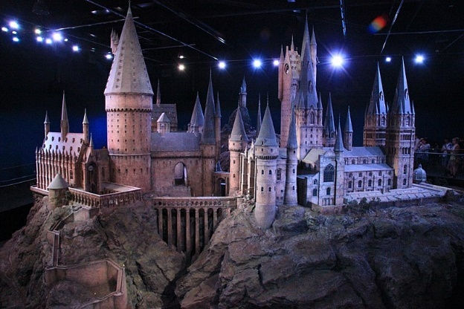
Hobbit holes and Hogwarts – part 2
Launch
Figure 5: 'Hogwarts model studio tour' by Karen Roe is licensed by CC-BY-3.0
Notes:
Ask students if they have seen the Harry Potter movies. You might like to show a short video or look at some photos.
When students saw exterior shots of Hogwarts, the school in the Harry Potter movies, they were seeing a small-scale model of the building. The model was built for the first movie, ‘Harry Potter and the Philosophers Stone’ and has been used in every one of the Harry Potter movies since.
Ask students why the film makers would create a model rather than building or using an existing castle. What are the benefits of using a scale model when filming?
You could display the Hogwarts scale model (Figure 5), or you could show a segment of this video on YouTube: https://www.youtube.com/watch?v=v59kwB37xQo (19:30-20:00 has people surrounding the model which will help students understand the scale)

Slide 8
Apply
Hagrid’s shack

Slide 9
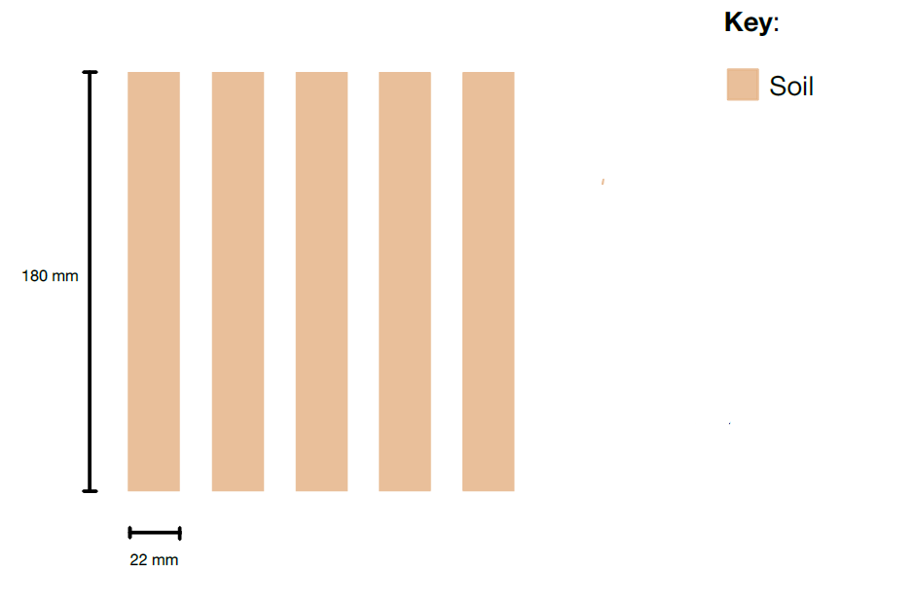
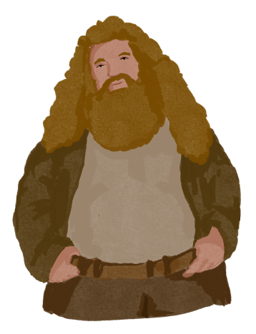
Hagrid’s Shack
Apply
Notes:
Apply Appendix A: Hagrid’s shack is a well-known location on Hogwarts grounds. Next to his shack is plot of land where Hagrid grows crops.
The set designers had to build a farm that was based on the scale model already built.
Given the scale drawing below calculate the total area to be filled with soil.

Slide 10
Success criteria
I can describe how scale is used in real life situations.
I can solve scale problems using ratios.

