Slide 1
How many angles?
Explicit teaching
Notes:
Presentation to accompany Stage 5 – unit 1 – lesson 4

Slide 2
Visible learning
Learning intentions
To be able to determine if two triangles are congruent, similar, or neither based on the number of angles known.
Success criteria
I can determine if two triangles are congruent, similar, or neither.
I can state whether two triangles will be similar based on the number and position of congruent angles.

Slide 3
Warm up
Similar triangles?

Slide 4
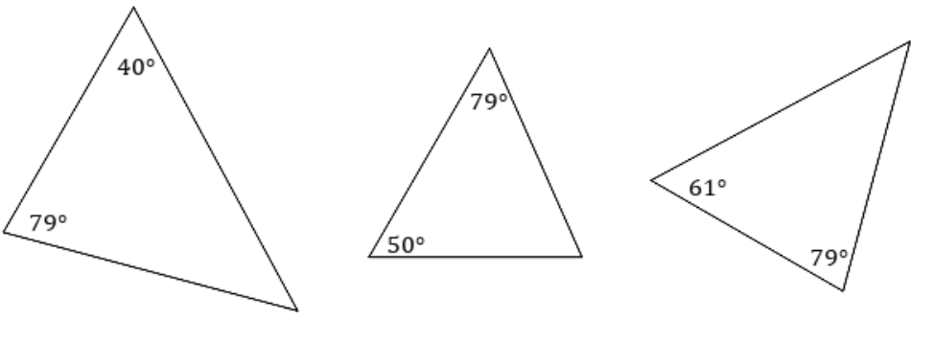
Similar Triangles?
Warm up
Notes:
Have students create a notice/wonder list (bit.ly/noticewonderstrategy) based on the three triangles.
Ultimately have students determine if any of the triangles are similar.
This is a great opportunity to define congruent and similar with students.

Slide 5
Launch
Enough information?

Slide 6
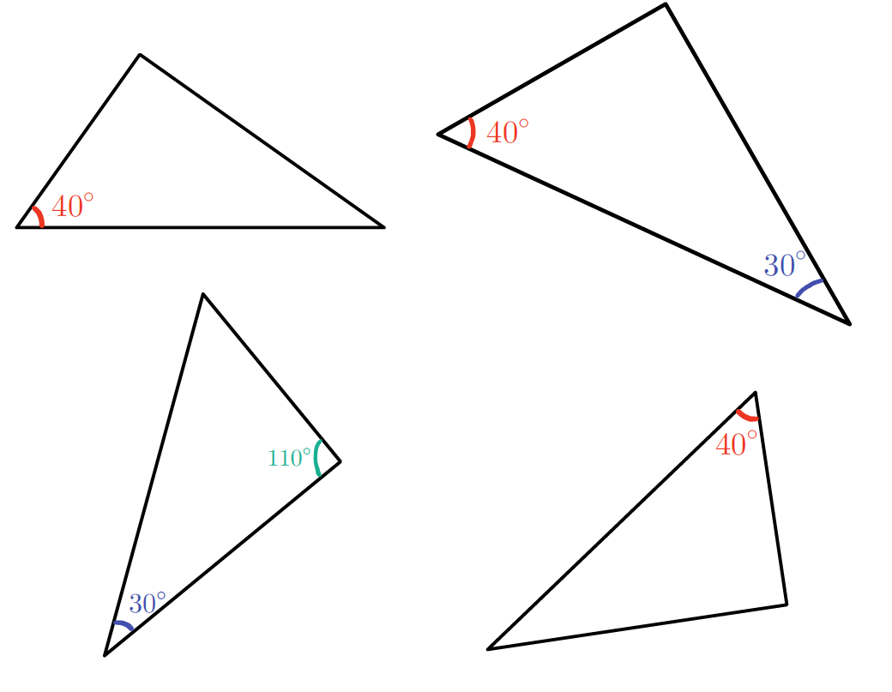
Enough information?
Launch
Notes:
Explain to students that the difference between the warmup and the launch is the number of angles, i.e., the amount of information that we know.
Ask students to determine if any of the triangles shown are similar.
Question students in a pounce/bounce (bit.ly/pausepouncebounce) style to have them explain and elaborate on one another’s explanations

Slide 7
Explore
Pasta angles

Slide 8
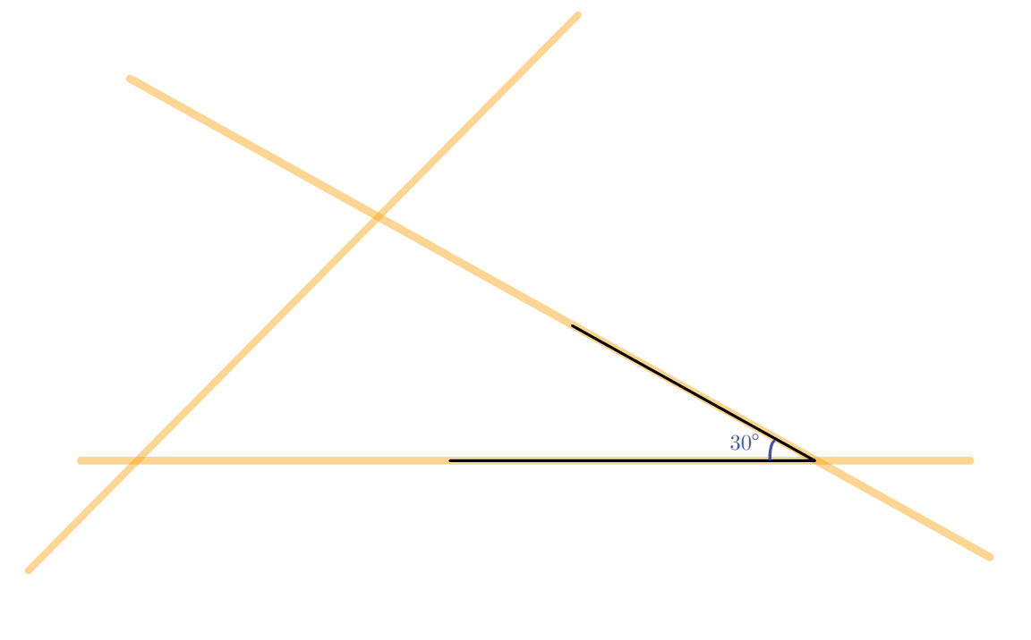
Pasta angles – part 1
Explore
One angle in common
Create a triangle using three pieces of pasta and angle 30°.
Tape your pasta triangle to a sheet of paper, so it won’t move.

Slide 9
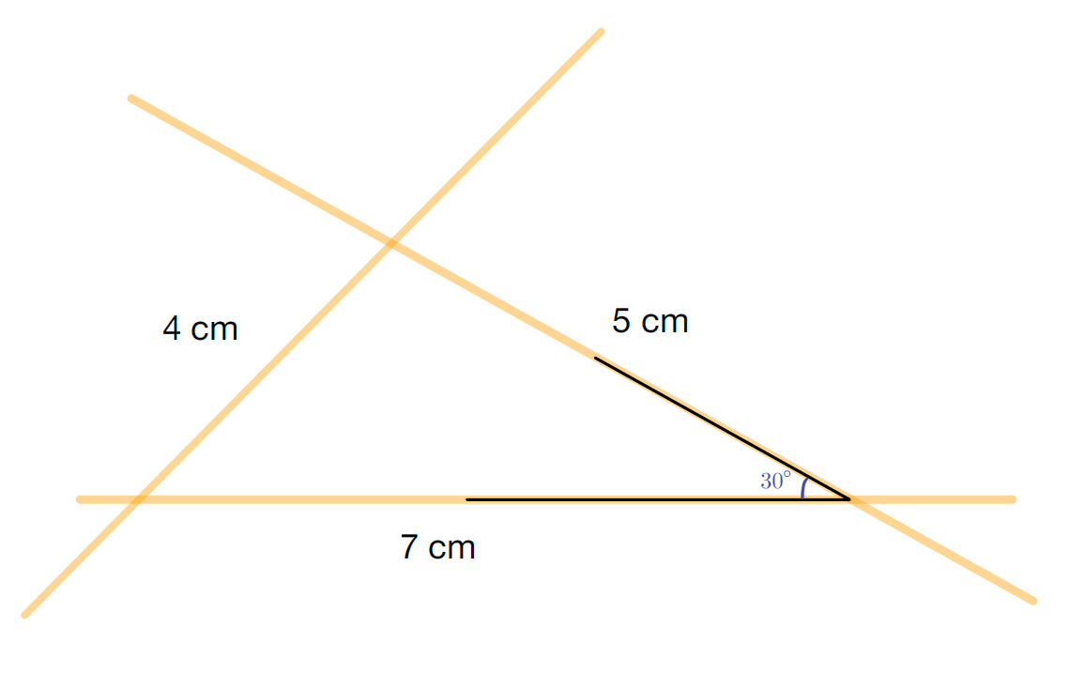
Pasta angles – part 2
Explore
One angle in common
Measure with a ruler and record the length on the paper next to each side.
Measure each angle (to the nearest 5 degrees) using a protractor and record the angle on the paper inside each vertex.

Slide 10
Pasta angles – part 3
Explore
One angle in common
Compare triangles with group members, and answer each question:
What is the same?
What is different?
Are any of your triangles congruent or similar?

Slide 11
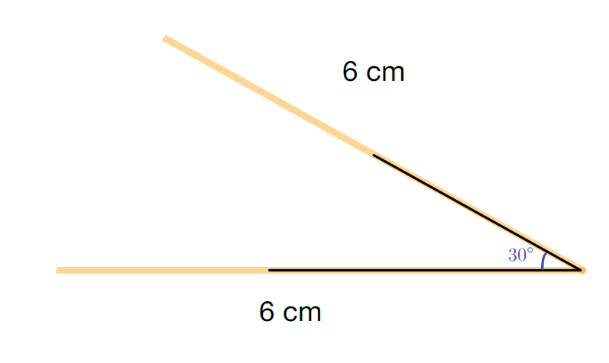
Pasta angles – part 4
Explore
One included angle in common
Create an included angle using the 30° angle, and two adjacent pieces of pasta measured and broken to be the same length.
Place a third piece of pasta to connect the ends of each side to complete the triangle.
Tape your pasta triangle to a sheet of paper, so it won’t move.

Slide 12
Pasta angles – part 5
Explore
One included angle in common
Measure with a ruler and record the length on the paper next to each side.
Measure each angle (to the nearest 5 degrees) using a protractor and record the angle on the paper inside each vertex.

Slide 13
Pasta angles – part 6
Explore
One included angle in common
Compare triangles with group members, and answer each question:
What is the same?
What is different?
Are any of your triangles congruent or similar?

Slide 14
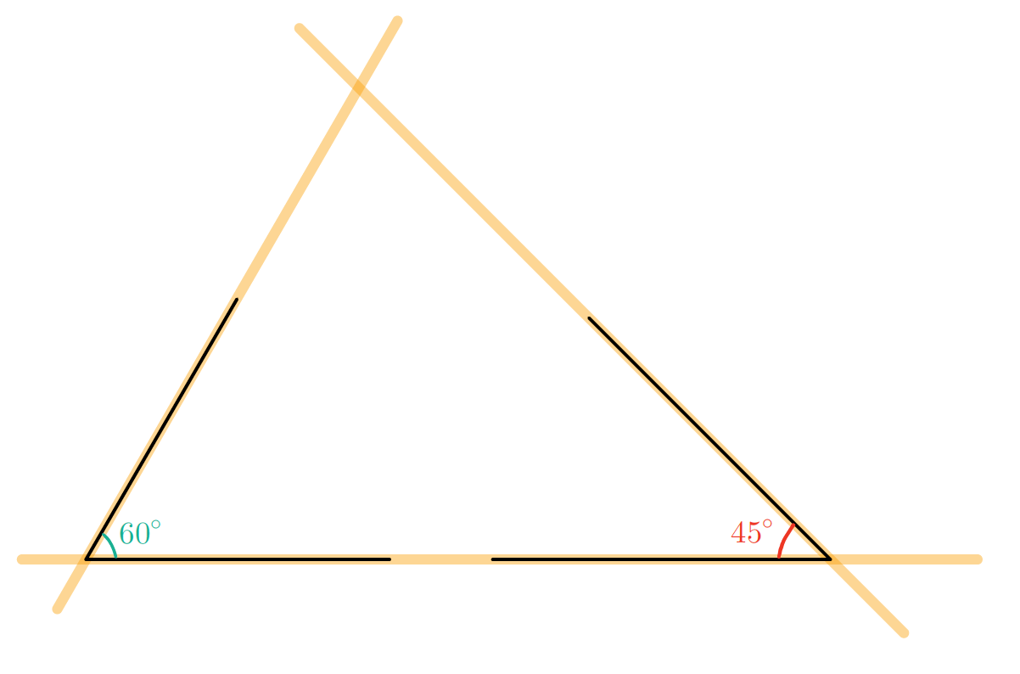
Pasta angles – part 7
Explore
Two angles in common
Create a triangle using three pieces of pasta and angles $45°$ and $60°$.
Tape your pasta triangle to a sheet of paper, so it won’t move.

Slide 15
Pasta angles – part 8
Explore
Two angles in common
Measure with a ruler and record the length on the paper next to each side.
Measure each angle (to the nearest 5 degrees) using a protractor and record the angle on the paper inside each vertex.

Slide 16
Pasta angles – part 9
Explore
Two angles in common
Compare triangles with group members, and answer each question:
What is the same?
What is different?
Are any of your triangles congruent or similar?

Slide 17
Summarise
Pasta angles

Slide 18
Enough information?
Summarise
Notes:
Remind students that at the start of the lesson, they were asked to determine which triangles were similar. Hopefully students can now see that for some triangles there is enough information to state that they are similar (however they could also be congruent), and for some triangles we don’t have enough information.
Have students write a heading in their notes: ‘How many angles to be similar’.
Have them write notes to their future selves, for each given number of congruent angles within two triangles, with an example for each. E.g.
1 angle: Only sufficient when it is an included angle between corresponding sides.
2 angles: Will always be a similar or congruent triangle.
3 angles: Will always be a similar of congruent triangle.

Slide 19
Success criteria
I can determine if two triangles are congruent, similar, or neither.
I can state whether two triangles will be similar based on the number and position of congruent angles.

