Slide 1
Scaled copies
Explicit teaching
Notes:
Presentation to accompany Stage 5 – unit 1 – lesson 02

Slide 2
Visible learning
Learning intentions
To be able to describe characteristics of similar figures.
Success criteria
I can identify similar figures.
I can explain why figures are similar or not similar.

Slide 3
Launch
Spot the dog

Slide 4
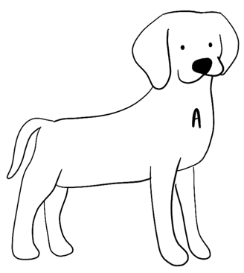
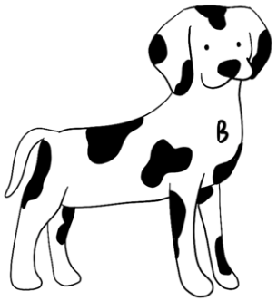
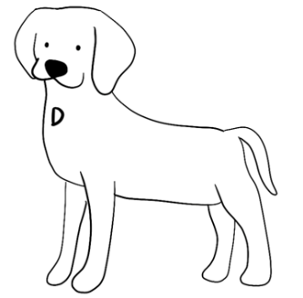
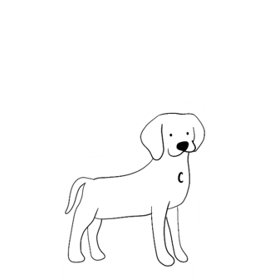
Spot the dog
Launch
Notes:
Students are to choose the dog they think is the odd one out (bit.ly/wodbstrategy)
There is no wrong answer. The aim of the activity is for students to be introduced to the idea that A does not belong because of distortion.

Slide 5
Explore
Find the fakes activity

Slide 6
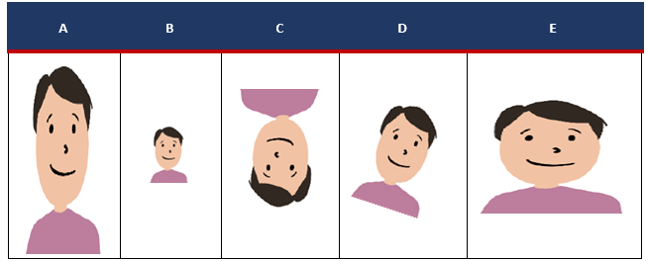
Find the fakes – part 1
Explore
Here is a portrait of a person.
Consider each version of the portrait below and answer each of the following questions:
How is each portrait the same as or different to the original?
Some of the portraits are similar to the original, which portraits do you think are similar?

Slide 7
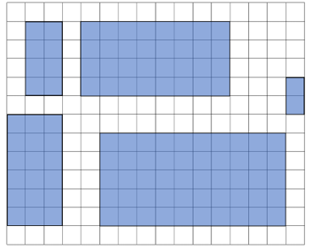
Find the fakes – part 2
Explore
Each of these 5 rectangles are similar. Use the figures to develop a definition for similar with a partner and collect mathematical evidence from the examples to support your thinking.

Slide 8
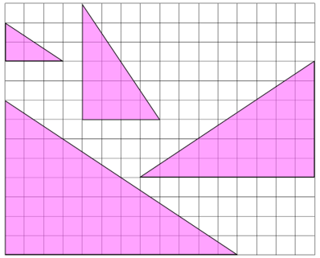
Find the fakes – part 3
Explore
Each of these 4 triangles are similar. Write your own definition of similar (to help you remember and understand).

Slide 9
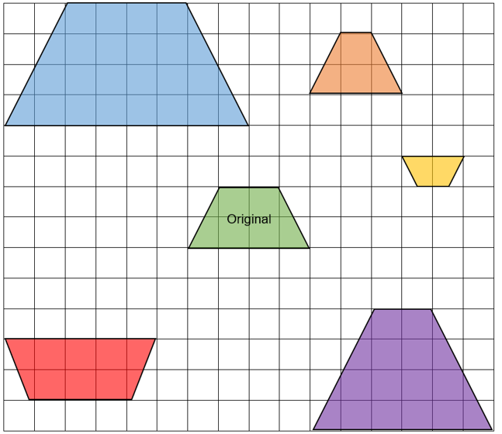
Find the fakes – part 4
Explore
Some of these shapes are similar to the original trapezium.
Identify the non-similar trapeziums (i.e. the fakes) and support your answers with mathematics.
Notes:
Have students refer to their definitions from Appendix A, to make initial predictions for which trapeziums are similar.
Challenge and address students’ misconceptions about similarity

Slide 10
Success criteria
I can identify similar figures.
I can explain why figures are similar or not similar.

