Slide 1
Comparing representations
Explicit teaching
Notes:
Presentation to accompany Stage 5 – unit 1 – lesson 10

Slide 2
Visible learning
Learning intentions
To recognise the similarities and differences between networks and maps.
Success criteria
I can explain the similarities and differences between networks and maps.
I can use network diagrams to solve problems.

Slide 3
Launch
Sprouts

Slide 4
Sprouts – part 1
Launch
Notes:
Players take turns in joining dots (vertices) according to simple rules, until one player cannot make a move.
Setup:
For this game, students will play in pairs.
They will need whiteboards and markers or paper and pens.
You can display Figure 1 to show an example game
How to play:
Start by drawing two vertices (dots) on a piece of paper.
Players then take turns to make a move, by drawing an edge (line) that connects two vertices, and then adding a new vertex (dot) on their edge.
When making a move, players must adhere to the following rules:
Your edge cannot cross another edge or pass through a vertex.
Your edge can start at a vertex and return to the same vertex.
A vertex can have at most three edges emerging from it. If an edge loops back to the same vertex, this counts as two edges.
The game is over when there are no moves a player can make.
The winner is the last player to successfully add an edge.

Slide 5
Sprouts – part 2
Launch
Notes:
Ask students to look for similarities and differences between the two games. Students should discover that the games are identical.
Explain that students have created a network diagram.
Highlight that network diagrams are about connections, where the lengths of the edges are unimportant.

Slide 6
Apply
Planning job site visits

Slide 7
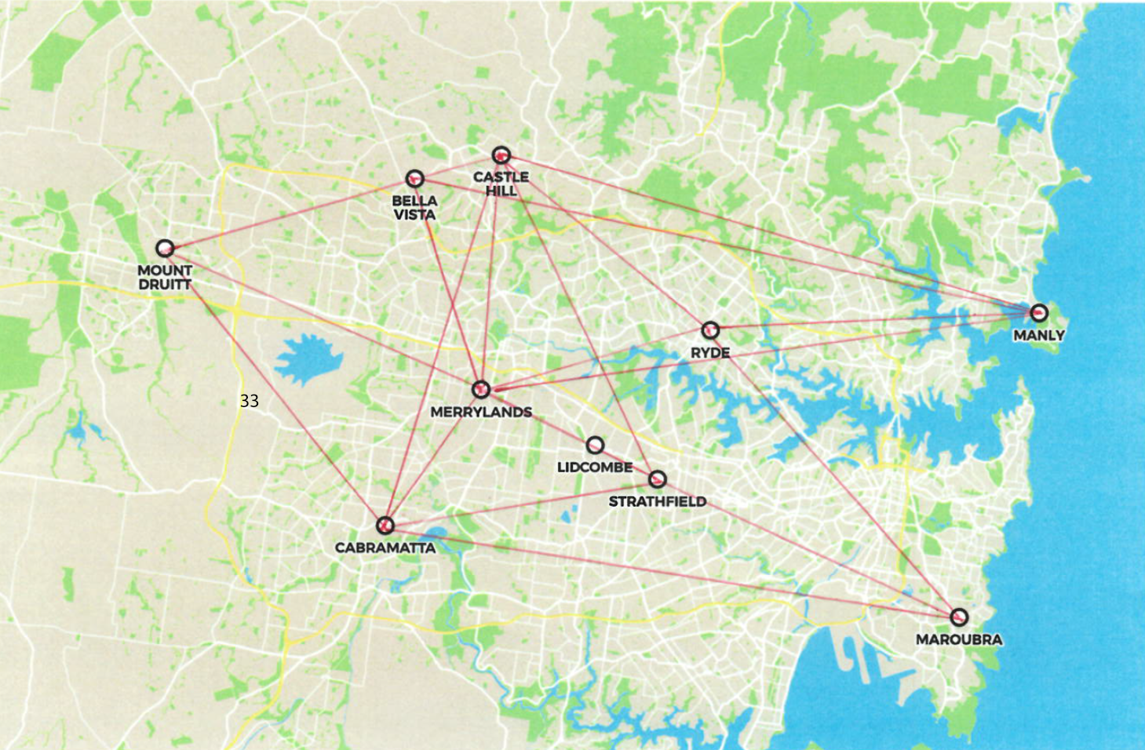
Planning job site visits
Apply
Notes:
Print and distribute Appendix A.
Upon completing the student facing task, have students add up their total travel times and compare with a partner.
List all total times on the board and have the students with the fastest times share their first several moves.
Encourage students to look for similarities in the fastest strategies.
Ask students to consider if they could have used distances instead of time for this activity? Use this question to conclude that maps and networks serve unique purposes.

Slide 8
Success criteria
I can explain the similarities and differences between networks and maps.
I can use network diagrams to solve problems.

