Slide 1
How long is a blue whale?
Explicit teaching
Notes:
Presentation to accompany Stage 5 – unit 1 – lesson 01

Slide 2
Launch
How long is a blue whale?

Slide 3
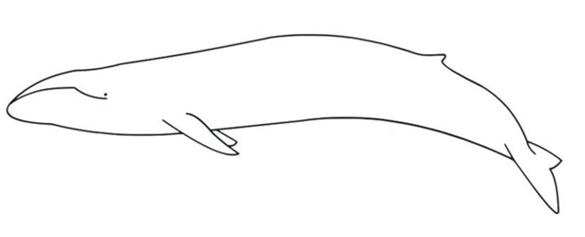
Measuring lengths and distances – part 1
Launch
Notes:
Notice wonder lists
Ask further questions such as:
“How long is a blue whale?”
“Would a blue whale fit in this room?”
“How much longer is a whale than you?”

Slide 4
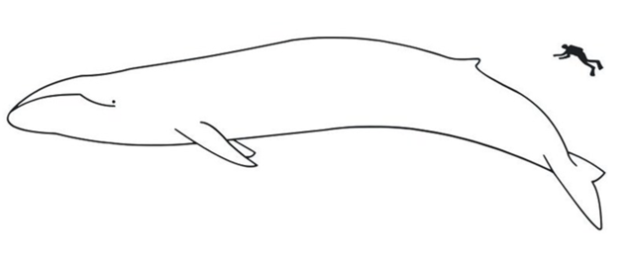
Measuring lengths and distances – part 2
1
2
3
Notes:
Students indicate via a finger vote which image shows a blue whale compared to an average human. (1 is correct).

Slide 5
Visible learning
Learning intentions
To visualise lengths by comparing familiar objects.
Success criteria
I can make approximate comparisons between familiar lengths and unseen long and short objects.
I can estimate the length of objects larger and smaller than me.
I can visualise proportion to check if my answers are logical.

Slide 6
Explore
Constructing a map

Slide 7
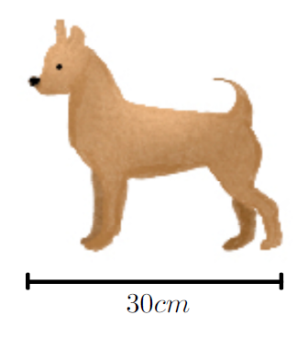
Measuring lengths and distances – part 3
Explore
Measure and record the dimensions of the classroom.
Notes:
Tell students they will be guessing how many chihuahuas long, things are (measuring from head to tail).

Slide 8
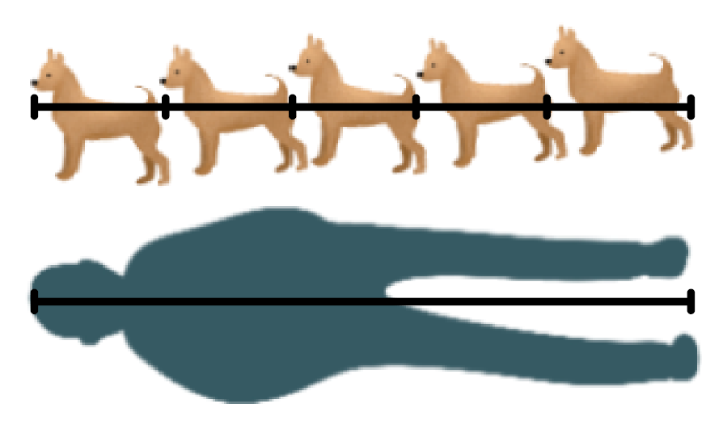
Measuring lengths and distances – part 4
Explore
The student is made up of ____ chihuahuas.
So, the student is ____ times longer than a chihuahua.
Notes:
As an example, if we say the average student is 150 cm tall, that would be 5 chihuahuas long, as shown
Ask students to answer using the following sentence structure scaffold as a pair/share:

Slide 9
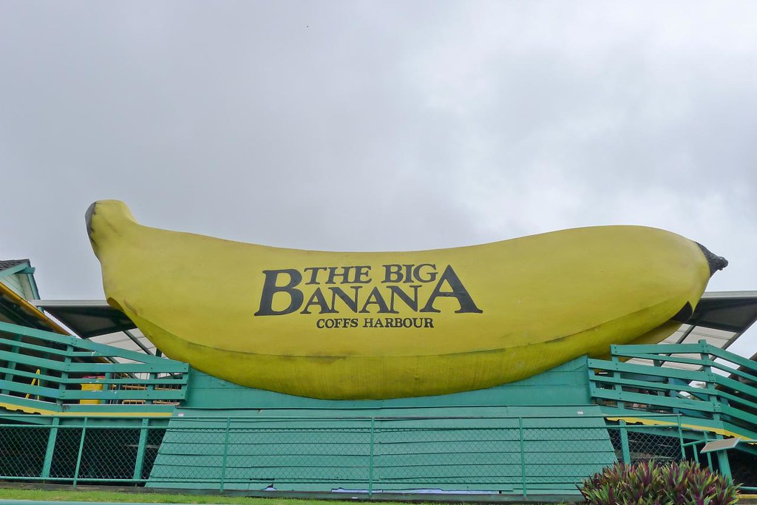
Measuring lengths and distances – part 5
Explore
Notes:
Organise students into random groups of three and provide each group with a mini whiteboard and one whiteboard marker.
Read each item aloud. Allow students time to discuss then write down how many chihuahuas long that object might be. Don’t read out the measurements in parentheses until students have made their predictions.
Big Banana (13 m which is 43 chihuahuas)
Whale (27 m which is 90 chihuahuas)
Bus (12.5 m which is 42 chihuahuas)
Cricket pitch (20 m which is 67 chihuahuas)
Crocodile (3 m which is 10 chihuahuas)
Volleyball court (15 m which is 50 chihuahuas)

Slide 10
Summarise
I’m as tall as a…

Slide 11
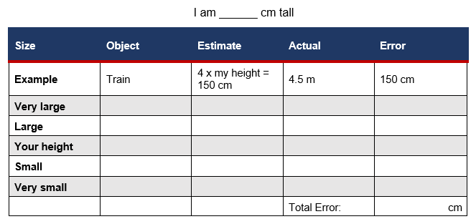
I’m as tall as a…
Summarise
Notes:
1. Students work in pairs to engage with this activity
2. Ask reflection questions from the activity such as:
“Was anything larger/smaller than you expected?”
“Is anyone proud of their error?”
“What were the more difficult objects to estimate and why?”
“What strategies did you use?”
Instructions:
In pairs:
Measure and record each person's height.
Choose an object that corresponds to each of the sizes: Very large, Large etc. Be creative!
Estimate how tall the object is in reference to your height.
Swap sheets with your partner and get them to find the actual heights of your objects using the internet.
Find the difference between the estimate and actual measurements to complete the error column for your partner’s sheet. You will need all measurements in centimetres so you can add it up to find the total error.

Slide 12
Success criteria
I can make approximate comparisons between familiar lengths and unseen long and short objects.
I can estimate the length of objects larger and smaller than me.
I can visualise proportion to check if my answers are logical.

