Slide 1
Going to the movies
Making decisions

Slide 2
Going to the movies – Frequency tables
How is this different to other frequency tables you’ve seen?
Class interval | Frequency
155-<160 | 3
160-<165 | 2
165-<170 | 9
170-<175 | 7
175-<180 | 10
180-<185 | 5
What does this symbol mean?
What might these 3 numbers be?
Notes:
Display the frequency table and ask students to read it silently.
They should give a thumbs up when they’ve finished reading.
Ask them to pair share to explain the table to each other.
Ask pairs to discuss the self explanation prompts
Randomly call on students to share their answers with the class.

Slide 3
Going to the movies – Exercise
Display the movie rankings as a frequency table using class intervals.
Review Rating | Frequency
4 – < 5 | 2
5 –< 6 | 2
6 –< 7 | 9
7 –< 8 | 17
8 –< 9 | 4
Notes:
Display the solution after students have had a chance to complete the exercise on their own and share their solution with a partner.
Discuss with students whether this table is easier to analyse and interpret than their first attempt, not using class intervals.
They should be able to identify that most ratings were between 7 and 8 and could even extend this to say that the majority of ratings were between 6 and 8. This was much harder to identify in their first attempt without class intervals.

Slide 4
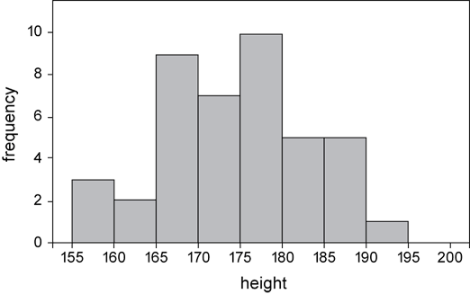
Frequency histograms – Features
The columns are next to one another with no gaps
The y-axis represents the frequency
A ½ column width is left between the vertical axis and first column
The x-axis represents the scores
Notes:
Ask students, in pairs to conduct a notice and wonder.
{Click} to display the features of a histogram
Alert students to how heights have been grouped into classes and we have one bar that represents how many people were between 155 and 160cm, rather than having a bar for each individual height.

Slide 5
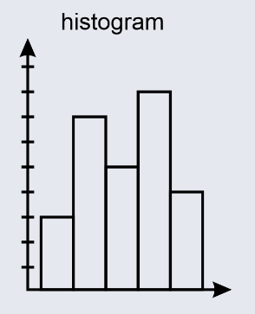
Frequency histograms – What are they?
A histogram is a graphical representation of a frequency distribution table.
It is usually used when the data is continuous.
Notes:
Explain to students that although a histogram is usually used for continuous data, it can be used for discrete data with a very wide range.
The data that we graphed for the release years for the Marvel movies was numeric discrete and we graphed it as a column graph because there was only a small amount of data.
If we had data for a one hundred year period, we would have reorganised the data into classes or bins (eg 2000- 2004, 2005-2009) and drawn a histogram.
Discuss with students why we need a histogram for continuous data – depending on our level of accuracy, imagine drawing a bar for each of 175.01, 175.02 175.03 etc

Slide 6
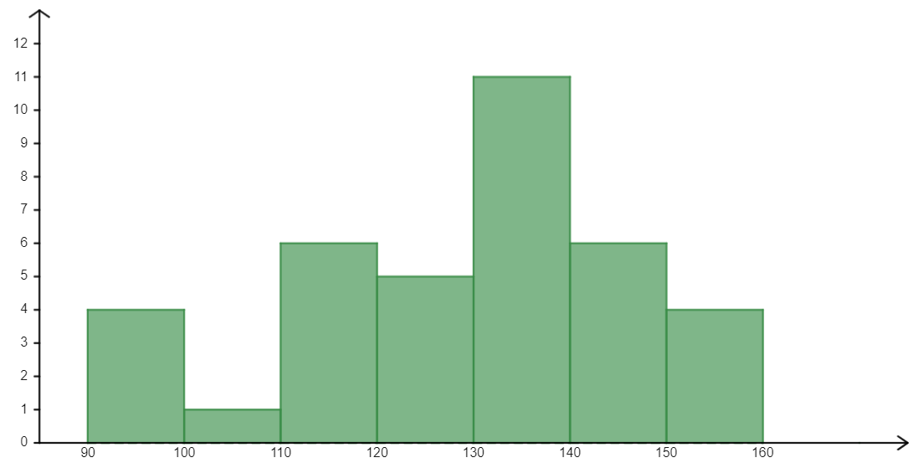
Frequency histograms – Worked example
Create a frequency histogram using the movie run time data in the frequency table.
Frequency table
Frequency histogram
What would happen if the 100-109 bin was 0?
Movie run time | Frequency
90-99 | 4
100-109 | 1
110-119 | 6
120-129 | 5
130-139 | 11
140-149 | 6
Frequency
How are these intervals represented on the graph?
What would happen if you went up by 2’s or 3’s?
Movie run times (in minutes)
Notes:
Reveal the questions.
Students read in silence
Students individually think and explain to themselves what is happening in each step
Students hold up a thumbs up to the teacher when they have finished reading and have some sort of understanding
Think, pair, share. Students explain the solution to their partner.
In pairs students then answer the self-explanation questions.
Finally, randomly select students to share their answers with the whole class.

Slide 7
Frequency histograms – Exercise
Create a frequency histogram using the movie review ratings shown in the frequency table.
Frequency table
Frequency histogram
Ratings | Frequency
4-4.9 | 2
5-5.9 | 2
6-6.9 | 9
7-7.9 | 17
8-8.9 | 4
Notes:
Students attempt to draw a frequency histogram for the data in the frequency table
They will then share their solution with a partner and compare and discuss. They are allowed to change their answer if their partner convinces them.
Teacher will then randomly call on students to share their solution
Teacher can then reveal the solution on the next slide

Slide 8
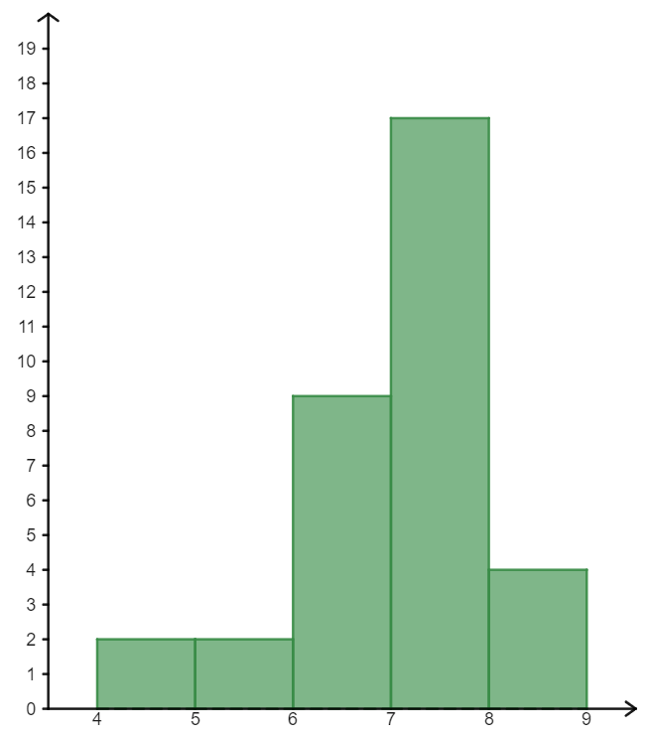
Frequency histograms – The answer
Frequency table
Frequency histogram
Ratings | Frequency
4-4.9 | 2
5-5.9 | 2
6-6.9 | 9
7-7.9 | 17
8-8.9 | 4
Frequency
Movie ratings

Slide 9
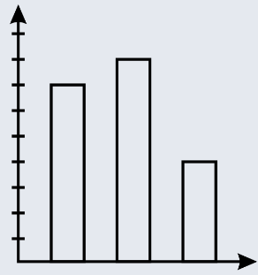
Frequency histograms
Comparing frequency histograms to column graphs
 | Frequency histogram | Column Graph
Columns together | yes / no | yes / no
Gap left at start | yes / no | yes / no
Can be drawn on its side | yes / no | yes / no
Data type used | categorical / numerical | categorical / numerical
Notes:
Students can answer this individually on their mini whiteboard
Pair/share to discuss and possibly change their mind
Randomly choose students to share their answer and justify.
It would be worthwhile to again discuss with students that although Histograms normally deal with continuous data, they can be used for discrete data as well.
Likewise, column graphs are usually used for categorical data, but they can be used for numerical discrete data if the range is not large.

Slide 10
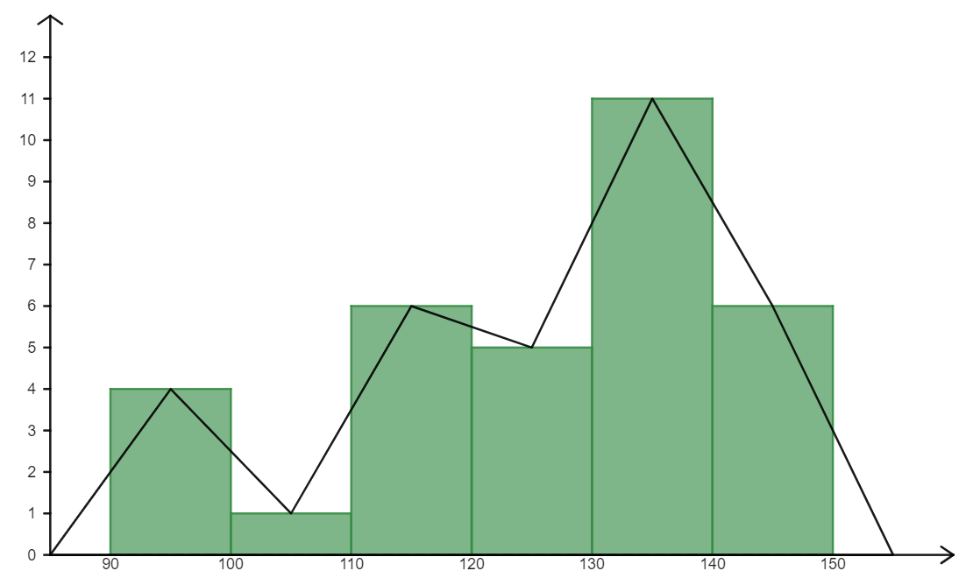
Frequency polygons - Features
Can you write a definition for a frequency polygon?
What do you notice?
Why might the frequency polygon start and end at zero?
Frequency
How is a frequency polygon different than a line graph?
Your turn… Add a frequency polygon to each of your histograms
Movie run time
Notes:
Show students the worked example.
Have them read silently to themselves
Discuss the graph with a partner and then answer the self explanation prompts as a pair
Teacher to randomly choose students to share their answers to the self explanation prompts with the class
Some suggested responses:
Definition: A frequency polygon is a graph that shows the frequencies of grouped data.
Why does polygon start and end at zero – there are no run times less than 90 so the polygon reflects this, likewise there are no run times over 150.
How is polygon different to a line graph – line graph shows data for a set period of time. The line graph indicates the data for the first data point being considered and the last data point being considered, it doesn’t show what comes before the time frame in consideration, or after it.
Students will then attempt to add a frequency polygon to their movie rating histogram.

Slide 11
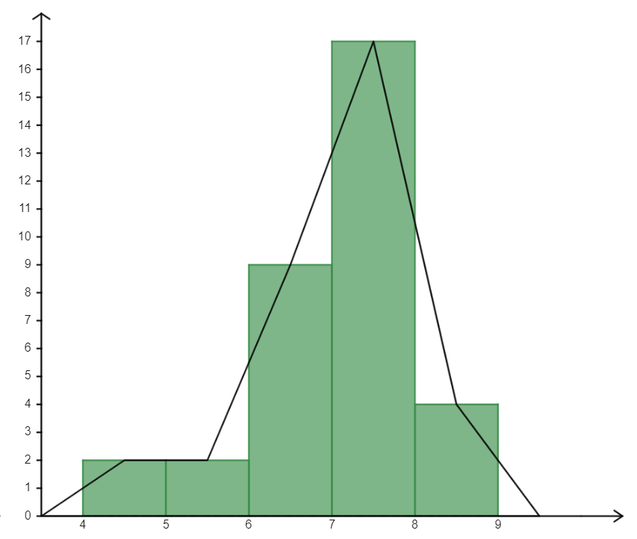
Frequency polygons – Solution
A frequency polygon is a graph that shows the frequencies of grouped data.
It is made by joining the midpoints of the columns of a frequency histogram
The polygon starts on the horizontal axis at what would be the midpoint of the bar before the first bar, and ends on the horizontal axis at what would be the midpoint of the bar after the last bar.
Frequency
Movie ratings
Notes:
After students have attempted a solution have them share and explain their solution to a partner.
They are allowed to change their answer if their partner can convince them.
Randomly select students to share their answer with the class before revealing this solution.

Slide 12
Success criteria
I can draw a histogram
I can draw a polygon
I can compare histograms with column graphs
I can compare polygons to line graphs

