Slide 1
Rock paper scissors
Making predictions

Slide 2
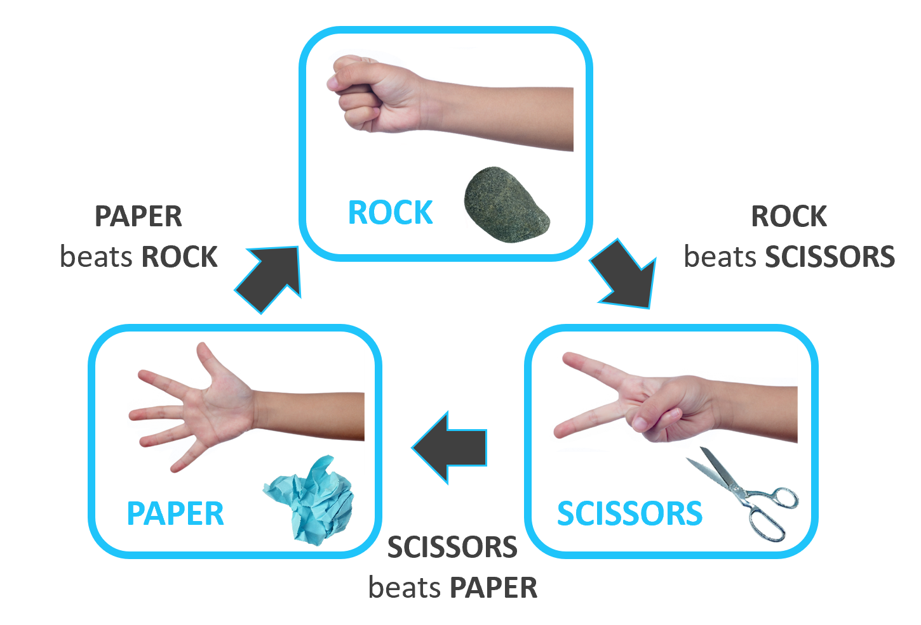
Rock paper scissors – part 1
What is the chance of winning?
Can you describe the chance of winning using probability terms?
Can you describe the chance of winning using numerical values? How did you calculate this?
reSolve: Mathematics by Inquiry (2020)
Notes:
Encourage students to list the sample space for the game by listing all of the different combination of moves each player can make.

Slide 3
Rock paper scissors – part 2
What is the chance of winning?
reSolve: Mathematics by Inquiry (2020)
Notes:
Tree diagrams are not part of the STage 4 course but could be shown to students as an extension. Hide these slides if you choose not to use them.

Slide 4
Rock paper scissors – part 3
What is the chance of winning?
reSolve: Mathematics by Inquiry (2020)

Slide 5
Rock paper scissors – part 4
What is the chance of winning?
reSolve: Mathematics by Inquiry (2020)

Slide 6
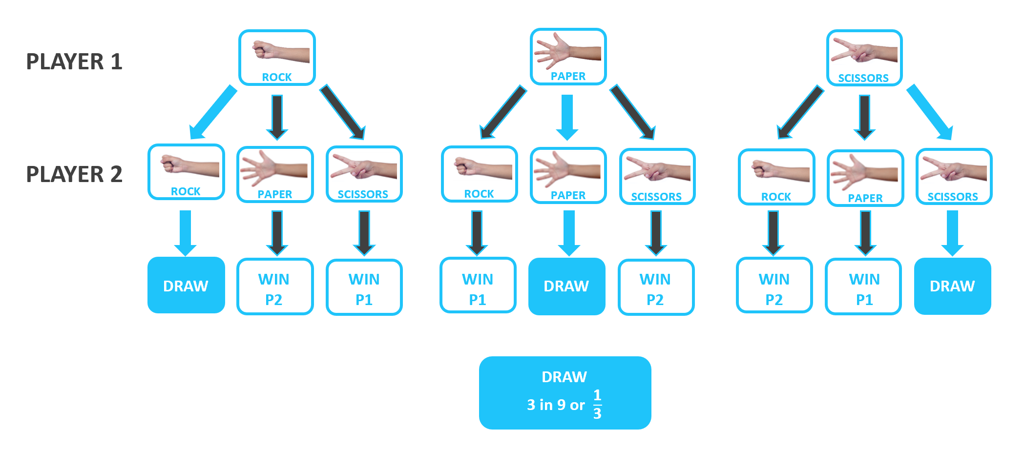
Rock paper scissors – part 5
What is the chance of winning?
reSolve: Mathematics by Inquiry (2020)

Slide 7
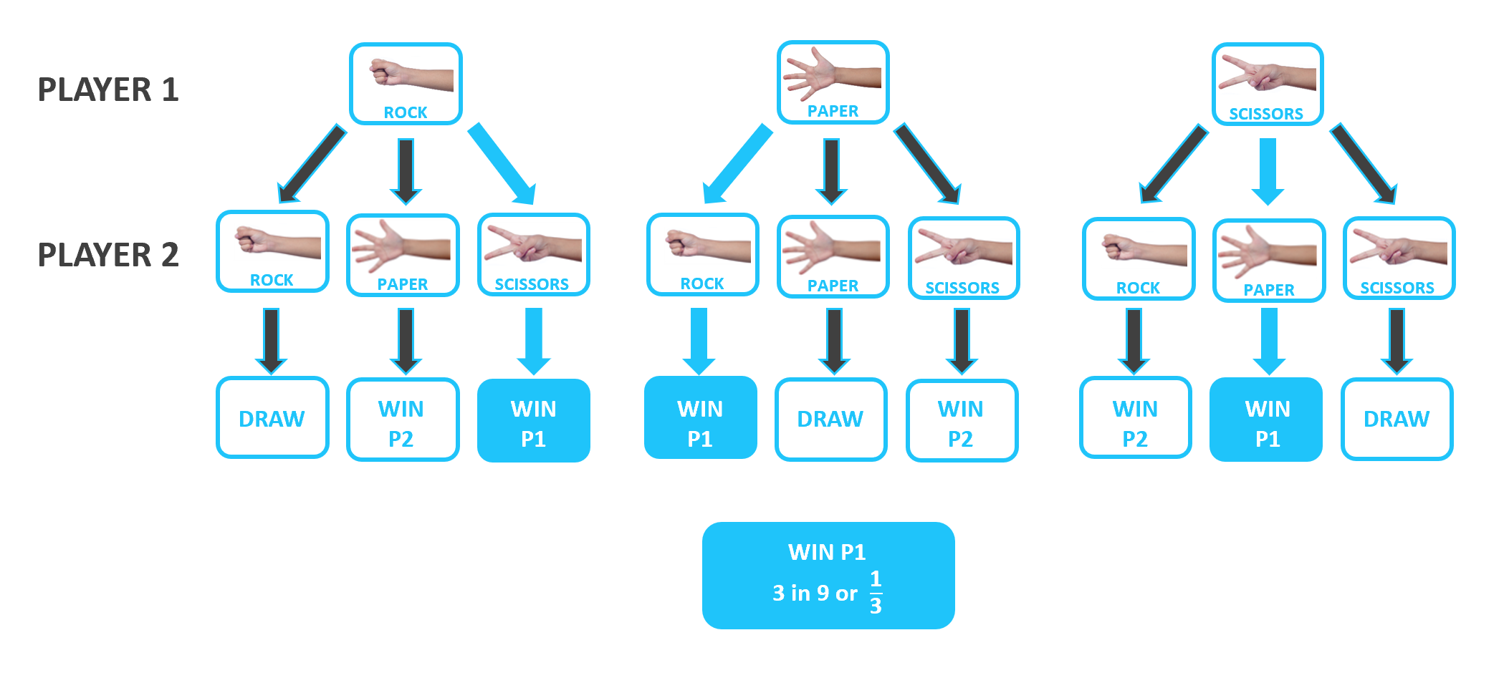
Rock paper scissors – part 6
What is the chance of winning?
reSolve: Mathematics by Inquiry (2020)

Slide 8
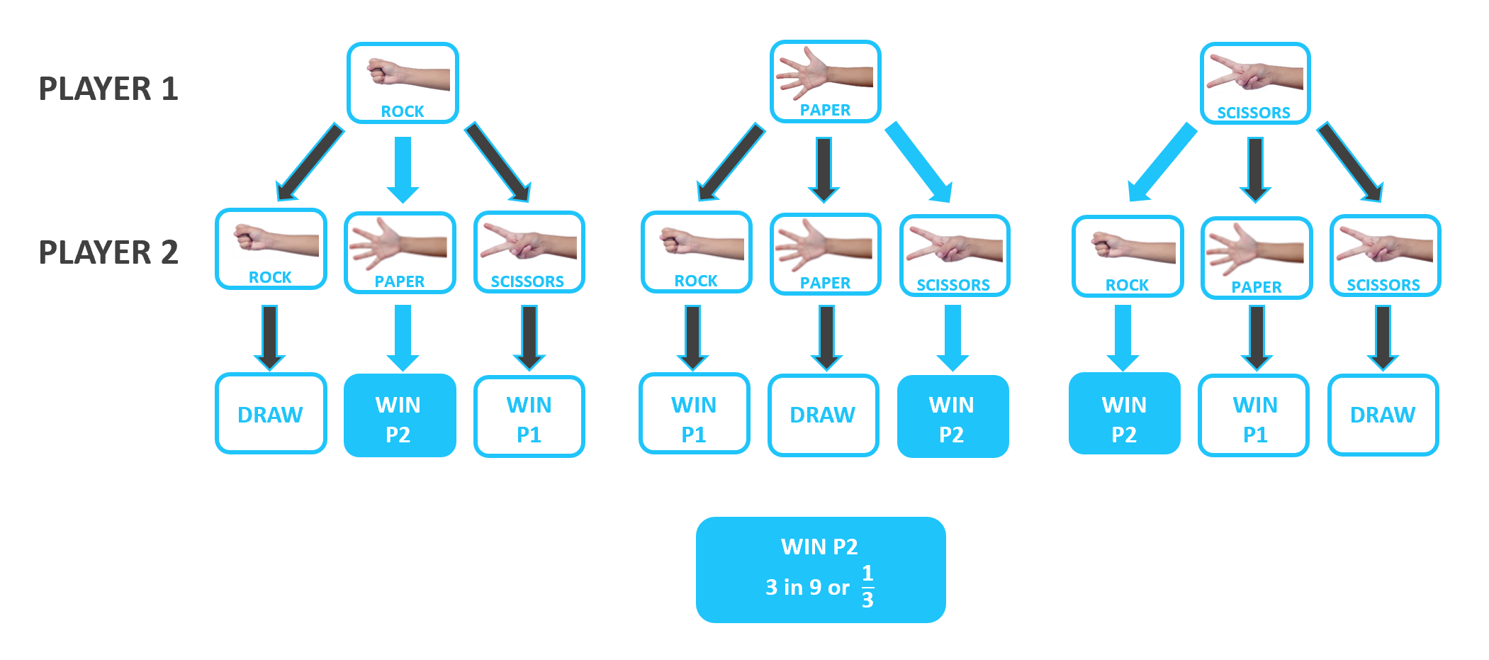
Rock paper scissors – part 7
What is the chance of winning?
reSolve: Mathematics by Inquiry (2020)

Slide 9
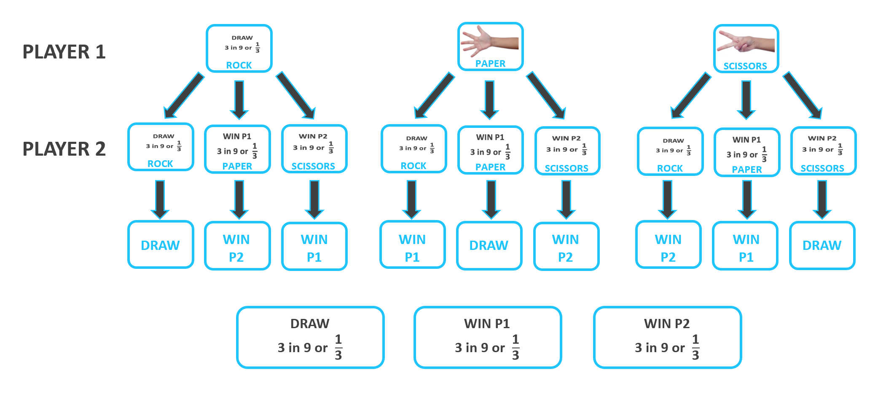
Rock paper scissors – part 8
What is the chance of winning?
reSolve: Mathematics by Inquiry (2020)

Slide 10
Rock paper scissors – part 9
What is the chance of winning?
Is there another way to represent the chances of winning rock paper scissors?
reSolve: Mathematics by Inquiry (2020)
Notes:
Tables are not part of the Stage 4 course, but could be shown to students as an extension. Hide these slides if you choose not to use them

Slide 11
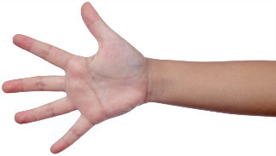
Rock paper scissors – part 10
What is the chance of winning?
 | DRAW | WIN P1 | WIN P2
 | WIN P2 | DRAW | WIN P1
 | WIN P1 | WIN P2 | DRAW
P1
P2
ROCK
PAPER
SCISSORS
reSolve: Mathematics by Inquiry (2020)

Slide 12
Rock paper scissors – part 11
What is the chance of winning?
 | DRAW | WIN P1 | WIN P2
 | WIN P2 | DRAW | WIN P1
 | WIN P1 | WIN P2 | DRAW
P1
P2
ROCK
PAPER
SCISSORS
ROCK
PAPER
SCISSORS
reSolve: Mathematics by Inquiry (2020)

Slide 13
Rock paper scissors – part 12
What is the chance of winning?
 | DRAW | WIN P1 | WIN P2
 | WIN P2 | DRAW | WIN P1
 | WIN P1 | WIN P2 | DRAW
P1
P2
ROCK
PAPER
SCISSORS
ROCK
PAPER
SCISSORS
reSolve: Mathematics by Inquiry (2020)

Slide 14
Rock paper scissors – part 13
What is the chance of winning?
DRAW
3 in 9 or $\frac{\text{1}}{\text{3}}$
 | DRAW | WIN P1 | WIN P2
 | WIN P2 | DRAW | WIN P1
 | WIN P1 | WIN P2 | DRAW
P1
P2
ROCK
PAPER
SCISSORS
ROCK
PAPER
SCISSORS
reSolve: Mathematics by Inquiry (2020)

Slide 15
Rock paper scissors – part 14
What is the chance of winning?
 | DRAW | WIN P1 | WIN P2
 | WIN P2 | DRAW | WIN P1
 | WIN P1 | WIN P2 | DRAW
PLAYER 1 WINS
3 in 9 or $\frac{\text{1}}{\text{3}}$
P1
P2
ROCK
PAPER
SCISSORS
ROCK
PAPER
SCISSORS
reSolve: Mathematics by Inquiry (2020)

Slide 16
Rock paper scissors – part 15
What is the chance of winning?
 | DRAW | WIN P1 | WIN P2
 | WIN P2 | DRAW | WIN P1
 | WIN P1 | WIN P2 | DRAW
PLAYER 2 WINS
3 in 9 or $\frac{\text{1}}{\text{3}}$
P1
P2
ROCK
PAPER
SCISSORS
ROCK
PAPER
SCISSORS
reSolve: Mathematics by Inquiry (2020)

Slide 17
Rock paper scissors – part 16
What is the chance of winning?
DRAW
3 in 9 or $\frac{\text{1}}{\text{3}}$
 | DRAW | WIN P1 | WIN P2
 | WIN P2 | DRAW | WIN P1
 | WIN P1 | WIN P2 | DRAW
P1
P2
ROCK
PAPER
SCISSORS
PLAYER 1 WINS
3 in 9 or $\frac{\text{1}}{\text{3}}$
ROCK
PLAYER 2 WINS
3 in 9 or $\frac{\text{1}}{\text{3}}$
PAPER
SCISSORS
reSolve: Mathematics by Inquiry (2020)

Slide 18
Rock paper scissors lizard Spock

Slide 19
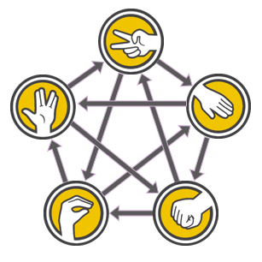
Rock paper scissors lizard Spock – part 1
SCISSORS cut PAPER
PAPER covers ROCK
ROCK crushes LIZARD
LIZARD poisons SPOCK
SPOCK smashes SCISSORS
SCISSORS decapitates LIZARD
LIZARD eats PAPER
PAPER disproves SPOCK
SPOCK vaporises ROCK
ROCK crushes SCISSORS
reSolve: Mathematics by Inquiry (2020)

Slide 20
Rock paper scissors lizard Spock – part 2
What is the chance of winning?
Can you describe the chance of winning using probability terms?
Can you describe the chance of winning using numerical values?
Can you create a representation for the chances of winning?
reSolve: Mathematics by Inquiry (2020)
Notes:
Ask students to list the sample space as they did for rock, paper, scissors. This can just be done by listing combinations. Students should realise that this is harder because there are more choices. Teacher should discuss, how do students know they have listed them all.
A table could be used to assist with ensuring that all combinations are considered, but as before, they are not technically part of the Stage 4 course.

Slide 21
Rock paper scissors lizard Spock – part 3
Your turn – What is the chance of winning?
P1
P2
reSolve: Mathematics by Inquiry (2020)

Slide 22
Rock paper scissors lizard Spock – part 4
Your turn – What is the chance of winning?
P1
 | DRAW | P2 WINS | P1 WINS | P2 WINS | P1 WINS
 | P1 WINS | DRAW | P2 WINS | P1 WINS | P2 WINS
 | P2 WINS | P1 WINS | DRAW | P2 WINS | P1 WINS
 | P2 WINS | P1 WINS | P1 WINS | DRAW | P2 WINS
 | P2 WINS | P1 WINS | P2 WINS | P1 WINS | DRAW
P2
reSolve: Mathematics by Inquiry (2020)

Slide 23
Rock paper scissors lizard Spock – part 5
Your turn – What is the chance of winning?
P1
 | DRAW | P2 WINS | P1 WINS | P2 WINS | P1 WINS
 | P1 WINS | DRAW | P2 WINS | P1 WINS | P2 WINS
 | P2 WINS | P1 WINS | DRAW | P2 WINS | P1 WINS
 | P2 WINS | P1 WINS | P1 WINS | DRAW | P2 WINS
 | P2 WINS | P1 WINS | P2 WINS | P1 WINS | DRAW
Player 1 wins
10 in 25 or $\frac{\text{2}}{\text{5}}$
P2
reSolve: Mathematics by Inquiry (2020)

Slide 24
Rock paper scissors lizard Spock – part 6
Your turn – What is the chance of winning?
P1
 | DRAW | P2 WINS | P1 WINS | P2 WINS | P1 WINS
 | P1 WINS | DRAW | P2 WINS | P1 WINS | P2 WINS
 | P2 WINS | P1 WINS | DRAW | P2 WINS | P1 WINS
 | P2 WINS | P1 WINS | P1 WINS | DRAW | P2 WINS
 | P2 WINS | P1 WINS | P2 WINS | P1 WINS | DRAW
Player 2 wins
10 in 25 or $\frac{\text{2}}{\text{5}}$
P2
reSolve: Mathematics by Inquiry (2020)

Slide 25
Rock paper scissors lizard Spock – part 7
Your turn – What is the chance of winning?
P1
 | DRAW | P2 WINS | P1 WINS | P2 WINS | P1 WINS
 | P1 WINS | DRAW | P2 WINS | P1 WINS | P2 WINS
 | P2 WINS | P1 WINS | DRAW | P2 WINS | P1 WINS
 | P2 WINS | P1 WINS | P1 WINS | DRAW | P2 WINS
 | P2 WINS | P1 WINS | P2 WINS | P1 WINS | DRAW
DRAW
5 in 25 or $\frac{\text{1}}{\text{5}}$
P2
reSolve: Mathematics by Inquiry (2020)

Slide 26
Rock paper scissors lizard Spock – part 8
Your turn – What is the chance of winning?
P1
 | DRAW | P2 WINS | P1 WINS | P2 WINS | P1 WINS
 | P1 WINS | DRAW | P2 WINS | P1 WINS | P2 WINS
 | P2 WINS | P1 WINS | DRAW | P2 WINS | P1 WINS
 | P2 WINS | P1 WINS | P1 WINS | DRAW | P2 WINS
 | P2 WINS | P1 WINS | P2 WINS | P1 WINS | DRAW
PLAYER 1 WINS
10 in 25 or $\frac{\text{2}}{\text{5}}$
P2
PLAYER 2 WINS
10 in 25 or $\frac{\text{2}}{\text{5}}$
DRAW
5 in 25 or $\frac{\text{1}}{\text{5}}$
reSolve: Mathematics by Inquiry (2020)

