Slide 1
To be, or not to be
Making predictions

Slide 2
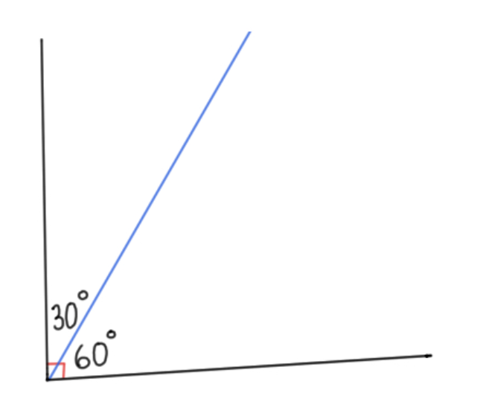
Complementary events – part 1
What do you think complementary might mean?
Complementary colours
Complementary ingredients
Complementary angles

Slide 3
To be, or not to be – complementary events
Two events are said to be complementary when one event occurs if and only if the other does not. For example: going to school or not going to school, rolling a 6 or not rolling a six
The complement of an event is all the other outcomes in the sample space. For example, the complement of rolling a 3 on a dice is not rolling a 3 (i.e. rolling 1, 2, 4, 5 or 6)

Slide 4
Complementary events – part 2
The complement of rolling a 3
$P\left(rolling a 3\right)=\frac{1}{6}$

Slide 5
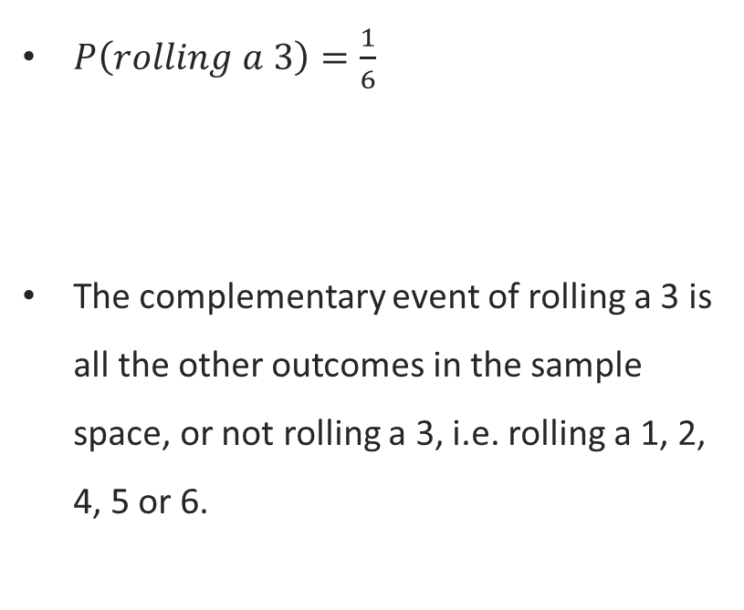
Complementary events – part 3
The complement of rolling a 3
$P\left(rolling a 3\right)=\frac{1}{6}$
The complementary event of rolling a 3 is all the other outcomes in the sample space, or not rolling a 3, i.e. rolling a 1, 2, 4, 5 or 6.

Slide 6
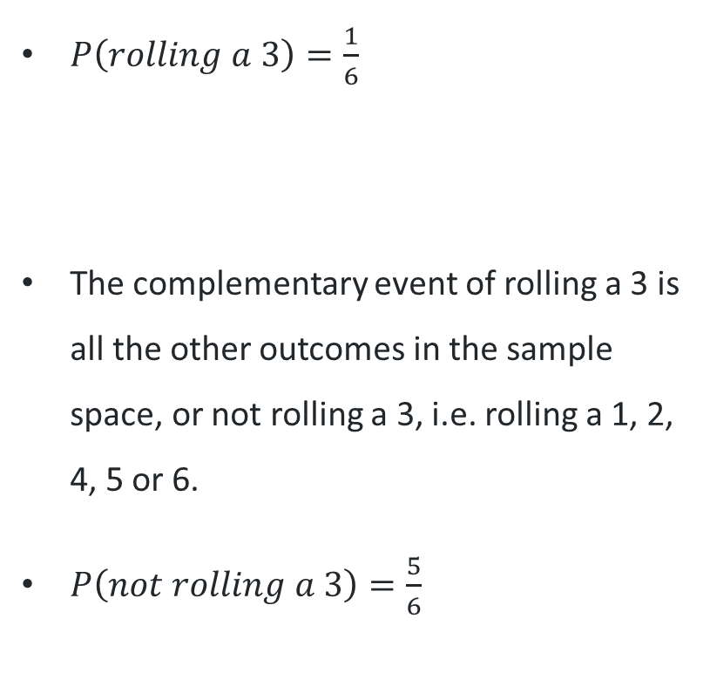
Complementary events – part 4
The complement of rolling a 3
$P\left(rolling a 3\right)=\frac{1}{6}$
The complementary event of rolling a 3 is all the other outcomes in the sample space, or not rolling a 3, i.e. rolling a 1, 2, 4, 5 or 6.
$P\left(not rolling a 3\right)=\frac{5}{6}$

Slide 7

Complementary events – part 5
Examining the probabilities
When the event and it’s complement are combined, what do you notice?
The total is $\frac{6}{6}$
How else can $\frac{6}{6}$ be written?

Slide 8
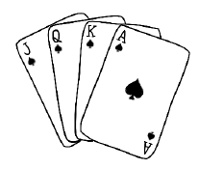
Complementary events – part 6
Self-explanation (1)
What is the probability of drawing an Ace?
What is the probability of the complement of drawing an Ace?

Slide 9
Complementary events – part 7
Self-explanation
What is the probability of drawing an Ace?
The probability of drawing an Ace = $\frac{1}{4}$
What is the probability of the complement of drawing an Ace?
The probability of the complement of drawing an Ace $=\frac{3}{4}$

Slide 10
Complementary events – part 8
Self-explanation (3)
What is the probability of drawing an Ace?
The probability of drawing an Ace = $\frac{1}{4}$
What is the probability of the complement of drawing an Ace?
The probability of the complement of drawing an Ace $=\frac{3}{4}$
Self-explanation prompts:
What does the ‘complement’ mean here?
Could this have been done a different way?

Slide 11
Complementary events – part 9
Adding to 1
The sum of the probability of an event and its complement is a total of 1
For the spinner:

Slide 12

Complementary events – part 10
Adding to 1
The sum of the probability of an event and its complement is a total of 1
For the spinner:
The probability of spinning blue, $P\left(blue\right)=\frac{2}{4}$

Slide 13

Complementary events – part 11
Adding to 1
The sum of the probability of an event and its complement is a total of 1
For the spinner:
The probability of spinning blue, $P\left(blue\right)=\frac{2}{4}$
The probability of the complement of spinning blue, $P\left(not blue\right)=\frac{2}{4}$

Slide 14

Complementary events – part 12
Adding to 1
The sum of the probability of an event and its complement is a total of 1
For the spinner:
The probability of spinning blue, $P\left(blue\right)=\frac{2}{4}$
The probability of the complement of spinning blue, $P\left(not blue\right)=\frac{2}{4}$
When you add these you get $\frac{4}{4}$, which is one whole

Slide 15
Complementary events – part 13
Your turn
For this spinner –
What is the probability of spinning purple?
What is the probability of the complement of spinning purple?

Slide 16
Complementary events – part 14
Your turn
For this spinner –
What is the probability of spinning purple?
The probability of spinning purple is $\frac{1}{4}$
What is the probability of the complement of spinning purple?
The probability of not spinning purple is $\frac{3}{4}$

Slide 17
Complementary events – part 15
Your turn non-routine
On their way to school, Sam must pass through a set of traffic lights. Sam is on their L plates and won’t drive through an amber light.
What is the probability that Sam will stop at the traffic lights?
What is the probability of not stopping?
Notes:
Students might discuss how long each light stays on for which is a valid discussion.
Discuss with students if the outcomes are equally likely...
This leads into the next lesson.

Slide 18
Complementary events – part 16
Your turn non-routine
On their way to school, Sam must pass through a set of traffic lights. Sam is on their L plates and won’t drive through an amber light.
What is the probability that Sam will stop at the traffic lights?
The probability that Sam will stop at the traffic lights is $\frac{2}{3}$ (on a red or amber light)
What is the probability of not stopping?
The probability that Sam will not stop at the traffic lights is $\frac{1}{3}$ (on a green light)
Notes:
Students might discuss how long each light stays on for which is a valid discussion.
Discuss with students if the outcomes are equally likely...
This leads into the next lesson.

Slide 19
Complementary events – part 17
Your turn non-routine
On their way to school, Sam must pass through a set of traffic lights. Sam is on their L plates and won’t drive through an amber light.
What is the probability that Sam will stop at the traffic lights?
The probability that Sam will stop at the traffic lights is $\frac{2}{3}$ (on a red or amber light)
What is the probability of not stopping?
The probability that Sam will not stop at the traffic lights is $\frac{1}{3}$ (on a green light)
Is this correct? Are the outcomes equally likely?
Notes:
Students might discuss how long each light stays on for which is a valid discussion.
Discuss with students if the outcomes are equally likely...
This leads into the next lesson.

Slide 20
Success criteria
I can identify two events that occur at once
I can describe the complement of an event
I can evaluate the correct probability of the complement of an event
I can justify that sum of the probability of an event and its complement is a total of 1

