Slide 1
Same, same, but different
Making predictions

Slide 2
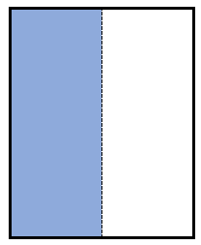
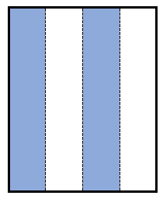
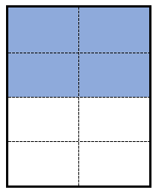
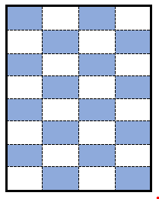
Equivalent fractions – part 1
What are they?
Equivalent fractions are fractions that are equal in value. Equivalent fractions are alternative ways of writing the same fraction.
What do you notice about each of the following?
Notes:
Key points here:
Same shading
Same whole

Slide 3
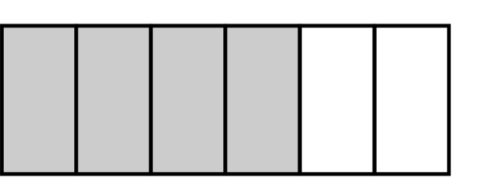

Equivalent fractions – part 2
How could you represent $\frac{2}{3}$ differently?
Worked example – Generating equivalent fractions
Generate an equivalent fraction for $\frac{2}{3}$
Split each part in 2
An equivalent fraction is $\frac{4}{6}$
How else could you create an equivalent fraction?
OR
Notes:
Reveal the questions.
Students read in silence
Students individually think and explain to themselves what is happening in each step
Students hold up a thumbs up to the teacher when they have finished reading and have some sort of understanding
Think, pair, share. Students explain the solution to their partner.
In pairs students then answer the self-explanation questions.
Finally, randomly select students to share their answers with the whole class.

Slide 4
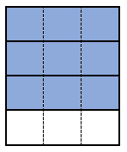

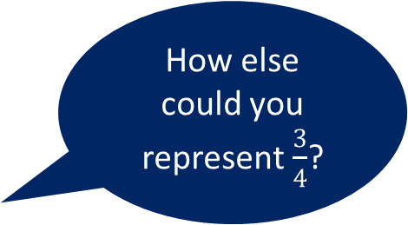
Equivalent fractions – part 3
Your turn – Generating equivalent fractions
How else could you represent $\frac{3}{4}$?
Generate an equivalent fraction for $\frac{3}{4}$
Split each part in 3
An equivalent fraction is
$$\frac{9}{12}$$
Notes:
Reveal the question and give students time to complete the question on their own.
They can then pair/share with a partner and make corrections if necessary.
Randomly Call on students to give their answers and then reveal one approach

Slide 5
Equivalent fractions – part 4
Generating equivalent fractions – how many can you create?
Using the model below of $\frac{1}{2}$ create as many equivalent fractions as you can.
Notes:
This is a open-ended question for students to explore.
Students should work on this independently and then compare with the student next to them.
As a pair can they create anymore?
Is there a limit on the number can be created?

Slide 6
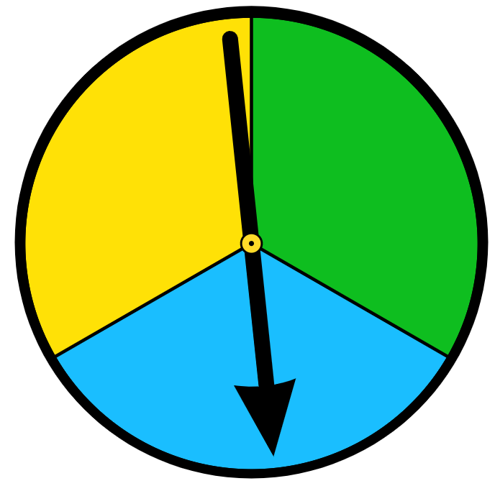
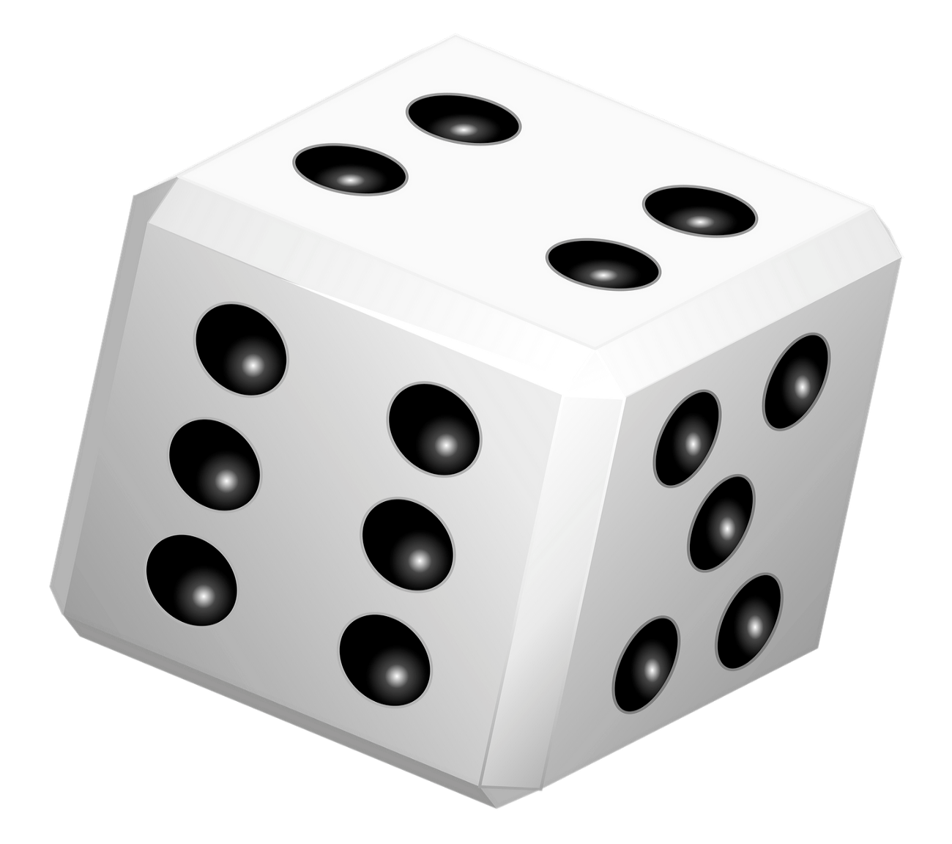
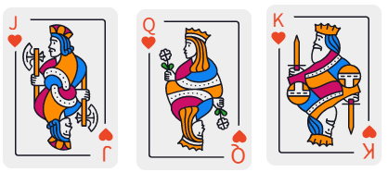
Equivalent fractions – part 5
Probability and equivalent fractions
Which one doesn’t belong? Display answer on your mini whiteboard.
Think, pair, share. Justify why.
Class discussion
The probability of not spinning blue.
The probability of not rolling a 5 or 6.
Randomly selecting the queen from the cards below.
Notes:
Students can answer this individually on their mini whiteboard
Pair/share to discuss and possibly change their mind
Randomly choose students to share their answer and justify.

