Slide 1
Rolling to 10
Explicit teaching

Slide 2
Sample space and probability – 1
Worked example – six-sided dice
How else could we display the sample space?
The sample space is $\left(S\right)=\{1, 2, 3, 4, 5, 6\}$
Why is each cell equal in size?
Each side outcome is equally likely.
The probability of rolling a 1, is $P\left(1\right)= \frac{1}{6}$
Why is one cell coloured?
The outcome 1 is one side of the dice.
Why is the cell labelled $\frac{1}{6}$?
The outcome 1 has a 1 in 6 chance of occurring.

Slide 3
Sample space and probability – 2
Your turn – eight-sided dice
The sample space is
$$S=\left\{1, 2, 3, 4, 5, 6, 7, 8\right\}$$
$$P\left(3\right)= \frac{1}{8}$$
The probability of rolling a 3 is
$$\frac{1}{8}$$
Notes:
Students now try this example on their own.
Give them time before revealing the answers.

Slide 4
Sample space and probability – 3
Worked example – six-sided dice
How else could you write this answer?
The probability of rolling an even number, is $P\left(even\right)= \frac{3}{6}$
Why are these three cells coloured?
Notes:
Reveal the question and its solution
Students read in silence
Students explain to themselves what is happening in each step
Thumb up when finished reading
Explain to a partner
Answer self-explanation questions
Share answers with whole class

Slide 5
Sample space and probability – 4
Your turn – eight-sided dice
How else could you write this answer?
$$P\left(even\right)= \frac{4}{8}$$
The probability of rolling an even number is
$$\frac{1}{8}$$
$$\frac{1}{8}$$
$$\frac{1}{8}$$
$$\frac{1}{8}$$
Notes:
Students now try this example on their own.
Give them time before revealing the answers.

Slide 6
Sample space and probability – 5
Worked example – spinner
The sample space is $S=\left\{red, purple, green, blue\right\}$
The probability of spinning blue is $P\left(blue\right)=\frac{1}{5}$
How else could we display the sample space?
The probability of spinning purple is $P\left(purple\right)=\frac{2}{5}$

Slide 7
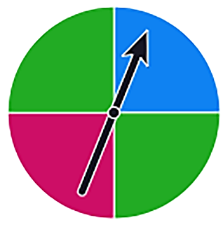
Sample space and probability – 6
Your turn – spinner
The sample space is
$$S=\left\{blue, pink, green\right\}$$
$$P\left(pink\right)=\frac{1}{4}$$
The probability of spinning pink is
$$P\left(green\right)=\frac{2}{4}$$
The probability of spinning green is

Slide 8
Success criteria
I can determine the sample space of events
I can determine the probability of simple events
I can compare the probability of different outcomes in events
I can explain the term equally likely
8

