Slide 1
HSC Examination IPT – Multimedia Option Topic
Unpacking what is expected in a 6 mark response

Slide 2
2020 Examination
Since 2019 there has been an emergence of a 6 mark question.
Previously the highest amount was a 5 mark question.
Students are allocated 1 hour and 10 minutes for
completing two option topics worth 40 marks.

Slide 3
Question 28 e)
Attempt the question allowing about 12 minutes to write a response.
Question:
A virtual world multimedia system is being developed for education. The system will integrate elements such as images, animation, audio and video and will allow users to interact in real time.
Explain software, communication and processing technologies that have made the creation of this multimedia system possible.

Slide 4
How did you go?
Writing a response can be challenging
Did you have subject knowledge you could recall?
Could you understand the terminology in the question?
Did you know how to structure your response?
Can you remember what is expected of you when understanding:
a scenario based question
the length and depth of response required for 6 marks

Slide 5
HSC Markers feedback
What did the markers notice in student responses?
In better responses, students were able to:
explain the emerging information technology used in the creation of the system.
Areas for students to improve include:
demonstrating their knowledge and understanding of the authoring software, communication and different technologies that may be used to create virtual world multimedia system.
Did your first attempt at a response have these features?

Slide 6
Breaking down the question
scenario
Highlighting the key components.
A virtual world multimedia system is being developed for education. The system will integrate elements such as images, animation, audio and video and will allow users to interact in real time.
Explain software, communication and processing technologies that have made the creation of this multimedia system possible.
Explain
Relate cause and effect; make the relationships between things evident; provide why and/or how.
Before you can explain you must: Identify → outline→ describe→ explain.
Key words for explain: “the effect of” or “the result of”.
Components of a virtual world MMS
Software technology
Communication technology
Processing technology

Slide 7
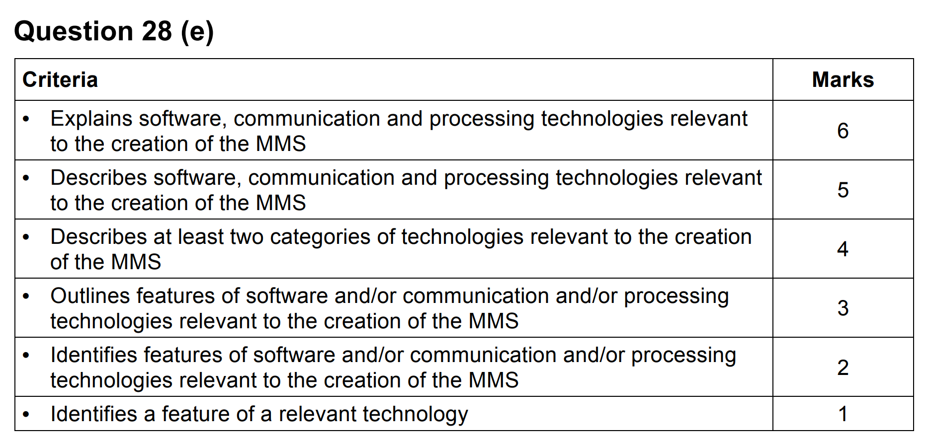
Marking Criteria
What is the HSC marker is looking for?

Slide 8
Criteria and Key Terms Guide
Criteria – 6 Mark Question
Explains software, communication and processing technologies relevant to the creation of the MMS | 6
Describes software, communication and processing technologies relevant to the creation of the MMS | 5
Describes at least two categories of technologies relevant to the creation of the MMS | 4
Outlines features of software and/or communication and/or processing technologies relevant to the creation of the MMS | 3
Identifies features of software and/or communication and/or processing technologies relevant to the creation of the MMS | 2
Identifies a feature of a relevant technology | 1
Key Terms Guide
Explain | Relate cause and effect; make the relationships between things evident; provide why and/or how. Before you can explain you must: Identify → outline→ describe→ explain. Key words for explain: “the effect of” or “the result of”.
Describe | Characteristics and features. Before you can describe you must: Identify → outline → describe.
Outline | Sketch in general terms.
Identify | Name.

Slide 9
1 Mark Response
Identifies a feature of a relevant technology
A multimedia system has to have a powerful computer to run.

Slide 10
2 Mark Response
Identifies features of software and/or communication and/or processing technologies relevant to the creation of the MMS
A multimedia system has to have a powerful computer and network connection to run images, animation, audio and video in real time.

Slide 11
3 Mark Response
Outlines features of software and/or communication and/or processing technologies relevant to the creation of the MMS
A multimedia system has to have a powerful device like a smart phone or laptop with decent CPU and RAM to run. Bandwidth and network connection must be fast so you can download images, animation, audio and video in real time.

Slide 12
4 Mark Response
Describes at least two categories of technologies relevant to the creation of the MMS
A multimedia system which incorporates a virtual world has to have a powerful device like a smart phone or laptop with decent CPU and RAM. Bandwidth and network connection must be fast so you can download images, animation, audio and video in real time smoothly and without lag or buffering.

Slide 13
5 Mark Response
Describes software, communication and processing technologies relevant to the creation of the MMS
A virtual world designed for an educational user to learn needs to have software, communication and processing technology capable of running in real time. Software technology is created by graphic designers, animators and other people in multimedia roles. It allows the user to experience and learn in a virtual world.
Communication technology has improved and fast bandwidth allows interactivity in the virtual world such as graphics, animation and audio to be experienced in real time and without lag or buffering issues affecting the user. Processing technology on smart phones, tablets and laptops has increased. Images, animation, audio and video used in virtual worlds will require greater CPU processing capacity and increased RAM. Realistic images, audio animation and video will generate large file sizes and the hardware required to create and view the final product needs to enable the timely rendering of these data types to ensure the product is viewed smoothly and seamlessly.

Slide 14
6 Mark Response Structure
Explains software, communication and processing technologies relevant to the creation of the MMS
Step 1
Outline what technologies are needed when virtual world MMS are created.
Step 2
Describe software technology and explain with example its relationship to MMS.
Step 3
Describe communication technology and explain with example its relationship to MMS.
Step 4
Describe processing technology and explain with example its relationship to MMS.

Slide 15
6 Mark Response Knowledge
Software Technology
Authoring and animation software have evolved enabling graphic designers, animators and other people in multimedia roles the ease of creating high quality multimedia items that can be used to enhance the virtual world experience.
Communication Technology
Improvements in bandwidth allow the components of the virtual world such as graphics, animation and audio to be experienced in real time and without the staggered nature buffering issues can create. This enables users of the virtual world the ability to interact with other users.
Processing Technology
Images, animation, audio and video used in virtual worlds will require greater CPU processing capacity and increased RAM. Realistic images, audio animation and video will generate large file sizes and the hardware required to create and view the final product needs to enable the timely rendering of these data types to ensure the product is viewed smoothly and seamlessly.

Slide 16
Acknowledgements
NSW HSC Examination Industrial Technology 2020 © NSW Education Standards Authority (NESA) for and on behalf of the Crown in right of the State of New South Wales 2020.
See the NESA website for additional copyright information.
Notes:
Required if you need to acknowledge external contributors, intellectual property of others that you have used in your content

Slide 17
© State of New South Wales (Department of Education), 2021. The copyright material published on this website is subject to the Copyright Act 1968 (Cth), and is owned by the NSW Department of Education or, where indicated, by a party other than the NSW Department of Education.
Notes:
Required for all Department produced content.

