Slide 1
STEM Learning Sequence –Stage 3
Teaching and learning resources

Slide 2
Teacher information
How to use the Power Point
You may wish to use this slide deck as a teaching tool to work through with your students, or save to USB for home use or download as a PDF.
This slide deck is to be developed for your context. Included are many examples that can be added to, deleted or adapted for your students.
Revise slides and teacher notes for your needs.
Revise student workbook and update with relevant details. Printed and or digital copies.
Considerations around timeframes, number and frequency of feedback sessions, and how they will be conducted for each student throughout the project needs to be developed.
Digital platforms and protocols for student, parent and teacher feedback sessions need to be negotiated.

Slide 3
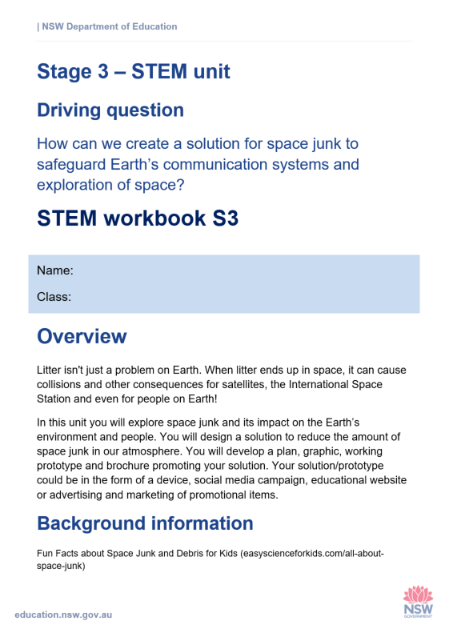
Teacher information
Student workbook
Non-digital - The student workbook can be printed and used for students at home with support from a parent or carer.
Digital - Using this slide deck to progress students through the booklet would be ideal. It provides students with some background knowledge, examples, discussion opportunities and further online research opportunities required to complete tasks.

Slide 4
Overview
All about space debris

Slide 5
Background knowledge for students
Behind the news
https://www.abc.net.au/btn/classroom/space-junk-clean-up/10834252
https://www.nasa.gov/mission_pages/station/news/orbital_debris.html
Notes:
Information on these sites supports students with further information. Could set as a task with feedback to group.

Slide 6
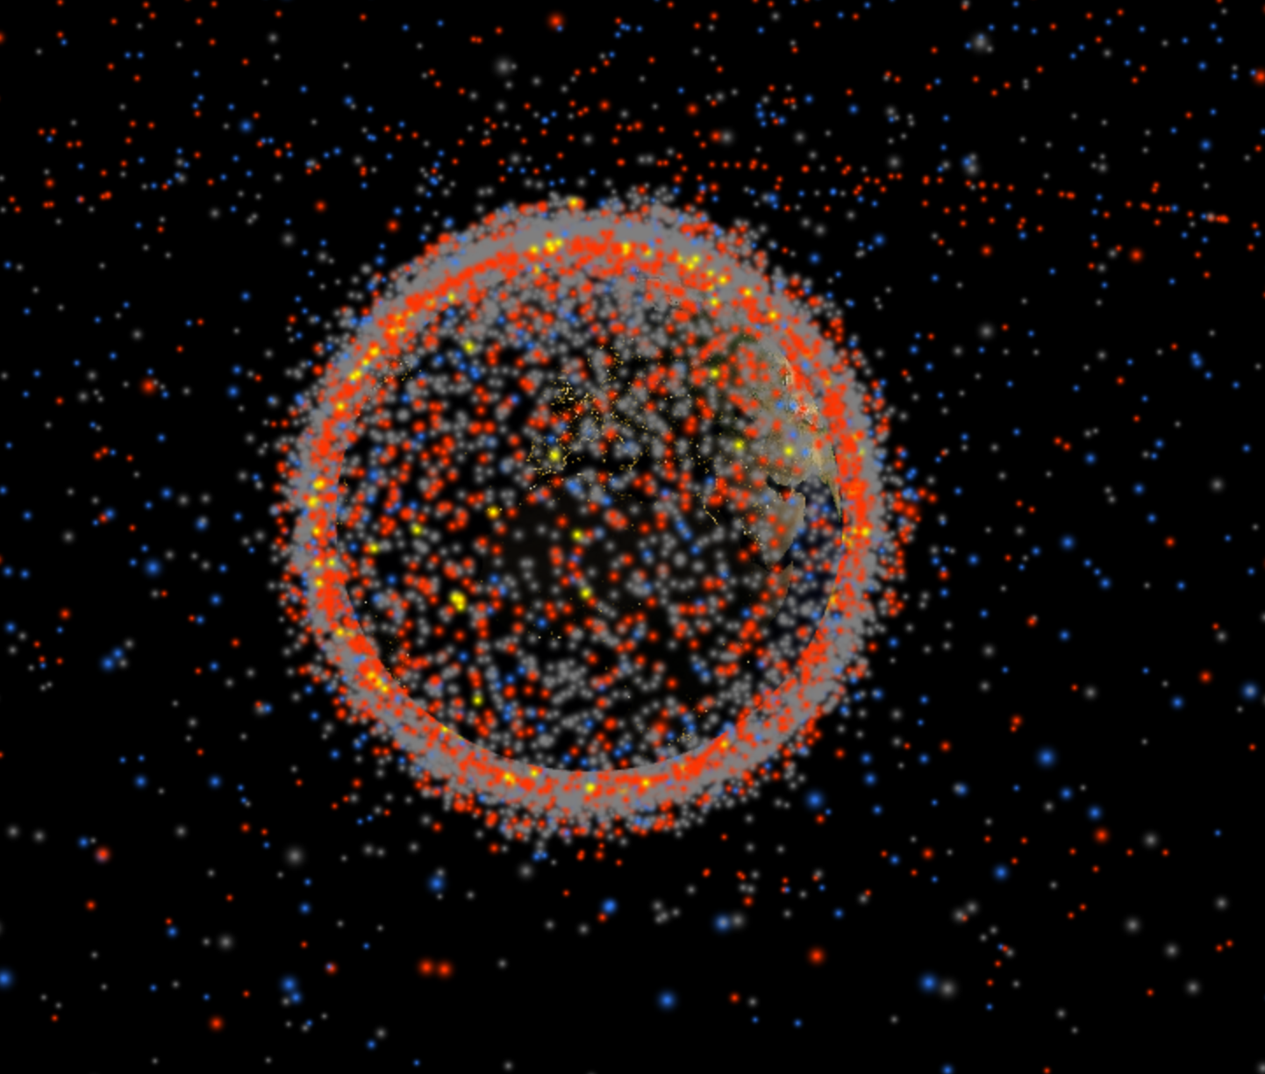
Background knowledge for students
Stuff in Space is a real time 3D map of objects in Earth orbit
http://www.stuffin.space/
The website updates daily with orbit data from Space-Track.org and uses the excellent satellite library to calculate satellite positions.
Notes:
Interactive website illustrating all space junk orbiting Earth. Navigate and investigate.

Slide 7
STEM S3
How can we create a solution for space junk to safeguard Earth’s communication systems and exploration of space?
https://www.ufo-spain.com/2019/02/19/prueban-exito-arpon-para-capturar-basura-espacial/
Notes:
Student resource slides

Slide 8
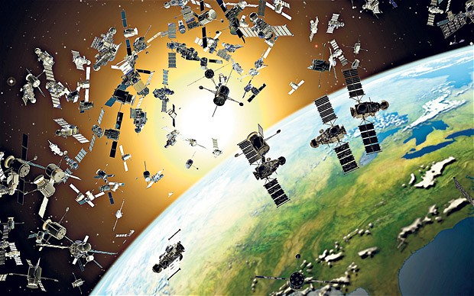
Break it down
Questions for learning
What is space junk?
Space junk or space debris is any natural or man made particle which surrounds the Earth. Natural particles such as meteoroids orbit the sun, while most artificial debris orbits the Earth.
http://www.stuffin.space/
Space junk: a conceptual artwork representing defunct satellites, failed missions, and shrapnel orbiting a few hundred miles above Earth. Photo: Science Photo Library
Notes:
Refer students to stuff in space website

Slide 9
Space junk
Let’s explain
Space waste is the collection of unused objects in orbit around Earth. It might be used rocket parts or parts of satellites from disintegration, erosion, and collisions. If their orbits intersect or overlap with new spacecraft, waste may collide with working space crafts or satellites. Sometime this space debris crosses in the Earth’s atmosphere and causes damage where ever it falls.
http://kinooze.com/what-is-space-junk/
Notes:
Use website to discover more information.

Slide 10
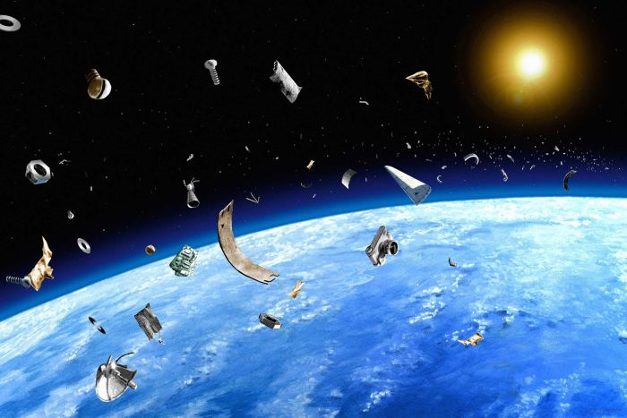
Space junk
abc.net.au news space-junk-why-it-is-coming-back-to-bite-us
Most space junk comes from orbiting satellites and the rockets that shot them into place. (Getty Images: Science Photo Library
Notes:
News report with detailed information. Could be downloaded to USB or bookmarked for online research.
Few humans have ever stepped foot in space but as a species we've already managed to make a mess of Earth's backyard. Space junk from satellites and rockets is crowding out spacecraft and telecommunication satellites in Earth's orbit, and putting humans at risk.
It's a big problem, and getting bigger every day.
We explain just how big the problem is, and what we're going to do about it

Slide 11
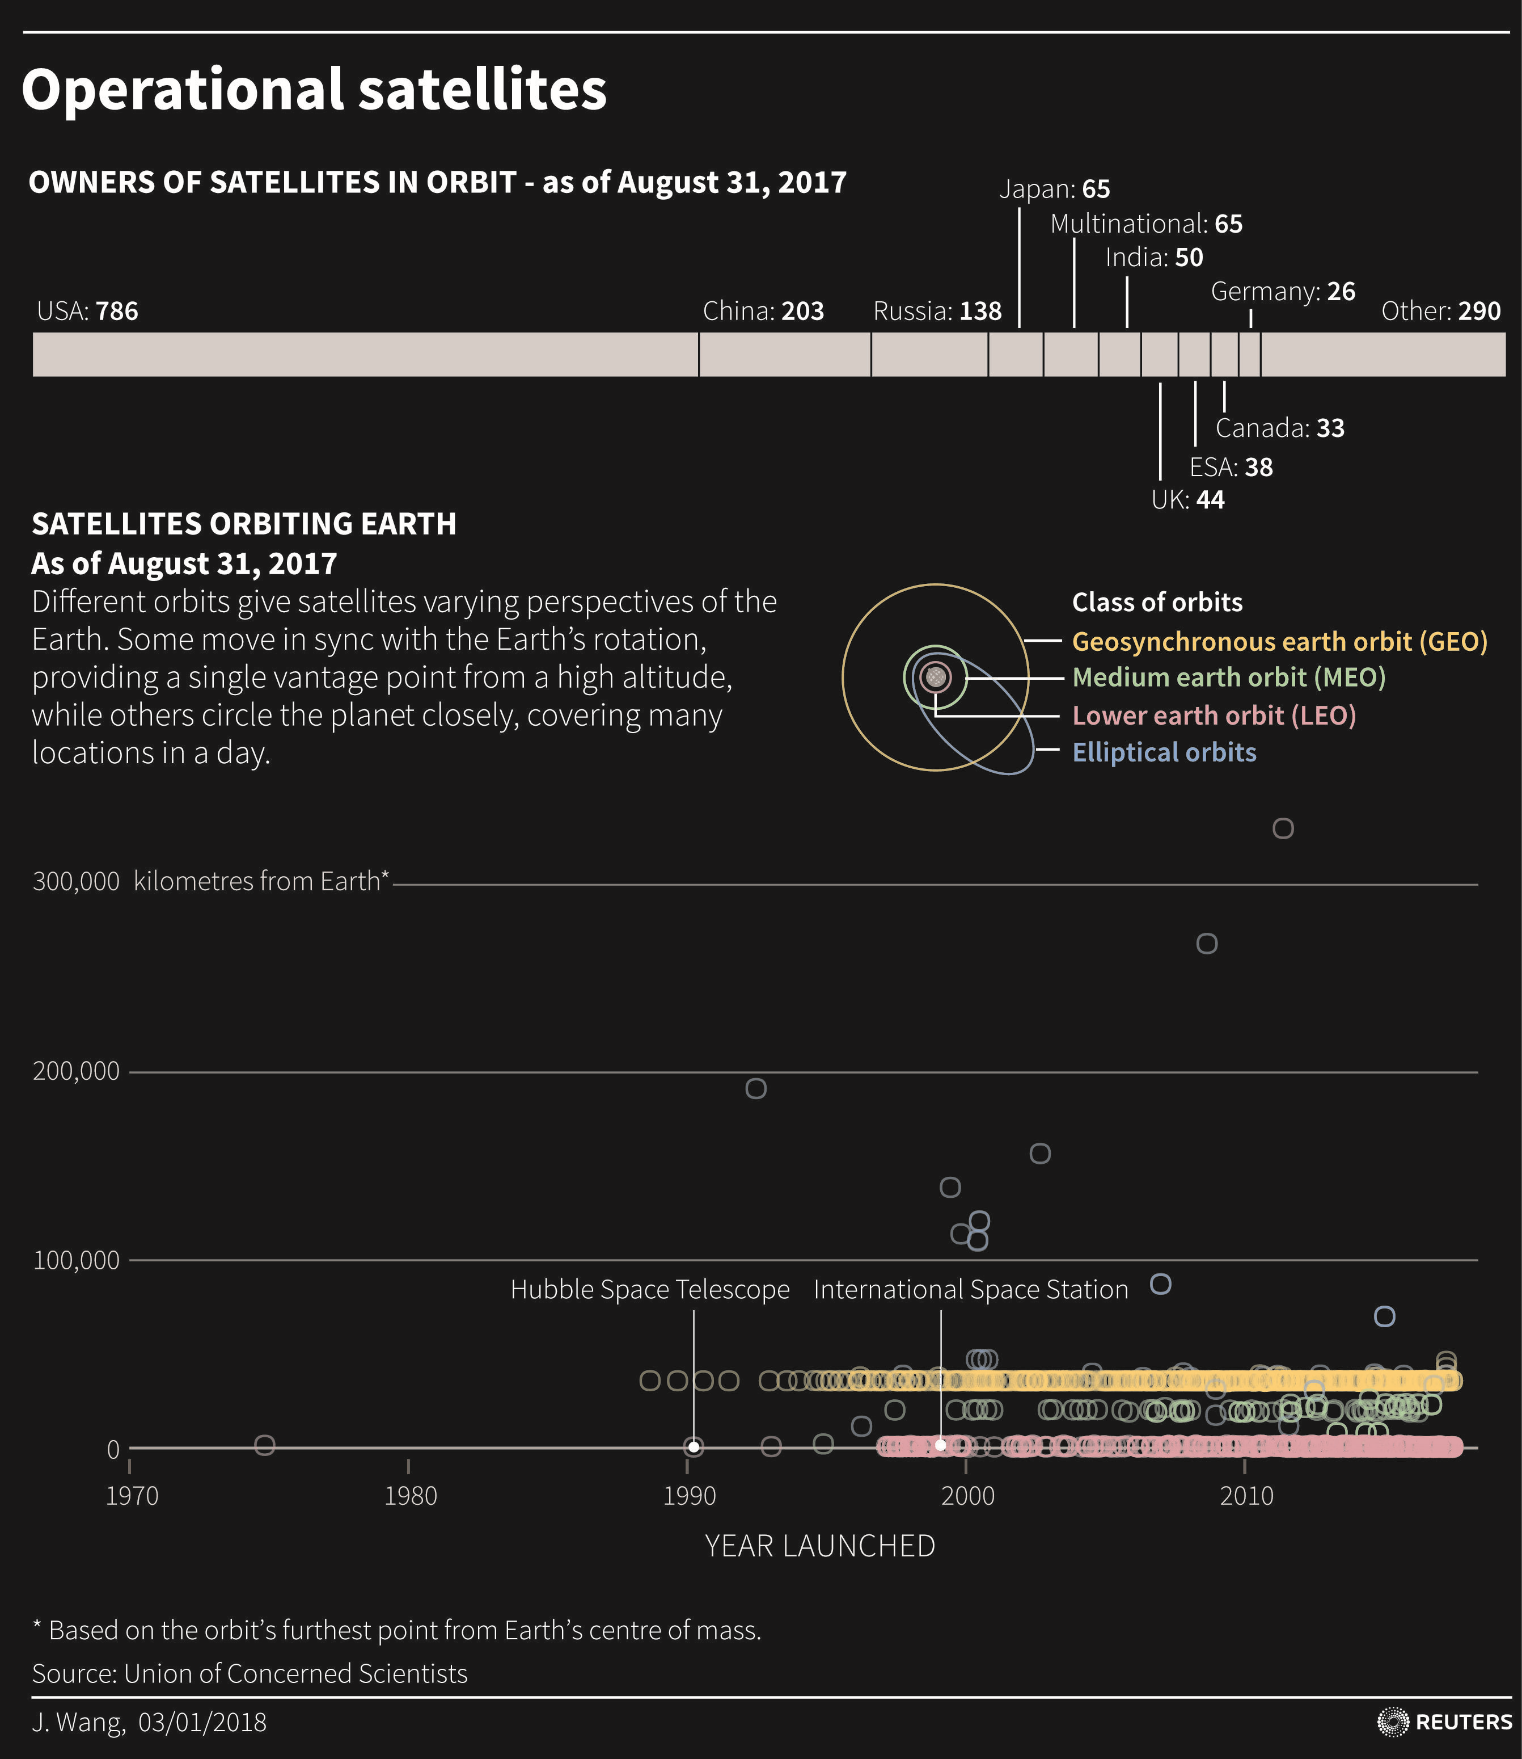
Break it down
Questions for learning
When did space junk become a problem?
Notes:
Unpack with students. Discuss timelines. Technological evolution.

Slide 12
Space junk
Questions for learning
What is space junk made of?
Orbital debris consists of any parts of non-functional space crafts, abandoned vehicles of launch stages, paint flakes, loose fragments from rocket explosions, among other things. It can also include mission related debris such as objects lost during spacewalks.
Is space junk dangerous?
Space junk alone is not dangerous, until it collides with a satellite or spacecraft. The pieces of debris can travel at speeds up to 28164 km per hour – which is fast enough for even a small piece of debris to cause damage. Even tiny flecks of paint can cause damage to a spacecraft at this speed.
Notes:
Animated – question show first then answers.

Slide 13
Space junk
Questions for learning
Can the debris be tracked?
Larger pieces of debris – those that are between the size of a marble and a softball, can be tracked as they orbit the Earth. However, there are millions of manmade particles, too small to be tracked, orbiting the Earth.
Can we limit our waste disposal in space?
Faced with this scenario, as early as the 1980s NASA and other groups within the U.S. attempted to limit the growth of debris. Other countries, however, were not as quick to adopt this sort of measure, and the problem continued to grow throughout the 1980s, especially due to a large number of launches in the Soviet Union
Notes:
Animated – question show first then answers.

Slide 14
Space junk
Questions for learning
Where is space junk located?
Who is responsible for space junk?
Notes:
Students need to answer these questions through research or from what they have learned already.

Slide 15
Mathematics
Space distances – an asteroid called Florence
Florence's distance from the Sun varies from 150 000 000km at its nearest (during summer 2017) to 375 000 000km when furthest away.
Sourced https://nrich.maths.org/13270
Notes:
In the picture below you can see the orbits of Mercury, Venus, Earth (label is slightly hidden) and Mars, along with the orbit of an asteroid called Florence (named after Florence Nightingale).
The picture shows their positions in August 2017. Florence was at its nearest position to Earth at the start of September 2017.

Slide 16
Mathematics
Space distances – an asteroid called Florence
Starting when Florence is nearest to the sun, what distance will it be from the Sun after travelling...
1. 100 km further from the Sun?
2. 1 000 km further from the Sun?
3. 10 000 km further from the Sun?
4. 100 000 km further from the Sun?
5. 1 000 000 km further from the Sun?
Sourced https://nrich.maths.org/13270
Notes:
Workout the answers and write in your workbook

Slide 17
Mathematics
Space distances – an asteroid called Florence
Starting with Florence furthest from the sun, what distance will it be from the Sun after travelling...
6. 100 km nearer the Sun?
7. 1 000 km nearer the Sun?
8. 10 000 km nearer the Sun?
9. 100 000 km nearer the Sun?
10. 1 000 000 km nearer the Sun?
Sourced https://nrich.maths.org/13270
Notes:
Workout the answers and write in your workbook

Slide 18
Activity 1
STEM - empathise

Slide 19
Space junk
Questions for learning
Why do we need to create a solution for space junk?
Notes:
Future exploration of space is in jeopardy as we will not be able to launch in the near future due to large amounts of space junk.

Slide 20
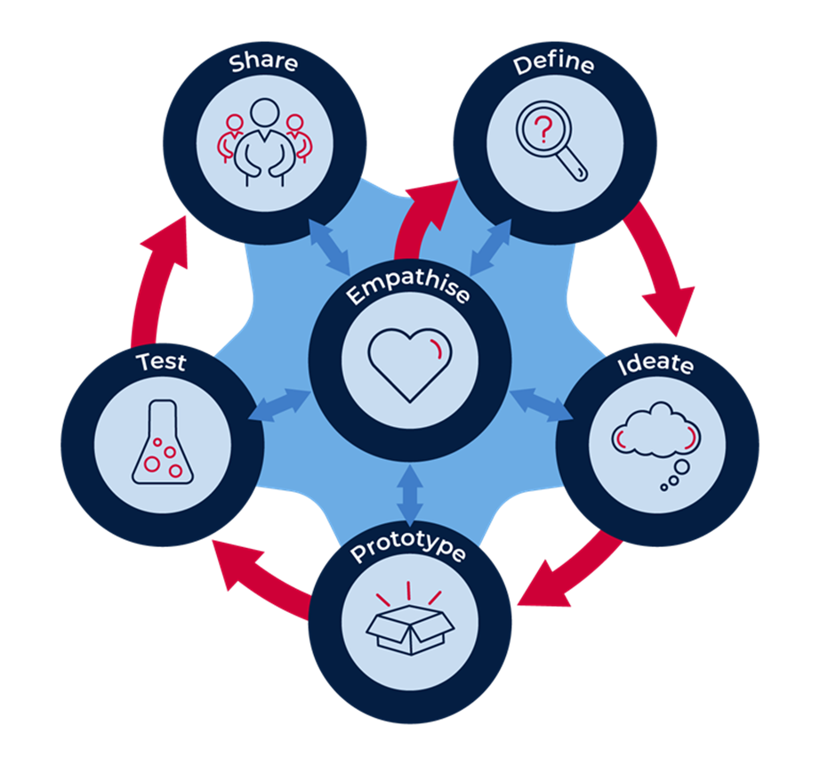
Discuss
The design process model
Notes:
Discuss with students. The first step in the empathise and defining The Problem. It is crucial that this step not be completed without thorough consideration. Defining the problem includes understanding what is needed as well as any constraints or rules that must be followed.
Next comes Brainstorming - ideating! Creativity is important here, but it can also be overwhelming to know where to start in coming up with an idea. Look at each material available and write out how each material may be useful in solving the problem.
From the list made in the brainstorming step, a design may be drawn showing parts previously identified as important. Labelling each part in their sketch will help them in the next step as well as keep track of how much of each material is needed.
Then comes the moment the students have been waiting for – Build - prototyping! From their design sketch, kids can bring their creations to life. Here, they may discover that some materials will not work as they had planned and some changes may be necessary.
Once the designs have been built, Testing may begin. This step is where frustration may set-in and many kids become discouraged if their design continues to fail. The key is teaching that failure is an important part of the Design Process. Failure is what shapes designs to their optimal performance. Because of this truth, failure should be celebrated as an opportunity to make something better!
When they are truly happy with the design – share!

Slide 21
Space junk
Empathise
Empathise
From almost the first moment that man started traveling beyond Earth's atmosphere, we've been leaving behind all sorts of debris in space. Not only is it wasteful, but space junk can be dangerous as well - to satellites, to space stations, and when some of it plummets back to Earth, to human life on the ground.

Slide 22
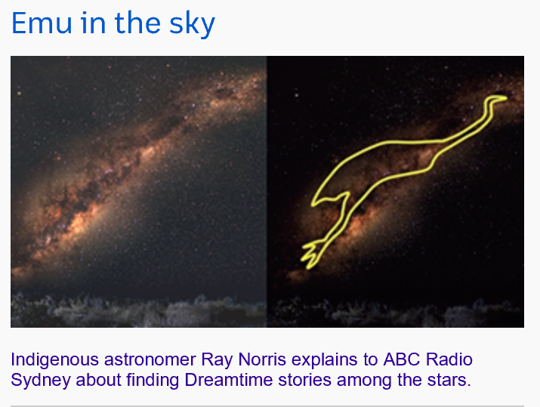
The world's first astronomers
Aboriginal perspectives
.abc.net.au/news aboriginal-astronomy-basis-of-dreamtime-stories-stargazing
https://safeyoutube.net/w/lnR4
Through Our Eyes - Dhinawan 'Emu' In The Sky with Ben Flick
Notes:
Use the website to develop students understanding of aboriginal perspectives as the traditional owners of the land.
Emu in the sky - The Emu in the Sky is a well-known Aboriginal Astronomical constellation that’s outlined by dark areas of the night sky., not the stars

Slide 23
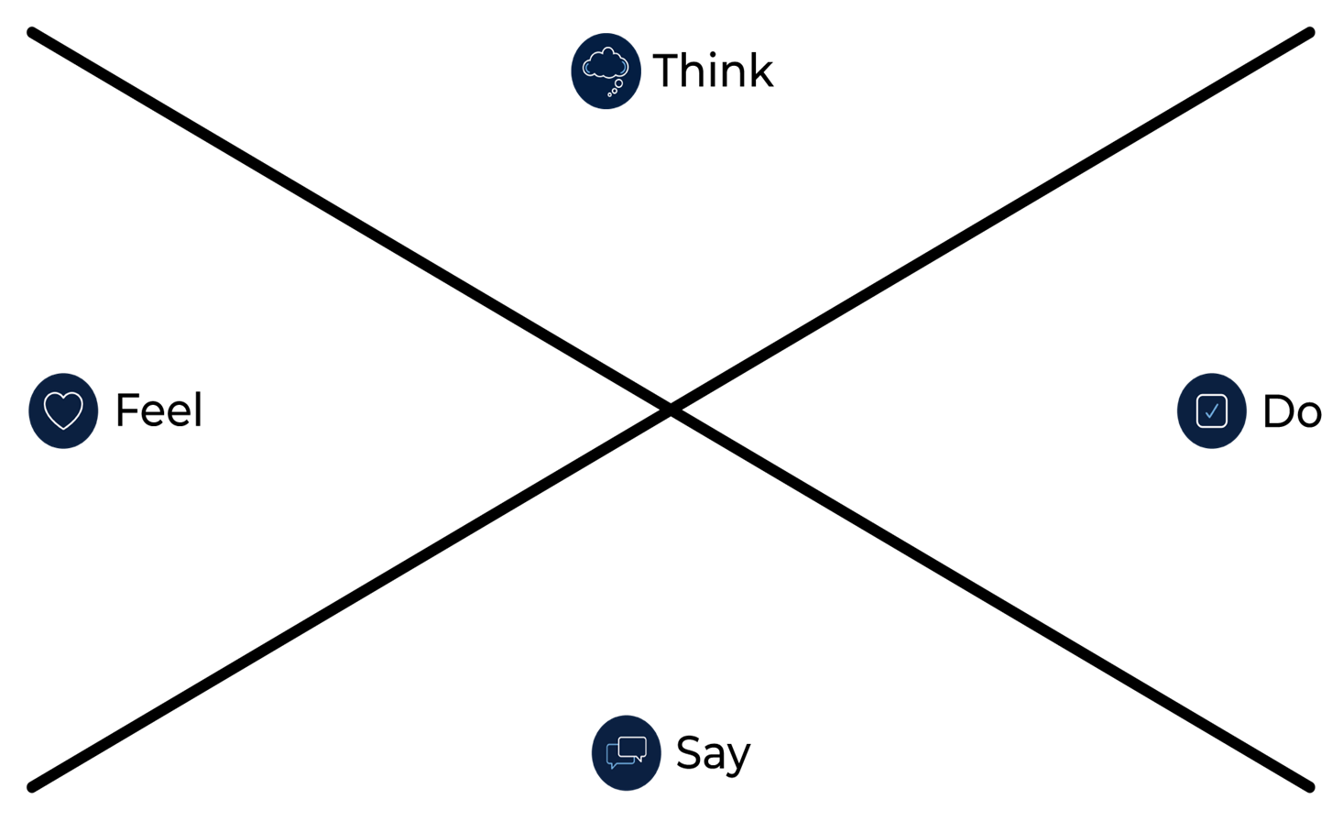
Brainstorm/think
Activity 1- Empathy map
Notes:
Complete the empathy map to demonstrate your understanding of the ‘impacts of space junk’.
•Think - think about the all the people who are affected by space junk, what are the positives and negatives of cleaning it up?
•Feel – how do you feel about that fact that there are no rules for what happens to space junk, and that space explorers are at real risk of harm by it?
•Do – what are the advantages and disadvantages if we do nothing?
•Say – what would you say to let others know about this issue?

Slide 24
Activity 2
STEM - define

Slide 25
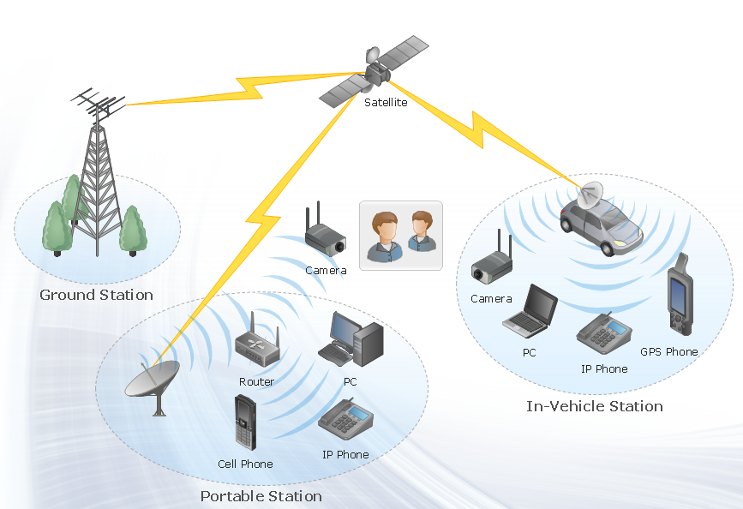
Satellites
Define
Understanding satellites
A satellite is an object which has been sent into space in order to collect information or to be part of a communications system. Satellites move continually round the Earth or around another planet. A rocket is used to launch communications satellites. The signals are sent by satellite link.
https://www.elprocus.com/important-of-network-in-embedded-systems-for-beginners/
Notes:
Discuss types of satellites and their uses. Ask students to name satellites that impact on their everyday life at home. Example TV, weather report, GPS, mobile phone, internet etc.

Slide 26
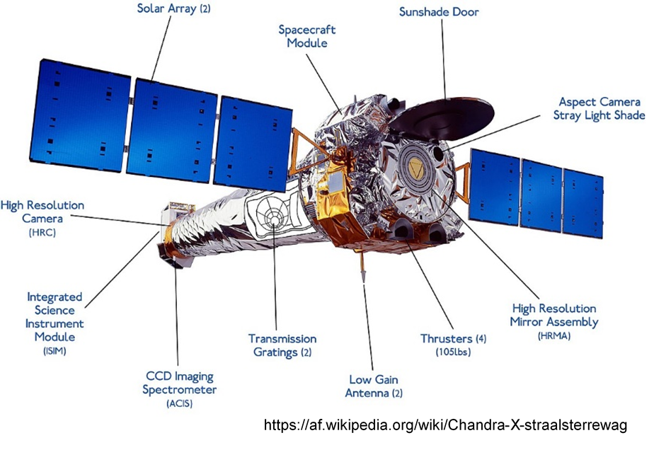
What is a satellite?
Notes:
A satellite is an object in space that orbits or circles around a bigger object. There are two kinds of satellites: natural (such as the moon orbiting the Earth) or artificial (such as the International Space Station orbiting the Earth).

Slide 27
Space exploration
Why is this important?
https://www.space.com/38700-nasa-history.html - NASA: 60 Years of Space Exploration
Buzz Aldrin stands on the moon during NASA’s Apollo 11 mission in July 1969.
(Image: © NASA)
Notes:
Discuss. Students could contribute to a shared space with their thoughts or discuss as a group.

Slide 28
Brainstorm/think
What are the harsh conditions of space?
Temperature spikes
Gravity
Radiation
Pressure
Impacts
Vibrations
Notes:
Discuss with students the need to consider a range of materials suitable for these harsh conditions.

Slide 29
Brainstorm/think
What materials can survive in space?
How materials testing provides survivability in space?
https://www.nts.com/ntsblog/materials-survive-in-space/
Notes:
Use this site to identify materials and their properties that are used to create space vehicles.

Slide 30
Brainstorm/think
Could we recycle the space junk here on Earth?
Why is this important?
Notes:
Provocation for learning solutions. Students brainstorm some possible answers.

Slide 31
Research
Activity 2 - create a report
What are human-made satellites and how do they work?
List some of the uses of human-made satellites?
Why is it important to explore our solar system?
What is space debris?
What are the harsh conditions of space?
List materials that can survive in space.
How could we recycle space junk here on Earth?
Notes:
Students use their workbook or could create a report in Power Point, sway, word, etc to collate their answers.

Slide 32
Activity 3
STEM - ideate

Slide 33
Brainstorm/think
Ideate
How can we reduce space junk?
Pose questions. Ask numerous ‘What if…?” questions.
Piggyback on an existing idea by developing it further (elaboration).
Propose alternatives. “Instead of doing it that way, maybe we could try it this way?”
Pool. Collect several ideas from different sources and combine them.
Pinch existing ideas (e.g. products) and suggest improvements.
Pause… Don’t judge the ideas yet!
How might we …. ?
Notes:
Discuss the process of ideating. Ideation is often the most exciting stage in a Design Thinking project, because during Ideation, the aim is to generate a large quantity of ideas that you can then filter and cut down into the best, most practical or most innovative ones in order to inspire new and better design solutions and products.

Slide 34
Brainstorm/think
Activity 3 - successful ideation
Adapting: Be able to switch how you see, understand, and extend thinking as new ideas get generated.
Connecting: Be able to connect concepts, attributes or themes in order to create new possibilities.
Disrupting: Be able to overturn commonly held beliefs, assumptions or norms in order to re-think normal approaches.
Flipping: Turn dead-ends or deadlocks into opportunities by flipping them over or rapidly changing direction towards greater possibility.
Dreaming and Imagining: Be able to visualise a new picture of reality by turning needs into pictures or stories.
Experimental: Be open and curious enough to explore possibilities and take risks; be willing and eager to test out ideas and keen to venture into the unknown.
Recognise Patterns: Seek to spot common threads of meaning, and ways of seeing, doing and behaving.
Curiosity: Be willing to ask uncomfortable, silly or even crazy questions. Be willing to explore and experience, in order to understand and learn something new and different.
Notes:
Discuss the process of ideating. Ideation is often the most exciting stage in a Design Thinking project, because during Ideation, the aim is to generate a large quantity of ideas that you can then filter and cut down into the best, most practical or most innovative ones in order to inspire new and better design solutions and products.

Slide 35
Brainstorm/think
What is a prototype?
Example
https://pbskids.org/designsquad/build/robo-arm/
https://safeyoutube.net/w/AVD4 - how to make a cardboard prototype
Notes:
List reasons

Slide 36
How do you clean up space junk?
Some examples
This Satellite Net Is Cleaning Up Space Junk
https://safeyoutube.net/w/J024
‘Terminator tape’ could conquer Earth’s space junk problem
https://safeyoutube.net/w/8z24
How are you going to develop an innovative solution to the space junk problem?
Notes:
Discuss with students.

Slide 37
Find the best solution
Use the table
Idea | Description of solution | Possible? Practical? | Potential for success | Identify the positives and negatives
1
2
3
4
5
Notes:
Students place 5 of their ideas in the table, fill and then choose from the results. Discuss and or share an example.

Slide 38
Activity 4
STEM - prototype

Slide 39
A prototype is a model that tests out an idea.
Prototype
Activity 4 - steps to build a prototype
Draw a flat prototype - sketching your idea is the first step in making your idea physical. Drawing is a great way to capture and explain the core of your idea.
Develop a working prototype - this last step is about creating a working (or real looking) product. It should include some of the working parts of your product. For example, a working arm, wheels that spin, net that shoots out or folds in, if a device. It could be how your website will navigate – site map. A mind map of your social media platform.

Slide 40
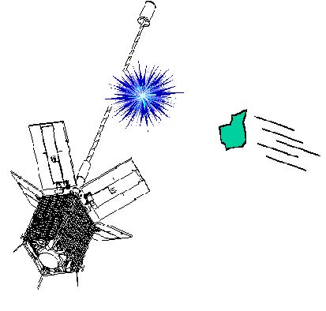
Prototype
Developing the draft
This is what my prototype will look like. (Need to add annotations)
This what my prototype will do. Be clear!
List of materials I will need to create my prototype.
https://commons.wikimedia.org/wiki/File:Cerise_sat_broke.jpg
Notes:
Highlight the importance of detail detail detail!

Slide 41
Brainstorm/think
Steps to build a prototype?
Upon completion of the working prototype, create an advertising brochure that contains all the important information about your product. This way you can swiftly show something to your audience to prove your design works.
Notes:
Brainstorm with students.
•Draw a flat prototype - sketching your idea is the first step in making your idea physical. Drawing is a great way to capture and explain the core of your idea.
•Build a tangible prototype - now you have explored your ideas on paper, it’s time to build a handmade, 3-D non-working prototype. Your objective is simply to build a cheap and tangible version of your idea. This way you go one step further than your line-drawing and ‘paper reality’. Your prototype in this phase should be nothing more than an inexpensive demonstration of your idea in a physical way. By building a 3-D version, you might also stumble upon flaws in your idea that you might not have discovered from simply looking at a flat drawing.
•Develop a working prototype - this last step is about creating a working (or real looking) product. It should include some of the working parts of your product. For example, a working arm, wheels that spin, net that shoots out or folds in.

Slide 42
Prototype
Creating a brochure
Command attention with the cover.
Attract attention with compelling text.
Set the tone with colour.
Choose the right font and font size.
Use white space strategically.
Organize with boxes.
Bring the brochure to life with pictures and images are another way to communicate your message without using text.
Notes:
Refer students to the details in their workbook. Discuss the elements of what your expectations are. Digital or other.

Slide 43
Activity 5
STEM - test

Slide 44
Model prototype
Test
Activity 5 – how can we test?
Obviously we cannot take model prototypes for junk collection into space, so how could you test to see that your design works? Make a list of 4 ways to test the suitability of your design.
1.
2.
3.
4.
Notes:
Discuss with students. Could refer to NASA website and how they test their rockets etc.

Slide 45
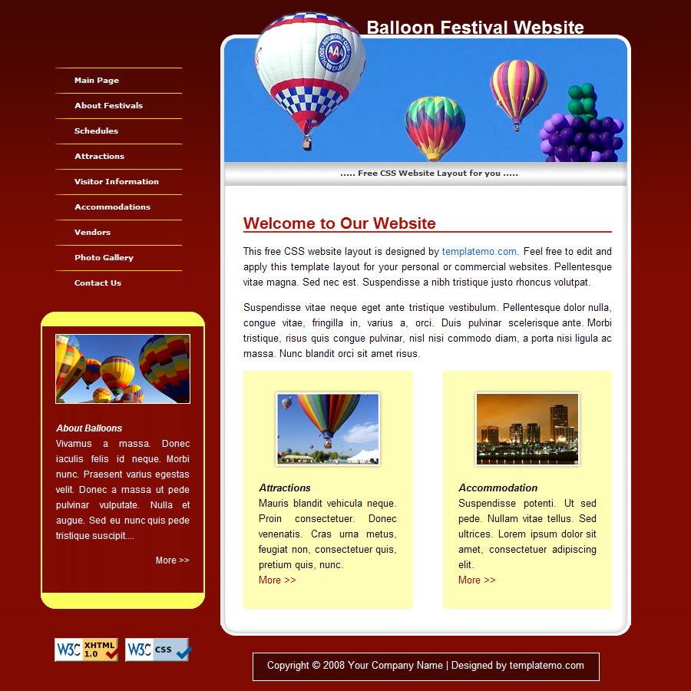
Prototype solutions
How can we test?
Share with an audience for feedback. Choosing the right audience helps ensure your product test is as useful as possible.
Create a presentation. A good presentation can be a vital part of the testing your process. Present to an audience and get feedback.
https://templatemo.com/tm-019-balloon
Notes:
Discuss with students. Could refer to NASA website and how they test their rockets etc.

Slide 46
Activity 6
STEM - share

Slide 47
Let's celebrate
Share
Activity 6
It is important to share your great work with others for feedback. Discuss the project, what you have learned and how your design works with other people you know.
When you get back to school you can present your prototype to the class with a justification as to why you ended up with the design/prototype you have.
Create a persuasive presentation demonstrating your solution and why it should be selected as the best idea to go further.

Slide 48
Reflection
Think about your actions, processes and thinking…
Describe two actions you took during the process which you are most proud of.
•
•
Identify two actions in the process which you now think you could have done better.
•
•
So, what would you do differently if there was a ‘next time’?
What do you now know that you didn’t know before this project began?
Notes:
Work through with students and get them to reflect using these prompts.

Slide 49
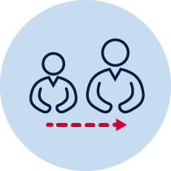
Adult support
Support guide
Online research, students should seek permission from an adult in their home.
Guidelines for online behaviours. https://www.digitalcitizenship.nsw.edu.au/parents-articles
Limited or no access to a computer - may need support to use a device like a smartphone, for research.
No devices, encourage substantial discussions to support understanding of questions presented.
Notes:
Parent, carer support guide to de developed for your context.

Slide 50
Congratulations!
STEM champions
https://thekritic.net/about/

