Slide 1
THE HANDMAID’S TALE
Stories of Speculation: Key Ideas

Slide 2
Dystopia
Perception (often conflicted and biased) of a ‘perfect world’
Totalitarian control
Conformity, censorship, surveillance, restricted freedoms, oppression
A protagonist who sees the system for what it is and questions/rebels

Slide 3
Dystopian Protagonists
Handmaid’s Tale
- A woman oppressed by a patriarchal system
Hunger Games
- A lower-class teen who becomes a ‘sacrificial lamb’
Children of Men
- A former resistance fighter who become the protector of a pregnant teen in an infertile world
1984
- A government worker who takes part in his society’s censorship agenda
Fahrenheit 451
- A ‘fireman’ who burns the books that his society has banned
Brave New World
- An upper-caste lab worker who rebels against his cloning society’s systems

Slide 4
We admire the best dystopian novels because they’re written well and depict people we can relate to. We’re fascinated by the terrible things these characters face, and by how some react bravely and some react cowardly or with resignation. We, as readers, rubberneck to see the misery; we can’t avert our eyes even as we’re enraged by what despots and other vicious officials are doing to citizens. And we’re compelled to turn the pages as we wonder if rebels and other members of the populace can somehow remake a wretched society into something more positive. We also wonder who will survive and who won’t.
Last but not least, we admire dystopian novels because, by giving us worst-case scenarios of the future, maybe our current society can be jolted enough to avoid those scenarios eventually happening in real life. Like some of the characters in dystopian novels, we might feel a little against-all-odds hope. Then again, maybe not…
- Dave Astor, 2012, The Huffington Post

Slide 5
Get creative
Use WordArt.com to collate a collection of words that capture the ‘feel’ of the novel. Select an apt image for the shape. Paste in your books
Compose a two-paragraph flash fiction that captures part of Offred’s world from the point of view of: Serena Joy, Nick, Aunt Lydia, or Rita

Slide 6
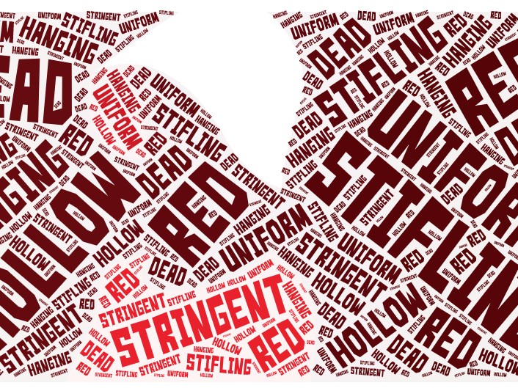

Slide 7
“You have to
treat them
like ….”
- Trump

