Slide 1
Graffiti type and symbols

Slide 2
Graffiti writing
Watch the Dondi White Memorial (00:02:48)
https://youtu.be/7i96w1Jfuxc
Notes:
https://scontent-syd2-1.xx.fbcdn.net/v/t1.0-9/22813975_10154846508611990_7015197926411343929_n.jpg?oh=e9309220aa0ce990504f12931f8d0263&oe=5AC745D4 accessed 10/12/2017

Slide 3
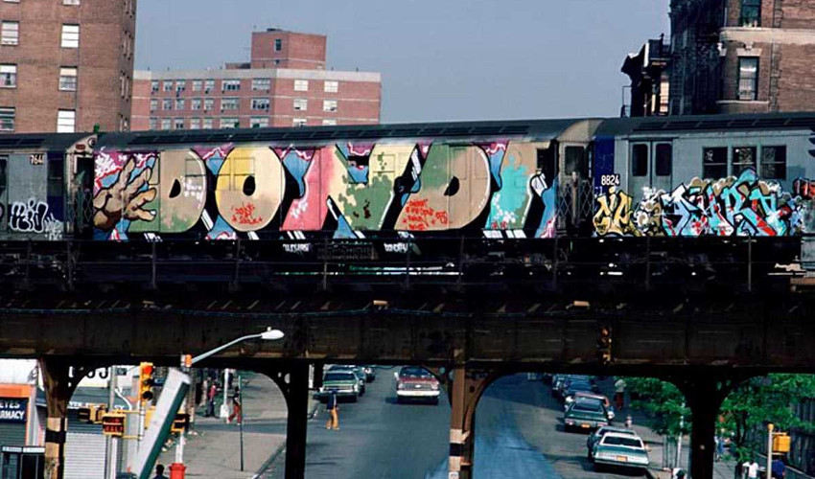
Graffiti writing
Since cave paintings, people have been expressing themselves on walls.
Once considered vandalism, graffiti began its transformation to art and communication from the 1970s to present day.
The streets present a medium where people can create without constraints.
Some artists have remained anonymous and go by a psydoneum such as Banksy.
The graffiti world crosses all age gender and race barriers.
Notes:
https://d2jv9003bew7ag.cloudfront.net/uploads/Dondi-White-Children-of-the-Grave-Part-Two-1980.jpg accessed 10/12/2017

Slide 4
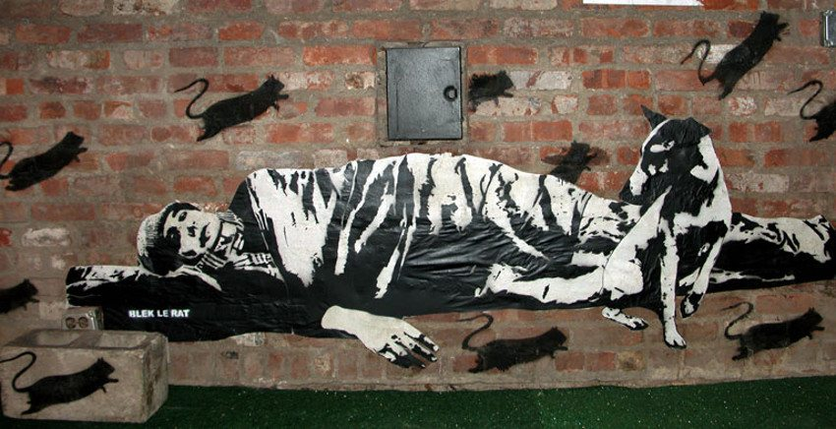
Blek le rat
Blek le rat was one of the original Stencil artists from the 80’s.
He stencilled rats around the streets of paris to address controversial social and justice issues.
Research and answer in your journal/blog:
Who is Blek le rat?
What is your favourite Blek le rat artwork and why?
Notes:
http://blekleratoriginal.com/wp-content/uploads/2016/11/Blek-le-Rat-New-York-City-USA-photo-credits-artist.jpeg accessed 10/12/2017

Slide 5
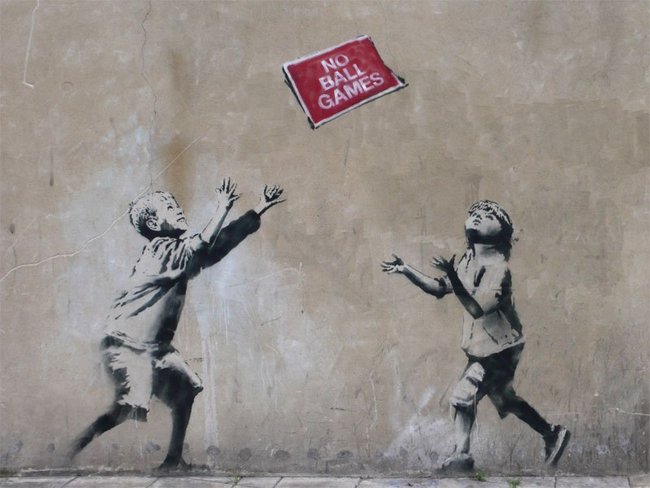
Banksy
Banksy was heavily influenced by the work of Blek Le rat.
He has taken the form of graffiti to a new accepting audience who value his images as works of art and as a commodity.
Research and answer in your journal/blog:
Who is Banksy?
What is your favourite Banksy artwork and why?
Notes:
https://i.pinimg.com/originals/f9/98/16/f998167ef2fe83298e407e12ea9fff18.jpg accessed 10/12/2017

Slide 6
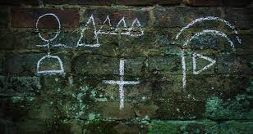
Sub-culture secret languages
The sub culture of Hobos originates in the early part of the 20th-30th century, and the great depression in America.
Hobos were travelling workers who would move from town to town in search of work. They were usually on jumping on and off trains for transformation.
Hobos were usually people employed to do the jobs that nobody else wanted to do.
People often feared them.
Notes:
http://all-that-is-interesting.com/wordpress/wp-content/uploads/2017/05/hobo-code-bricks.jpg accessed 10/12/2017

Slide 7
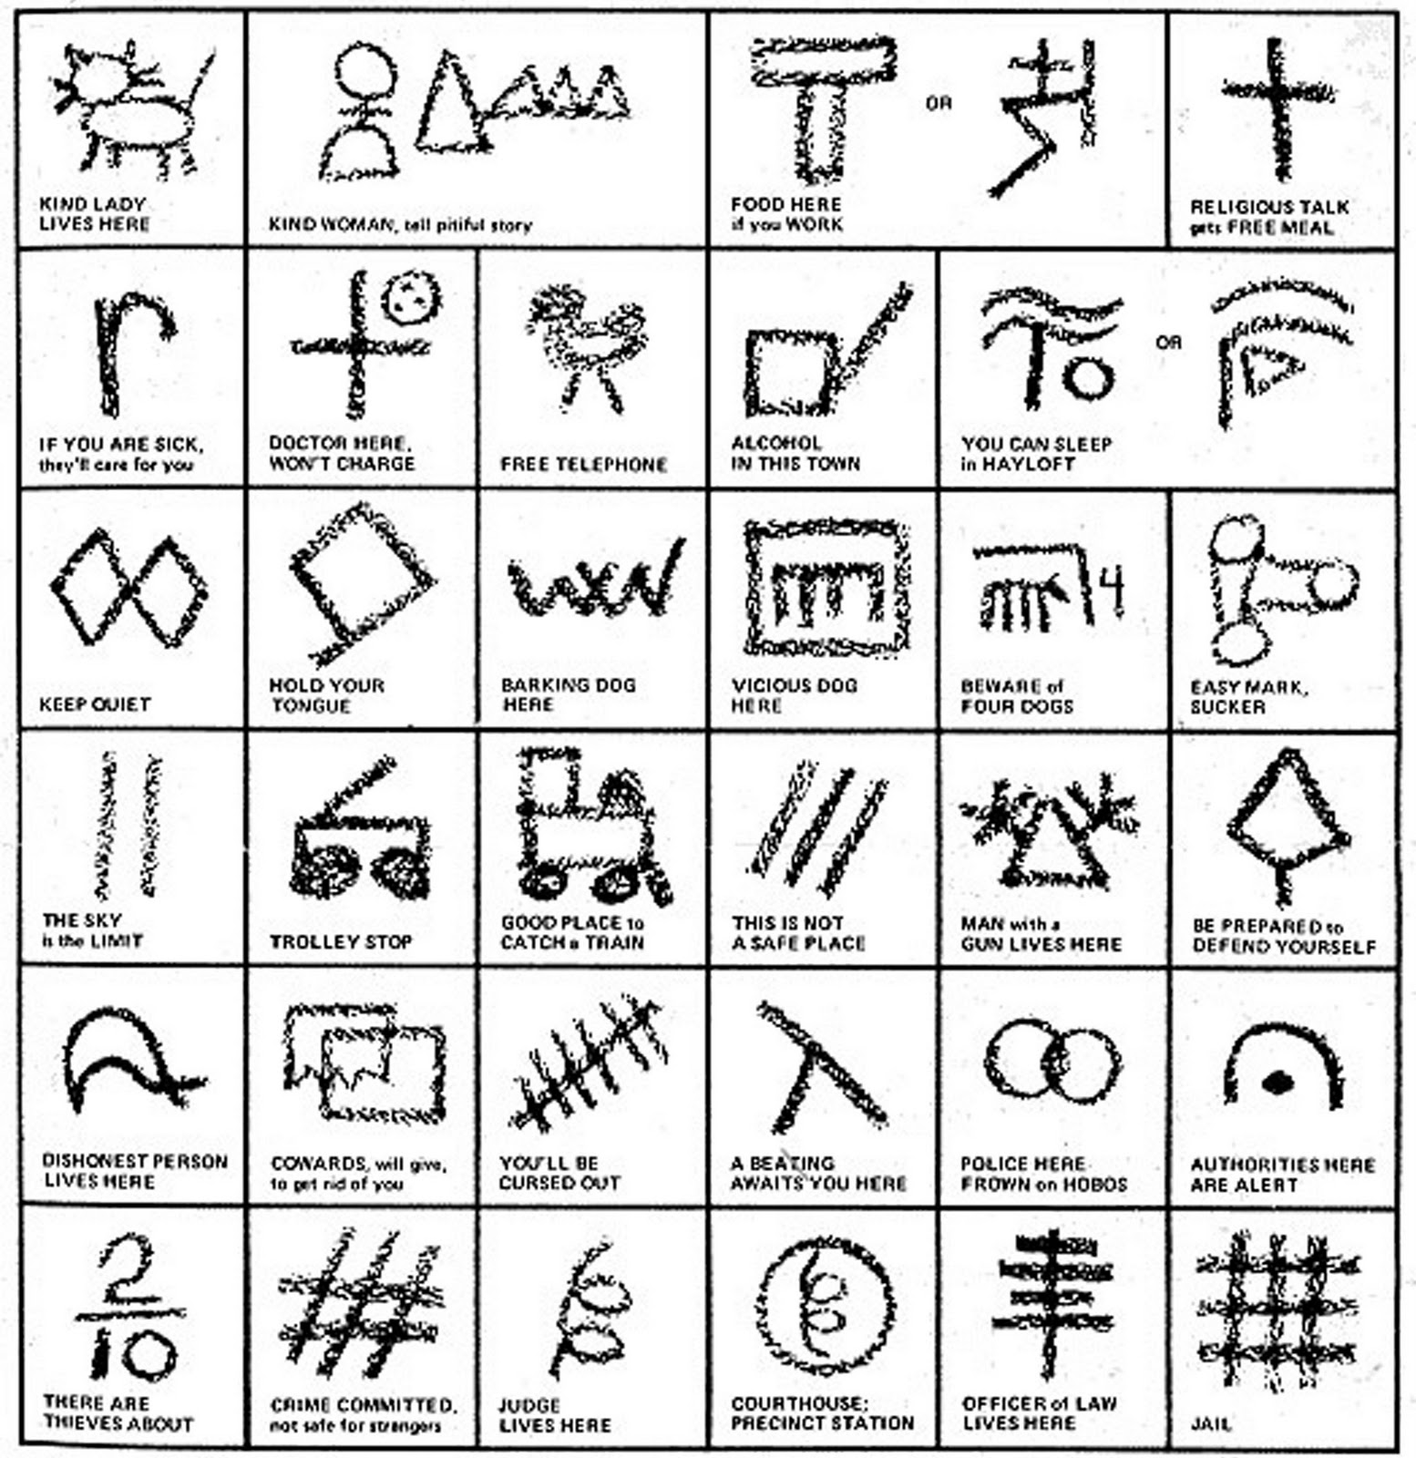
Hobo Glyphs
Hobos invented a graphic code of symbols that alerted other Hobos to dangers, food, medical help, dogs, or kind people able to give assistance and work.
The transient worker life of the Hobo has in modern times changed, and the term is now referred to in a purely derogatory sense.
Notes:
http://nowiknow.com/wp-content/uploads/1_hobo-code.jpg accessed 10/12/2017

Slide 8
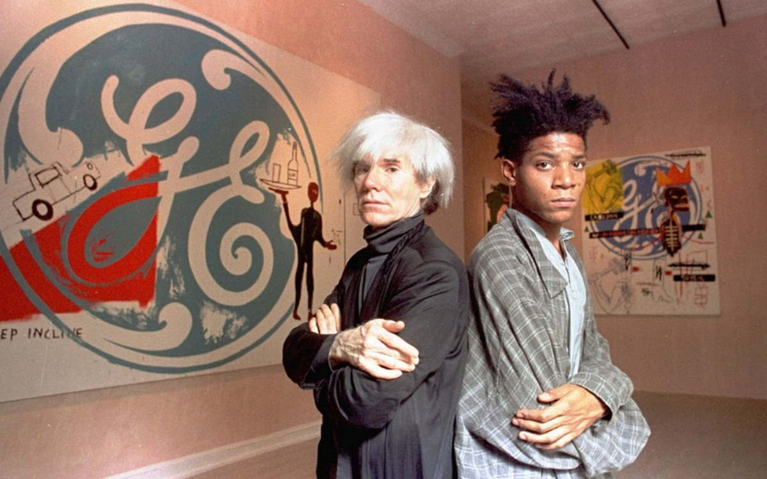
Jean Michael Basquiat
Basquiat, became one of the most celebrated artist to emerge from the neo expressionist movement in the early 1980s.
He began as a graffiti artist and raise to the top of the American art scene before his premature death at the age of 28.
Notes:
http://d2jv9003bew7ag.cloudfront.net/uploads/Warhol-and-Basquiat-FEATURE-2.jpg accessed 10/12/2017

Slide 9
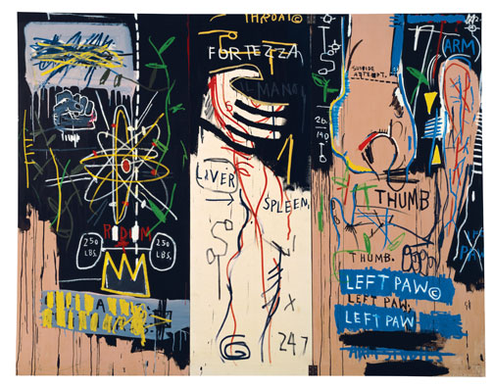
Basquiat's work
Basquiat's work reintroduced the figure into art, after the dominance of minimalism.
He drew upon his urban upbringing and afro American Caribbean roots.
Basquiat's Graffiti name of SAMO became a famous part of New York street culture.
He often used symbols in his work that were appropriations of Hobo glyphs.
Basquiat later used these in his canvas paintings to add a layer of meaning and conceptual references to his work.
Notes:
http://isak.typepad.com/.a/6a00d8341c627153ef010536fd1d5e970b-800wi accessed 10/12/2017

