Slide 1

My Future, My Culture, My Way.
Back to school
Toolkit for stakeholders supporting the My Future, My Culture, May Way campaign
We acknowledge the Ongoing Custodians of the land, waterways and mountains on which we learn, grow and share. We acknowledge Elders past and present for their tireless effort in paving the way for our future young people. We extend that respect to our future leaders and youth of today.

Slide 2
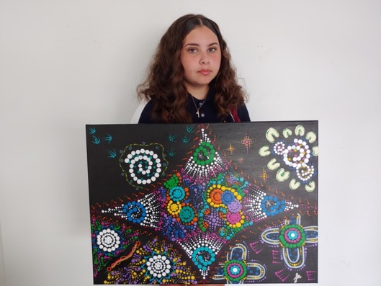
Artwork by Felicity Adams
“This artwork is about the journey we take through school and our continuation to learn and grow. Each section represents our growth and understanding during our schooling until we are full of knowledge and prepared for the world beyond school. The four outside sections represent us continuously learning and trying to reach our full potential. For the middle section, I used dots in different colours, patterns, and sizes to represent all the knowledge we accumulate during school, including what we learn about ourselves and our culture. Our mix of knowledge and understanding is represented as a beautiful, intertwined piece of art” – Felicity Adams
About the artist
Felicity Adams is a proud descendant of the Kamilaroi people, currently living and learning on Dharug Country. She treasures, respects and lives the values of family, community and culture. Felicity first discovered her passion for painting in 2019 and has continued to develop and hone her skills in art. She loves the freedom of expressing her culture and identity through her art. Felicity aims to pursue a career as a First Nations artist and hopes to break barriers and stereotypes through her work.
Pictured: Artist, Felicity Adams, Chifley College Shalvey Campus

Slide 3

Introduction
My Future, My Culture, My Way is a campaign to help Aboriginal and/or Torres Strait Islander students through the journey to attaining the Higher School Certificate (HSC) by supporting them, their parents and carers, and communities.
About this presentation
Returning to school after the summer holidays is a critical time for students. The patterns set in Term 1 provide a foundation for the year ahead.
This presentation provides school based staff with information about how to support students when they are returning to school.
At this time, many students will be feeling anxious about changes to their routine and class structure from last year. We want to support you with key messages and resources to help guide conversations about heading back to school in 2023.

Slide 4
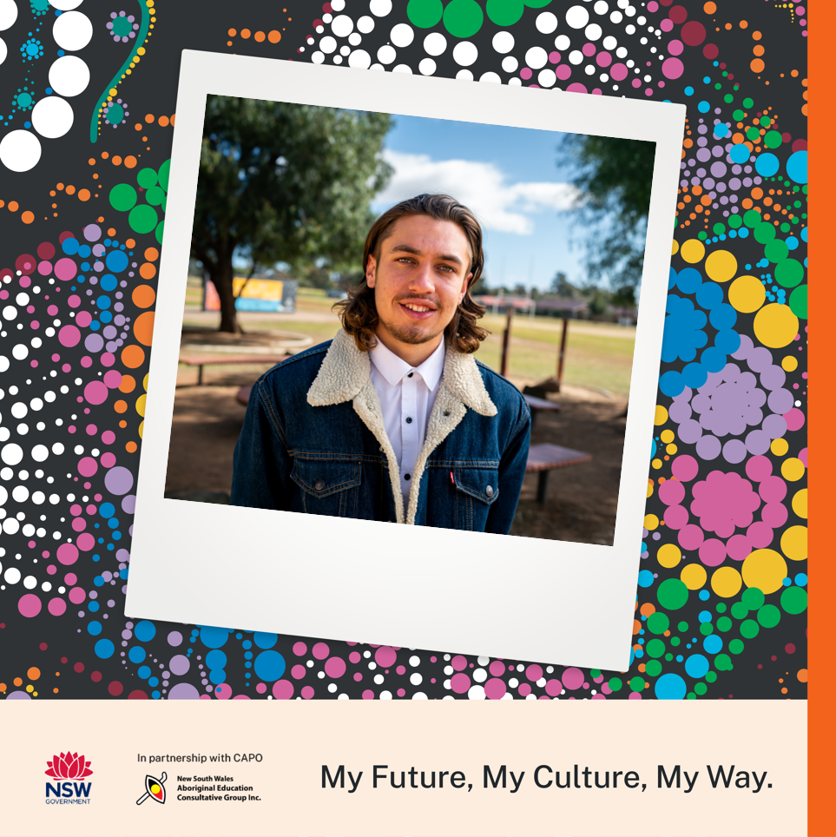
My Future, My Culture, My Way.
In this Back to School kit, you'll find some tools to help you engage members of your communities, including:
links to resources
content that could be used in newsletters
social media posts
case studies profiling Aboriginal and/or Torres Strait Islander HSC graduates
Maintaining a connection to culture while lifting literacy and numeracy standards across NSW public schools will give students the opportunity to reach their potential. It will improve overall academic outcomes and increase the likelihood of students moving into tertiary studies, further education and training and into better jobs.
Your support will connect students with culture, encourage pride in their identity, and help them to achieve academically, setting them up for a bright future.

Slide 5
About the campaign
Recent studies show a clear link between completion of Year 12/HSC and positive future employment, health and higher educational outcomes. Achieving the HSC at the same rate as non-Aboriginal students gives Aboriginal and/or Torres Strait Islander students equality in opportunity now and later in life.
My Future, My Culture, My Way is a campaign to achieve the Aboriginal Education and Culture Premier’s Priority, which aims to increase the proportion of Aboriginal students attaining a HSC by 50% by 2023, while maintaining their cultural identity.
This is one of 14 Premier’s Priorities which represent the Government’s commitment to greatly enhancing quality of life for people in NSW.
The goals of the campaign are focussed on what we can do to support your community. Together we’ll:
Engage students in the benefits of HSC completion, to support attitudinal change and continued motivation.
Empower parents, carers, families and community with information and resources to enhance awareness of the importance of HSC attainment; and how we can work together to support students through school.
Enable education sector staff to support students and families in culturally safe ways.

Slide 6
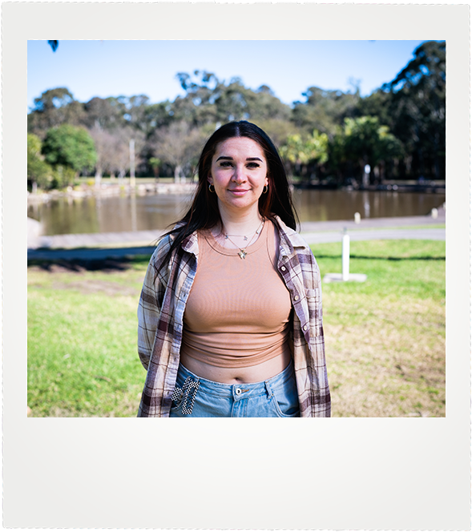
My Future, My Culture, My Way.
Back to school

Slide 7
Starting strong
With the move to high school, Year 7 students are expected to be more independent and responsible for their own learning. Students also need to navigate changes in friendships as they move from being the big fish in a little pond to little fish in a big pond.
There are many resources available to support students, parents and stakeholders through this transition, including:
10 tips for starting a new high school
What to expect in Year 7
Helping your teen feel more confident on their first day
What you can do: share the resources above via your channels such as newsletters and social media.

Slide 8
Returning to school for Years 11 and 12
It is essential that Aboriginal and/Torres Strait Islander students feel supported and connected to their culture when returning to school, especially in Years 11 and 12.
For senior high school students, returning to school after summer holidays can be a shock, with lazy summer days replaced by the structured routine of school. The early excitement of seeing friends can soon be lost when the reality of assessments hits later in the term.
To help prepare Years 11 and 12 students, the department has created a guide which includes study tips from former Year 12 students, advice on educational pathways and information on Connection to Country in schools.
No matter what your role, by supporting Aboriginal and/or Torres Strait Islander students to stay at school and complete their HSC, you are making a difference to improve equity.
What you can do: speak to your Aboriginal and/or Torres Strait Islander students about how they are finding returning to school. Share the ‘Getting ready for Year 11 and 12’ Guide and discuss plans for the HSC and educational pathways.

Slide 9
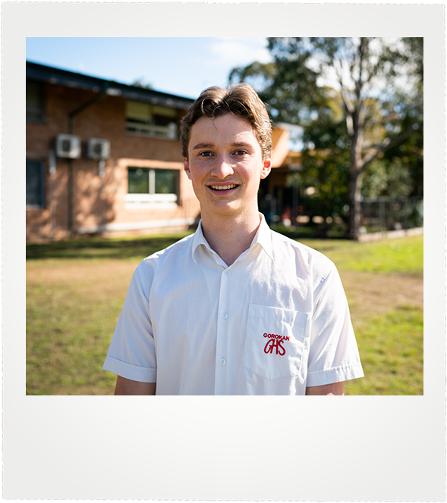
My Future, My Culture, My Way.
Attendance

Slide 10
Attendance matters
Encouraging attendance is a key way we can support better outcomes for Aboriginal and/or Torres Strait Islander students.
You can’t be successful in Year 11 and 12 without showing up in Years 7 to 10. Supporting positive school attendance is a shared responsibility.
Regular student attendance helps students to:
develop a sense of belonging
develop and maintain friendships
be more engaged at school
progress with their learning
be more aware of career and life options.

Slide 11
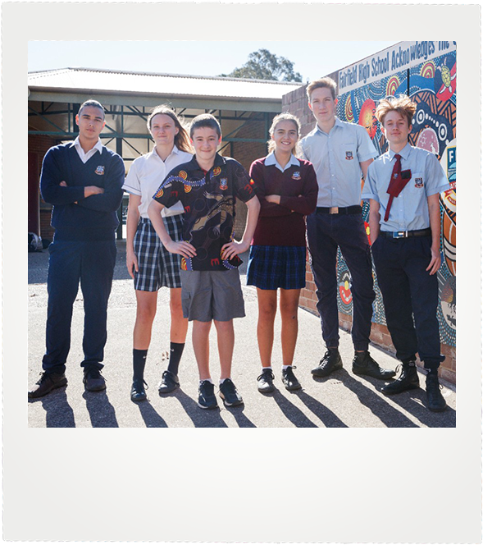
How to encourage attendance
Parents and families can foster positive attendance habits by:
helping students learn the importance of getting up ready for the school day
ensuring students arrive on time from the start of the school day, ready to participate in learning
reducing disruption to learning where possible, by planning appointments outside of school time
making sure the school knows if a student will be absent (within 7 days of the first day of any absence)
working with the school to encourage and support regular attendance.

Slide 12
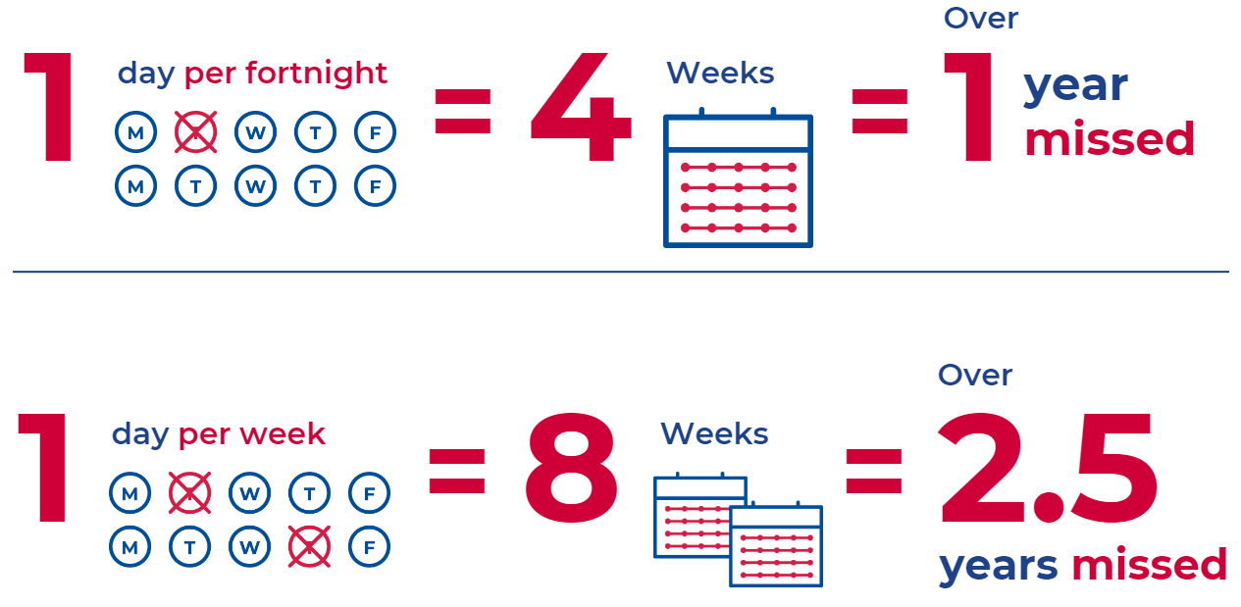
Every day matters
Every day matters is a NSW school attendance campaign aimed at parents and carers.
It includes videos, case studies and other resources which you can share via your newsletters and social media channels.
What you can do: share the ‘Every day matters’ campaign in your newsletter and via your social channels.

Slide 13
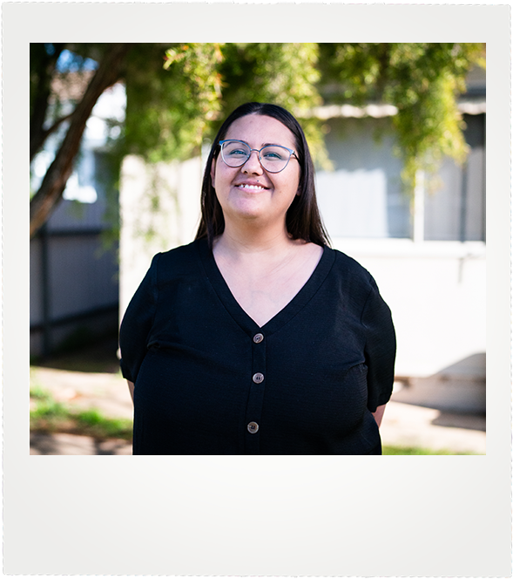
Professional learning - attendance
There is a great suite of content available on the department’s website that includes attendance strategies and resources for school staff.
The modules include:
Supporting Student Attendance e-Learning
The use of Scout data analysis for school attendance reports
Attendance Matter School Development Days Package
What you can do: undertake Professional Learning to support student attendance.

Slide 14
Aboriginal student retention - a conversation guide for school leaders
A conversation guide to improve Aboriginal student retention (PDF, 1.6mb) was recently launched to support conversations between Directors, Educational Leadership, Principals and School Leaders.
The guide covers strategies across 7 key themes:
  Create a culturally inclusive environment
  Strive for excellence
  Establish a baseline
  Plan and act early
  Take action to address challenges
  Utilise systemic support
  Partner with agencies and NGOs
What you can do: If you are a principal or school leader, read the conversation guide and develop strategies to improve attendance for Aboriginal and/or Torres Strait Islanders students in your school community.

Slide 15
Why the HSC matters
The HSC provides a springboard for life.
Recent studies show a clear link between completing the HSC and positive future employment, health and higher educational outcomes, benefiting students and their communities.
For some students, the HSC journey can be challenging. Support and pathways are available to guide students on their journey.
As part of the Premier’s Priority, we are aiming increase the proportion of Aboriginal and/or Torres Strait Islander students attaining a HSC by 50%, by 2023 while maintaining their cultural identity.
This priority recognises that staying connected to culture is important throughout a student’s studies. It helps students to stay strong, in mind, body and spirit, and to reach their full potential.
Communities have an important role to play to reach this ambitious target. You can help involve students with language and culture to help maintain cultural identity, provide them with academic support and encourage them on their journey to the HSC.
What you can do: celebrate the achievements of HSC graduates in your community via special events, newsletters, social media and your school website.

Slide 16
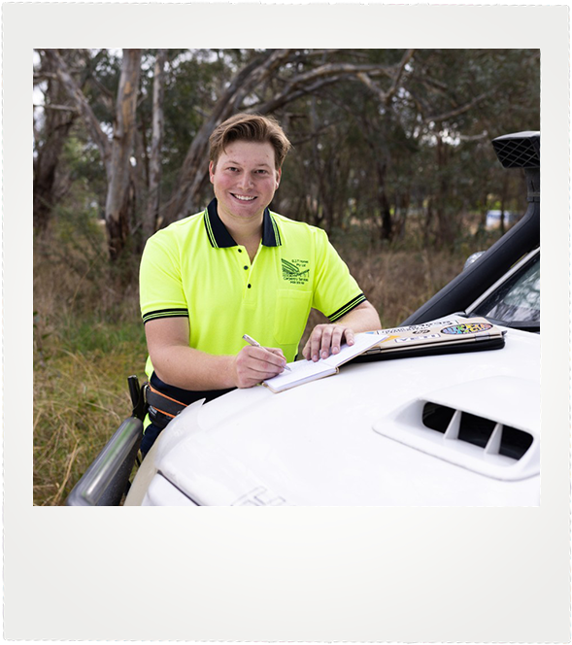
Life post school
One way to encourage Years 11 and 12 students to engage with their final years of schooling is to ask them to consider their plans after completing the HSC.
There are many possible pathways for each student’s chosen career. A good starting point is to take a careers quiz to see what fits the student’s personality and interests.
Some of the options available include:
Vocational Education and Training (VET)
TAFE NSW
Gap Year
Work experience of internships
Find out more on the department’s website.
What you can do: Highlight the aspirations and future pathways of your recent HSC graduates at a special school assembly. Ask them to share their plans over the years ahead.

Slide 17
New case studies
As part of the My Future, My Culture, My Way campaign, we have developed a set of case studies which feature examples of NSW Aboriginal and/or Torres Strait Islanders graduates who have completed their HSC. These examples provided great snapshots for students about where the HSC can take them in the future.
Milan
Shaun
Tahlia
What you can do: Share these case studies via newsletters or social channels. You can also share local success stories from your school community using the hashtag #MyFutureMyCultureMyWay.

Slide 18
How we can work together
Put information on your website
Use information from this toolkit to write a description about the campaign on your organisation’s homepage, a news item, case study or blog. Include an image icon that clicks through to the NSW Department of Education’s website.
Look for ways to post the campaign’s key messages on your website. For example:
  if your main audience is parents and carers, let them know how they can support their children with returning to school
  talk about the benefits of completing the HSC if you have a page for teenagers on your website.
Add information into your newsletter
Put the poster, print advertisement or infographic into local newsletters to community organisations, service providers and local leaders.
Share the good news stories from the resources section or from your local community. Insert the summary we’ve provided and link to the full article.
Include parts of our key messages in your own newsletters and publications.

Slide 19
How we can work together
Post about the campaign on social media
Use your social media platform to share messages about the campaign. See this document for:
  key messages you could use to start a conversation on Facebook about the HSC.
  social media tiles and videos you can share on your Instagram, Facebook or LinkedIn pages.
Add the hashtags to posts about the campaign: #MyFutureMyCultureMyWay #stayhealthyHSC
Share the social media tiles and messages on your community’s local Facebook page for news or residents.
Post good news stories about HSC completion from your community, or links to the good news stories from the resources section and congratulate the people involved.
Follow the NSW Department of Education on Facebook to read and share the stories that are posted.

Slide 20
How we can work together
Share your story
Let your community know how the HSC can benefit mob. Personal experiences can help show young people, parents and carers what’s possible. You could write your own story or make a short video (under 2 minutes) to share on your website or social media. Explain, again, how the HSC can benefit mob – or explicitly state that people should use their voice and ideas to share a personal explanation with their feed.
Examples of what makes a good story or what is likely to resonate most would help. If you can send these stories to us at premiersprioritycorro@det.nsw.edu.au, we'd be delighted to share them via our state-wide networks too.
Things you could share include:
Case studies from the My Future, My Culture, My Way campaign
Examples of HSC graduates from your mob and their future pathways
Advice for parents and carers on how to support students starting high school in Year 7
Guidance for parents and carers of Years 11 and 12 students on how to ensure they remain engaged in the months ahead
Content which celebrates the importance of the HSC as a pathway for future employment
Information about the various pathways on offer to complete an HSC

Slide 21
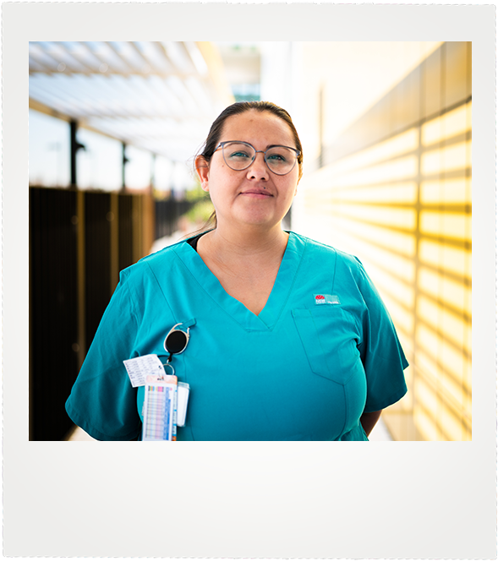
My Future, My Culture, My Way.
Key messages

Slide 22
Key messages
These key messages are important points about the My Future, My Culture, My Way campaign and the HSC.
You can use them:
to start conversations with families, students and the education sector.
as talking points in meetings or presentations.
as a base for content for your own communications, like newsletters, social media and your website.
You can also use the information from the Introduction and About the Campaign sections of this toolkit to supplement these messages.
Students
Completing your HSC gives you great opportunities for your future. There are different pathways to complete your HSC, to best suit your individual needs.
Your HSC is your journey. Talk to your family, school or mentors about the options available.
Staying connected to culture is important throughout your studies. It helps you to stay strong, in mind, body and spirit, and to be the best you can be and reach your full potential.
Your education is the key to your future, to help you discover and achieve your own goals and dreams.

Slide 23
Key messages
Parents, carers and families
Starting Year 7 can be a challenging time. It is essential to develop good habits from the start of high school. Families of Aboriginal and/or Torres Strait Islander students are encouraged to be actively involved in school life as part of an ongoing collaboration between home and school
The HSC is an important springboard for life – it provides improved employment outcomes for graduates
Years 11 and 12 students need to be well supported in their final years.
Regular attendance is essential – regularly missing days of school has a big impact in the long term
There are many pathways for students to complete the HSC and school career staff can assist students to work out a pathway based on their future career plans.
School staff
Helping students returning to school is a team effort.
Aboriginal and/or Torres Strait Islander students will be at their best when they feel connected to their culture. Schools should regularly celebrate culture so students can thrive and feel supported.
Celebrate the importance of the HSC as a pathway for future employment and opportunities, and then many avenues to complete the HSC
School staff have access to a wide range of resources to support student retention and attendance including professional learning to develop attendance strategies

Slide 24
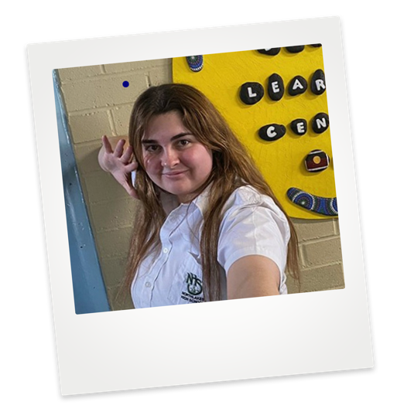
Key messages
Connection to culture
Research shows that a connection to culture, language and heritage is a key driver behind Aboriginal and/or Torres Strait Islander students attaining their HSC.
When Aboriginal and/or Torres Strait Islander students are supported to maintain a strong connection to culture during their schooling years, they’re more likely to complete Year 12.
It’s important for all schools to recognise and celebrate the cultures, histories and customs of all students and communities in order to foster classroom environments where students feel supported to achieve great things.
Recognising culture at school can be a reason Aboriginal and/or Torres Strait Islander students succeed in education.

Slide 25
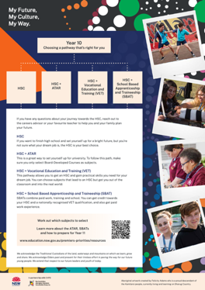
My Future, My Culture, My Way.
Resources

Slide 26

Resources
Download these products and use them in your newsletters, publications and websites. Print them out and hand them to clients and people in your community. Everyone has a part to play. You might also like to use the key messages on pages 17-21 to develop your own news items for your mob about My Future, My Culture, My Way.
Student factsheet
Parents and carers factsheet
A3 infographic

Slide 27
Resources - Back to school social media posts
Share these social media posts with your community
Social Post 1:​
Returning to school after the summer holidays can be a challenge, but it is an important time for students in their HSC years, setting routines for the year ahead.​
To help these students stay motivated at school, cultural safety is paramount.​
Cultural safety can help students achieve their potential by creating a sense of belonging; students who are more engaged at school have better academic outcomes. ​
Read a case study about how cultural safety contributes to the success of Aboriginal and/or Torres Strait Islander students.
Social Post 2:
Set your child up for success this year with some healthy school habits.
Attendance is key in supporting children reach their potential. As a parent/carer you can support your child's attendance by helping them get up for the school day with enough time to get ready in the morning.
It is very important to make sure that children arrive on time at the start of the school day, so they are ready to participate in learning.
Discover the ‘Every Day Matters’ campaign to learn more about how consistent attendance improves student outcomes and career options.
Social Post 3:
Everyone’s ‘best’ looks different! It is important for students to know that they have the choice of multiple pathways when it comes to completing the HSC.
One of these alternative pathways includes school-based apprenticeships and traineeships (SBATs), which suit students who are looking for real world, on the job experience in various industries.
SBATs develop job ready skills for the student's chosen certificate, while building life skills including resilience and organisation. SBATs also get students straight into the workforce, creating future employment opportunities.
If this sounds like something a student or your child would be interested in, read more on the department’s website.

Slide 28
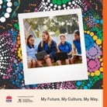
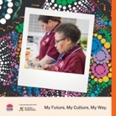
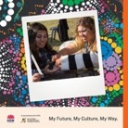
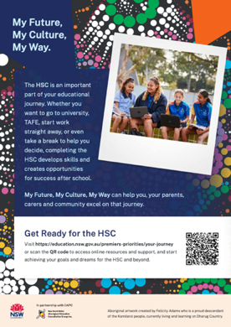
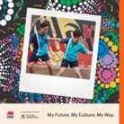
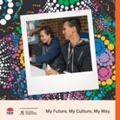
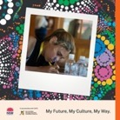
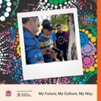
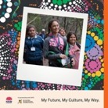
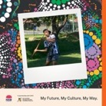
Resources
Social Media Tiles 1000px x 1000px
Poster (A4 and/or A3)
.

Slide 29
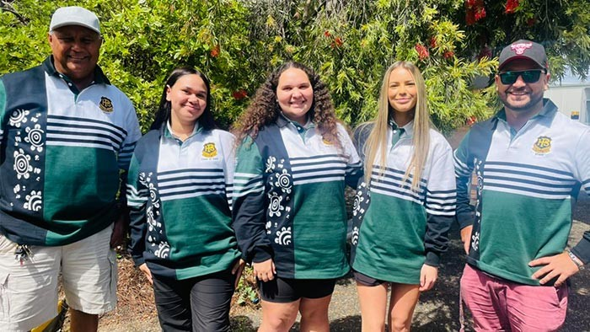
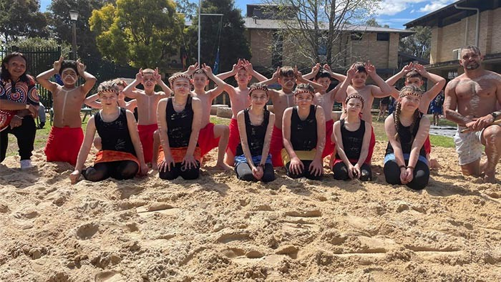
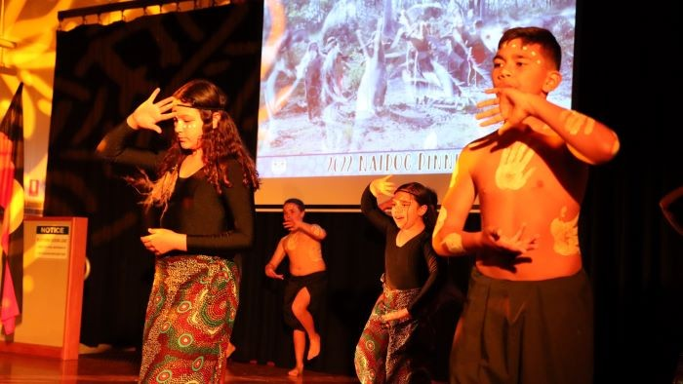
Resources
Good news stories
The school that wears its culture on its sleeve
How one school changed the conversation on attendance
Cultural safety helps exceptional students shine
Willmot Public School has demonstrated how a focus on wellbeing and Aboriginal knowledge and cultural safety can significantly lift attendance.
The small school of around 165 students has been supporting families and students to attend school and in Term 2 this year managed to lift attendance rates by 20 per cent.
It’s well known that schools are central to the success of Aboriginal and/or Torres Strait Islander students, and a new report by the Centre for Education Statistics and Evaluation has revealed how schools can make this happen.
Bringing together evidence on ways that schools can contribute to the educational success of Aboriginal and/or Torres Strait Islander students, the report, Strong strides together, aims to support teachers and school leaders by identifying four evidence-based themes to create high-quality learning environments.
When Tamworth’s Peel High School asked its incoming HSC students if they wanted to have Aboriginal artwork on their Year 12 jerseys, every single one said yes.
One of those students was Shakayla Spearim, a Gomeroi and Dunghutti woman, who is considered an emerging artist.

Slide 30
My Future, My Culture, My Way.
Want to know more?
Visit My Future, My Culture, My Way, follow the Department of Education on social media, talk to your school, or contact your local AECG.

