Slide 1

My Future, My Culture, My Way.
Supporting Students on the HSC Journey
Toolkit for stakeholders supporting the My Future, My Culture, May Way campaign
We acknowledge the Traditional Custodians of the land, waterways and mountains on which we learn, grow and share. We acknowledge Elders past and present for their tireless effort in paving the way for our future young people. We extend that respect to our future leaders and youth of today.

Slide 2

Table of Contents
Artwork by Felicity Adams | 3
Toolkit introduction | 4
About the campaign | 7
How we can work together | 10
Print and share the messages and material | 11
Start a conversation about the campaign | 12
Start a conversation with service providers, students, parents and your wider community | 13
Put information on your website | 14
Post about the campaign on social media | 15
Share your story | 16
Add information into your newsletter | 16
Key messages | 17
Students | 18
Parents, carers and families | 19
Community | 19
Education sector | 20
Connection to culture | 21
Resources | 22
Good news stories | 25
Social media content | 26
Join us on Facebook | 26
Publish your own posts | 26
Suggested social media copy | 27

Slide 3
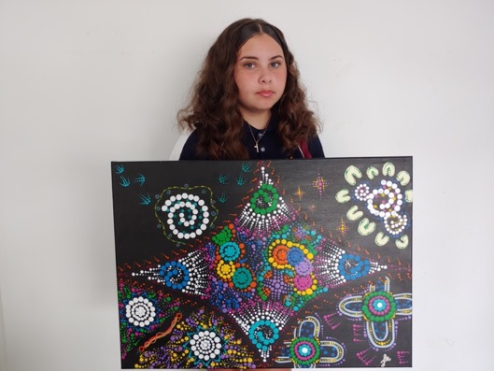
Artwork by Felicity Adams
“This artwork is about the journey we take through school and our continuation to learn and grow. Each section represents our growth and understanding during our schooling until we are full of knowledge and prepared for the world beyond school. The four outside sections represent us continuously learning and trying to reach our full potential. For the middle section, I used dots in different colours, patterns, and sizes to represent all the knowledge we accumulate during school, including what we learn about ourselves and our culture. Our mix of knowledge and understanding is represented as a beautiful, intertwined piece of art” – Felicity Adams
About the artist
Felicity Adams is a proud descendant of the Kamilaroi people, currently living and learning on Dharug Country. She treasures, respects and lives the values of family, community and culture. Felicity first discovered her passion for painting in 2019 and has continued to develop and hone her skills in art. She loves the freedom of expressing her culture and identity through her art. Felicity aims to pursue a career as a First Nations artist and hopes to break barriers and stereotypes through her work.
Pictured: Artist, Felicity Adams, Chifley College Shalvey Campus

Slide 4
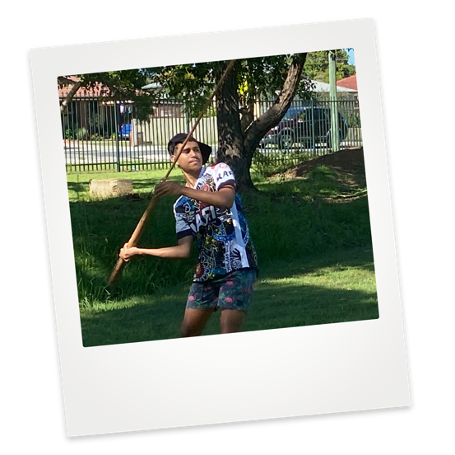
My Future, My Culture, My Way.
Toolkit introduction

Slide 5
Toolkit introduction
My Future, My Culture, My Way is a new campaign to help Aboriginal students through the journey to attaining the Higher School Certificate (HSC) by supporting them, their parents and carers, and communities.
When your kids complete the HSC, the whole community benefits. We want all students to achieve their very best. For some students, the HSC journey can be challenging and different supports and connection to culture may help them through.
As part of the Premier’s Priorities, the NSW Department of Education, NSW Coalition of Aboriginal Peak Organisations (CAPO) and the Premier’s Implementation Unit have co-designed the My Future, My Culture, My Way campaign. We now need your help to implement it.
We aim to increase the proportion of Aboriginal students attaining Year 12 by 50%, while maintaining their cultural identity.
This Priority recognises that staying connected to culture is important throughout a student’s studies. It helps students to stay strong, in mind, body and spirit, and to reach their full potential.
Communities have an important role to play to reach this ambitious target. You can help involve students with language and culture to help maintain cultural identity, and also provide them with academic support and encourage them on their journey to the HSC.

Slide 6
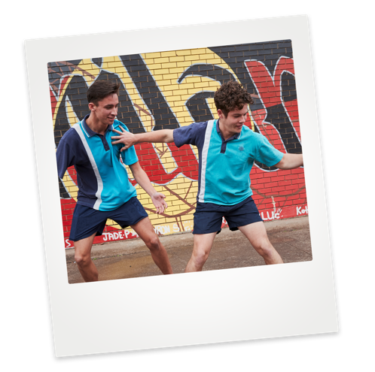
My Future, My Culture, My Way.
In this My Future, My Culture, My Way kit, you'll find some tools to help you engage members of your communities, including:
poster
social media tiles
fact sheet for parents and carers
fact sheet for students
infographic on the HSC journey
Maintaining a connection to culture while lifting literacy and numeracy standards across NSW public schools will give students the opportunity to reach their potential. It will improve overall academic outcomes and increase the likelihood of students moving into tertiary studies, and into better jobs.
Your support will connect students with culture, encourage pride in their identity, and help them to achieve academically, setting them up for a bright future.

Slide 7
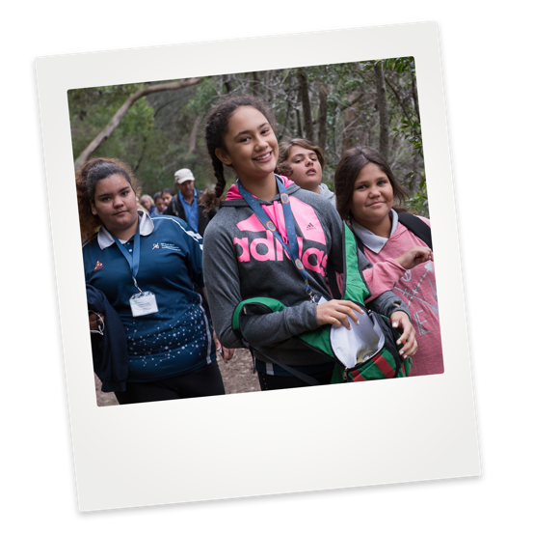
My Future, My Culture, My Way.
About the campaign

Slide 8
About the campaign
Recent studies show a clear link between completion of Year 12 and positive future employment and higher educational outcomes. Achieving the HSC at the same rate as non-Indigenous students gives Aboriginal and Torres Strait Islander students equality in opportunity now and later in life.
My Future, My Culture, My Way is a campaign to achieve the Aboriginal Education and Culture Premier’s Priority, which aims to increase the proportion of Aboriginal students attaining Year 12 by 50% by 2023, while maintaining their cultural identity.
This is one of 14 Premier’s Priorities which represent the Government’s commitment to greatly enhancing quality of life for people in NSW.
The goals of the campaign are focussed on what we can do to support your community. Together we’ll:
Engage students in the benefits of HSC completion, to support attitudinal change and continued motivation.
Empower parents, carers, families and community with information and resources to enhance awareness of the importance of HSC attainment; and how we can work together to support students through school.
Enable education sector staff to support students and families in culturally safe ways.

Slide 9
About the campaign
The campaign includes advertising, print and social media components. It has information and resources specially designed for Aboriginal and Torres Strait Islander people.
It also has a strong focus on encouraging community leaders, stakeholders, employers, existing workers and influential people to share My Future, My Culture, My Way with the target audiences:
students.
parents, carers, family and community.
the education sector.
To keep all the information easily accessible, we’ve added some pages to the NSW Department of Education website for:
students, to help them plan for the final years of school and support them through the HSC journey.
parents, carers and communities, to help you understand how the HSC works and how to help students prepare and get through it.
And this toolkit provides you and members of the education sector with some useful information to display and distribute.

Slide 10
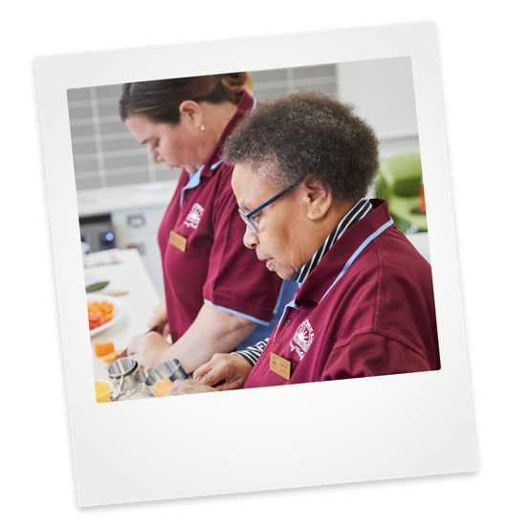
My Future, My Culture, My Way.
How we can
work together

Slide 11
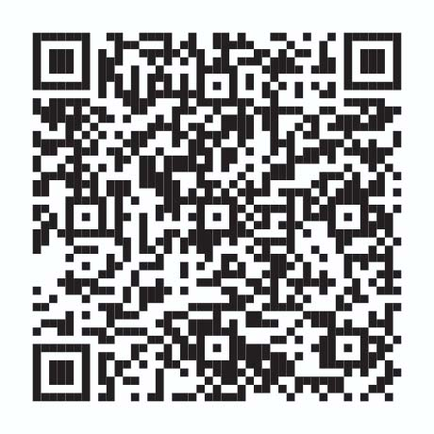
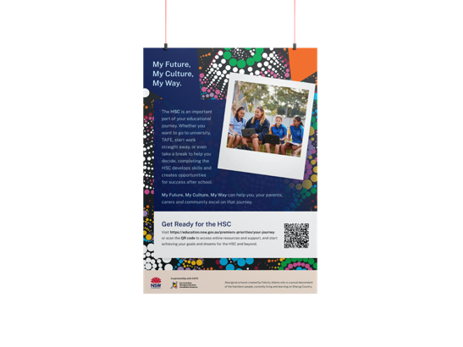
How we can work together
Whatever your role in the community, everything you do to support Aboriginal Year 11 and 12 students will help achieve equality in opportunity.
With your help, we can secure the futures of your children and families.
Print and share the messages and material
Put up the poster, print advertisement and infographic from the resources at your local school, your local youth hostel, at the entrance to your community sports hall, at the community store and on local noticeboards.
Share copies of the fact sheets with information for students and parents and carers about completing the HSC.
Ask your local school if they have local print materials to display in your organisation.
Print this toolkit and have copies at the front counter of your organisation or community centre.
Train staff on using the key messages and toolkit to start conversations.
Hand a printed copy of the key messages to community members and clients to remind them about your conversation.
Email a link to the toolkit to local community leaders, organisations and service providers.
Download resources from the NSW Department of Education

Slide 12
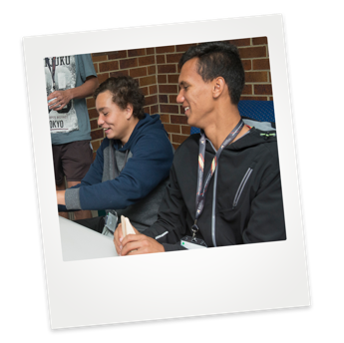
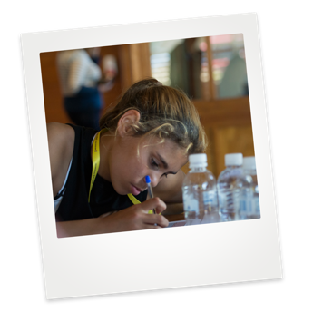
How we can work together
Start a conversation about the campaign
Yarn with mob about the campaign, the HSC, the benefits of attaining it, and how a strong connection to culture can support HSC attainment. The key messages (see pages 17-21) can guide your conversation. You could:
  ask what they know about the HSC and build on their understanding.
  find out what their own experience was.
  talk about goals for their kids and how the HSC can help them get there.
  mention the good news stories from the resources section (see page 25) or from your local community as a starting point.
Make it an agenda item to talk about the campaign at staff meetings and/or community meetings using the key messages. You can also:
  print and distribute the poster, fact sheets and infographic
  brainstorm how to help connect kids with culture and strengthen their identity while on the HSC journey.

Slide 13
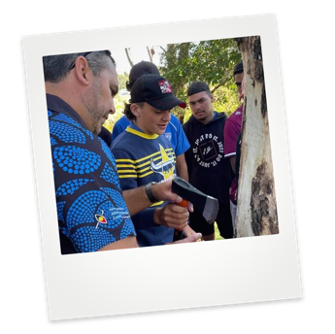
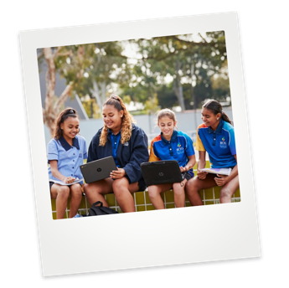
How we can work together
Start a conversation with service providers, students, parents and your wider community. You could:
  ask if they know about the HSC.
  ask what their, or their child’s, plans are after school.
  explain the importance of the HSC.
  discuss connection to culture, language and identity, and how these things can help with HSC attainment.
  link HSC attainment back to the benefits for community and for children’s life outcomes.
Use the infographic to show the HSC journey in a simple way to others.
Encourage people you work with to share the campaign’s messages and materials with their own networks.
Ask people who have completed the HSC to share their stories about finishing school, the rewards that come with it, and how culture, language or identity helped them on their journey.

Slide 14
How we can work together
Put information on your website
Use information from this toolkit to write a description about the campaign on your organisation’s homepage, a news item, case study or blog. Include an image icon that clicks through to the NSW Department of Education’s website.
Look for ways to post the campaign’s key messages on your website. For example:
  if your main audience is parents and carers, let them know how they can support their children to complete the HSC.
  talk about the benefits of completing the HSC if you have a page for teenagers on your website.
Add information into your newsletter
Put the poster, print advertisement or infographic into local newsletters to community organisations, service providers and local leaders.
Share the good news stories (see page 25) from the resources section or from your local community. Insert the summary we’ve provided and link to the full article.
Include parts of our key messages (see pages 17-21) in your own newsletters and publications.

Slide 15
How we can work together
Post about the campaign on social media
Use your social media platform to share messages about the campaign. See pages 17-28 for:
  key messages you could use to start a conversation on Facebook about the HSC.
  social media tiles and videos you can share on your Instagram, Facebook or LinkedIn pages.
Add the hashtags to posts about the campaign: #MyFutureMyCultureMyWay #stayhealthyHSC
Share the social media tiles and messages on your community’s local Facebook page for news or residents.
Post good news stories about HSC completion from your community, or links to the good news stories from the resources section and congratulate the people involved.
Follow the NSW Department of Education on Facebook to read and share the stories that are posted.

Slide 16
How we can work together
Share your story
Let your community know how the HSC can benefit the mob. Personal experiences can help show young people, parents and carers what’s possible. You could write your own story or make a short video (under 2 minutes) to share on your website or social media. Explain, again, how the HSC can benefit mob – or explicitly state that people should use their voice and ideas to share a personal explanation with their feed.
Examples of what makes a good story or what is likely to resonate most would help. If you can send these stories to us at premiersprioritycorro@det.nsw.edu.au, we'd be delighted to share them via our state-wide networks too.
Things you could share include:
How your family, community and culture helped you through your final years of school.
What you did during Year 12 to deal with stress.
How you connected with culture along your journey.
How you built or maintained a strong identity through Years 11 and 12.
How the HSC helped you achieve your goals.

Slide 17
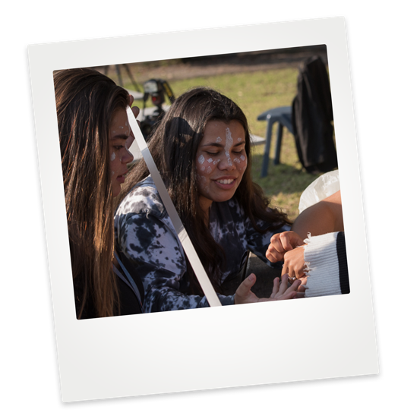
My Future, My Culture, My Way.
Key messages

Slide 18
Key messages
These key messages are important points about the My Future, My Culture, My Way campaign and the HSC.
You can use them:
to start conversations with families, students and the education sector.
as talking points in meetings or presentations.
as a base for content for your own communications, like newsletters, social media and your website.
You can also use the information from the Introduction and About the Campaign sections of this toolkit to supplement these messages.
Students
Completing your HSC gives you great opportunities for your future and to be the best you can be. There are different ways to complete your HSC, to best suit your individual needs.
Your HSC is your journey. Talk to your family, school or mentors about the options available.
Staying connected to culture is important throughout your studies. It helps you to stay strong, in mind, body and spirit, and to be the best you can be and reach your full potential.
Your education is the key to your future, to helping you discover and achieve your own goals and dreams.

Slide 19
Key messages
Parents, carers and families
HSC completion is an important step for a child’s future success. It gives them the tools for life and helps them to give back to community.
HSC is a big milestone and is the final step in a child’s school learning journey. It opens up opportunities for their future and helps them transition from school to further study or employment and achieve their goals in life. There are ways we can help students through their HSC on a shared journey with families and the school community.
We know that staying connected to culture is integral to student wellbeing and educational success. We all play a role in supporting our kids to complete their HSC journey. By learning more about the HSC we can talk to our kids and help them through when they need support.
Community
The HSC stands for the Higher School Certificate. The Higher School Certificate (HSC) is the culmination of your child’s school career and the highest educational award that can be achieved at secondary school in New South Wales.
When our kids complete the HSC, we all benefit. Our whole community is filled with pride, and we can celebrate the achievements and success of completing school. It is an important step for their future.
Getting our kids to complete the HSC is important for their future and in developing life skills. It helps them to get a good job or progress further studies and get the best opportunities in life. When our kids get their HSC, it shows other kids in our community they can do it too. Success grows success and shows what our people and culture are capable of.

Slide 20
Key messages
Education sector
We want all students to achieve their very best. For some students, their HSC journey can be challenging and different supports and connection to culture may help them through.
For Aboriginal and Torres Strait Islander students, maintaining connection to culture and identity is critical to overall wellbeing and education success. Aboriginal students are known, valued and cared for through Personalised Learning Pathways, creating a generation of rising young Aboriginal students to reach their full potential.
We all play a role in supporting students to succeed by nurturing and providing a growth mindset to be their best, working closely in partnership with families and community. There are different ways we can support students in their HSC journey. There are resources to meet the learning and cultural needs of every Aboriginal student.

Slide 21
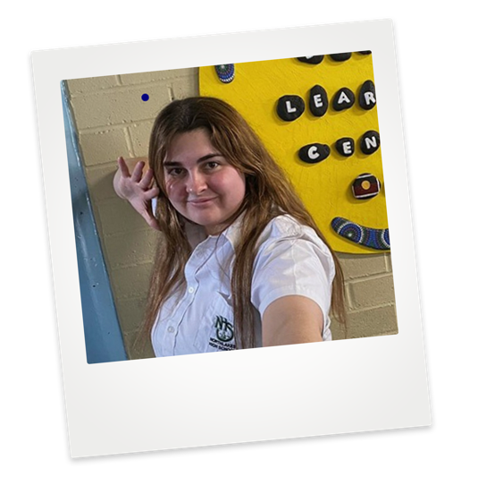
Key messages
Connection to culture
Research shows that a connection to culture, language and heritage is a key driver behind Aboriginal students attaining their HSC.
When Aboriginal students are supported to maintain a strong connection to culture during their schooling years, they’re more likely to complete Year 12.
It’s important for all schools to recognise and celebrate the cultures, histories and customs of all students and communities in order to foster classroom environments where students feel supported to achieve great things.
Recognising culture at school can be a reason Aboriginal students succeed in education.

Slide 22
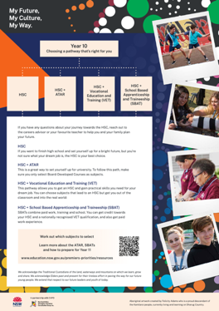
My Future, My Culture, My Way.
Resources

Slide 23

Resources
Download these products and use them in your newsletters, publications and websites. Print them out and hand them to clients and people in your community. Everyone has a part to play. You might also like to use the key messages on pages 17-21 to develop your own news items for your mob about My Future, My Culture, My Way.
Student factsheet
Parents and carers factsheet
A3 infographic

Slide 24
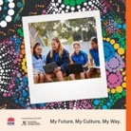
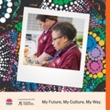
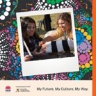
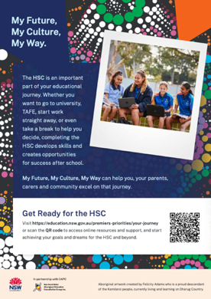
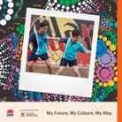
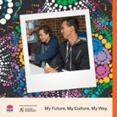
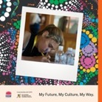
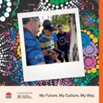
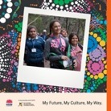
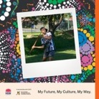
Resources
Social Media Tiles 1000px x 1000px
Poster (A4 and/or A3)
See section, ‘Social media content’ (pages 26-28) for guidance on how to use the My Future, My Culture, My Way campaign social assets.

Slide 25
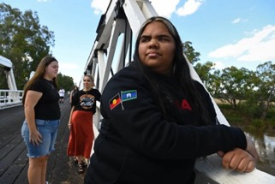
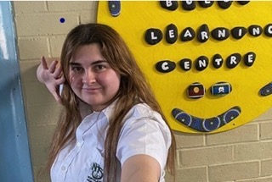
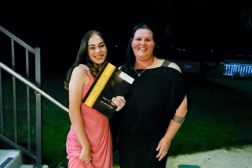
Resources
Good news stories
‘Very proud’: Dubbo College breaks record for most Aboriginal HSC graduates
Connecting to culture supports Aboriginal students
Stronger Communities with Aboriginal Community Connectors
Warren Welham is the principal of Northlakes High School, on the NSW Central Coast, where around two in 10 students identify as Aboriginal. He talks about how his school has, and continues to celebrate and recognise Aboriginal culture over many years in different ways.
Aboriginal Community Connectors are changing lives in regional NSW. Drawing on the strengths, resilience and resourcefulness in communities, Casey has supported a student to be the first in her family to finish the HSC, and built unique local relationships with organisations like the Tamworth Regional Astronomy Club to support student engagement and cultural exchange.
Kamilaroi woman Isabella Fernando was among 71 Aboriginal students who graduated from Dubbo College Senior Campus, in a state and possibly national record for the largest Indigenous cohort to finish their final year. She’s the first person in her family to finish the HSC and go to university.

Slide 26
Social media content
Join us on Facebook
The NSW Department of Education Facebook page is a place to have conversations about the HSC and get support with the process, whether you’re doing it or helping someone to do it.
Publish your own posts
Where possible, share stories of schooling success through your social media channels, particularly from people in your community. Local stories help others connect with the messages. You can also send these stories to us at premiersprioritycorro@det.nsw.edu.au, and we'd be delighted to share them via our state-wide networks.
In addition to the key messages above (see pages 17-21), here is some suggested copy to help you post on platforms like Facebook, Twitter and LinkedIn. You can use this copy as a starting point and change them to suit your own audiences and channels.
Where possible, add:
a link to more information, like the My Culture, My Future, My Way page
an image or a video
appropriate hashtags, including #MyFutureMyCultureMyWay and #stayhealthyHSC

Slide 27
Suggested social media copy
Support students to do the HSC
Education is key to a strong future. When your children have their Higher School Certificates, they’re more likely to get a job in the industry they want. When you were a kid, what did you want to be when you ‘grew up’?
Did you know that there is more than one way to do the HSC? Talk to your family, school or mentors about ways you can get your high school qualifications.
Completing the HSC gives students tools for life and helps them give back to the community. But it can be challenging. You can help students through their HSC and achieve their life goals. What are your tips for doing the HSC?
Connection to culture helps students succeed
Research shows staying connected to culture supports student wellbeing and educational success. By learning more about the HSC, we can give them the full range of support to achieve at school while staying strong in their identity.
Do you know a First Nations student going through Year 11 or 12? Connection to culture and identity is critical to their education. Check out the resources to support them with their learning and cultural needs.
For some students, the HSC journey can be tough. But different supports and connection to culture may help them through. What helped you stay focussed when you were going through school?

Slide 28
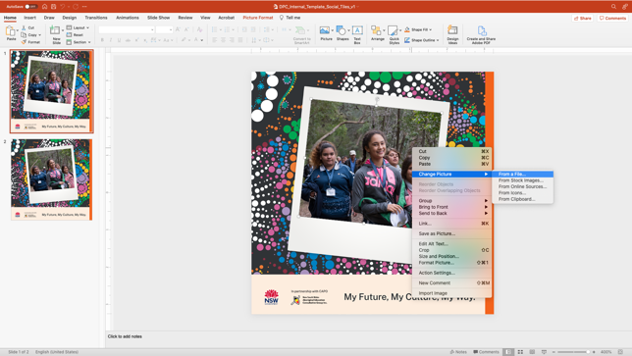
Social tile template for internal use
The photographs within the polaroid treatment of the social tile design can be custom populated using the PowerPoint-based template which is saved here:
Simply right click on the photograph and select ‘Change Picture’ to swap out the image. Once the image has been swapped out, export the PowerPoint slide as a JPEG for immediate use on social media platforms. The slide will export the tile at 1000x1000px.

Slide 29
My Future, My Culture, My Way.
Want to know more?
Visit My Future, My Culture, My Way, follow the Department of Education on social media, talk to your school, or contact your local AECG.

