Slide 1


(CLASS NAME)
You can replace the images on this page with your school logo and a headshot of yourself. Right click the placeholder image and select the ‘change picture’ button.
Don’t forget to delete these speech bubbles and all of its contents before finalising the presentation.
MEET THE TEACHER
MEET THE TEACHER
Insert
(School Name)
with
(Teacher Name)

Slide 2
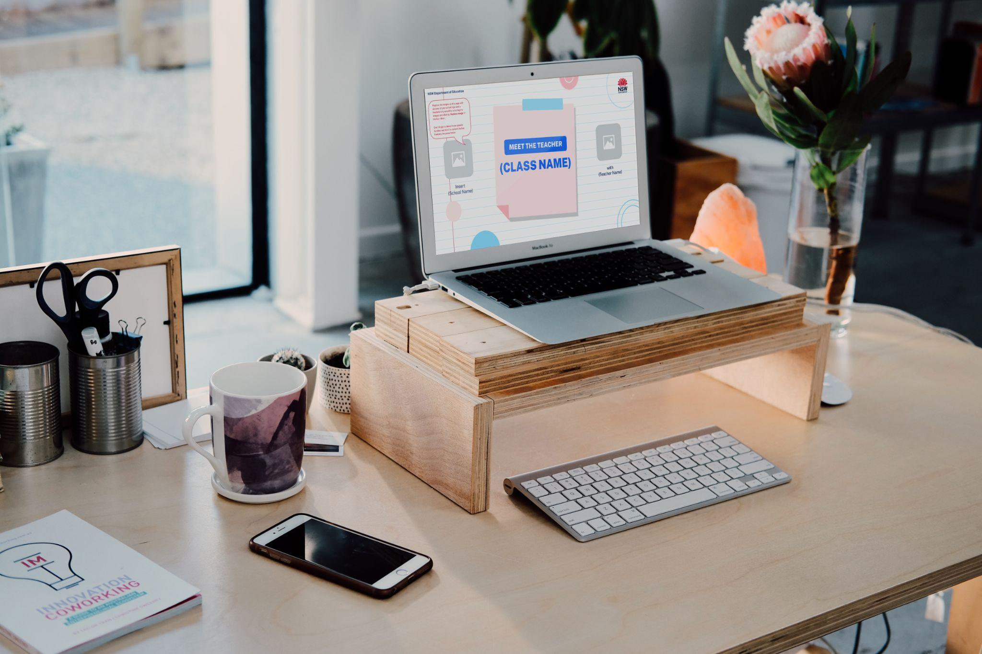
How to use this slide pack
This slide pack was designed for primary and secondary teachers to use to ‘Meet the Teacher’ or as an induction/overview exercise with a new class.
This slide deck is customisable and designed for you to select from a range of slides that work best in your school context.
You can replace the text with your own information.
You can replace the icons using the icon library on slide 3.
You can replace images by double clicking and uploading from your Google Drive or a folder on your device.
You can right click on a slide and hide it or you may choose to delete the slide completely.
If you have questions about operating the slide pack, or have suggested improvements, please email teachnsw@det.nsw.edu.au

Slide 3


















































Icon library
This is your icon library. Feel free to use these throughout your slide deck.

Slide 4
Acknowledgement of Country
NSW Department of Education
Type your acknowledgement of Country here.
You may choose to develop a whole class acknowledgement or use an existing acknowledgement.
Learn more about acknowledging Country on the department’s webpage.
Replace the image in the circle with one of your own by right clicking the image and selecting the ‘change picture’ button.
Don’t forget to delete these speech bubbles and all of its contents before finalising the presentation.

Slide 5
Overview
Replace the image in the circle with one of your own by right clicking the image and selecting the ‘change picture’ button.
Don’t forget to delete these speech bubbles and all of its contents before finalising the presentation.
Insert an overview of the contents in the presentation.
Consider when you want parents/carers/students to ask questions e.g. throughout the presentation of your slides or at the end.

Slide 6
Teaching programs (primary school)
English: | Space to edit
Mathematics: | Space to edit
History: | Space to edit
Geography: | Space to edit
Science/Technology: | Space to edit
PDH: | Space to edit
PE: | Space to edit
CAPA: | Space to edit
Other: | Space to edit

Slide 7
Teaching programs (secondary school)
Insert scope and sequence or overview of focus each term
Term 1 | Topic/focus area:
Term 2 | Topic/focus area:
Term 3 | Topic/focus area:
Term 4 | Topic/focus area:

Slide 8
Replace the image in the circle with one of your own by right clicking the image and selecting the ‘change picture’ button.
Don’t forget to delete these speech bubbles and all of its contents before finalising the presentation.
You may choose to provide an overview of yourself using the space below.
Insert information here:
Insert information here:
Mrs McDonald
6F

Slide 9
Meet the team
Replace the image in the circle with one of your own by right clicking the image and selecting the ‘change picture’ button.
Don’t forget to delete these speech bubbles and all of its contents before finalising the presentation.
Ms Irving
6S
Mr Collins
6C
Mr Zhang
6M
With permission, you may choose to provide an overview of your stage or faculty.
Mrs McDonald
6F
Mr Wilson
6B
Ms Dang
6A

Slide 10
Weekly overview
NSW Department of Education
Replace the image in the circle with one of your own by right clicking the image and selecting the ‘change picture’ button.
Don’t forget to delete these speech bubbles and all of its contents before finalising the presentation.
Insert summary of weekly activities/events parents/carers need to be aware of.
Monday | Library
Tuesday | SRE/SEE
Wednesday | Recycling
Thursday | Sport
Friday | Assembly

Slide 11
Our class
Sport/library/other important days are on: | Space to edit
We have assemblies on: | Space to edit
Students should come to class prepared with: | Space to edit
Other: | Space to edit
Include important details that all students/parents/carers should know.

Slide 12

Our class or school values and expectations
Respect
Treating others with kindness, empathy, and consideration.
Integrity
Being honest, trustworthy, and having strong moral principles.
Responsibility
Taking ownership of your actions and choices.
Perseverance
Showing determination and resilience in the face of challenges.
You may choose to provide an overview of the school values or come up with a set of classroom expectations together.
Kindness
Showing compassion and care for others.
Curiosity
Asking questions, exploring new ideas, and seeking knowledge.

Slide 13







Communication platforms
Provide an overview of the ways the school/classroom teacher will communicate with parents/carers.
You may wish to delete any platform logos that your school does not use.

Slide 14
Policies and procedures template
Duplicate the next slide based on the number of policies or procedures you want to highlight with parents/caregivers or students for your school context.
You may want to consider creating slides covering the below areas:
Attendance (see exemplar)
Bell times and school pick-up and drop off (see exemplar)
Food
Homework
Technology
Uniform
NAPLAN
Payments and permission notes
Learning and Support team processes
Wellbeing
Lost property
Co-curricular activities
Contacting the school
Replace the image in the circle with one of your own by right clicking the image and selecting the ‘change picture’ button.
Don’t forget to delete these speech bubbles and all of its contents before finalising the presentation.

Slide 15
Attendance matters
NOTE: This slide is an exemplar.
Personalise it with your school’s policies or procedures. Feel free to use any of the icons on slide 3.
Regular attendance is crucial for your child's success
at school. It helps them:
Stay on top of their learning
Build strong relationships with their teachers and peers
Develop important social and emotional skills
If your child is absent, please notify the school as soon as possible.
Let's work together to ensure your child attends school regularly.

Slide 16
Bell times and school pick-up and drop off
NOTE: This slide is an exemplar.
Personalise it with your school’s policies or procedures. Feel free to use any of the icons on slide 3.
8:30 AM: School commences
10:30 AM: Morning recess
11:00 AM: Lessons resume
12:30 PM: Lunch
1:15 PM: Lessons resume
2:50 PM: School concludes
Please note: Bell times may vary slightly depending on the specific school and year level.
Morning drop-off: 8:45 AM - 9:00 AM
Afternoon pick-up: 2:45 PM
Please ensure your child arrives on time to avoid disruption to the school day.

Slide 17
Thank you for downloading this template
If you have any questions relating to this template,
please email teachnsw@det.nsw.edu.au

