Slide 1
Deep dive into the new Science 7–10 Syllabus
2
Science 7–10 Syllabus implementation
Notes:
Timing – 10sec
Welcome back to session 2, a deep dive into the new Science 7–10 Syllabus. Please turn to page X in your participant workbook.
CLICK

Slide 2
Activity 2.1
The potential of curriculum reform
What does this curriculum reform allow us to progress that we already aspired to do?
Consider:
What are the changes you want to see in your science classroom?
What has been working well, what has not?
Teaching the nature of science
Incorporate modern teaching tools
Cultivate real-world applications
Notes:
Timing – 0.5min
The scale of the NSW Curriculum Reform provides an opportunity to progress our aspirations for our students, our teaching and our schools. Now is a good time to consider the opportunities ahead. Take a moment to reflect on these questions and record your thoughts in your workbook.
CLICK

Slide 3
Delving into the detail
Similarities
The skills are embedded into the content
Differences
Content
Language
Investigations
Notes:
Timing - 1min
We will take just a quick overview of the key similarities and differences we will explore in this session.
CLICK
The important similarity to note is that the skills are still embedded into the content. This has not changed with the new syllabus.
CLICK
The major points of difference are:
Changes in content – decluttering the syllabus has seen a removal of content with new changes to develop a depth of understanding in the existing content.
There has been a language shift in the syllabus towards the use of higher order verbs. This leads to greater depth of knowledge and understanding being developed through the content statements
The increased emphasis on conducting investigations rather than verification experiments means that we will need to change the way we have historically been doing practical work. Verification experiments will no longer achieve the intended outcomes. We need to move, instead, toward inquiry. Leading the students through developing their own questions and hypotheses, developing plans, analysing the data and drawing conclusions.
CLICK

Slide 4
Changes in content
Stage 4 – Living systems
Determine the role, structure and function of the components of a plant, including the xylem and phloem, in maintaining plants as multicellular organisms.
Stage 5 – Data science 2
Investigate how data, or its analysis and interpretation, can be distorted to manipulate findings that support specific viewpoints.
Notes:
Timing – 1.5min
When we contrast the two syllabus documents there are some key changes in the content statements, we will highlight two here.
CLICK
We see many examples of where a refined focus in the content descriptors where meta language is specified to deepen the learning in these areas, for example the specific inclusion of the terms xylem and phloem to describe plant structures which was formerly not specifically included in our syllabus.
CLICK
With the decluttering of content, we can integrate more modern topics relevant to students current and future worlds, the Stage 5 Data Science 2 focus area includes an investigation into the way data is distorted or manipulated by others to support specific viewpoints. This understanding will be invaluable to students growing up in our modern society.
CLICK

Slide 5
Changes in language
Stage 4 – Solutions and mixtures
Conduct a series of practical investigations to explore common techniques to separate mixtures.
Stage 5 – Energy
Use the law of conservation of energy, and calculations to explain, that total energy is maintained in energy transfers and transformations in a closed system.
Notes:
Timing – 1.5min
When we contrast the two syllabus documents, where content statements are similar, there is an increased depth of knowledge and understanding, we will highlight two here.
CLICK
In the current Stage 4 syllabus, we perform a highly prescriptive array of 6 separation techniques under the verb of relate, this low level verb does not encourage a depth of investigation nor does this statement even require a practical investigation to be undertaken in this area. In the new Science 7–10 Syllabus we see a reduced length of this similar content descriptor where the prescription of each separation technique is no longer required (now listed in examples) and we will explore (a higher level verb) through practical investigations as deemed contextually relevant to your students.
CLICK
In the current Stage 5 syllabus, we apply the law of conservation of energy to account for total energy. The verbs used here do not encourage a depth of understanding to be developed. This content descriptor has been strengthened by the increased depth of specific calculations to be undertaken and used to explain (a much higher verb) how the law of conservation of energy is validated.
CLICK

Slide 6
Changes in investigations
The NESA definition of investigate is – to plan, inquire into and draw conclusions about.
Observing the Universe – Conduct an investigation using scientific tools and instruments to make a series of observations over time
Forces – Conduct a series of practical investigations using simple machines to investigate the action of forces
Diseases – Use modelling to investigate how infectious diseases can be spread
Environmental sustainability – Investigate data to determine what trends are evident in the world’s climate
Life Skills: Forces – Investigate how technological developments have reduced the harmful impact of forces in everyday life
Notes:
Timing – 1.5min
A major focus in our new syllabus is to develop a holistic approach to investigations in science by encouraging student led investigation in a variety of content statements. To investigate, NESA defines this as where students plan, inquire into and draw conclusions about the topic being investigated. Lets look at a few examples.
CLICK
In Stage 4 we will investigate using scientific tools and instruments to make observations over time, indicating that this is a longitudinal study into a particular area of interest.
CLICK
Staying in stage 4 for one more example, practically investigating simple machines to investigate the action of forces will allow a wide range of opportunities for a breadth of practical applications of learning in this focus area.
CLICK
Stage 5 diseases includes the specific use of modelling as an investigation tool to dive deeper into the transmission of infectious diseases.
CLICK
Stage 5 also gives the opportunity to investigate data for climate trends, this higher focus on the use of data informed conclusions is evident across many areas of the new Science 7–10 Syllabus.
CLICK
This focus on investigations is also present in our life skills course, this content statement allows students to investigate the harmful impact of forces and how technology can be used to mitigate these issues.
CLICK

Slide 7
Activity 2.2
Exploring the new syllabus
Select a focus area from the new syllabus that interests you.
Analyse the focus area, considering the following aspects:
Identify new or revised content.
Explore the opportunities for investigations.
Notes:
Timing - 1min (Facilitator ppt, OR pause the video here while the activity is completed)
Now it is your turn to work in small groups to delve deeper into the syllabus. We have recommended specific focus areas for analysis. Take into account the following aspects: new or revised content and the opportunities for investigation. Highlight key changes as you analyse the focus area.
You have 20 minutes to complete this activity. We will then come back as a group and share our findings.
CLICK

Slide 8
Activity 2.3
Engage – the first phase of curriculum implementation
The phases of engage, enact and embed can be used as a guide for effective curriculum implementation in schools.
During the Engage phase, teachers explore new aspects and identify changes in practice required for effective syllabus implementation.
Reflection questions
How will the new Science 7–10 Syllabus affect my classroom practice?
What will I need to implement the new Science 7–10 Syllabus?
Notes:
Timing – 1min
Take a moment now to reflect on your teaching practice. Identify any changes that you need to make to your practice to align with the changes in the syllabus.
The department has produced resources to guide teachers and school leaders through curriculum implementation. The resources outline activities and questions to explore at each of the three phases, Engage, Enact and Embed.
The new Science 7–10 Syllabus was released in 2023, so everyone will currently be in the Engage phase. This is the time to explore new aspects of the syllabus, including the evidence base underpinning them, and identify changes in practice that will be required for effective syllabus implementation.
Hit pause now and record your thoughts to the 2 reflection questions in your workbook. (3 min)
If completing this activity in a faculty group, allocate a few minutes to sharing views before moving on the next activity.
CLICK
Further info for facilitator guide
Engage phase
Video – Phases of curriculum implementation – overarching guidance when implementing a new syllabus (3:22).
CLICK

Slide 9
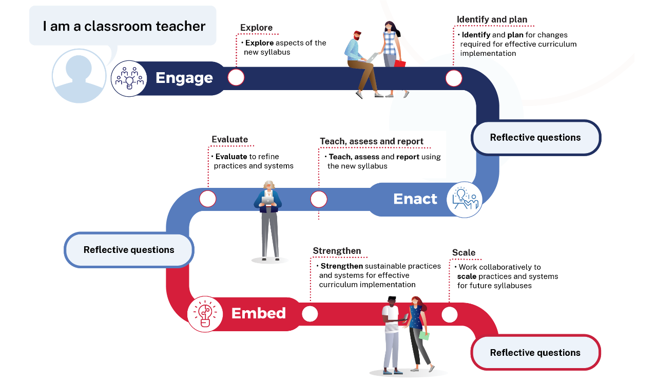
Curriculum implementation journey
Notes:
Curriculum implementation journey resources have been created to provide guidance for teachers and school leaders implementing a new syllabus. Each journey includes suggested activities, reflective questions and useful resources that can be used flexibly across a range of schools for each phase of implementation.
Curriculum implementation journeys align to the phases and include:
Principal journey
Head teacher journey
Assistant principal journey
Assistant principal, curriculum and instruction journey
Teacher journey
Each role specific journey has a downloadable graphic to support implementation.
CLICK
The new Science 7–10 syllabus was released last year in 2023. In 2024, all science teachers will currently be in the Engage phase.
CLICK

Slide 10
Sample resources to support implementation
The department will produce sample units and assessments to support teachers
A scope and sequence with sample units
Assessment tasks aligned to sample units
These resources are designed to be adopted and adapted to your school context
Notes:
Timing - 1min
Video end session 2 start session 3
You may have noticed that significant changes need to be made to your teaching and learning practices and programs.
This may seem to be a monumental task, but the science curriculum team are here to help. We are developing a comprehensive package including:
CLICK
a scope and sequence for all outcomes with sample units
CLICK
assessment tasks aligned to sample units.
CLICK
Our resources are designed for you to adopt and adapt.
CLICK

Slide 11
Strategic planning for change
3
Science 7–10 Syllabus implementation

Slide 12
Activity 3.1
Kanban board – planning for effective science syllabus implementation
To do
Work in progress
Done
Spend 5 minutes as a team to start your ‘to do list’ for your Kanban board.
Notes:
A Kanban board is a visual project management tool used to manage workflow in projects. It can be a physical or a digital board with columns and cards. Each column represents a stage or step in the workflow, and each card represents a task, or work item. The cards move from left to right across the board as they progress through the workflow.
Work in progress (WIP) limits should be set for the work in progress column to control the number of items that can be in progress at any given time. This helps prevent the overload and ensures a smooth flow of work.
CLICK
Pause the video here and as a team start to brainstorm some of the cards that need to go onto the To do list. Spend about 5 minutes doing this.
The notes below go into the facilitators guide to support the discussion:
Some suggestions include:
Mapping the working scientifically outcomes against content.
Evaluate current programming practice
Identify resource needs
Identify potential depth studies
Develop a scope a sequence
Complete micro learning
It is recommended that you continue to use this Kanban board throughout the implementation of the new science syllabus to keep track of the tasks that will need to be completed.

Slide 13
Activity 3.2
The pruning protocol
What is something that you have paused or stopped or would like to pause or stop in your school or faculty to allow for deep curriculum implementation?
Notes:
We are starting an important change in how we teach. We need to think about where we are now, what our next steps are, and how we can make room for these new ideas in our classrooms. For those who want to improve our students' performance in major exams like the HSC, now is the perfect time to start laying the groundwork in Stage 4 and 5. Through this change, we have the chance to focus on the key concepts in science. Our goal is to make sure that by the time our students graduate, they are knowledgeable, engaged, and well-informed about science.

Slide 14
Creating space – pruning protocol
Reduce
Reallocate
School priorities – What work is being paused, delayed or shut down to make way for syllabus implementation?
Collaboration time – How could we reallocate existing time?
Faculty priorities – What work could you pause, delay or shut down?
Professional learning – How could we better harness the existing PL structures, processes and routines?
Personal priorities – In what areas could you reduce your involvement to effectively contribute to the Science Syllabus implementation?
Roles – How can we share the responsibility for curriculum implementation?
This adapted work is based on Dr. Simon Breakspear’s original, licensed under CC BY-NC-SA 4.0
Notes:
The pruning protocol
How are we going to ensure we have the time to implement the new syllabus well?
What might we have to pause, delay or shut down?
Some things are outside of the control of the faculty, so for this activity we are focusing on what can be done at the faculty and personal levels to create space. CLICK
Do you have any personal priorities that you can pull back a little from so that you can engage with the new Science syllabus and plan for effective implementation. It is not to dishonour anything that you are doing but more a reflection of how big this piece of work is. CLICK
As a faculty is there anything you are doing that you may need to pause, delay or shutdown? CLICK
Have there been any changes to school wide priorities so that curriculum implementation can be prioritised? CLICK
The other piece is to ask ourselves how we can reallocate… so not getting rid of… but reallocating. How are your syllabus implementation hours being used? How are you using faculty meetings currently? Could you use this time better to ensure the syllabus can be implemented effectively, so that you can engage with microlearning, look at the units that will be produced by the science curriculum team, adapt resources and develop meaningful and quality assessment tasks.
We cannot expect to get this syllabus implemented purely by working harder. We need to be realistic and get in and do some reduction to create some margin. So that we can learn what is working, and what is not working and adjust. If you are already working at 100%, now is a good time to create some space for this work.
Pause the video here and spend 5 minutes individually completing the creating space activity in your workbook. Then come together for another 5 minutes to discuss your ideas for creating space.
Note: the facilitator guide will contain some suggestions to promote discussion if required.

Slide 15
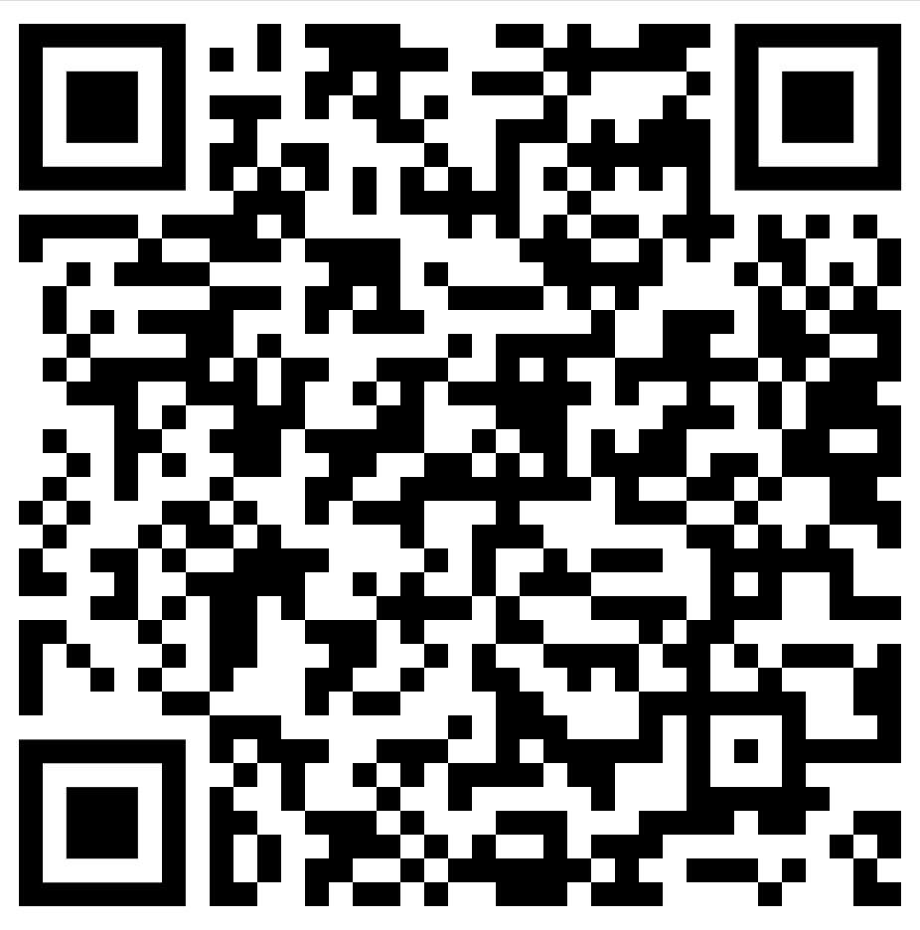
Where to next?
Stay on top of science curriculum by joining the Science statewide staffroom.
Joining gives you access to:
opportunities to collaborate
professional learning
early release draft resources
access to the Science SWS website resources (there are over 300!)
Join a statewide staffroom
Learn how to navigate the Science statewide staffroom website (5:17)
Notes:
https://web.microsoftstream.com/video/8b0b43f6-7a82-4424-bbe6-1d5e4f71b58d?list=watchlist
If you are not part of the Science statewide staffroom you can join by going to the QR code on the screen, select secondary and then Science NSW. Completion of this form will allow you access to the Science SWS MS Team and SharePoint website.
The video link on this slide will show you how to add the Science SWS tile to your essentials and how to find the 300+ resources produced by the Science curriculum team.

Slide 16
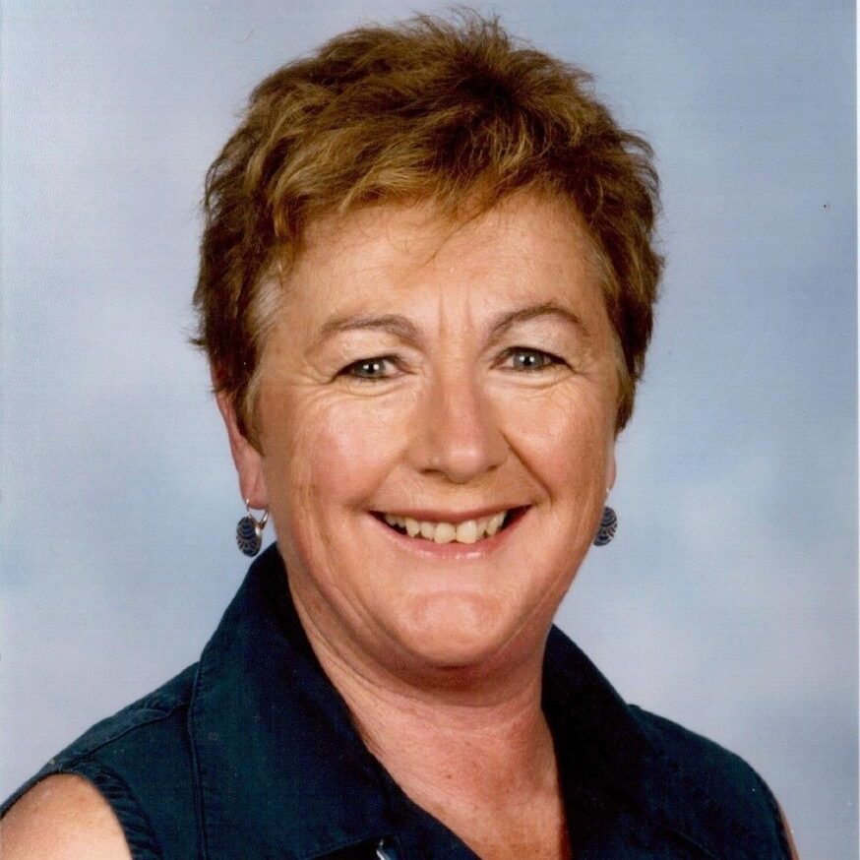
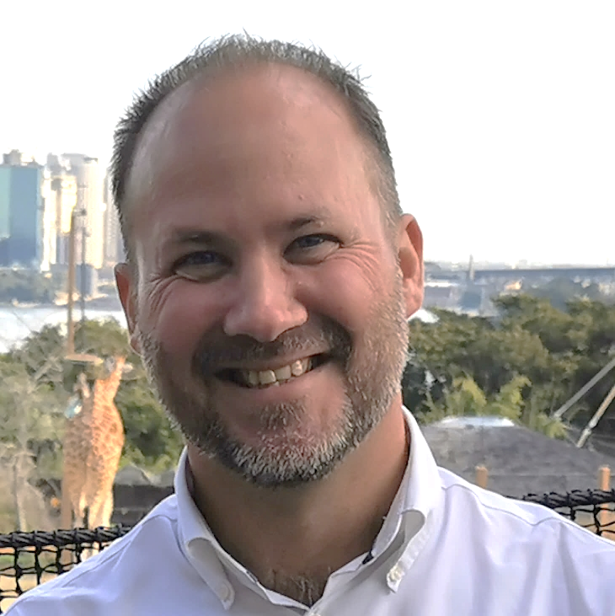
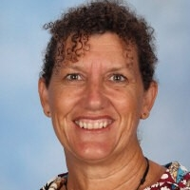
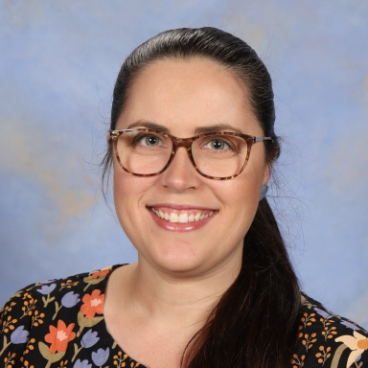
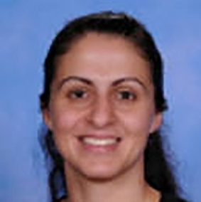
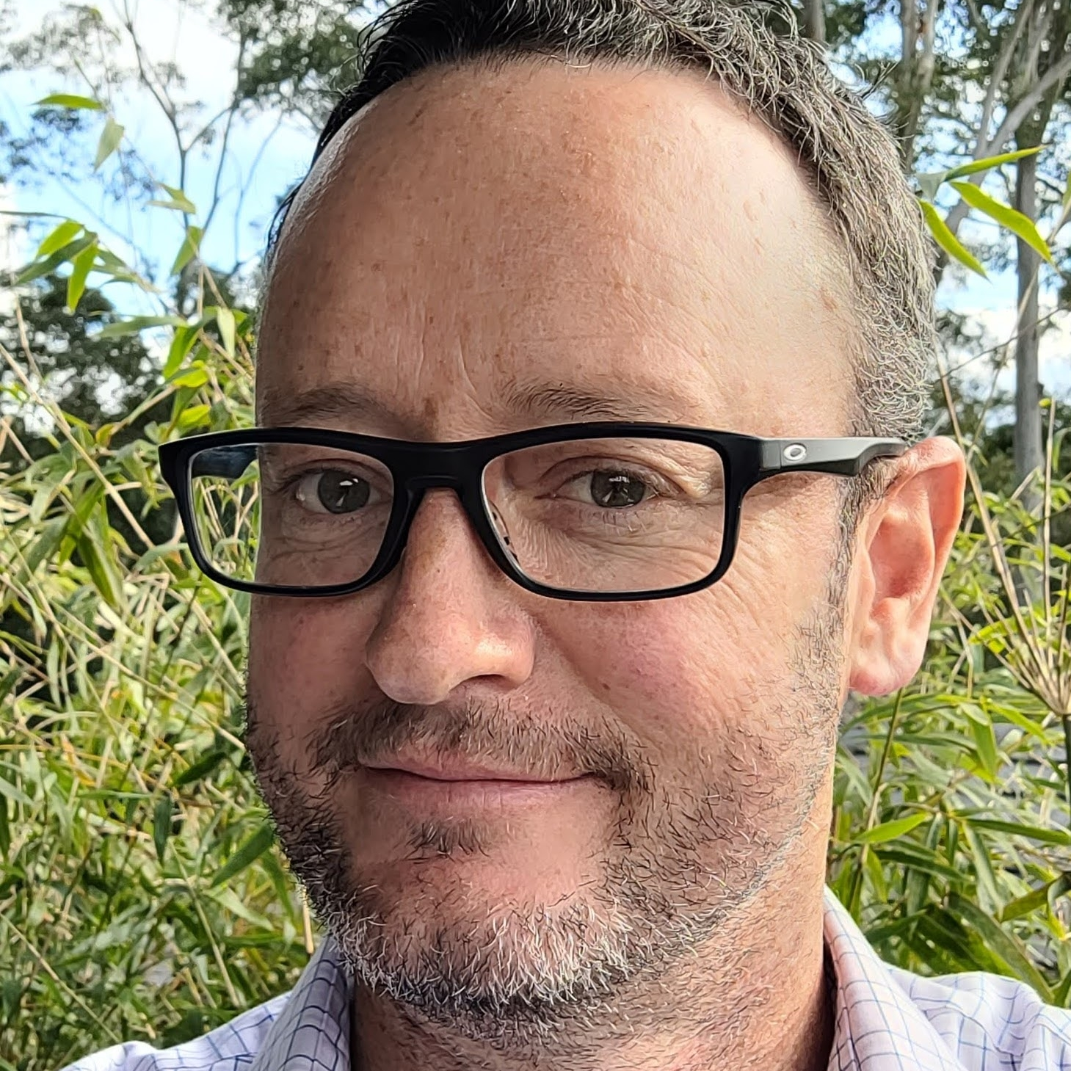
Science Curriculum Team 7–12
Sham Nair
Science Coordinator 7–12
Alexa Barr
Science Advisor 7–12
Chris Bormann
Science Advisor 7–12
Bronwyn Gilmore
Science Advisor 7–12
Maninder Kaur
Science Advisor 7–12
Lewanna Kenton
Science Advisor 7–12
Tina Linaris
Science Advisor 7–12
Ben Surwald
Science Advisor 7–12
Joshua Westerway
Science Advisor 7–12

Slide 17
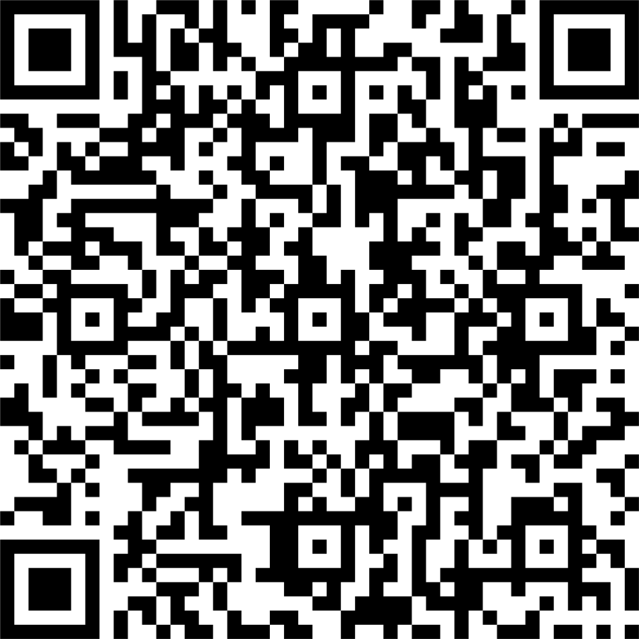
Evaluation
We value your feedback. Please complete the Engaging with the new Science 7–10 Syllabus evaluation to help us provide further support.
https://forms.office.com/r/WwjZUmj6fq
Notes:
Please scan the QR code on the screen to provide feedback on the ‘Engaging with the new Science 7–10 Syllabus’ professional learning session.

Slide 18
References
This presentation contains NSW Curriculum and syllabus content. The NSW Curriculum is developed by the NSW Education Standards Authority. This content is prepared by NESA for and on behalf of the Crown in the right of the State of New South Wales. The material is protected by Crown copyright.
Please refer to the NESA Copyright Disclaimer for more information https://educationstandards.nsw.edu.au/wps/portal/nesa/mini-footer/copyright.
NESA holds the only official and up-to-date versions of the NSW Curriculum and syllabus documents. Please visit the NSW Education Standards Authority (NESA) website https://educationstandards.nsw.edu.au/wps/portal/nesa/home and the NSW Curriculum website https://curriculum.nsw.edu.au.
Science 7–10 © Syllabus NSW Education Standards Authority (NESA) for and on behalf of the Crown in right of the State of New South Wales, 2023.
Breakspear S (2023) The Power Of Kanban, The Strategic Schools Podcast, Breakspear Learning website, accessed 09 November 2023.
Waters C (2010) Learn more about learning progressions, ACER discover website, accessed 04 December 2023.

Slide 19
Copyright
© State of New South Wales (Department of Education), 2024
The copyright material published in this resource is subject to the Copyright Act 1968 (Cth) and is owned by the NSW Department of Education or, where indicated, by a party other than the NSW Department of Education (third-party material).
Copyright material available in this resource and owned by the NSW Department of Education is licensed under a Creative Commons Attribution 4.0 International (CC BY 4.0) licence.
This licence allows you to share and adapt the material for any purpose, even commercially.
Attribution should be given to © State of New South Wales (Department of Education), 2024.
Material in this resource not available under a Creative Commons licence:
the NSW Department of Education logo, other logos and trademark-protected material
Material owned by a third party that has been reproduced with permission. You will need to obtain permission from the third party to reuse its material.
Links to third-party material and websites
Please note that the provided (reading/viewing material/list/links/texts) are a suggestion only and implies no endorsement, by the New South Wales Department of Education, of any author, publisher, or book title. School principals and teachers are best placed to assess the suitability of resources that would complement the curriculum and reflect the needs and interests of their students.
If you use the links provided in this document to access a third party’s website, you acknowledge that the terms of use, including licence terms set out on the third-party’s website apply to the use which may be made of the materials on that third-party website or where permitted by the Copyright Act 1968 (Cth). The department accepts no responsibility for content on third-party websites.

