Slide 1
Home ground advantage
Explicit teaching

Slide 2
Summarise

Slide 3
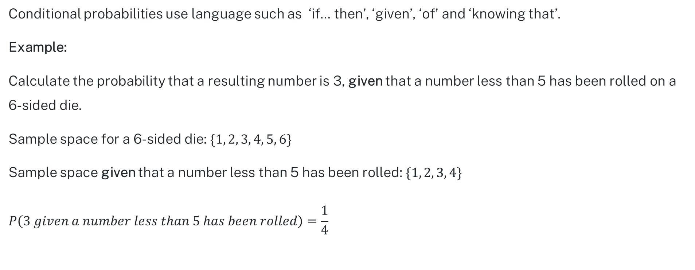
Conditional language
Conditional probabilities use language such as ‘if… then’, ‘given’, ‘of’ and ‘knowing that’.
Example:
Calculate the probability that a resulting number is 3, given that a number less than 5 has been rolled on a
6-sided die.
Sample space for a 6-sided die: $\{1, 2, 3, 4, 5, 6\}$
Sample space given that a number less than 5 has been rolled:$\{1, 2, 3, 4\}$
$$P\left(3 given a number less than 5 has been rolled\right)=\frac{1}{4}$$

Slide 4

Conditional notation
The mathematical notation for the probability of event A given event B has happened is $P\left(A | B\right).$
$P\left(A \right| B)$ is read as ‘Probability of A given B’.
$P\left(A \right| \overline{B})$ is read as ‘Probability of A given not B’.

Slide 5
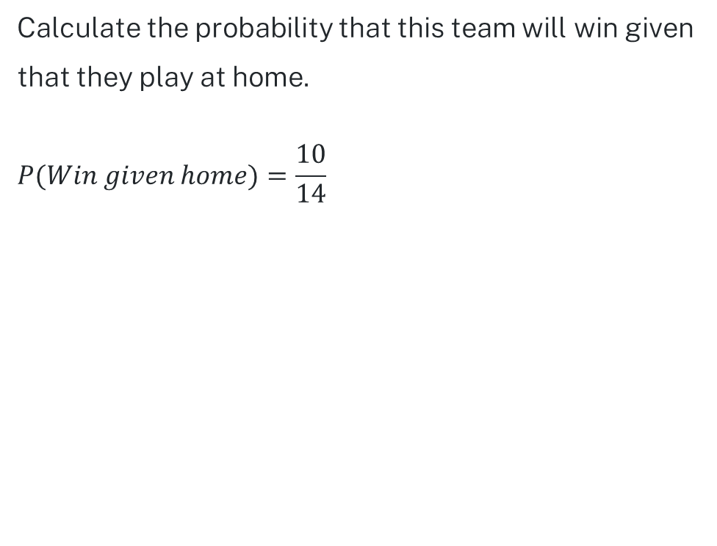
Example 1
Calculate the probability that this team will win given that they play at home.
$$P(Win given home)=\frac{10}{14}$$
 | Home | Away | Total
Win | 10 | 5 | 15
Loss | 4 | 7 | 11
Total | 14 | 12 | 26

Slide 6
Example 1 – self-explanation prompts
Calculate the probability that this team will win given that they play at home.
$$P(Win given home)=\frac{10}{14}$$
 | Home | Away | Total
Win | 10 | 5 | 15
Loss | 4 | 7 | 11
Total | 14 | 12 | 26
Why was the 10 selected?
What language in the question indicated conditional probability?
Why was the 14 selected?

Slide 7
Your turn 1
If a team lost, what is the probability they played at home?
 | Home | Away | Total
Win | 10 | 6 | 16
Loss | 1 | 3 | 4
Total | 11 | 9 | 20

Slide 8

Your turn 1 – solution
If a team lost, what is the probability they played at home?
$$P\left(home given loss\right)=\frac{1}{4}$$
 | Home | Away | Total
Win | 10 | 6 | 16
Loss | 1 | 3 | 4
Total | 11 | 9 | 20

Slide 9

Example 2
Calculate$P\left(\overline{Win} \right| Home)$
$$P\left(\overline{Win} \right| Home)=\frac{4}{14}$$
 | Home | Away | Total
Win | 10 | 5 | 15
Loss | 4 | 7 | 11
Total | 14 | 12 | 26

Slide 10
Example 2 – self-explanation prompts
Calculate$P\left(\overline{Win} \right| Home)$
$$P\left(\overline{Win} \right| Home)=\frac{4}{14}$$
 | Home | Away | Total
Win | 10 | 5 | 15
Loss | 4 | 7 | 11
Total | 14 | 12 | 26
How would you read this probability aloud?
How do you determine which total to use?

Slide 11

Your turn 2
Calculate$P\left(Win \right| \overline{Home})$
 | Home | Away | Total
Win | 7 | 5 | 12
Loss | 12 | 9 | 21
Total | 19 | 14 | 33

Slide 12

Your turn 2 – solution
Calculate$P\left(Win \right| \overline{Home})$
$$P\left(Win \right| \overline{Home})=\frac{5}{14}$$
 | Home | Away | Total
Win | 7 | 5 | 12
Loss | 12 | 9 | 21
Total | 19 | 14 | 33

Slide 13
Copyright
© State of New South Wales (Department of Education), 2024
The copyright material published in this resource is subject to the Copyright Act 1968 (Cth) and is owned by the NSW Department of Education or, where indicated, by a party other than the NSW Department of Education (third-party material).
Copyright material available in this resource and owned by the NSW Department of Education is licensed under a Creative Commons Attribution 4.0 International (CC BY 4.0) licence.
This licence allows you to share and adapt the material for any purpose, even commercially.
Attribution should be given to © State of New South Wales (Department of Education), 2024.
Material in this resource not available under a Creative Commons licence:
the NSW Department of Education logo, other logos and trademark-protected material
Material owned by a third party that has been reproduced with permission. You will need to obtain permission from the third party to reuse its material.
Links to third-party material and websites
Please note that the provided (reading/viewing material/list/links/texts) are a suggestion only and implies no endorsement, by the New South Wales Department of Education, of any author, publisher, or book title. School principals and teachers are best placed to assess the suitability of resources that would complement the curriculum and reflect the needs and interests of their students.
If you use the links provided in this document to access a third party’s website, you acknowledge that the terms of use, including licence terms set out on the third-party’s website apply to the use which may be made of the materials on that third-party website or where permitted by the Copyright Act 1968 (Cth). The department accepts no responsibility for content on third-party websites.

