Slide 1
What’s on the packet is in the packet
Explicit teaching

Slide 2
Launch

Slide 3
Table 1
Packet Venn
Pig
Cow
Chicken
Dog
Duck
Cat
Bee
Human
Rabbit
Fish
Toucan

Slide 4
Explore

Slide 5
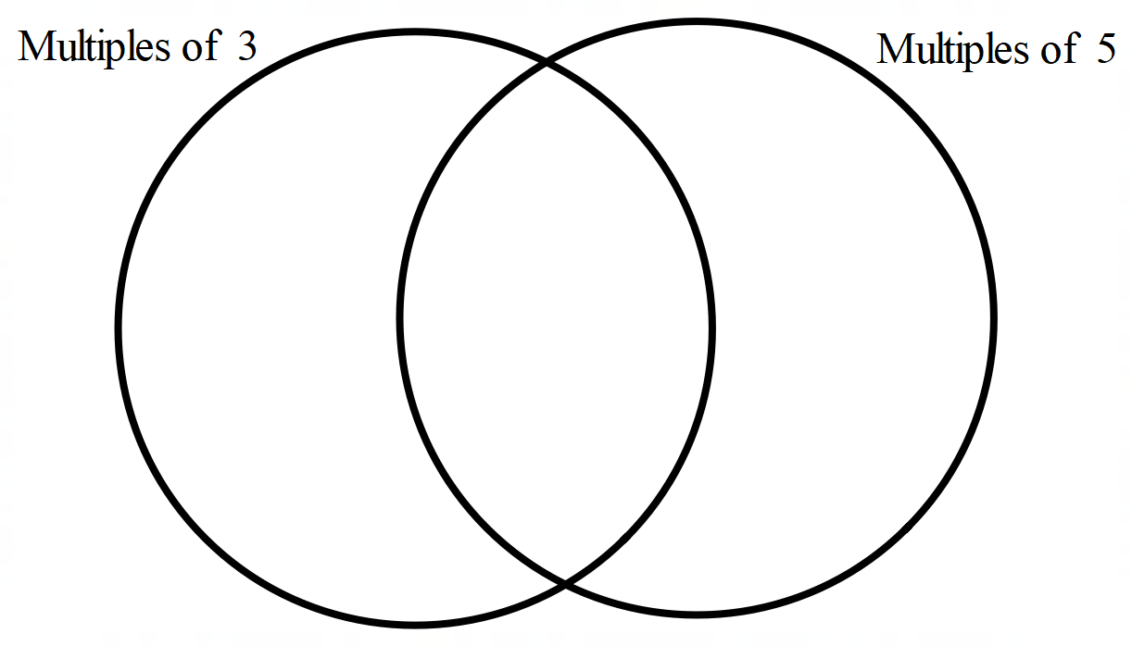
Figure 1
Multiples Venn
10
15
35
20
3
21
30
7
6
45

Slide 6
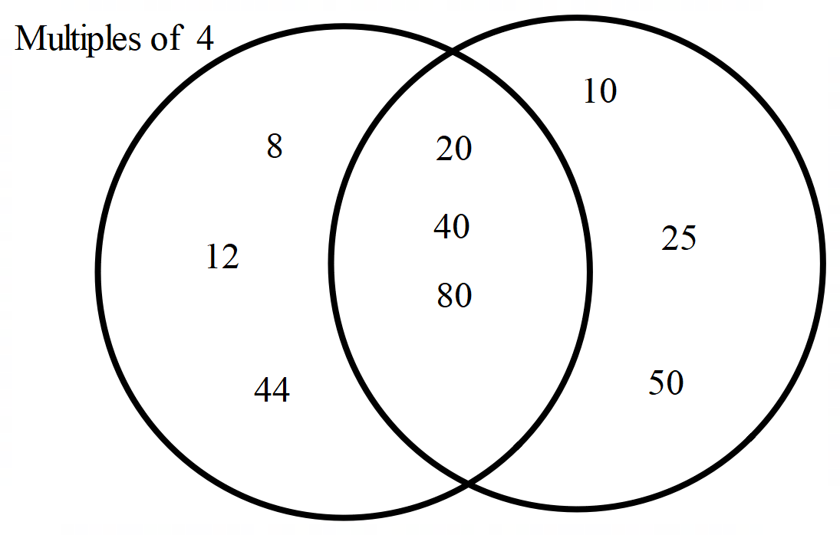
Figure 2
Multiples Venn 2

Slide 7
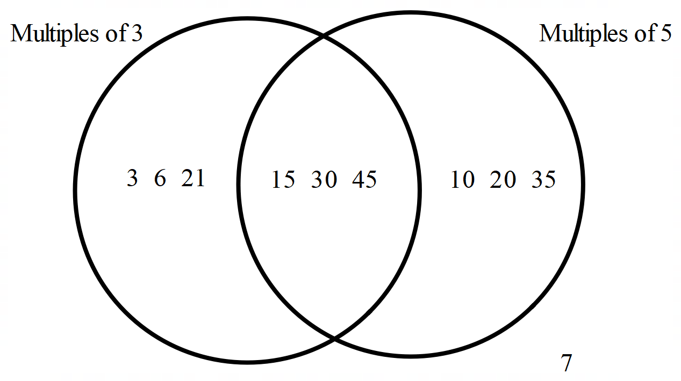
Problem 1 solutions
Exploring Venn diagrams
Write each number from the sample space in their corresponding sections of the Venn diagram.
Sample space {15, 10, 35, 20, 3, 21, 30, 7, 6, 45}

Slide 8
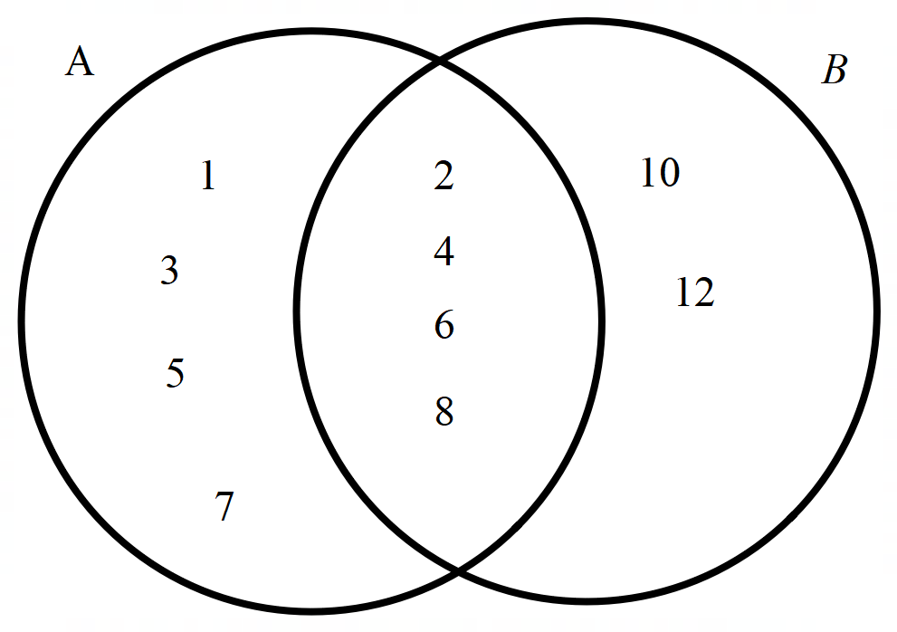
Problem 2 solutions
Exploring Venn diagrams
The Venn diagram below has been partially filled in. Write the remaining numbers from each set in their corresponding sections of the Venn diagram.
Set A = {1, 2, 3, 4, 5, 6, 7, 8}, Set B = {2, 4, 6, 8, 10, 12}

Slide 9
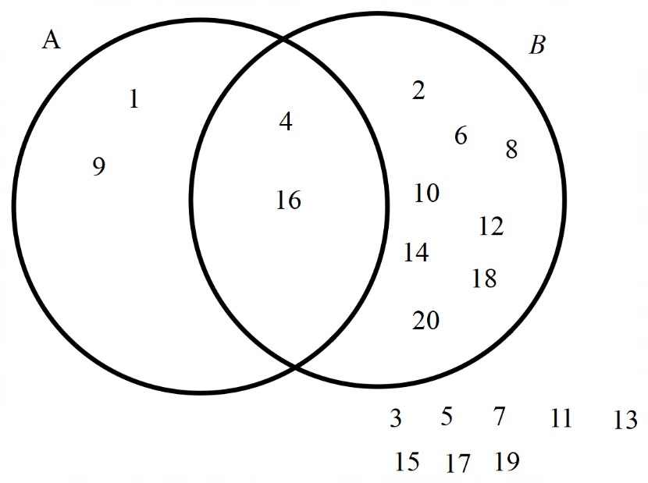
Problem 3 solutions
Exploring Venn diagrams
List Set A.
Set A = {1, 4, 9, 16}
List Set B.
Set B = {2, 4, 6, 8, 10, 12, 14, 16, 18, 20}
Describe each set in words.
Set A contains square numbers. Set B contains even numbers.
List the intersection of Set A and Set B?
Set A$∩$B = {4, 16}

Slide 10
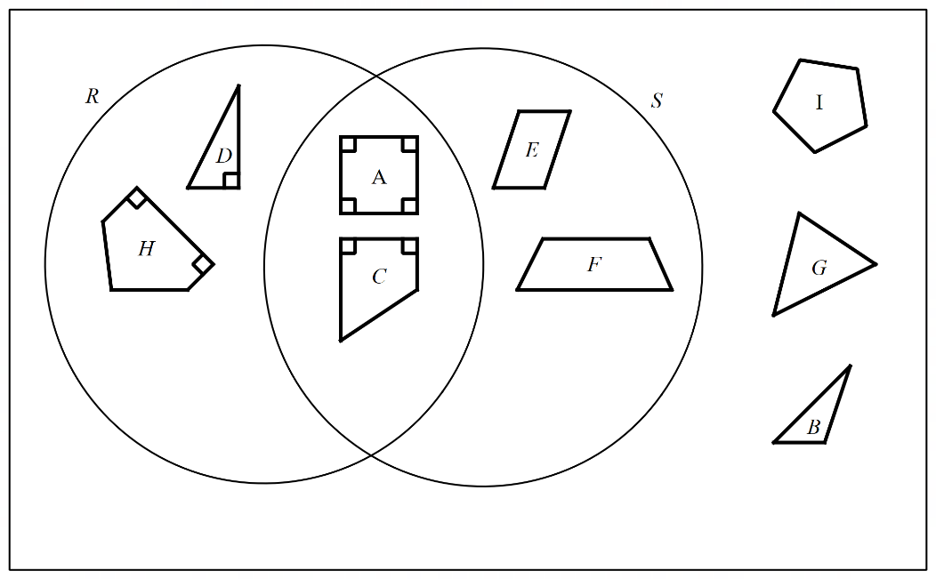
Problem 4 solutions
Exploring Venn diagrams
Sort the shapes below into 2 sets, R and S, using a Venn diagram.
Set R contains shapes with a right angle. Set S contains shapes with 4 sides.

Slide 11
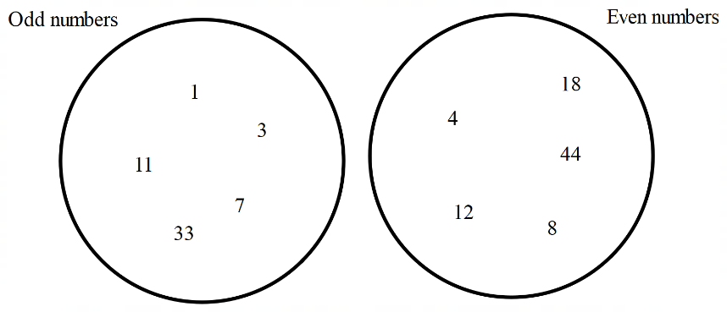
Problem 5 solutions
Exploring Venn diagrams
The Venn diagram below shows numbers sorted into 2 sets, Odd numbers and Even numbers.
Explain why there is no intersection between the 2 sets.
There isn’t a number that can be both even and odd at the same time.

Slide 12
Summarise

Slide 13
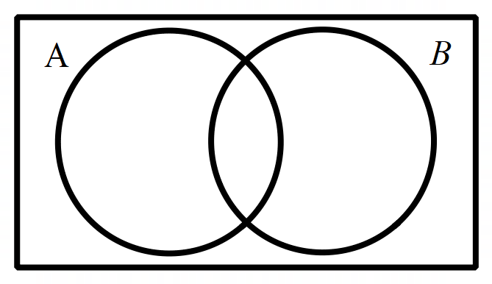
Example 1
Summarise
$$A$$

Slide 14
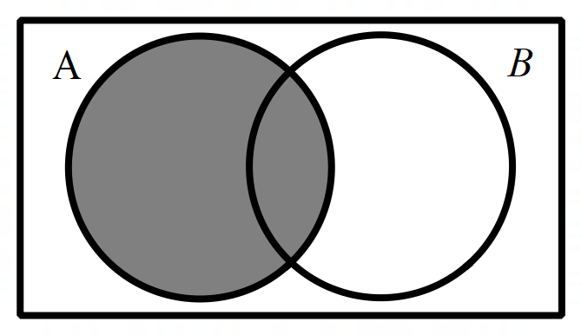
Example 1 – solution
Summarise
$$A$$

Slide 15
Example 2
Summarise
$$B$$

Slide 16
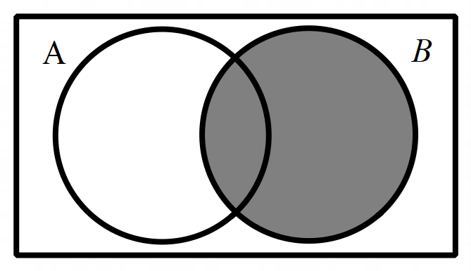
Example 2 – solution
Summarise
$$B$$

Slide 17
Example 3
Summarise
$$A∩B$$

Slide 18
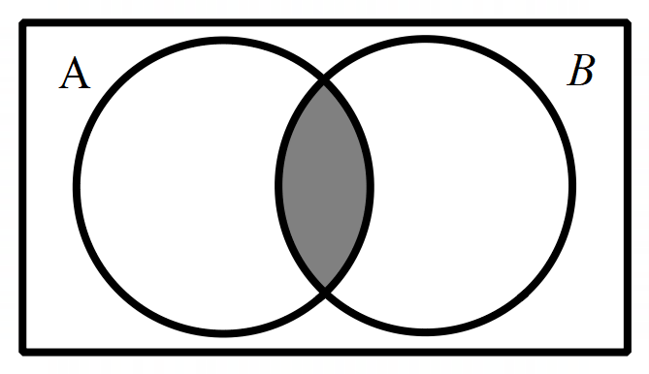
Example 3 – solution
Summarise
$$A∩B$$
​$A∩B$ means where both A and B occur

Slide 19
Example 4
Summarise
$$A∪B$$

Slide 20
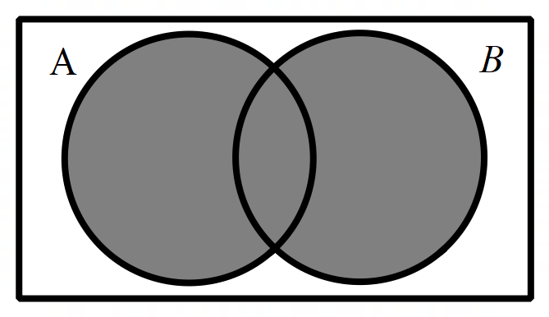
Example 4 – solution
Summarise
$$A∪B$$
​$A∪B$ means everywhere where A exists or B exists.

Slide 21
Example 5
Summarise
$$A′$$

Slide 22
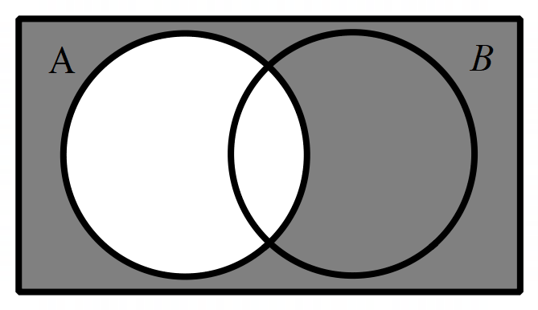
Example 5 – solution
Summarise
$$\overline{A}$$
$\overline{A}$ means not A
If A is inside the circle, then $\overline{A}$ is everywhere not inside the circle.

Slide 23
Example 6
Summarise
$$\overline{A}∩B$$

Slide 24
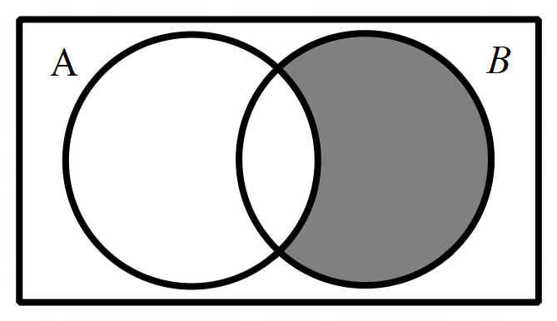
Example 6 – solution
Summarise
$$\overline{A}∩B$$
​$\overline{A}∩B$ means where not A intersects with B.
Not A is outside circle A and B is inside circle B.

Slide 25
Create your own
Create 2 of your own

Slide 26
Copyright
© State of New South Wales (Department of Education), 2024
The copyright material published in this resource is subject to the Copyright Act 1968 (Cth) and is owned by the NSW Department of Education or, where indicated, by a party other than the NSW Department of Education (third-party material).
Copyright material available in this resource and owned by the NSW Department of Education is licensed under a Creative Commons Attribution 4.0 International (CC BY 4.0) licence.
This licence allows you to share and adapt the material for any purpose, even commercially.
Attribution should be given to © State of New South Wales (Department of Education), 2024.
Material in this resource not available under a Creative Commons licence:
the NSW Department of Education logo, other logos and trademark-protected material
Material owned by a third party that has been reproduced with permission. You will need to obtain permission from the third party to reuse its material.
Links to third-party material and websites
Please note that the provided (reading/viewing material/list/links/texts) are a suggestion only and implies no endorsement, by the New South Wales Department of Education, of any author, publisher, or book title. School principals and teachers are best placed to assess the suitability of resources that would complement the curriculum and reflect the needs and interests of their students.
If you use the links provided in this document to access a third party’s website, you acknowledge that the terms of use, including licence terms set out on the third-party’s website apply to the use which may be made of the materials on that third-party website or where permitted by the Copyright Act 1968 (Cth). The department accepts no responsibility for content on third-party websites.

