Slide 1
Toadal eclipse
Explicit teaching

Slide 2
Launch

Slide 3
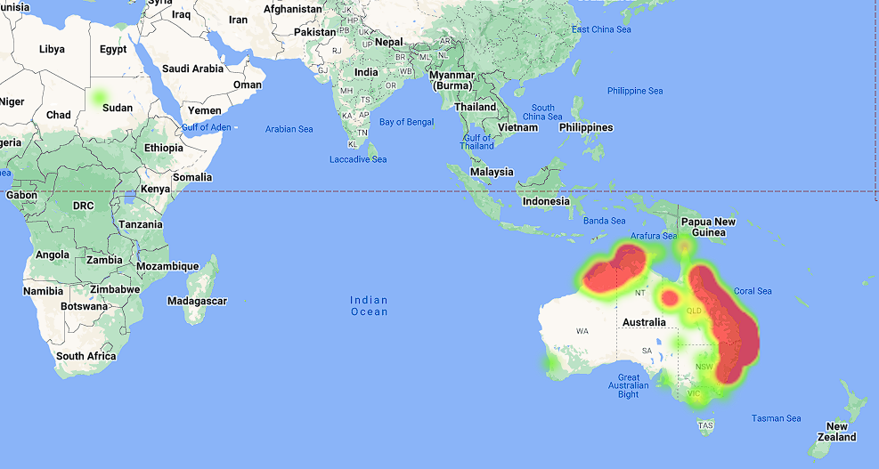
Slow reveal graph (1 of 3)
What do you notice and wonder?
Notes:
Image source: https://www.feralscan.org.au/toadscan/default.aspx
Students may notice that the heat map is only highlighted for Sudan and Australia, the heat density is much stronger in the North and East of Australia.
Students may wonder what the heat map represents. Students may have guesses to suggest.

Slide 4
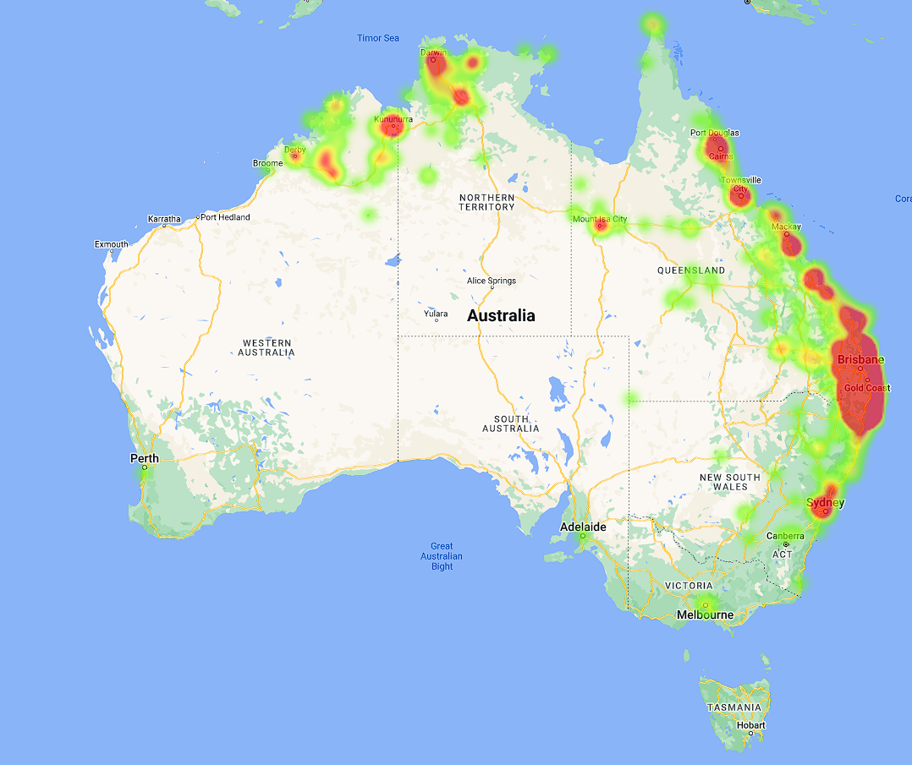
Slow reveal graph (2 of 3)
What do you notice and wonder?
Notes:
Image source: https://www.feralscan.org.au/toadscan/default.aspx

Slide 5
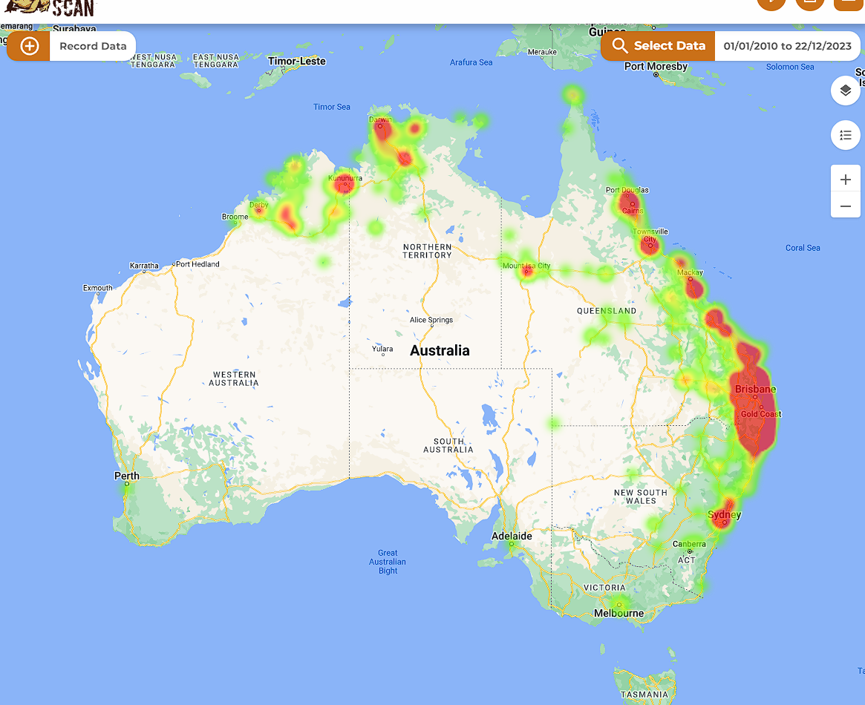
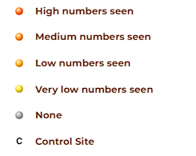
Slow reveal graph (3 of 3)
What do you notice and wonder?
Notes:
Image source: https://www.feralscan.org.au/toadscan/default.aspx

Slide 6
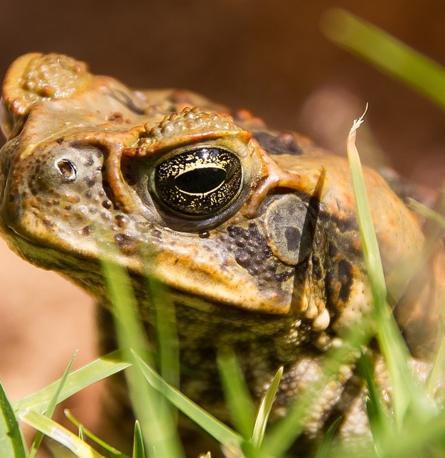
‘W-shredding’ gene drives could one day fight the cane toad
Publicly released: Wed 9 Oct 2019 at 1001 AEDT | 1201 NZDT
A new type of gene-editing technology, known as a 'w-shredder' gene drive, can make the females cane toads produce only sons.
Gene drives are a way of spreading a specific genetic alteration through a population rapidly.
Researchers are targeting sex chromosomes in pest animals as a way of either sterilising them, or ensuring they only produce only male offspring.
https://www.scimex.org/newsfeed/w-shredding-gene-drives-could-one-day-fight-the-cane-toad#:~:text=A%20new%20type%20of%20gene,moths%2C%20according%20to%20Australian%20research

Slide 7
Explore

Slide 8
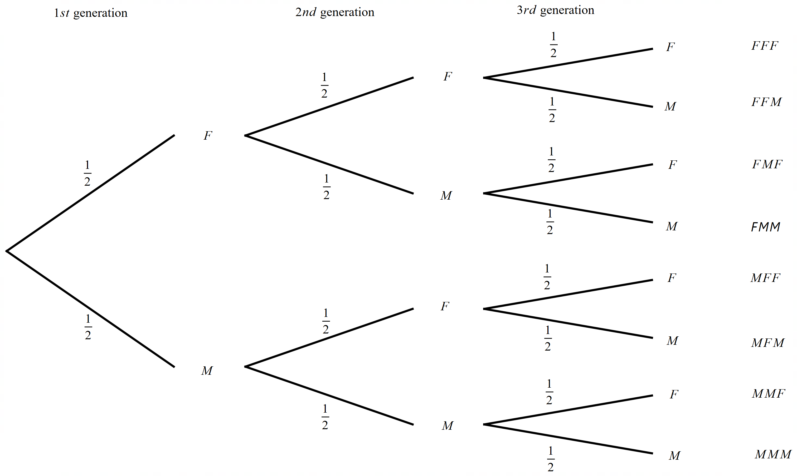
Tree diagrams (1 of 6)
Three generations

Slide 9
Summarise

Slide 10
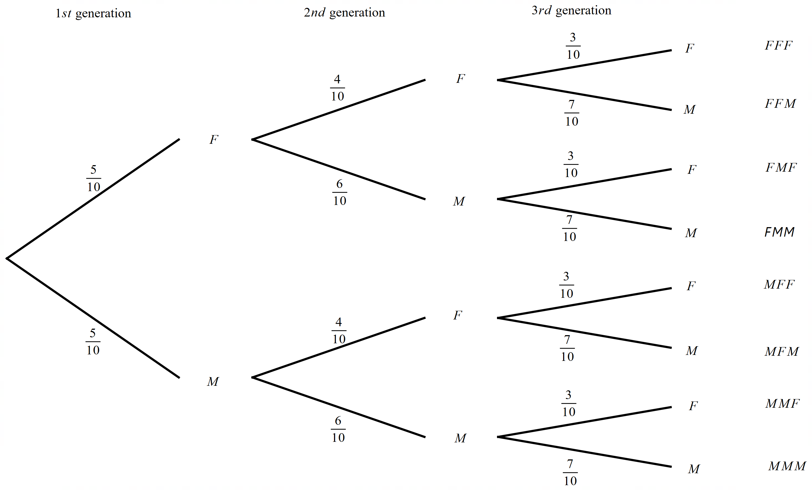
Tree diagrams (2 of 6)
Three generations affected by gene technology

Slide 11
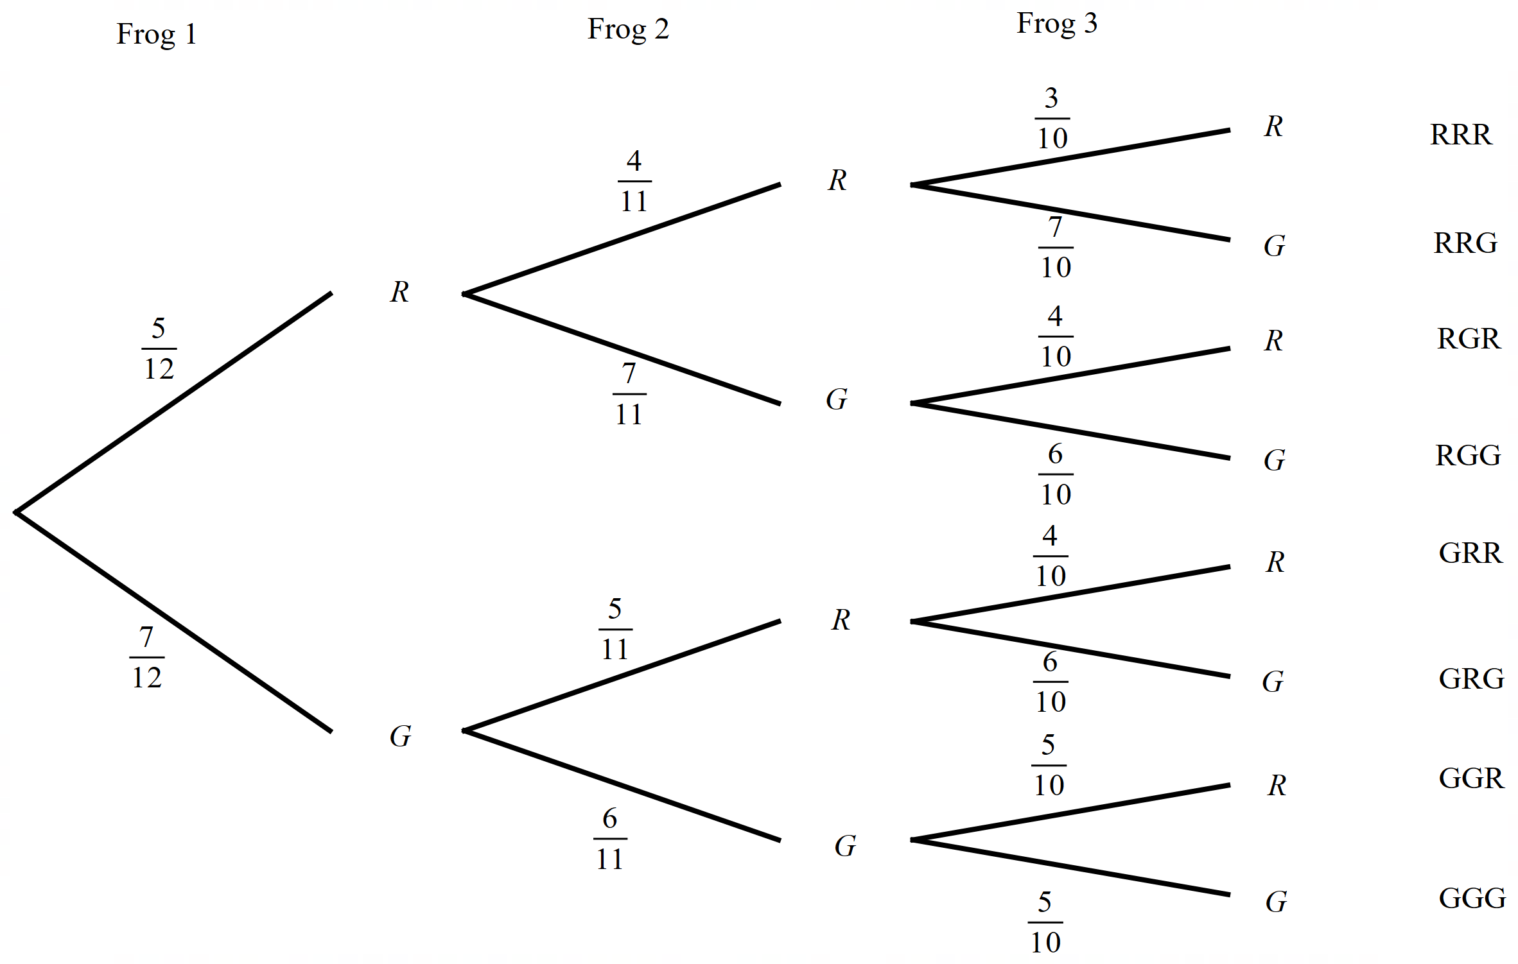
Tree diagrams (3 of 6)
Example 1
Red and green lolly frogs are sold in brown paper bags at the canteen. There are 5 red and 7 green frogs in your bag. You choose 3 frogs, one at a time from the bag.
Draw a tree diagram to represent this data.

Slide 12
Tree diagrams (4 of 6)
Example 1
Red and green lolly frogs are sold in brown paper bags at the canteen. There are 5 red and 7 green frogs in your bag. You choose 3 frogs, one at a time from the bag.
Draw a tree diagram to represent this data.
How many outcomes would you expect there to be if we considered a fourth choice of frog?
Which colour would you expect to see least often?

Slide 13
Tree diagrams (5 of 6)
Your turn 1
Caramel cube lollies and liquorish cube lollies are similar in shape but very different in taste. You have a bag with 4 caramel and 4 liquorish.
Draw a tree diagram to represent this data.

Slide 14
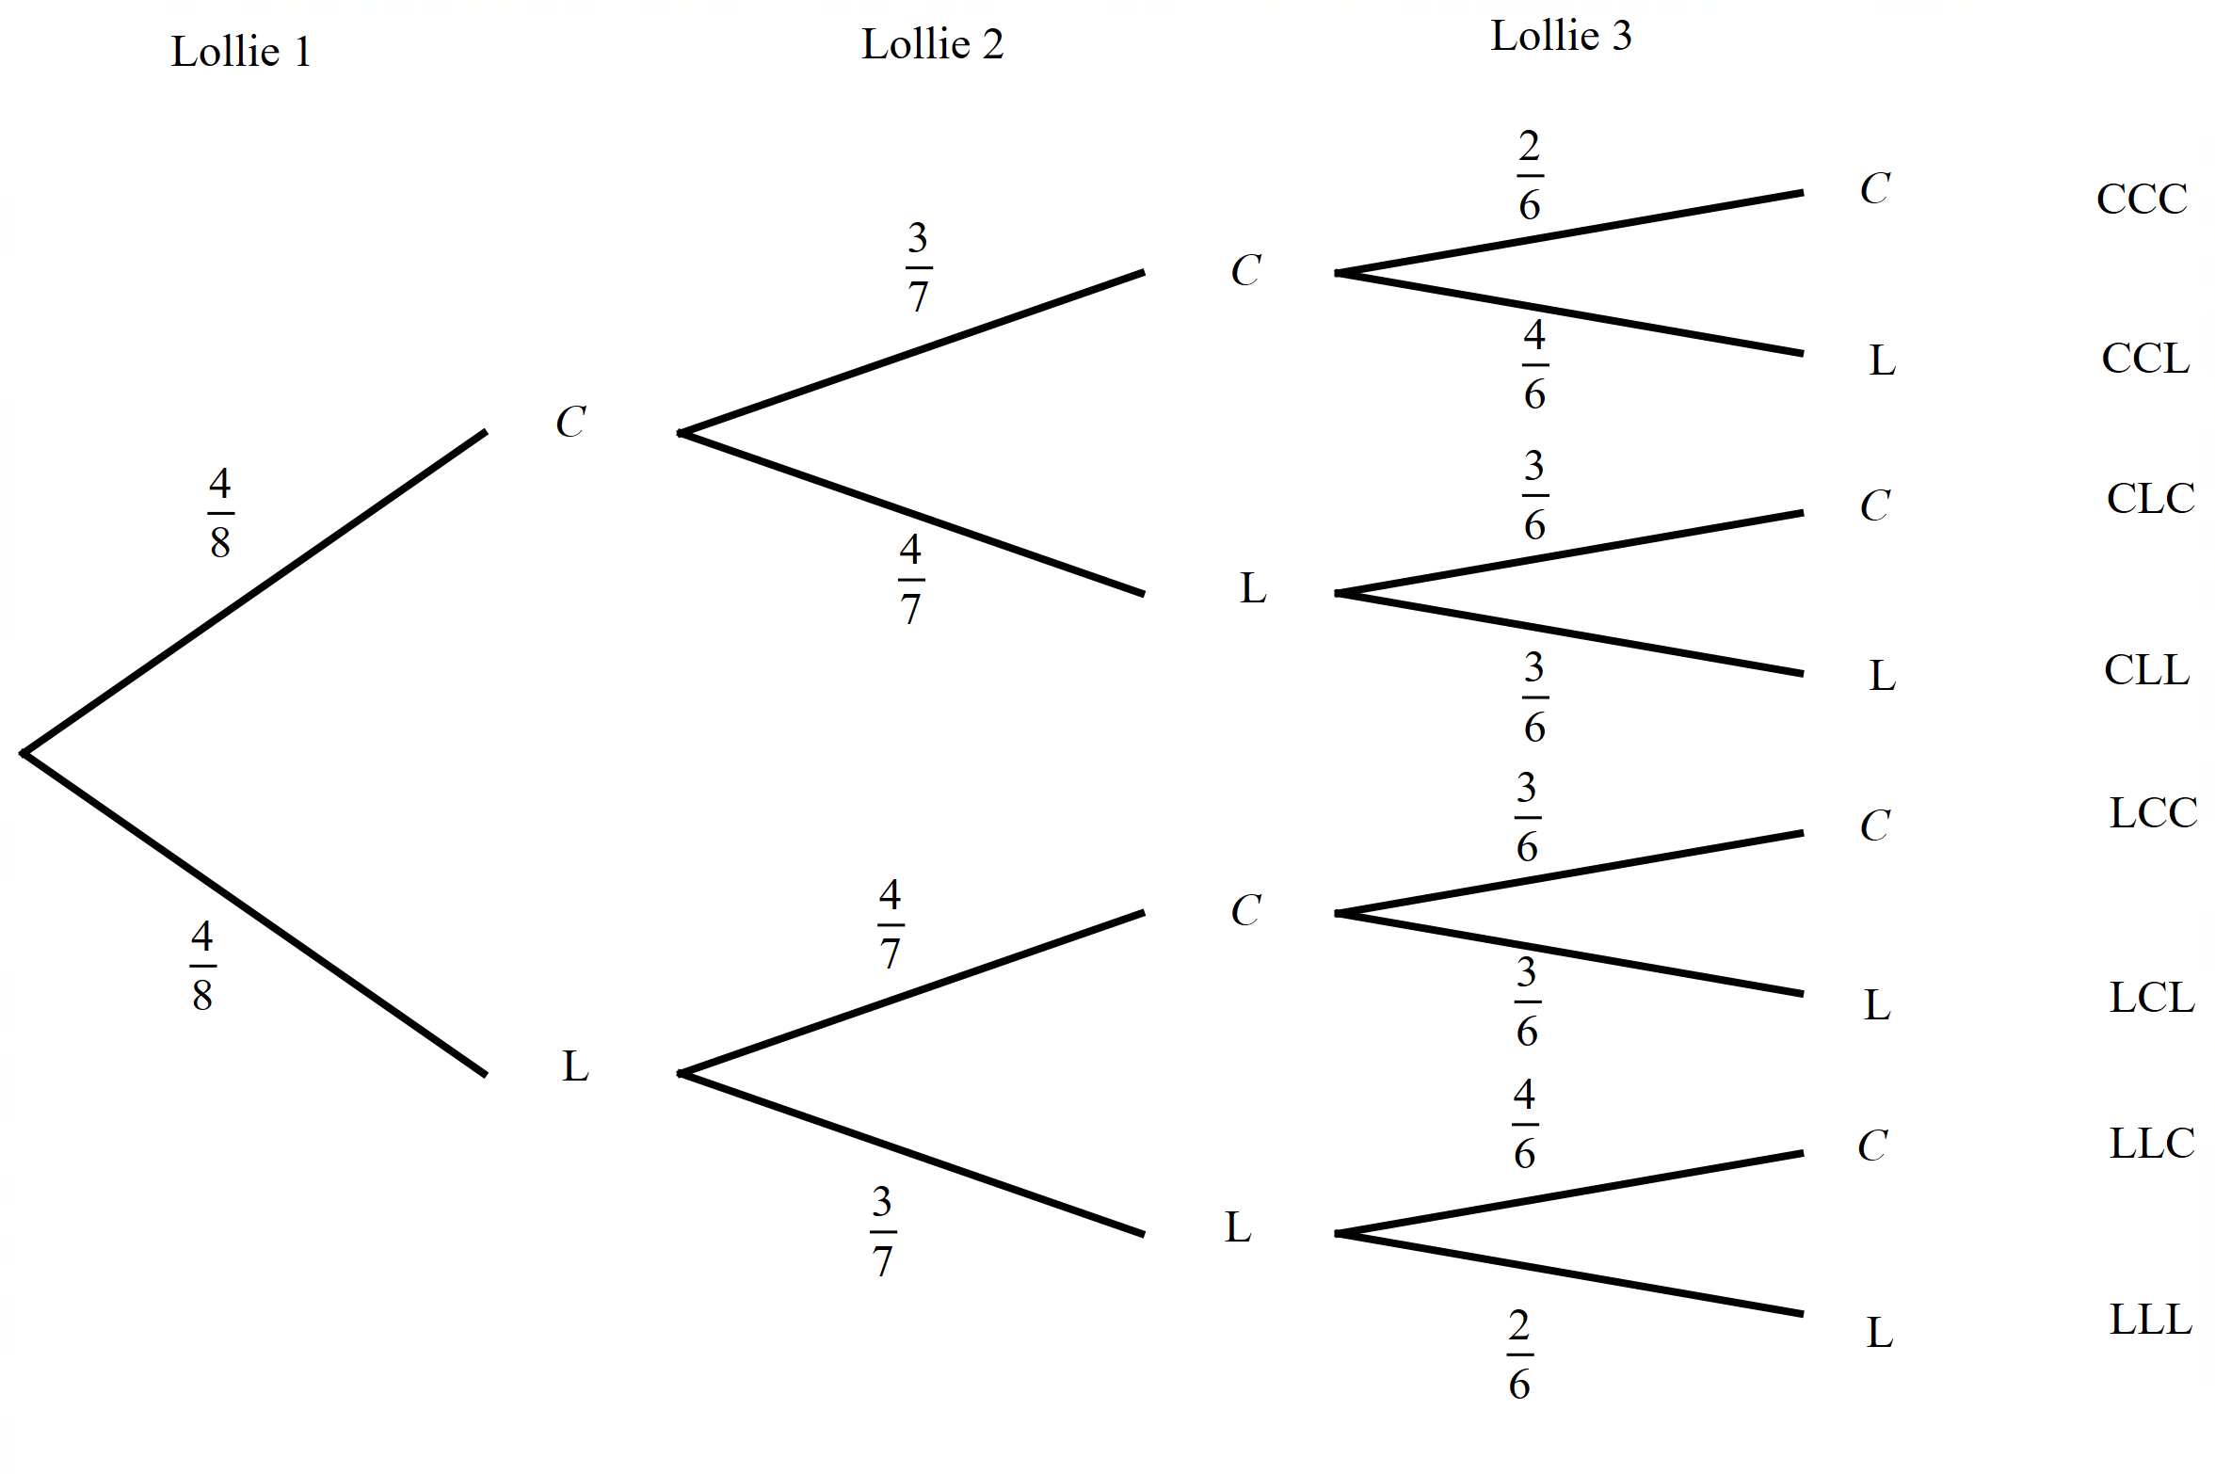
Tree diagrams (6 of 6)
Your turn 1 – solution
Caramel cube lollies and liquorish cube lollies are similar in shape but very different in taste. You have a bag with 4 caramel and 4 liquorish.
Draw a tree diagram to represent this data.

Slide 15
Copyright
© State of New South Wales (Department of Education), 2024
The copyright material published in this resource is subject to the Copyright Act 1968 (Cth) and is owned by the NSW Department of Education or, where indicated, by a party other than the NSW Department of Education (third-party material).
Copyright material available in this resource and owned by the NSW Department of Education is licensed under a Creative Commons Attribution 4.0 International (CC BY 4.0) licence.
This licence allows you to share and adapt the material for any purpose, even commercially.
Attribution should be given to © State of New South Wales (Department of Education), 2024.
Material in this resource not available under a Creative Commons licence:
the NSW Department of Education logo, other logos and trademark-protected material
Material owned by a third party that has been reproduced with permission. You will need to obtain permission from the third party to reuse its material.
Links to third-party material and websites
Please note that the provided (reading/viewing material/list/links/texts) are a suggestion only and implies no endorsement, by the New South Wales Department of Education, of any author, publisher, or book title. School principals and teachers are best placed to assess the suitability of resources that would complement the curriculum and reflect the needs and interests of their students.
If you use the links provided in this document to access a third party’s website, you acknowledge that the terms of use, including licence terms set out on the third-party’s website apply to the use which may be made of the materials on that third-party website or where permitted by the Copyright Act 1968 (Cth). The department accepts no responsibility for content on third-party websites.

