Slide 1
Explicit Phonics Instruction
S A T P – lesson 5

Slide 2
Our Learning Intention
We are learning the graphemes that represent phonemes to help us read and spell words.
Notes:
Looking at our Learning Intention…
Today we are learning to match graphemes to phonemes so that we can read and spell words.
Can you tell us what we are learning today?
[Student responds by repeating the statement]
Great. Today we are learning to match graphemes to phonemes. That means we are learning the ways to write the sounds we hear in words. This will help us with our reading and our writing.
The learning objective clarifies the purpose and reason for the lesson. It is important to share this with students so that they can self-regulate and take control of their own learning.

Slide 3
Our Success Criteria
I can use the graphemes that represent phonemes to help me to read and write words.
Notes:
Let’s look at our Success Criteria. I can write the graphemes that represent phonemes.
How we will know if we are successful?
[Student responds]
This is how we know. Firstly, I can write the graphemes that represent phonemes. This means we will be writing letters for the sounds we already know. Secondly, I can read and write at least 3 words. So by the end of the lesson, you should be able to read and write some new words. Isn’t that exciting!
Today the graphemes we learn will be single letters but sometimes they are two or three letters all together. Let’s get started!
Sharing the success criteria with students promotes their active engagement in the lesson and critical thinking in relation to the specific skills being taught.
This is also the opportunity to share the relevance of the lesson in relation to the big picture of their lives and as part of the learning sequence

Slide 4
Ready?
Notes:
Let’s start with some practise- when the grapheme comes up on screen, I want you to write it in the air with your finger and say the phoneme.
Ready? Here we go…
Go through the graphemes at a reasonable pace that ensures students have time to read and say the phoneme for each grapheme. Do not flick through too quickly. The aim is to ensure the students’ phoneme-grapheme correspondence is becoming automatic. If teachers flick through too quickly, the risk is that students may say the previous phoneme and lose any phoneme-grapheme correspondence.
When using a synthetic approach to teaching phonics, it is important that each grapheme is presented clearly and explicitly.

Slide 5
Notes:
[Students write the grapheme in the air and say the phoneme /t/]
You may feel the temptation to add images, pictures or borders. Remember to keep the board clear for the clear target of instruction.
The purpose of this section: There is a very strong connection between body movement, the symbol/grapheme and the sound/phoneme. This allows for stronger mapping and helps students cement their learning. This activity can also be used as a strategy in the future. When students are writing or reading, they can associate the grapheme and phoneme with the kinesthetic movement.

Slide 6
Notes:
[Students write the grapheme in the air and say the phoneme /æ/]
/æ/ is the way we represent the short ‘a’ sound as in the word cat. For more information on the pronunciation of phonemes see this resource: Pronunciation and articulation of the phonemes in Standard Australian English in the Reading Hub, or watch these videos – vowel phonemes: https://vimeo.com/340099655 and consonant phonemes: https://vimeo.com/340096859

Slide 7
Notes:
[Students write the grapheme in the air and say the phoneme /p/]

Slide 8
Notes:
[Students write the grapheme in the air and say the phoneme /æ/]
/æ/ is the way we represent the short ‘a’ sound as in the word cat. For more information on the pronunciation of phonemes see this resource: Pronunciation and articulation of the phonemes in Standard Australian English in the Reading Hub, or watch these videos – vowel phonemes: https://vimeo.com/340099655 and consonant phonemes: https://vimeo.com/340096859

Slide 9
Notes:
[Students write the grapheme in the air and say the phoneme /s/]

Slide 10
Notes:
[Students write the grapheme in the air and say the phoneme /p/]

Slide 11
Notes:
[Students write the grapheme in the air and say the phoneme /t/]

Slide 12
Notes:
[Students write the grapheme in the air and say the phoneme /s/]

Slide 13
Notes:
[Students write the grapheme in the air and say the phoneme /æ/]
/æ/ is the way we represent the short ‘a’ sound as in the word cat. For more information on the pronunciation of phonemes see this resource: Pronunciation and articulation of the phonemes in Standard Australian English in the Reading Hub, or watch these videos – vowel phonemes: https://vimeo.com/340099655 and consonant phonemes: https://vimeo.com/340096859

Slide 14
Notes:
Let’s practise some blending to read some words.
Say the phonemes represented by these letters as they move into the Elkonin boxes with me. Ready …. [click to start animation]
/s/ …….. /æ/…………/t/ s-a-t sat
Let’s try and make another word.
Variation: Have loose letters instead, such as magnetic letters, and have the teacher physically move them to make words.

Slide 15
Notes:
Have a go at this one by yourself. Ready?…. [click to start animation]
/t/ …….. /æ/…………/p/ t-a-p tap
Let’s try another one.
Variation: Have loose letters instead, such as magnetic letters, and have the teacher physically move them to make words.

Slide 16
Notes:
Have a go at this one by yourself. Ready?…. [click to start animation]
/s/ …….. /a/…………/p/ s-a-p sap
Let’s try another one.
Variation: Have loose letters instead, such as magnetic letters, and have the teacher physically move them to make words.

Slide 17
Ready?
Notes:
Now we’re going to see if we can remember to use those blending skills to read the words.
When the word comes on the screen. Say it slowly, then blend it altogether to say the word.
Ready? Here we go…
Go through at a reasonable pace that ensures students have time to say the word slowly first and then blend together if they need to. Do not flick through too quickly. The aim is to ensure the students’ phoneme-grapheme correspondence and blending is becoming automatic.

Slide 18
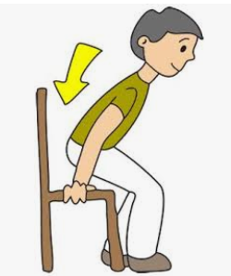
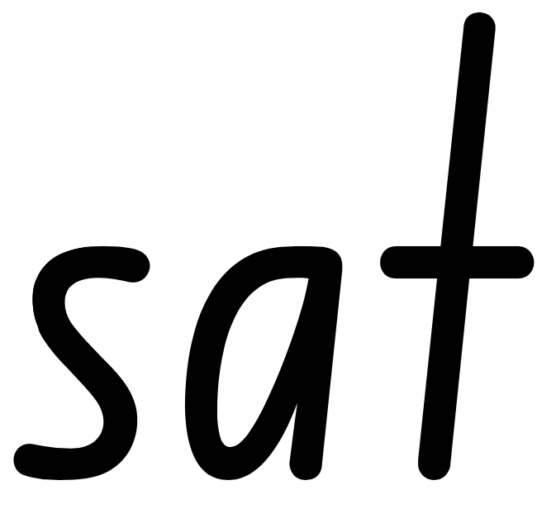
Notes:
/s/…./æ/ …../t/
Blend it together….s-a-t
The word is sat.
[click to show image]
The boy sat at his desk.

Slide 19
Notes:
Let’s try that again with this word.
/t/…./æ/…./p/
t-a-p
tap
[click to show image]
Will you please turn off the tap?

Slide 20
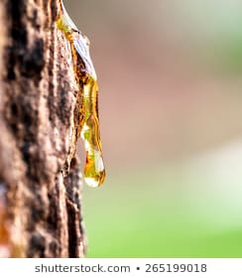
Notes:
Can you do this one yourself. Out loud, say the phonemes slowly and then blend through the word.
What word is it? Sap.
[click to show image]
Trees have sap inside them.

Slide 21
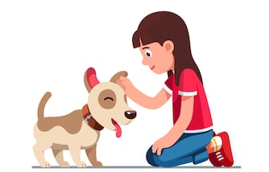
Notes:
Here is another word. Say the phonemes slowly out lod and then blend them together to read the word.
What word is it? Pat
[click to show image]
The dog likes a pat.

Slide 22
Writing words
1. Say
2. Segment
3. Write
4. Check
Notes:
Remember the 4 steps that we use when writing words.
First we say the word. [click to appear]
Then we segment the phonemes. [click to appear]
Then we write down the graphemes. [click to appear]
Lastly, we check to see if we spelt the word correctly. [click to appear]

Slide 23
Notes:
Let’s segment this word together.
/s/ /æ/ /t/
And we can blend them back together
s-a-t [blending modelled by teacher]
The word is...?
[Class replies ‘sat’]
Yes, the word is sat.
Students should be taught enough letters together to be able to blend immediately (synthesising). The letters covered in this example allow for blending a number of words (e.g. tap, sat, sap, pat). Some students may even begin to read four letter words (taps, pats).
The arrows underneath the words on the next few slides are to remind students that English is read from left to right. Some languages do not read from left to right, and knowing the background and literacy skills of your students will help you teach to their needs.

Slide 24
Notes:
Now we are going to write sat.
Say the word sat [students say the word sat]
Now segment it [students say /s/ /æ/ /t/ ]
Now see if you can remember the graphemes for each phoneme in sat /s/ /æ/ /t/ [allow enough time for students to write the word, encourage them to repeatedly say the phonemes if they need support]
[Students write the word sat]
Are you ready to check it?
Decoding and encoding need to be concurrently in order to strengthen connections.
We can introduce the image now, to help students make the link between a physical action they can see or do, and words, and the graphemes used to represent the smallest parts of the words we say. This also acts as a prompt so students can remember the word they are trying to write.

Slide 25
Notes:
The word was sat. Did you spell it correctly?
/s/ /æ/ /t/
sat
Providing a prompt question encourages students to review their word, and gives them opportunities to self-correct.
It is critical that the teacher provides immediate feedback to students at point of error, so students do not practise the incorrect spelling. However, this needs to be balanced with the ability of students to be able to check their own work and determine if they have any mistakes. One way to do this could be for students to check their work, then turn their whiteboard to face the teacher. The teacher gives appropriate feedback and corrects anyone who did not spell it correctly, e.g. “Great try, check yours again before showing me”.
Note: Be mindful of the images you select. In this lesson, sat could be mistaken for chair. Tap could be mistaken for drip. Pat could be mistaken for dog. If students are completing independent activities following this lesson, using the same images as those in the introductory part of the lesson alleviates the ambiguity of the words and pictures when practising independently.

Slide 26
Notes:
Great work! Let’s segment this word together:
/t/ /æ/ /p/
t-a-p [blending modelled by teacher]
The word is...?
[Class replies ‘tap’]
Yes, the word is tap.

Slide 27
Notes:
Now we are going to write tap. Remember, the four steps that we use when writing words: First we say the word, then we segment the phonemes, then we write down the graphemes that represent each phoneme, then we check to see if we got it right. Let’s practise now.
Say the word tap [students say the word tap]
Now segment it [students say /t/ /æ/ /p/ ]
Now see if you can remember the graphemes for each phoneme in tap /t/ /æ/ /p/ [allow enough time for students to write the word, encourage them to repeatedly say the phonemes if they need support]
[Students write the word tap]

Slide 28
Notes:
The word was tap. Did you spell it correctly?
/t/ /æ/ /p/
tap

Slide 29
Notes:
Great! Let’s try one last one. Let’s segment this word together:
/p/ /æ/ /t/
p-a-t [blending modelled by teacher]
The word is...?
[Class replies ‘pat’]
Yes, the word is pat.

Slide 30
Notes:
Now we are going to write pat. Remember the four steps that we use when writing words: First we say the word, then we segment the phonemes, then we write down the graphemes that represent each phoneme, then we check to see if we got it right. Let’s practise now.
Say the word pat [students say the word pat]
Now segment it [students say /p/ /æ/ /t/ ]
Now see if you can remember the graphemes for each phoneme in pat [allow enough time for students to write the word, encourage them to repeatedly say the phonemes if they need support]
[Students write the word pat]

Slide 31
Notes:
The word was pat. Did you spell it correctly?
/p/ /æ/ /t/
pat

Slide 32
Notes:
Look at the words at the bottom. Which word matches the picture? You might need to blend the phonemes to help you work out each word.
The picture shows a tap, so which word says tap?
When you think you know, point to it!
[Wait until all students are pointing]
Let’s see if you’re right…

Slide 33
Notes:
Great work!

Slide 34
Notes:
Look at the words at the bottom again. Which word matches the picture? Remember blending each word can help you work it out.
The picture shows sat, so which word says sat?
When you think you know, point to it!
[Wait until all students are pointing]
Let’s see if you’re right…

Slide 35
Notes:
Excellent you are pointing to sat

Slide 36
Notes:
Which word matches the picture?
The picture shows a pat, so which word says pat?
Point to it!
[Wait until all students are pointing]
Let’s see if you’re right…

Slide 37
Notes:
Fabulous – you read the word that says pat

Slide 38
Notes:
Which word matches the picture?
The picture shows some sap, so which word says sap?
Point to it!
[Wait until all students are pointing]
Let’s see if you’re right…

Slide 39
Notes:
Excellent

Slide 40
Our Learning Intention
We are learning the graphemes that represent phonemes to help us read and spell words.
Notes:
Let’s look back on our Learning Intention. Did we learn to match graphemes with the sounds, or phonemes that we know? Did we use that to help us to read and write words?

Slide 41
Our Success Criteria
I can use the graphemes that represent phonemes to help me to read and write words.
Notes:
What about our Success Criteria? We said that we would be successful today if we could use the graphemes that represent phonemes to read and write words. Were you able to do that?

