Slide 1
Writing about music in Stage 6
NSW Department of Education
Module 4 – Music 1 aural skills activities
Pxfuel (2023) earphones on a laptop [image], accessed 25/9/2023
Notes:
Image from: https://www.pxfuel.com/en
/free-photo-xzgqf

Slide 2
10 aural skills activities
NSW Department of Education
The following activities are designed to be used as single classroom revision activities and are not sequential.

Slide 3
Contents
Module 4 – Music 1 aural skills activities
Items | Slide number
Activity 1 – do you know your concepts? | 4
Activity 2 – concept collaboration | 5
Activity 3 – celebrity heads | 6
Activity 4 – which song is that? | 7
Activity 5 – general analysis | 8
Activity 6 – concept stations | 9
Activity 7 – reorder it! | 10
Activity 8 – three excerpts | 11
Activity 9 – concept style cards | 12
Activity 10 – concept contest | 13
Further ideas to revise the concepts | 14

Slide 4
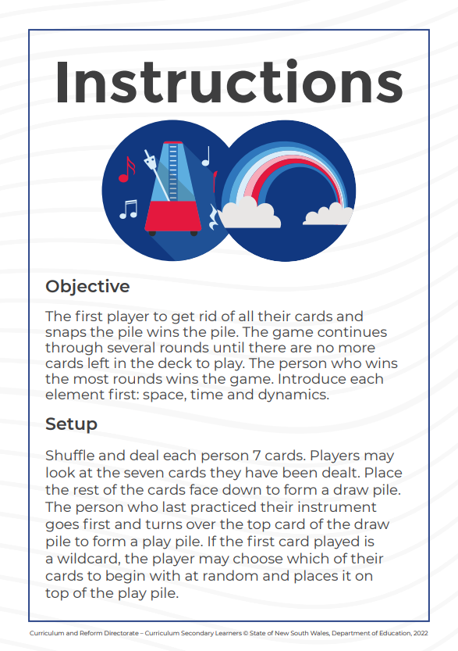
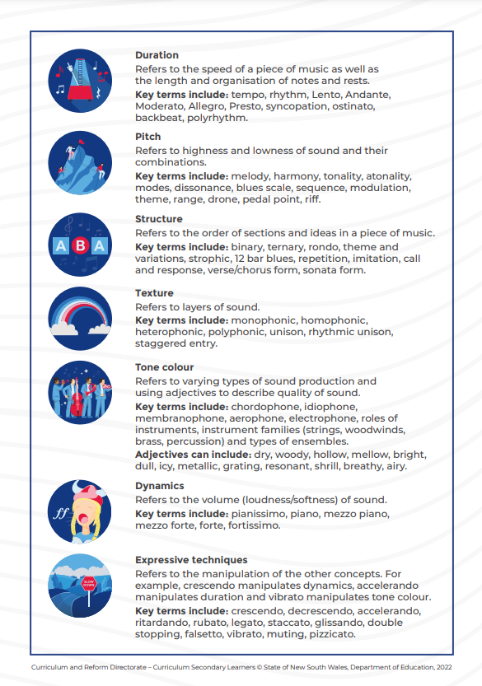
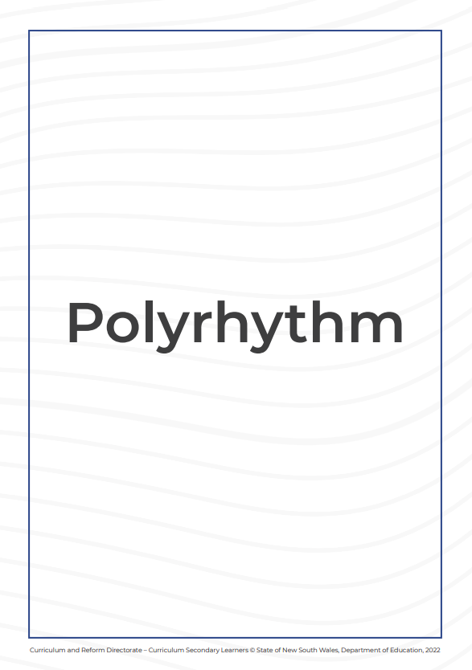
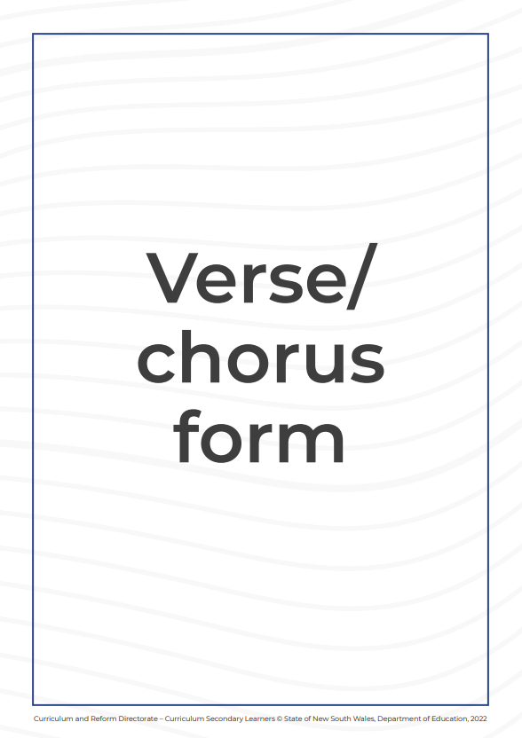
Activity 1 – do you know your concepts?
Teachers are to download a copy of the NSW DoE ‘Concepts of Music' card game from the Writing about music in Stage 6 – Music 1 aural skills webpage for students to complete the following activities.
Activity A Play the ‘concepts of music’ card game in small groups.
Activity B As a class, students take turns selecting a card and grouping the cards in piles according to which concept of music the card belongs to.

Slide 5
Activity 2 – concept collaboration
Form small teams of 3–6 people.
One person from each team goes to the front of the class and plays ‘scissors, paper, rock’ with another team member. The winner of each pair gets to select which concept of music their group would like.
Teams are given 3 minutes to brainstorm the components contained within the musical concept allocated and document their ideas on a sheet of paper.
Each team swaps their concept sheet with another team that has a different concept to their team.
Repeat the exercise by adding further information and swapping concept sheets once more. (Each team will contribute to 3 sheets in total.)
Take a photo of the final completed sheet and upload the image to a shared digital platform.
Note – this activity can also be done on the board.

Slide 6
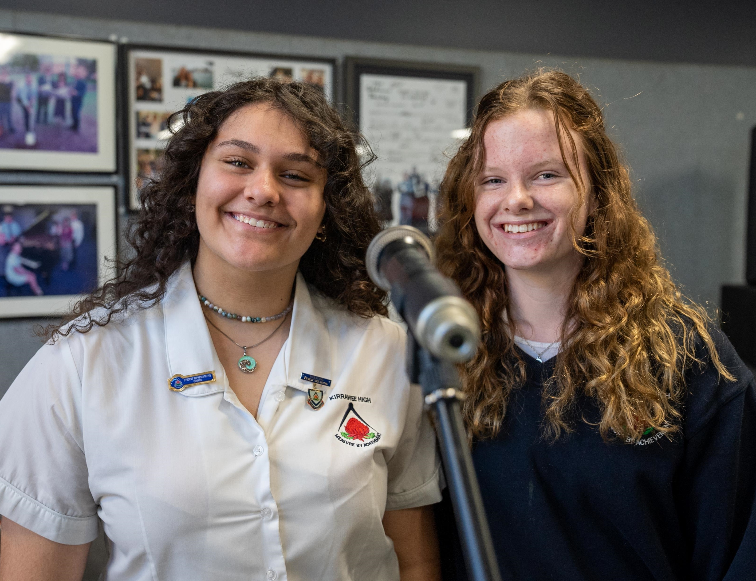
Activity 3 – celebrity heads
Three students are seated in a row in front of the whiteboard.
The teacher writes a musical feature found within a concept of music above their head, for example: ‘syncopation’. Each student is allocated a different musical feature.
The 3 participating students take turns in asking the class ‘yes’ or ‘no’ questions to identify the musical feature.
The first student to correctly guess their musical feature wins the game.

Slide 7
Activity 4 – which song is that?
Students are given an envelope of musical observations belonging to 2 different excerpts.
Students listen to each excerpt and identify which musical observation belongs to which song.

Slide 8
Activity 5 – general analysis
The aim of this activity is to analyse an excerpt to find out what musical features you can already describe, and which concept(s) need more revision in a general listening.
Draw a table with the concepts of music as headings and copy in your musical observations.
Listen to an excerpt and write down any musical observations that you can hear.
Answer the following questions:
Which concept(s) had the most points?
Which concept(s) had the least points?
Which concept do you need to revise more?
List the concepts of music and provide a brief explanation of each.
Next to each musical observation, note which concept(s) you refer to.
Share with the class and discover if there are any similarities or differences between your peers.

Slide 9
Activity 6 – concept stations
The teacher sets up 6 ‘concept of music’ stations around the classroom. Each station contains a piece of paper with the concept heading written on it.
Students are split evenly between the 6 stations.
Students are given one playing of a musical excerpt and write down their musical observations according to the given concept.
Students rotate and repeat the exercise until they have visited all 6 concept stations.
The teacher collates the answers as a class and uploads them to a shared digital platform.
Students use this information to create their own final written response to the question.

Slide 10
Activity 7 – reorder it!
Click on ‘Activity 7 – reorder it sample’ to download an example of this activity.
In pairs, students are given an envelope which contains a sample aural response cut up into sentences.
Students are to listen to the excerpt and reorder the sentences to form the correct chronological answer.
1
2

Slide 11
Activity 8 – three excerpts
Individually prepare 3 blank pages without a heading or number.
Listen to 3 excerpts that are similar in quality for example, tone colour. This could include 3 excerpts that are acapella.
Analyse each excerpt according to the concepts of music, in as much detail as possible on the 3 blank pages you have prepared.
Exchange your responses with another student in the class, where the aim is to identify which analysis corresponds to which excerpt.
The aim is to make your analysis detailed, to be identified by its specific musical features.
This activity can be adjusted to any concept of music, using excerpts that share the same musical qualities. For example, 3 excerpts or full pieces with a polyphonic texture (texture); or complex rhythms (duration).

Slide 12
Activity 9 – concept style cards
1.
Stylistic features
2.
Concept categories
3.
Whole class discussion
4.
Small group activity
5.
Document
6.
Independent work
7.
Peer marking
In pairs, students listen to 3 pieces in various styles of a genre. For example, the styles of blues, swing and bebop, within the genre of jazz. Students list the stylistic features of each excerpt on separate flashcards.
The flashcards are scattered across the floor and students classify the stylistic features under the concepts of music headings on the board.
As a class, students discuss and justify which flashcards should remain as general stylistic features of the genre under each concept. Statements that are specific to the style are collated and discussed.
Students listen to a new excerpt of the genre and identify if the general stylistic features are consistent with the new excerpt.
Students note the general stylistic features of the genre in their workbook.
Students apply their knowledge of the general stylistic features to a new listening excerpt and provide examples to support the response.
Students review and refine their responses through teacher facilitated small group discussions

Slide 13
Activity 10 – concept contest
1. Students are given sticky notes. The teacher writes an aural skills question on the board.
2. Play the excerpt. Once the excerpt begins, students write one musical observation on their sticky note and move quickly to place their sticky note on the board.
The first to the board with a correct observation wins a point. If another person makes the same observation, they must return to their seat and write a new observation.
3. Repeat for as many playings as necessary. The winner is the student with the most points at the end of the playings.

Slide 14
Further ideas to revise the concepts
Individually
Starter sentences: ‘In section (section name) the (performing media) is playing (description of the concepts of music).’
Cloze passages – fill in the blanks of a pre-prepared aural response.
While practising your instrument, stop yourself and ask – What is the structure? What are the duration elements within this piece? What are the dynamics like? How does this piece create contrast?
‘Rainbow editing’ – what, where, who, why? (refer to module 2, slide 33)
Create a list of musical features under each of the concepts and highlight the terms that need further clarification. For these terms, locate a musical example, as well as a definition.
Create a digital glossary of musical features under concepts headings. For each, define and locate a musical example to attach to the document.
Collaboratively
During a practical lesson, stop to consider, ‘What is the duration/texture/pitch material used in this section?’ Annotate the responses on the board or in a shared document.
Peer marking – mark others’ work and provide feedback using the aural skills marking criteria.
Work in small groups to identify musical observations – this could be noted on individual whiteboards.
Identify and mark any compositional devices you can find on a score and then categorise each observation according to the concepts of music.

Slide 15
References
This presentation contains NSW Curriculum and syllabus content. The NSW Curriculum is developed by the NSW Education Standards Authority. This content is prepared by NESA for and on behalf of the Crown in the right of the State of New South Wales. The material is protected by Crown copyright.
Please refer to the NESA Copyright Disclaimer for more information https://educationstandards.nsw.edu.au/wps/portal/nesa/mini-footer/copyright.
NESA holds the only official and up-to-date versions of the NSW Curriculum and syllabus documents. Please visit the NSW Education Standards Authority (NESA) website https://educationstandards.nsw.edu.au/wps/portal/nesa/home and the NSW Curriculum website https://curriculum.nsw.edu.au.
Creative arts 11–12 © Syllabus NSW Education Standards Authority (NESA) for and on behalf of the Crown in right of the State of New South Wales, 2024.

Slide 16
Copyright
© State of New South Wales (Department of Education), 2023
The copyright material published in this resource is subject to the Copyright Act 1968 (Cth) and is owned by the NSW Department of Education or, where indicated, by a party other than the NSW Department of Education (third-party material).
Copyright material available in this resource and owned by the NSW Department of Education is licensed under a Creative Commons Attribution 4.0 International (CC BY 4.0) licence.
This licence allows you to share and adapt the material for any purpose, even commercially.
Attribution should be given to © State of New South Wales (Department of Education), 2024.
Material in this resource not available under a Creative Commons licence:
the NSW Department of Education logo, other logos and trademark-protected material
Material owned by a third party that has been reproduced with permission. You will need to obtain permission from the third party to reuse its material.
Links to third-party material and websites
Please note that the provided (reading/viewing material/list/links/texts) are a suggestion only and implies no endorsement, by the New South Wales Department of Education, of any author, publisher, or book title. School principals and teachers are best placed to assess the suitability of resources that would complement the curriculum and reflect the needs and interests of their students.
If you use the links provided in this document to access a third party’s website, you acknowledge that the terms of use, including licence terms set out on the third-party’s website apply to the use which may be made of the materials on that third-party website or where permitted by the Copyright Act 1968 (Cth). The department accepts no responsibility for content on third-party websites.

