Slide 1
The periodic table
Supporting document
NSW Department of Education
‘Periodic Table Large’ by 2012rc is licensed under CC BY 3.0.

Slide 2
Quick writes
Notes:
There are many ways that this resource can be used, including:
The teacher sharing a copy of the resource with all students so that students can view the prompts and then record their individual responses.
The teacher can project the stimulus prompt(s) for students to view and then record their response(s) in their workbook.
This activity is designed to encourage students to develop their writing skills. Encourage students to write as much information as they can in a short time. Dot points are acceptable for this activity. It can be differentiated to accommodate a range of representations to suit your class requirements.

Slide 3
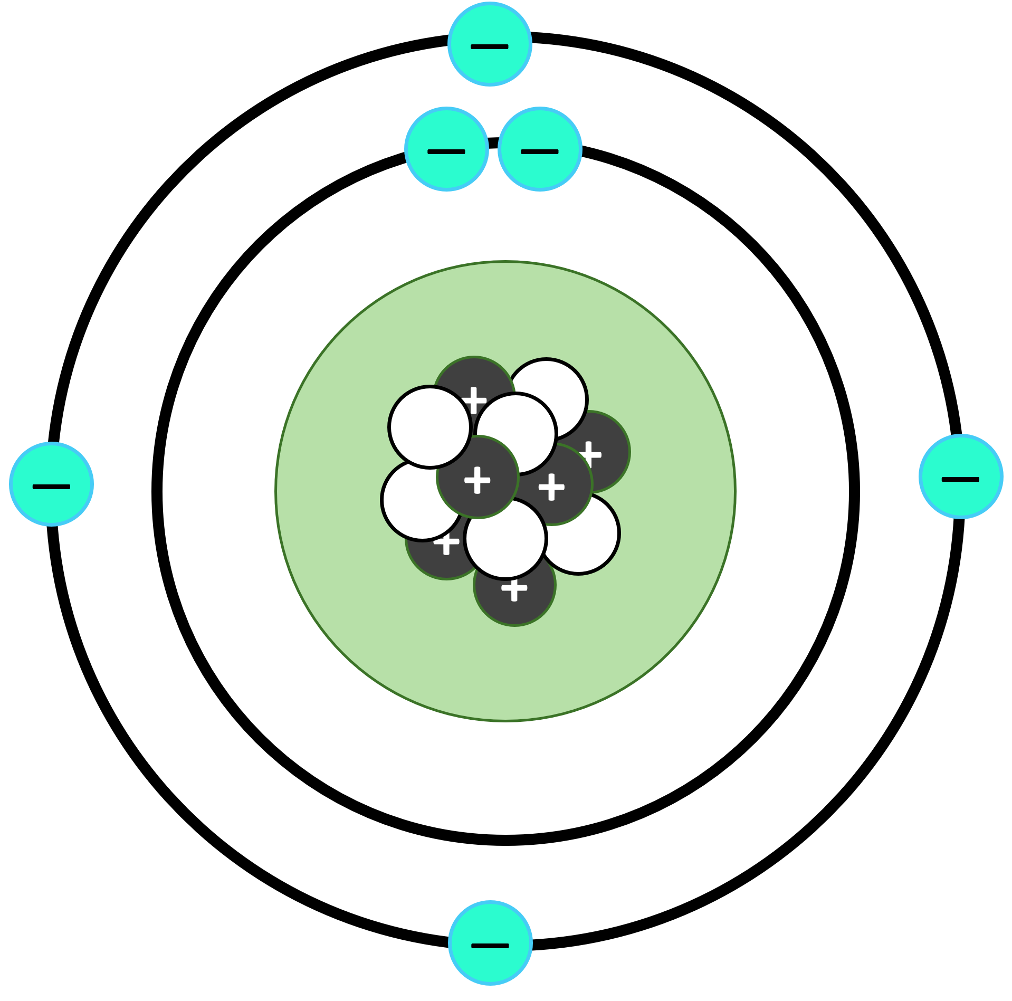
Image prompt
Describe this atom in as much detail as you can.
Notes:
This is an example of an image prompt.

Slide 4
Title
Writing time – 5 minutes
Create your response…
Notes:
The 5-minute timer will start automatically after 10 seconds.

Slide 5
The Periodic Table – classification of elements
Notes:
This can be facilitated using The periodic table - classification of elements [8:56 minutes].
Create a key for the annotations on the periodic table. This can be done individually or as a class.

Slide 6
Double Venn diagram
Modern periodic table
Baumhauer’s Spiral
Elements are organised in rows and columns.
All the elements in a group have similar properties.
Metals are mostly on the left.
Non-metals are mostly on the right.
All the elements in one period have the same number of electron shells.
The elements are organised in a spiral.
The smallest element, H, is at the centre of the spiral.
Elements with similar properties form the ‘spokes’ of the spiral wheel.
Elements with similar properties are ‘grouped’ together.
As the radius gets bigger, it gets further from H on the periodic table.

Slide 7
References
This presentation contains NSW Curriculum and syllabus content. The NSW Curriculum is developed by the NSW Education Standards Authority. This content is prepared by NESA for and on behalf of the Crown in the right of the State of New South Wales. The material is protected by Crown copyright.
Please refer to the NESA Copyright Disclaimer for more information https://educationstandards.nsw.edu.au/wps/portal/nesa/mini-footer/copyright.
NESA holds the only official and up-to-date versions of the NSW Curriculum and syllabus documents. Please visit the NSW Education Standards Authority (NESA) website https://educationstandards.nsw.edu.au/wps/portal/nesa/home and the NSW Curriculum website https://curriculum.nsw.edu.au.
2012rc (2020) Periodic table large [photograph], File: Periodic table large.svg, Wikimedia Commons website, accessed 24 May 2023.
SR KellyOP (8 Sep 2021) Carbon atom (Bohr model).png [photograph], File:Carbon atom (Bohr model).png, Wikimedia Commons website, accessed 24 May 2023.

Slide 8
Copyright
© State of New South Wales (Department of Education), 2023
The copyright material published in this resource is subject to the Copyright Act 1968 (Cth) and is owned by the NSW Department of Education or, where indicated, by a party other than the NSW Department of Education (third-party material).
Copyright material available in this resource and owned by the NSW Department of Education is licensed under a Creative Commons Attribution 4.0 International (CC BY 4.0) licence.
This licence allows you to share and adapt the material for any purpose, even commercially.
Attribution should be given to © State of New South Wales (Department of Education), 2023.
Material in this resource not available under a Creative Commons licence:
the NSW Department of Education logo, other logos and trademark-protected material
Material owned by a third party that has been reproduced with permission. You will need to obtain permission from the third party to reuse its material.
Links to third-party material and websites
Please note that the provided (reading/viewing material/list/links/texts) are a suggestion only and implies no endorsement, by the New South Wales Department of Education, of any author, publisher, or book title. School principals and teachers are best placed to assess the suitability of resources that would complement the curriculum and reflect the needs and interests of their students.
If you use the links provided in this document to access a third party’s website, you acknowledge that the terms of use, including licence terms set out on the third-party’s website apply to the use which may be made of the materials on that third-party website or where permitted by the Copyright Act 1968 (Cth). The department accepts no responsibility for content on third-party websites.

