Slide 1
Graphing general mayhem
Explicit teaching

Slide 2
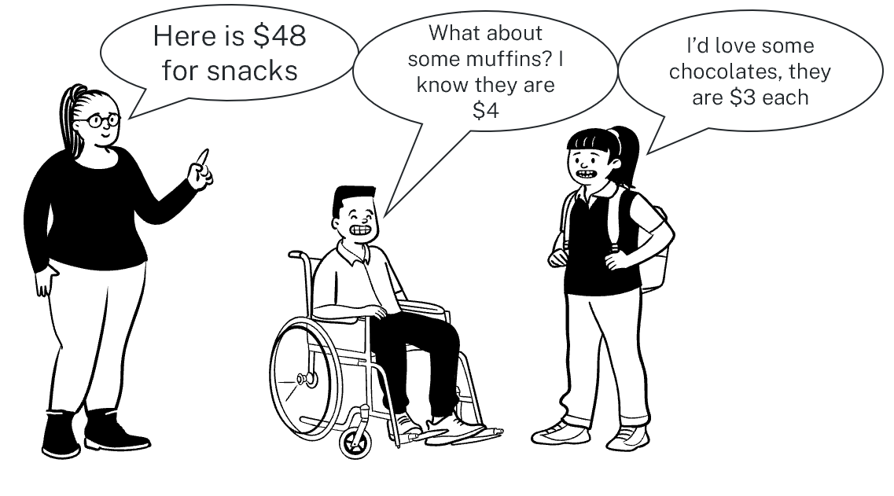
Launch
Representing real-life scenarios
What combinations of muffins and chocolates could Kai and Kaitlin buy?

Slide 3
Always, sometimes, never
Linear relationships review
Equations of linear relationships represent a graph of a straight line.
Variables of linear relationships can have exponents of any value.
Equations with a variable in the denominator of a fraction represent a straight line.

Slide 4
Frayer diagram
General form
Definition (in own words) | Characteristics
Examples $$x+y−2=0$$ $$4x−2y−15=0$$ $$5x+2y−17=0$$ | Non-examples $$y=15x+2$$ $$4x−2y=15$$ $\frac{1}{2}x−4y+2=0$ $$2x+\frac{7}{2}y−5=0$$ $$−x+y+2=0$$ $$4y−3x+7=0$$
General form of a line

Slide 5
Rearranging to general form (1)
Example 1
Rearrange $y=\frac{6}{5}x+4$ to general form.
Method 1:
$$5y=6x+20$$
$$0=6x−5y+20$$
$$\text{Method}\text{ 2:}$$
$$0=\frac{6}{5}x−y+4$$
$$0=6x−5y+20$$

Slide 6
Rearranging to general form (2)
Example 1
Rearrange $y=\frac{6}{5}x+4$ to general form.
Method 1:
$$5y=6x+20$$
$$0=6x−5y+20$$
$$\text{Method}\text{ 2:}$$
$$0=\frac{6}{5}x−y+4$$
$$0=6x−5y+20$$
Why do both of these methods work?

Slide 7
Rearranging to general form (3)
Your turn – question 1
Rearrange the following equation to general form.
$$y=\frac{4}{3}x−4$$

Slide 8
Rearranging to general form (4)
Your turn – solution 1
Rearrange the following equation to general form.
$$y=\frac{4}{3}x−4$$
Method 1:
$$3y=4x−12$$
$$0=4x−3y−12$$
$$\text{Method}\text{ 2:}$$
$$0=\frac{4}{3}x−y−4$$
$$0=4x−3y−12$$

Slide 9
Rearranging to general form (5)
Incorrect example
Sham has incorrectly rearranged this equation into general form.
$$y=−\frac{7}{4}x+2$$
$$4y=−7x+2$$
$$7x+4y−2=0$$
What advice would you give Sham to avoid this mistake again?

Slide 10
Rearranging from general form (1)
Example 2
Rearrange the equation $3x+4y+2=0$ into gradient-intercept form. What is the gradient? What is the y-intercept?
$3x+4y+2=$0
$$4y=−3x−2$$
$$y=−\frac{3}{4}x−\frac{2}{4}$$
$$y=−\frac{3}{4}x−\frac{1}{2}$$
Gradient = $−\frac{3}{4}$
y-intercept = $−\frac{1}{2}$

Slide 11
Rearranging from general form (2)
Example 2
Rearrange the equation $3x+4y+2=0$ into gradient-intercept form. What is the gradient? What is the y-intercept?
$3x+4y+2=$0
$$4y=−3x−2$$
$$y=−\frac{3}{4}x−\frac{2}{4}$$
$$y=−\frac{3}{4}x−\frac{1}{2}$$
Gradient = $−\frac{3}{4}$
y-intercept = $−\frac{1}{2}$
Why are both these terms negative?
When is this form preferred?

Slide 12
Rearranging from general form (3)
Your turn – question 2
Rearrange the equation 9𝑥−2𝑦+4=0 into gradient-intercept form. What is the gradient? What is the y-intercept?

Slide 13
Rearranging from general form (4)
Your turn – solution 2
Rearrange the equation $9x−2y+4=0$ into gradient-intercept form. What is the gradient? What is the y-intercept?
$$9x−2y+4=0$$
$$9x+4=2y$$
$$y=\frac{9}{2}x+\frac{4}{2}$$
$$y=\frac{9}{2}x+2$$
Gradient = $\frac{9}{2}$
y-intercept = $2$

Slide 14
Copyright
© State of New South Wales (Department of Education), 2023
The copyright material published in this resource is subject to the Copyright Act 1968 (Cth) and is owned by the NSW Department of Education or, where indicated, by a party other than the NSW Department of Education (third-party material).
Copyright material available in this resource and owned by the NSW Department of Education is licensed under a Creative Commons Attribution 4.0 International (CC BY 4.0) licence.
This licence allows you to share and adapt the material for any purpose, even commercially.
Attribution should be given to © State of New South Wales (Department of Education), 2023.
Material in this resource not available under a Creative Commons licence:
the NSW Department of Education logo, other logos and trademark-protected material
Material owned by a third party that has been reproduced with permission. You will need to obtain permission from the third party to reuse its material.
Links to third-party material and websites
Please note that the provided (reading/viewing material/list/links/texts) are a suggestion only and implies no endorsement, by the New South Wales Department of Education, of any author, publisher, or book title. School principals and teachers are best placed to assess the suitability of resources that would complement the curriculum and reflect the needs and interests of their students.
If you use the links provided in this document to access a third party’s website, you acknowledge that the terms of use, including licence terms set out on the third-party’s website apply to the use which may be made of the materials on that third-party website or where permitted by the Copyright Act 1968 (Cth). The department accepts no responsibility for content on third-party websites.

