Slide 1
Line it up
Explicit teaching

Slide 2
Line it up (2)
The café wall
This image has been rotated and cropped, the original is by Fibonacci.
‘Café wall illusion’ by Fibonacci is licensed under CC BY-SA 3.0.

Slide 3
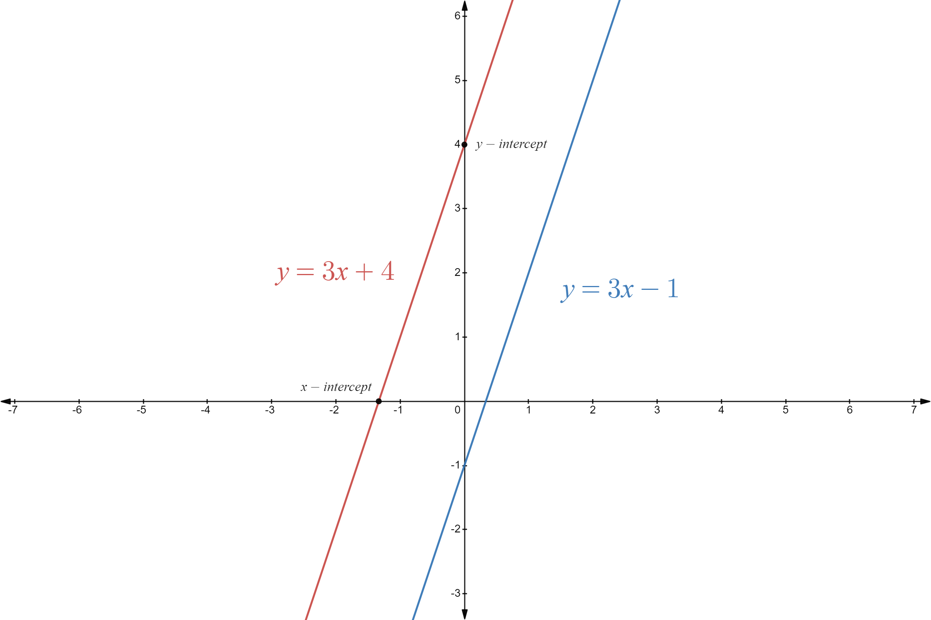
Line it up (3)
First example
Establish a line that is parallel to the linear relationship $y=3x+4$.

Slide 4
Line it up (4)
First prompts
Establish a line that is parallel to the linear relationship $y=3x+4$.
What aspects of this equation are the same as $y=3x+4$?
What is different?

Slide 5
Line it up (5)
First your turn
Establish a linear equation to create a line that is parallel to $y=−5x+1$.

Slide 6
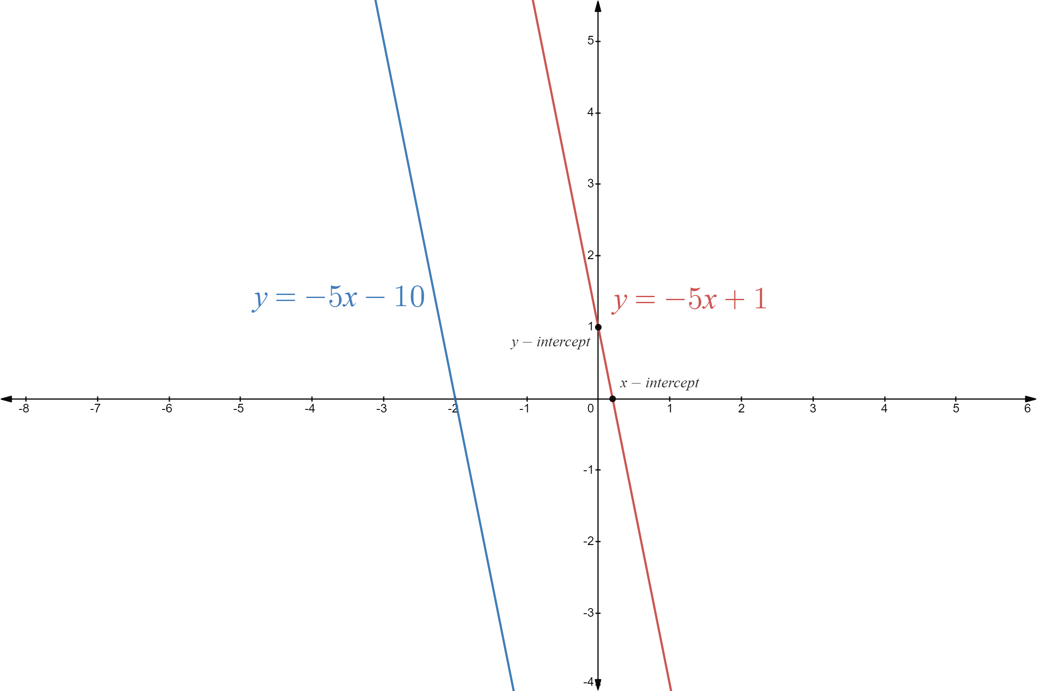
Line it up (6)
First solutions
Establish a linear equation to create a line that is parallel to $y=−5x+1$.
Why might knowing where the intercepts occur be helpful?
This is only one solution – what is the component that will be in all lines parallel to $y=−5x+1$?

Slide 7
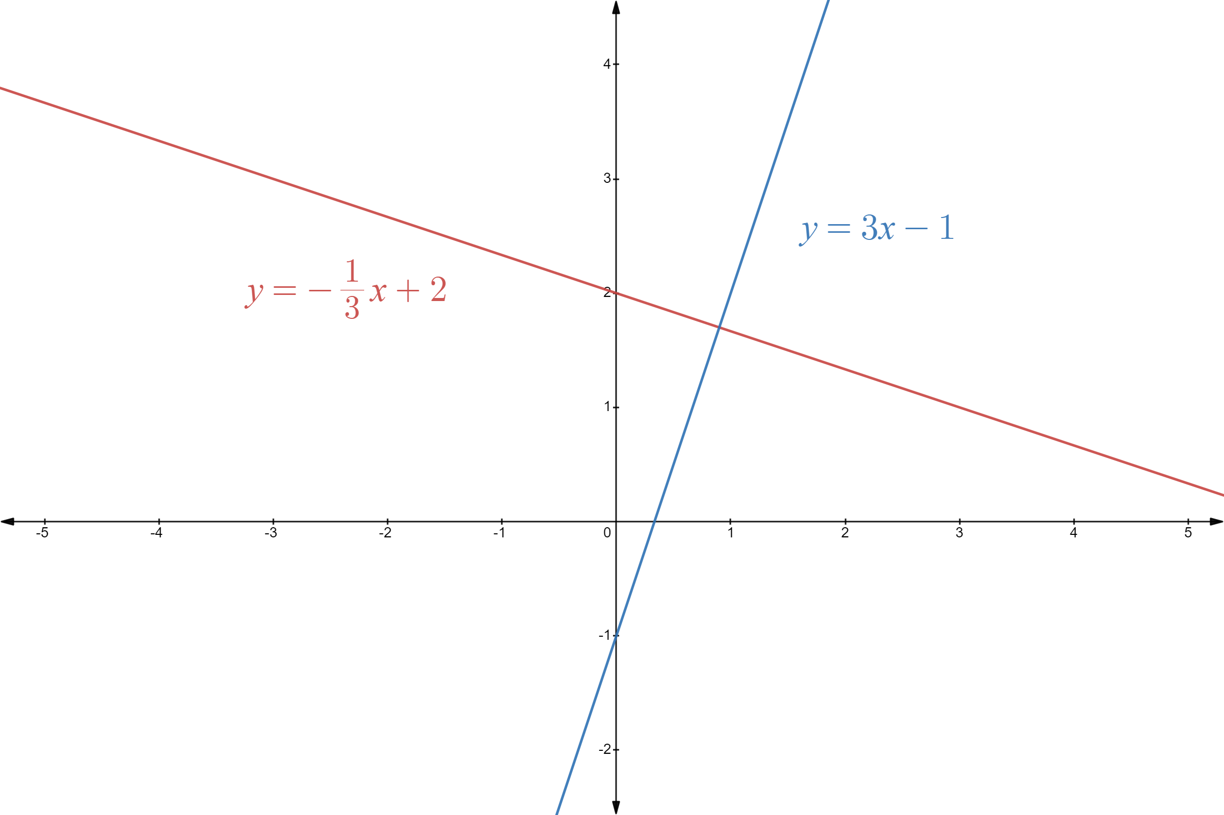
Line it up (7)
Second example
Establish an equation for a line that is perpendicular to the linear relationship $y=−\frac{1}{3}x+2$ and represent this on the cartesian plane.
$$y=−\frac{1}{3}x+2$$
$$m_{1}=−\frac{1}{3}$$
$$m_{1}×m_{2}=−1$$
∴ ${−\frac{1}{3}×m}_{2}=−1$
$$m_{2}=−1×−3 \\ m_{2}=3$$
∴ $y=3x−1$ is a solution

Slide 8
Line it up (8)
Second prompts
Establish an equation for a line that is perpendicular to the linear relationship $y=−\frac{1}{3}x+2$ and represent this on the cartesian plane.
$$y=−\frac{1}{3}x+2$$
$$m_{1}=−\frac{1}{3}$$
$$m_{1}×m_{2}=−1$$
∴ ${−\frac{1}{3}×m}_{2}=−1$
$$m_{2}=−1×−3 \\ m_{2}=3$$
∴ $y=3x−1$ is a solution
$m$ represents the gradient, but why is there an $m_{1}$ and $m_{2}$?
Although the constant is $−1$ in this example, why could any other value be chosen and still be correct?
What are the similarities and differences with $y=−\frac{1}{3}x+2$?

Slide 9
Line it up (9)
Second your turn
Establish an equation for a line that is perpendicular to the linear relationship $y=−4x−3$ and represent this on the cartesian plane.

Slide 10
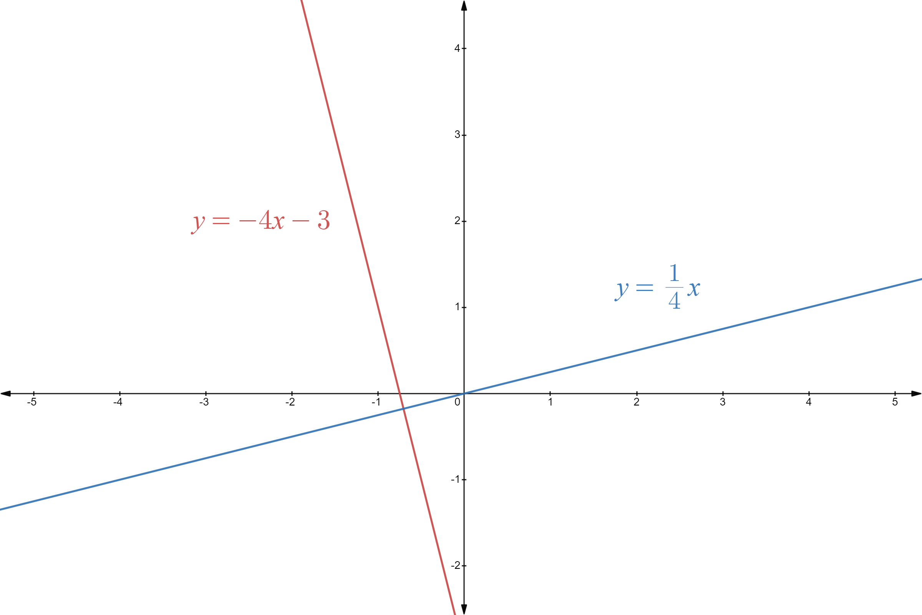
Line it up (10)
Second solutions
Establish an equation for a line that is perpendicular to the linear relationship $y=−4x−3$ and represent this on the cartesian plane.
$$y=−4x−3$$
$$m_{1}=−4$$
$$m_{1}×m_{2}=−1$$
∴ ${−4×m}_{2}=−1$
$$m_{2}=−1×−\frac{1}{4} \\ m_{2}=\frac{1}{4}$$ ∴ $y=\frac{1}{4}x$ is a solution
What is the name given to this relationship?
What similarities are there with the equation for your solution?

Slide 11
Copyright
© State of New South Wales (Department of Education), 2023
The copyright material published in this resource is subject to the Copyright Act 1968 (Cth) and is owned by the NSW Department of Education or, where indicated, by a party other than the NSW Department of Education (third-party material).
Copyright material available in this resource and owned by the NSW Department of Education is licensed under a Creative Commons Attribution 4.0 International (CC BY 4.0) license.
This license allows you to share and adapt the material for any purpose, even commercially.
Attribution should be given to © State of New South Wales (Department of Education), 2023.
Material in this resource not available under a Creative Commons license:
the NSW Department of Education logo, other logos and trademark-protected material
material owned by a third party that has been reproduced with permission. You will need to obtain permission from the third party to reuse its material.
Links to third-party material and websites
Please note that the provided (reading/viewing material/list/links/texts) are a suggestion only and implies no endorsement, by the New South Wales Department of Education, of any author, publisher, or book title. School principals and teachers are best placed to assess the suitability of resources that would complement the curriculum and reflect the needs and interests of their students.
If you use the links provided in this document to access a third-party's website, you acknowledge that the terms of use, including licence terms set out on the third-party's website apply to the use which may be made of the materials on that third-party website or where permitted by the Copyright Act 1968 (Cth). The department accepts no responsibility for content on third-party websites.

