Slide 1
How can I get my money back?
Explicit teaching

Slide 2
Explore

Slide 3
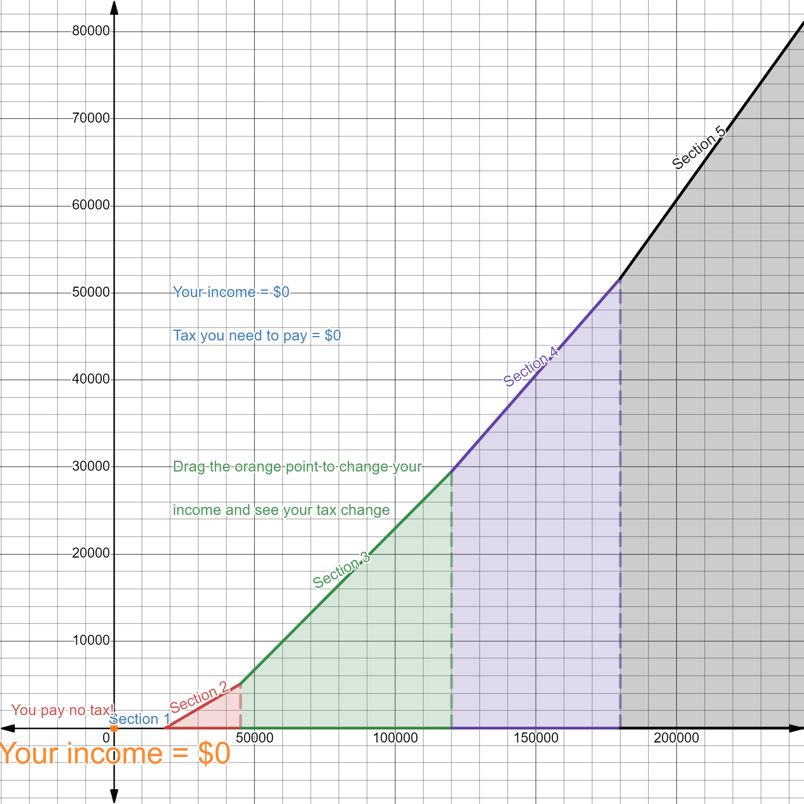
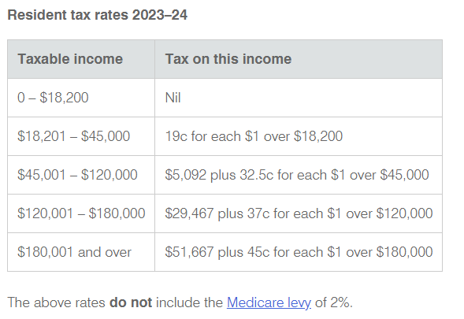
ATO 2023–24
Individual income tax rates
Image created using Desmos and is licensed under the Desmos Terms of Service.
Notes:
Tell students that this is the tax rates for 2023–24.

Slide 4
Where do these amounts come from?
Individual income tax rates
Notes:
Ask students to consider where the fixed amounts in the final 3 rows come from, with reference to the ‘tiered’ tax system they just learnt from the video with the cake metaphor.

Slide 5
Analysing row 3
Individual income tax rates
For a taxable income of $45 000:
$$45 000=18 200+26 800$$
 | Amount | Tax paid
1 | $18 200 | nil
2 | $26 800 | $$0.19×26 800=\$5092$$
Total tax paid $=0+5092$ $=\$5092$
Notes:
Ask students to consider where the fixed of $5092 comes from by calculating the tax paid for a taxable income of $45000.

Slide 6
Analysing row 4
Individual income tax rates
For a taxable income of
$$\$120 000=18 200+26 800+75 000$$
 | Amount | Tax paid
1 | $18 200 | nil
2 | $26 800 | $$0.19×26 800=\$5092$$
3 | $75 000 | $$0.325×75 000=\$24 375$$
Total tax paid $=5092+24 375$
$$=\$29 467$$
Notes:
Ask students to consider where the fixed of $29 467 comes from by calculating the tax paid for a taxable income of $120 000.

Slide 7
Analysing row 5
Individual income tax rates
Can you explain where $51 667 comes from?
Notes:
Ask students to consider where the fixed of $51 667 comes from.

Slide 8
Summarise

Slide 9
Calculating tax payable (1)
Using the tax tables – example 1
Using the tax table, calculate the tax payable for an individual with a taxable income of $42 600.
Taxable income | Tax on this income
0 – $18 200 | Nil
$18 201 – $45 000 | 19c for each $1 over $18 200
$45 001 – $120 000 | $5092 plus 32.5c for each $1 over $45 000
$120 001 – $180 000 | $29 467 plus 37c for each $1 over $120 000
$180 001 and over | $51 667 plus 45c for each $1 over $180 000
$$Tax payable=0.19×\left(42 600 −18 200\right) \\ =0.19×24 400 \\ =\$4636$$

Slide 10
Calculating tax payable (2)
Using the tax tables – example 1 self-explanation prompts
Using the tax table, calculate the tax payable for an individual with a taxable income of $42 600.
Taxable income | Tax on this income
0 – $18 200 | Nil
$18 201 – $45 000 | 19c for each $1 over $18 200
$45 001 – $120 000 | $5092 plus 32.5c for each $1 over $45 000
$120 001 – $180 000 | $29 467 plus 37c for each $1 over $120 000
$180 001 and over | $51 667 plus 45c for each $1 over $180 000
Why is this row highlighted?
$$Tax payable=0.19×\left(42 600 −18 200\right) \\ =0.19×24 400 \\ =\$4636$$
Why were these numbers subtracted?
Where did 0.19 come from?

Slide 11
Calculating tax payable (3)
Your turn – question 1
Using the tax table, calculate the tax payable for an individual with a taxable income of $36 700.
Taxable income | Tax on this income
0 – $18 200 | Nil
$18 201 – $45 000 | 19c for each $1 over $18 200
$45 001 – $120 000 | $5092 plus 32.5c for each $1 over $45 000
$120 001 – $180 000 | $29 467 plus 37c for each $1 over $120 000
$180 001 and over | $51 667 plus 45c for each $1 over $180 000

Slide 12
Calculating tax payable (4)
Your turn – solution 1
Using the tax table, calculate the tax payable for an individual with a taxable income of $36 700.
Taxable income | Tax on this income
0 – $18 200 | Nil
$18 201 – $45 000 | 19c for each $1 over $18 200
$45 001 – $120 000 | $5092 plus 32.5c for each $1 over $45 000
$120 001 – $180 000 | $29 467 plus 37c for each $1 over $120 000
$180 001 and over | $51 667 plus 45c for each $1 over $180 000
$$Tax payable=0.19×\left(36 700 −18 200\right) \\ =0.19×18 500 \\ =\$3515$$

Slide 13
Calculating tax payable (5)
Using the tax tables – example 2
Using the tax table, calculate the tax payable for an individual with a taxable income of $88 300.
Taxable income | Tax on this income
0 – $18 200 | Nil
$18 201 – $45 000 | 19c for each $1 over $18 200
$45 001 – $120 000 | $5092 plus 32.5c for each $1 over $45 000
$120 001 – $180 000 | $29 467 plus 37c for each $1 over $120 000
$180 001 and over | $51 667 plus 45c for each $1 over $180 000
$$Tax payable=5092+0.325×\left(88 300−45 000\right) \\ =5092+0.325×43 300 \\ =\$19 164.50$$

Slide 14
Calculating tax payable (6)
Using the tax tables – example 2 self-explanation prompts
Using the tax table, calculate the tax payable for an individual with a taxable income of $88 300.
Taxable income | Tax on this income
0 – $18 200 | Nil
$18 201 – $45 000 | 19c for each $1 over $18 200
$45 001 – $120 000 | $5092 plus 32.5c for each $1 over $45 000
$120 001 – $180 000 | $29 467 plus 37c for each $1 over $120 000
$180 001 and over | $51 667 plus 45c for each $1 over $180 000
Why were these numbers subtracted?
$$Tax payable=5092+0.325×\left(88 300−45 000\right) \\ =5092+0.325×43 300 \\ =\$19 164.50$$
Why was 5092 added?
Where did 0.325 come from?

Slide 15
Calculating tax payable (7)
Your turn – question 2
Using the tax table, calculate the tax payable for an individual with a taxable income of $137 200.
Taxable income | Tax on this income
0 – $18 200 | Nil
$18 201 – $45 000 | 19c for each $1 over $18 200
$45 001 – $120 000 | $5092 plus 32.5c for each $1 over $45 000
$120 001 – $180 000 | $29 467 plus 37c for each $1 over $120 000
$180 001 and over | $51 667 plus 45c for each $1 over $180 000

Slide 16
Calculating tax payable (8)
Your turn – solution 2
Using the tax table, calculate the tax payable for an individual with a taxable income of $137 200.
Taxable income | Tax on this income
0 – $18 200 | Nil
$18 201 – $45 000 | 19c for each $1 over $18,200
$45 001 – $120 000 | $5092 plus 32.5c for each $1 over $45 000
$120 001 – $180 000 | $29 467 plus 37c for each $1 over $120 000
$180 001 and over | $51 667 plus 45c for each $1 over $180 000
$$Tax payable=29 467+0.37×\left(137 200−120 000\right) \\ =29 467+0.37×17 200 \\ =\$35 831$$

Slide 17
Calculating tax payable (9)
Using the tax tables – example 3
Using the tax table, calculate the tax payable for an individual who earns $98 000 p.a., made $750 in interest and spent $200 on new work boots they can claim on tax.

Slide 18
Calculating tax payable (10)
Using the tax tables – example 3 self-explanation prompts
Using the tax table, calculate the tax payable for an individual who earns $98 000 p.a., made $750 in interest and spent $200 on new work boots they can claim on tax.
Taxable income | Tax on this income
0 – $18,200 | Nil
$18,201 – $45 000 | 19c for each $1 over $18 200
$45 001 – $120,000 | $5092 plus 32.5c for each $1 over $45 000
$120 001 – $180 000 | $29 467 plus 37c for each $1 over $120 000
$180,001 and over | $51 667 plus 45c for each $1 over $180 000
Why was one number added and the other subtracted?
$$Taxable income=98 000+750−200 \\ =98 550$$
$$Tax payable=5092+0.325×\left(98 550−45 000\right) \\ =5092+0.325×53 550 \\ =\$22 495.75$$
Why might the taxable income be greater than the income?

Slide 19
Calculating tax payable (11)
Your turn – question 3
Using the tax table, calculate the tax payable for an individual who earns $195 700 p.a. and paid $650 in professional equipment.
Taxable income | Tax on this income
0 – $18 200 | Nil
$18 201 – $45 000 | 19c for each $1 over $18 200
$45 001 – $120 000 | $5092 plus 32.5c for each $1 over $45 000
$120 001 – $180 000 | $29 467 plus 37c for each $1 over $120 000
$180 001 and over | $51 667 plus 45c for each $1 over $180 000

Slide 20
Calculating tax payable (12)
Your turn – solution 3
Using the tax table, calculate the tax payable for an individual who earns $195 700 p.a. and paid $650 in professional equipment.
Taxable income | Tax on this income
0 – $18 200 | Nil
$18 201 – $45 000 | 19c for each $1 over $18 200
$45 001 – $120 000 | $5092 plus 32.5c for each $1 over $45 000
$120 001 – $180 000 | $29 467 plus 37c for each $1 over $120 000
$180 001 and over | $51 667 plus 45c for each $1 over $180 000
$$Taxable income=195 700−650 \\ =195 050$$
$$Tax payable=51 667+0.45×\left(195050−180 000\right) \\ =51 667+0.45×15 050 \\ =\$58 439.50$$

Slide 21
PAYG taxation system
Review
Most employers take money out of worker’s pay and give it to the ATO. This is called pay as you go.
Why might this happen?

Slide 22
Net earnings (1)
Definition
An individual's net earnings is the part of your pay left after deductions and tax have been taken out.
Net earnings = total earnings − (deductions and taxation)
What could ‘total earnings’ refer to?
What might be some examples of deductions?

Slide 23
Net earnings (2)
Calculating net earnings – example 4
Matilda earns a gross weekly pay of $760. Her employer removes $78 in pay-as-you-go tax each week. She also has $16 in union fees deducted each week. Calculate her net earnings for the week.
$$Weekly net earnings=760−78−16 \\ =\$666$$

Slide 24
Net earnings (3)
Calculating net earnings – example 4 self-explanation prompts
Matilda earns a gross weekly pay of $760. Her employer removes $78 in pay-as-you-go tax each week. She also has $16 in union fees deducted each week. Calculate her net earnings for the week.
Why were the 2 amounts subtracted and not added?
$$Weekly net earnings=760−78−16 \\ =\$666$$
What might this number represent for Matilda?

Slide 25
Net earnings (4)
Your turn – question 4
Lewanna earns a gross fortnightly pay of $3730. Her employer removes $850 in pay-as-you-go tax each fortnight. She also has $460 in Higher Education Contribution Scheme (HECS) fees deducted each fortnight. Calculate her net earnings for the fortnight.

Slide 26
Net earnings (5)
Your turn – solution 4
Lewanna earns a gross fortnightly pay of $3730. Her employer removes $850 in pay-as-you-tax each fortnight. She also has $460 in Higher Education Contribution Scheme (HECS) fees deducted each fortnight. Calculate her net earnings for the fortnight.
$$Fortnightly net earnings=3730−850−460 \\ =\$2420$$

