Slide 1
How much will it cost?
Explicit teaching

Slide 2
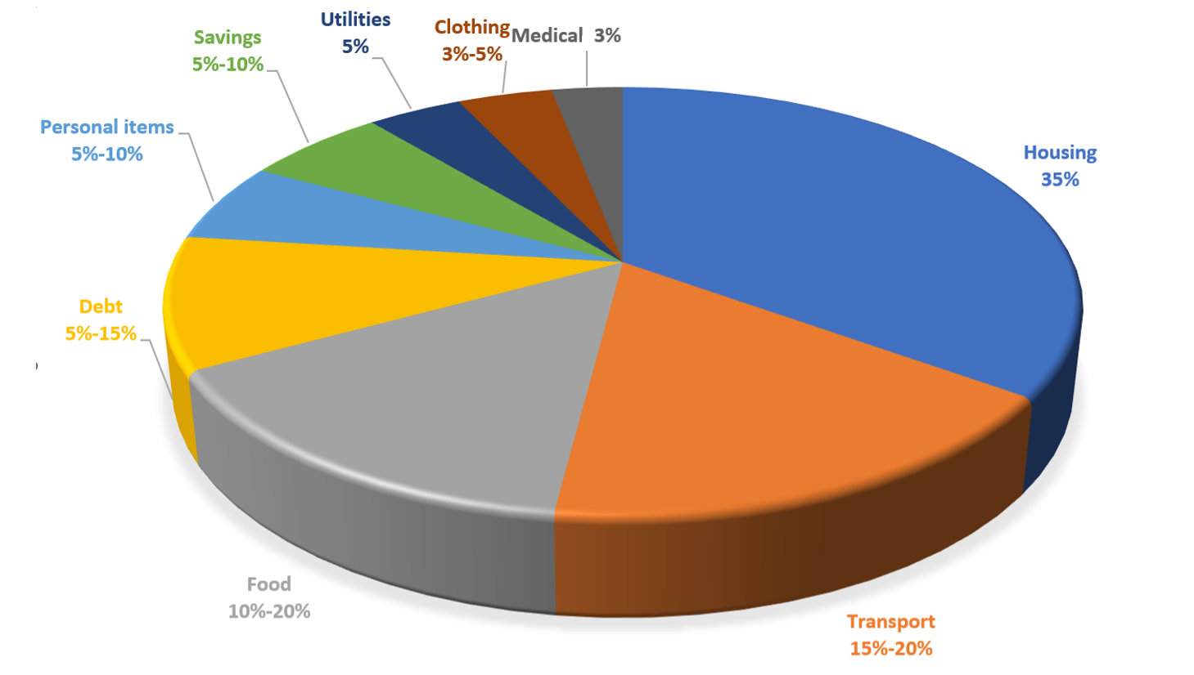
Average Australian spending
Sector graph of spending

