Slide 1
That’s ab-SURD!
Explicit teaching

Slide 2
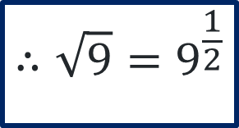
Worked example 1
Fractional indices
$${\left(\sqrt{9}\right)}^{2}=9^{1}$$
$${\left(9^{\frac{1}{2}}\right)}^{2}=9^{1}$$
$$\sqrt{9}×\sqrt{9}=9^{1}$$
$$∴\sqrt{9}=9^{\frac{1}{2}}$$

Slide 3
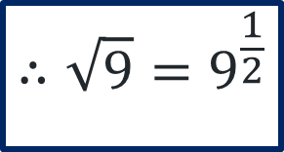
Self-explanation prompts 1
Fractional indices
$${\left(\sqrt{9}\right)}^{2}=9^{1}$$
$${\left(9^{\frac{1}{2}}\right)}^{2}=9^{1}$$
$$\sqrt{9}×\sqrt{9}=9^{1}$$
What index law makes this possible?
$$∴\sqrt{9}=9^{\frac{1}{2}}$$
How is this shown in the working above?

Slide 4
Your turn 1
Fractional indices
Justifying your response with working, show how to represent the surd shown using fractional indices.
$$\sqrt{6}×\sqrt{6}=6^{1}$$

Slide 5
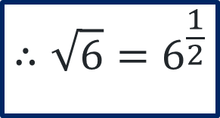
Your turn 1 – solutions
Fractional indices
$${\left(\sqrt{6}\right)}^{2}=6^{1}$$
$${\left(6^{\frac{1}{2}}\right)}^{2}=6^{1}$$
$$\sqrt{6}×\sqrt{6}=6^{1}$$
$$∴\sqrt{6}=6^{\frac{1}{2}}$$

Slide 6
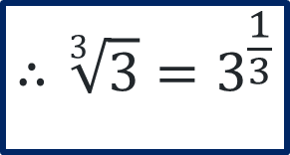
Worked example 2
Fractional indices
$${\left(\sqrt[3]{3}\right)}^{3}=3^{1}$$
$${\left(3^{\frac{1}{3}}\right)}^{3}=3^{1}$$
$$\sqrt[3]{3}×\sqrt[3]{3}×\sqrt[3]{3}=3^{1}$$
$$∴\sqrt[3]{3}=3^{\frac{1}{3}}$$

Slide 7
Self-explanation prompts 2
Fractional indices
$${\left(\sqrt[3]{3}\right)}^{3}=3^{1}$$
$${\left(3^{\frac{1}{3}}\right)}^{3}=3^{1}$$
$$\sqrt[3]{3}×\sqrt[3]{3}×\sqrt[3]{3}=3^{1}$$
How are the fractional power and the root directly related?
$$∴\sqrt[3]{3}=3^{\frac{1}{3}}$$

Slide 8
Your turn 2
Fractional indices
$$4\sqrt{16}×4\sqrt{16}×4\sqrt{16}×4\sqrt{16}=2^{1}$$

Slide 9
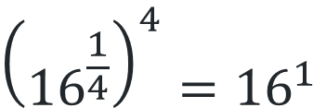
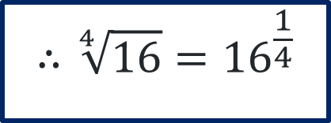
Your turn 2 – solutions
Fractional indices
$${\left(\sqrt[4]{16}\right)}^{4}={16}^{1}$$
$${\left({16}^{\frac{1}{4}}\right)}^{4}={16}^{1}$$
$$\sqrt[4]{16}×\sqrt[4]{16}×\sqrt[4]{16}×\sqrt[4]{16}={16}^{1}$$
$$∴\sqrt[4]{16}={16}^{\frac{1}{4}}$$

Slide 10
Worked example 3
Fractional indices
$${32}^{\frac{1}{5}}$$
$$\sqrt[5]{32}$$
$$2$$

Slide 11
Self-explanation prompts 3
Fractional indices
$${32}^{\frac{1}{5}}$$
$$\sqrt[5]{32}$$
$$2$$
Can you prove this is the correct answer?

Slide 12
Your turn 3
Fractional indices
Represent the term below without the use of fractional indices.
$${25}^{\frac{1}{5}}$$

Slide 13
Your turn 3 – solutions
Fractional indices
$${25}^{\frac{1}{5}}$$
$$\sqrt[5]{25}$$
This results in an irrational number, so leaving it in surd form is most accurate.

Slide 14
Worked example 4
Fractional indices
$$8^{\frac{4}{3}}$$
$${\left(8^{\frac{1}{3}}\right)}^{4}$$
$${\left(\sqrt[3]{8}\right)}^{4}$$
$$2^{4}$$
$$16$$
$${\left(8^{4}\right)}^{\frac{1}{3}}$$
$${\left(4096\right)}^{\frac{1}{3}}$$
$$\sqrt[3]{4096}$$
$$16$$

Slide 15
Self-explanation prompts 4
What index law makes this possible?
Why is it possible to solve this in two different ways?
Fractional indices
$$8^{\frac{4}{3}}$$
$${\left(8^{\frac{1}{3}}\right)}^{4}$$
$${\left(\sqrt[3]{8}\right)}^{4}$$
$$2^{4}$$
$$16$$
$${\left(8^{4}\right)}^{\frac{1}{3}}$$
$${\left(4096\right)}^{\frac{1}{3}}$$
What index law makes this possible?
$$\sqrt[3]{4096}$$
$$16$$

Slide 16
Your turn 5
Fractional indices
Show the steps necessary to remove the fractional index power, writing your answer in its simplest form.
You only need to show one way to reach a solution, not multiple.
$$4^{\frac{3}{2}}$$

Slide 17
Your turn 5 – solutions
Fractional indices
$$4^{\frac{3}{2}}$$
$${\left(4^{\frac{1}{2}}\right)}^{3}$$
$${\left(\sqrt{4}\right)}^{3}$$
$$2^{3}$$
$$8$$

