Slide 1
Negative indices
Explicit teaching

Slide 2




Half-life – plutonium
How can you write these numbers with indices?
$$8$$
$4$
$$2$$
$$1$$
Notes:
Display this slide and ask students to Think-Pair-Share how we could write the numbers with indices.
Reveal the next slide once they’ve had a chance to discuss.

Slide 3




Half-life – plutonium (2)
What would come next?
What is happening to the index value in each step?
What pattern is happening as the solution changes in each step?
$$2^{3}=8$$
$2^{2}=4$
$$2^{1}=2$$
$$2^{0}=1$$
Notes:
Reveal this slide and ask them to predict what would come next by looking at the patterns. They should discuss this in their pairs before you randomly choose a student to answer.

Slide 4

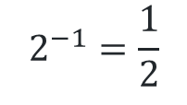



Half-life – plutonium (3)
Negative index
$$2^{3}=8$$
$2^{2}=4$
$$2^{1}=2$$
$$2^{0}=1$$
$$2^{−1}=\frac{1}{2}$$
Notes:
Ask students to consider what would happen if we continued the pattern

Slide 5
Half-life – plutonium (4)
What if we kept going further?
$$2^{3}$$ | $$2^{2}$$ | $$2^{1}$$ | $$2^{0}$$ | $$2^{−1}$$ | $$2^{−2}$$ | $$2^{−3}$$
$$8$$ | $$4$$ | $$2$$ | $$1$$ | $$\frac{1}{2}$$ | $$\frac{1}{4}$$ | $$\frac{1}{8}$$
Notes:
Display this table for a few minutes and ask students to look at it in silence before revealing the next slide.

Slide 6
Half-life – plutonium (5)
What do you notice?
$$2^{3}$$ | $$2^{2}$$ | $$2^{1}$$ | $$2^{0}$$ | $$2^{−1}$$ | $$2^{−2}$$ | $$2^{−3}$$
$$8$$ | $$4$$ | $$2$$ | $$1$$ | $$\frac{1}{2}$$ | $$\frac{1}{4}$$ | $$\frac{1}{8}$$
How else could we write these denominators?
What do the denominators have in common with other answers in the table?
Notes:
In their pairs, ask students to consider these questions. Randomly choose students to reveal their thoughts before showing the next slide.

Slide 7
Half-life – plutonium (6)
What do you notice?
$$2^{3}$$ | $$2^{2}$$ | $$2^{1}$$ | $$2^{0}$$ | $$2^{−1}$$ | $$2^{−2}$$ | $$2^{−3}$$
$$8$$ | $$4$$ | $$2$$ | $$1$$ | $$\frac{1}{2}$$ | $$\frac{1}{4}$$ | $$\frac{1}{8}$$
 |  |  |  | $$\frac{1}{2^{1}}$$ | $$\frac{1}{2^{2}}$$ | $$\frac{1}{2^{3}}$$
What is the connection between the first and third rows of the table?
Notes:
Ask students to consider the connections between the first and third rows.
Ask them to consider whether they think this would work for other bases.

Slide 8
Negative indices – your turn
Does this work for other bases?
$$5^{3}$$ | $$5^{2}$$ | $$5^{1}$$ | $$5^{0}$$ | $$5^{−1}$$ | $$5^{−2}$$ | $$5^{−3}$$
$$125$$ |  |  | $$1$$ |  |  | $$\frac{1}{125}$$
Notes:
Students should complete the table to test whether it would work for base 5

Slide 9
Negative indices – your turn – solutions
Base 5
$$5^{3}$$ | $$5^{2}$$ | $$5^{1}$$ | $$5^{0}$$ | $$5^{−1}$$ | $$5^{−2}$$ | $$5^{−3}$$
$$125$$ | $$25$$ | $$5$$ | $$1$$ | $$\frac{1}{5}$$ | $$\frac{1}{25}$$ | $$\frac{1}{125}$$
 |  |  |  | $$\frac{1}{5^{1}}$$ | $$\frac{1}{5^{2}}$$ | $$\frac{1}{5^{3}}$$
Notes:
Ask students to discuss in pairs and to consider if there are any bases that this wouldn’t work for.

Slide 10
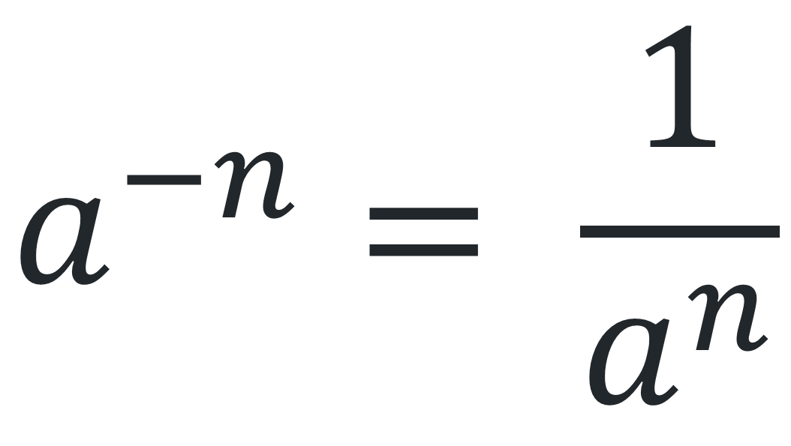
Negative indices rule
$$a^{−n}= \frac{1}{a^{n}}$$
Notes:
Ask students to discuss in pairs and to consider if there are any bases that this wouldn’t work for.

