Slide 1
Scientific notation
Explicit teaching

Slide 2
Writing numbers using scientific notation
Scientific notation
Scientific notation is written with:
A number between 1 and 10
And multiplied by a power 10
What is the difference between a very large and very small number when writing in scientific notation?

Slide 3
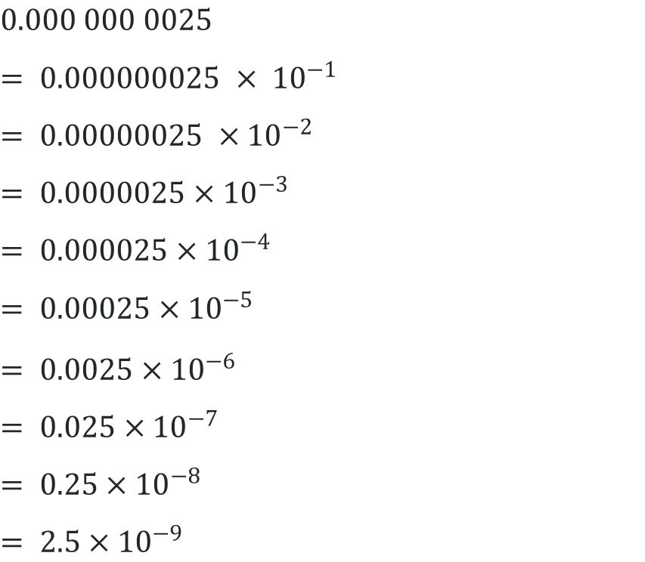
Scientific notation (2)
Converting small numbers to scientific notation – Worked example 1
$$0.000 000 0025$$
$$= 0.000000025 × {10}^{−1}$$
$$= 0.00000025 ×{10}^{−2}$$
$$= 0.0000025×{10}^{−3}$$
$$= 0.000025×{10}^{−4}$$
$$= 0.00025×{10}^{−5}$$
$$= 0.0025×{10}^{−6}$$
$$= 0.025×{10}^{−7}$$
$$= 0.25×{10}^{−8}$$
$$= 2.5×{10}^{−9}$$

Slide 4
Scientific notation (3)
Converting small numbers to scientific notation – Prompts 1
$$0.000 000 0025$$
$$= 0.000000025 × {10}^{−1}$$
$$= 0.00000025 ×{10}^{−2}$$
$$= 0.0000025×{10}^{−3}$$
$$= 0.000025×{10}^{−4}$$
$$= 0.00025×{10}^{−5}$$
$$= 0.0025×{10}^{−6}$$
$$= 0.025×{10}^{−7}$$
$$= 0.25×{10}^{−8}$$
$$= 2.5×{10}^{−9}$$
What is happening to the value of the decimal in front of the x 10*?
Why are we using negative powers of 10?

Slide 5
Scientific notation (4)
Your turn 1
Write 0.000154 in scientific notation.

Slide 6

Scientific notation (5)
Your turn 1 – solution
Write 0.000154 in scientific notation.
$$0.000154$$
$$=0.00154 ×{10}^{−1}$$
$$=0.0154 ×{10}^{−2}$$
$$=0.154 ×{10}^{−3}$$
$$=1.54 ×{10}^{−4}$$

Slide 7
Scientific notation (6)
Converting small numbers to scientific notation – Worked example 2
Write 0.000 003 45 in scientific notation.
0. 0 0 0 0 0 3 4 5
$$= 3.45 × {10}^{−6}$$

Slide 8
Scientific notation (7)
Converting small numbers to scientific notation – Prompts 2
Write 0.000 003 45 in scientific notation.
0. 0 0 0 0 0 3 4 5
$= 3.45 × {10}^{−6}$
How do you know to stop moving the digits after 6 moves?
What part of the answer tells you it is a very small number?
Where has the number negative 6 come from?

Slide 9
Scientific notation (8)
Your turn 2
Write 0.0745 in scientific notation.

Slide 10
Scientific notation (9)
Your turn 2 – solution
Write 0.0745 in scientific notation.
= 0. 0 7 4 5
$$= 7.45 × {10}^{−2}$$

Slide 11
Scientific notation (10)
Converting from scientific notation – Worked example 3
Write $4.61 × {10}^{−3}$ in decimal form.
$= 4. 6 1 _× {10}^{−3}$
$$= 0.00461$$

Slide 12
Scientific notation (11)
Converting from scientific notation – Prompts
Write $4.61 × {10}^{−3}$ in decimal form.
$= 4. 6 1 _× {10}^{−3}$
$$= 0.00461$$
Why are there three zeroes at the beginning of the solution?
How do you know to move the digits 3 spaces?

Slide 13
Scientific notation (12)
Your turn 3
Write $8.15 × {10}^{−4}$in decimal form.

Slide 14
Scientific notation (13)
Your turn 3 – solution
Write $8.15 × {10}^{−4}$in decimal form.
$$​$$
$$8 . 5 1 _ _× 10−4$$
$$= 0. 0 0 0 8 5 1$$

