Slide 1
Coding with numbers
Launch

Slide 2
Writing the number 13 in code
Coding with numbers
Number | 64 | 32 | 16 | 8 | 4 | 2 | 1
13 |  |  |  | 1 | 1 | 0 | 1
Code
1 1 0 1
What do you notice?
What do you think?
What do you wonder?

Slide 3
Writing the number 20 in code
Coding with numbers
Number | 64 | 32 | 16 | 8 | 4 | 2 | 1
20 |  |  | 1 | 0 | 1 | 0 | 0
Code
1 0 1 0 0
Can you describe what is happening?

Slide 4
An explanation of binary code
Coding with numbers
Number | 64 | 32 | 16 | 8 | 4 | 2 | 1
45 |  | 1 | 0 | 1 | 1 | 0 | 1
Code
1 0 1 1 0 1
We have just seen the numbers 13, 20 and 45 written using binary code.
Notes:
Binary code uses a concept that there are only two choices: yes or no, on or off, hot or cold.
Computer binary code uses only the 0 and 1 symbols.
Ask students if they can think of other scenarios that provide only two choices?
Binary code allows computers to manipulate, store and process all types of information to and from computer memory.
There are many combinations that students may reference. Examples include up/down, in/out, forwards/backwards.
If students reference win/lose, discussion linking to probability is possible, regarding the difference between win/lose and win/don’t win, which incorporates the option of a draw as well.

Slide 5
Comparing decimal numbers with binary code
Coding with numbers
Binary code
Number | 64 | 32 | 16 | 8 | 4 | 2 | 1
100 | 1 | 1 | 0 | 0 | 1 | 0 | 0
Code
1 1 0 0 1 0 0
Decimal number
Number | 10000 | 1000 | 100 | 10 | 1
100 |  |  | 1 | 0 | 0
Code
100
Notes:
Ask students what they notice and what they wonder

Slide 6
Using binary code
Coding with numbers
Can you determine the binary code for these numbers?
Remember to only use the symbols 0 and 1.
Number | 64 | 32 | 16 | 8 | 4 | 2 | 1
11
18
39
83
Code
Notes:
Can either code these numbers through class discussion or distribute Appendix A “Using binary code to code numbers” for students to work in pairs to code the numbers together.
If using Appendix A “Using binary code to code numbers”, use the Pounce Bounce strategy to encourage discussion students to provide an answer and to explain how they reached the answer. bit.ly/pausepouncebouncestrategy

Slide 7
How the binary values work
Coding with numbers
Did you notice that the binary values are doubled each time, as they move from right to left?
$$×2$$
$$×2$$
$$×2$$
$$×2$$
$$×2$$
$$×2$$
? | ? | 64 | 32 | 16 | 8 | 4 | 2 | 1
What would be the next two values to the left of 64?
Notes:
The next two values are 128 and 256.

Slide 8
Writing the binary values in a different form
Coding with numbers
256 | 128 | 64 | 32 | 16 | 8 | 4 | 2 | 1
What are some things that the numbers in the table have in common?
Notes:
Students could mention that the numbers are all even, from right to left they double each time, from left to right they halve each time. They could also look at relationships between pairs of numbers, 8 x 8=64, 4x4=16, and so on.
Then, 2x2x2-8 and 4x4x4=64. The aim is to encourage students to think about repeated multiplication.
So, if 4x4=16 and 2x2=4, then 4x4=2x2x2x2.

Slide 9
Writing the binary values in index form
Coding with numbers
Binary value | 64 | 32 | 16 | 8 | 4 | 2 | 1
Index form | $$2^{6}$$ | $$2^{5}$$ | $$2^{4}$$ | $$2^{3}$$ | $$2^{2}$$ | $$2^{1}$$ | $$2^{0}$$
What do you notice?
What do you think?
What do you wonder?

Slide 10
Comparing multiplication strategies
Coding with numbers
Binary value | 64 | 32 | 16 | 8 | 4 | 2 | 1
Index form | $$2^{6}$$ | $$2^{5}$$ | $$2^{4}$$ | $$2^{3}$$ | $$2^{2}$$ | $$2^{1}$$ | $$2^{0}$$
Binary values | Binary values in index form
$$4×2=8$$ | $$2^{2}×2^{1}=2^{3}$$
What do you notice?
What do you think?
Notes:
Distribute Appendix B “Using binary code to code numbers” and use the Think, Pair Share strategy (bit.ly/thinkpairsharestrategy).

Slide 11
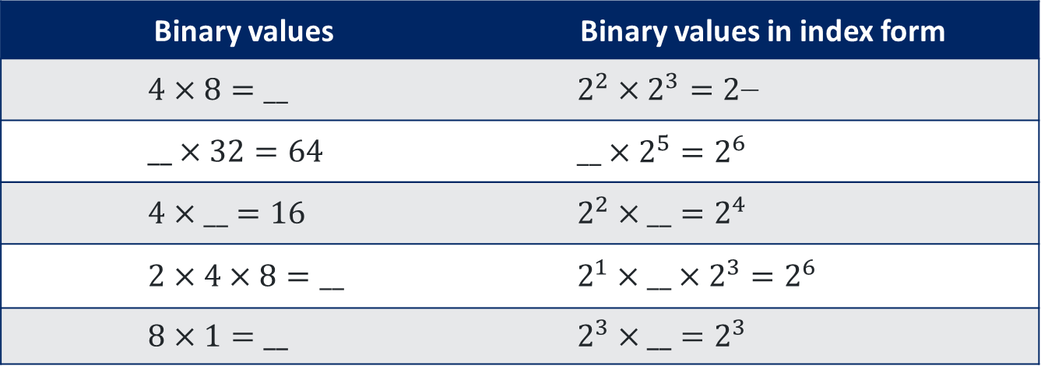
Investigating multiplication strategies
Coding with numbers
Binary value | 64 | 32 | 16 | 8 | 4 | 2 | 1
Index form | $2^{6}$ | $$2^{5}$$ | $$2^{4}$$ | $$2^{3}$$ | $$2^{2}$$ | $$2^{1}$$ | $$2^{0}$$
Binary values | Binary values in index form
$$4×8=__$$ | $$2^{2}×2^{3}=2^{__}$$
$$__×32=64$$ | $$__×2^{5}=2^{6}$$
$$4×__=16$$ | $$2^{2}×__=2^{4}$$
$$2×4×8=__$$ | $$2^{1}×__×2^{3}=2^{6}$$
$$8×1=__$$ | $$2^{3}×__=2^{3}$$
Notes:
Appendix B “Comparing Strategies” questions.

Slide 12
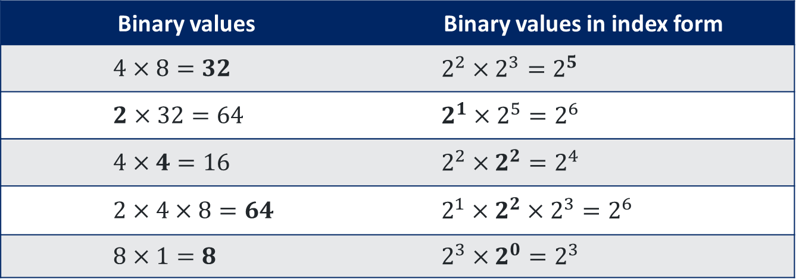
Investigating multiplication strategies – solutions
Coding with numbers
Binary value | 64 | 32 | 16 | 8 | 4 | 2 | 1
Index form | $$2^{6}$$ | $$2^{5}$$ | $$2^{4}$$ | $$2^{3}$$ | $$2^{2}$$ | $$2^{1}$$ | $$2^{0}$$
Binary values | Binary values in index form
$$4×8=32$$ | $$2^{2}×2^{3}=2^{5}$$
$$2×32=64$$ | $$2^{1}×2^{5}=2^{6}$$
$$4×4=16$$ | $$2^{2}×2^{2}=2^{4}$$
$$2×4×8=64$$ | $$2^{1}×2^{2}×2^{3}=2^{6}$$
$$8×1=8$$ | $$2^{3}×2^{0}=2^{3}$$
Notes:
Appendix B “Comparing Strategies” with answers.

Slide 13
Comparing division strategies
Coding with numbers
Binary value | 64 | 32 | 16 | 8 | 4 | 2 | 1
Index form | $$2^{6}$$ | $$2^{5}$$ | $$2^{4}$$ | $$2^{3}$$ | $$2^{2}$$ | $$2^{1}$$ | $$2^{0}$$
Binary values | Binary values in index form
$$8÷2=4$$ | $$2^{3}÷2^{1}=2^{2}$$
Notes:
Pose the question: What do you think happens when the numbers are being divided?
The lower table shows two division problems.
The values on the left are written as integers, and on the right the values are written in index form.

Slide 14
Investigating division strategies
Coding with numbers
Binary value | 64 | 32 | 16 | 8 | 4 | 2 | 1
Index form | $$2^{6}$$ | $$2^{5}$$ | $$2^{4}$$ | $$2^{3}$$ | $$2^{2}$$ | $$2^{1}$$ | $$2^{0}$$
Binary values | Binary values in index form
$$8÷4=__$$ | $$2^{3}÷2^{2}=2^{__}$$
$$64÷__=32$$ | $$2^{6}÷__=2^{5}$$
$$32÷4=__$$ | $$2^{5}÷2^{2}=__$$
$$__÷1=8$$ | $$__÷2^{0}=2^{3}$$
$$16÷16=__$$ | $$2^{4}÷2^{4}=__$$
Notes:
Appendix B “Comparing Strategies” questions.

Slide 15
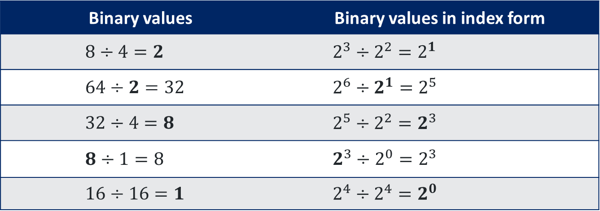
Investigating division strategies – solutions
Coding with numbers
Binary value | 64 | 32 | 16 | 8 | 4 | 2 | 1
Index form | $$2^{6}$$ | $$2^{5}$$ | $$2^{4}$$ | $$2^{3}$$ | $$2^{2}$$ | $$2^{1}$$ | $$2^{0}$$
Binary values | Binary values in index form
$$8÷4=2$$ | $$2^{3}÷2^{2}=2^{1}$$
$$64÷2=32$$ | $$2^{6}÷2^{1}=2^{5}$$
$$32÷4=8$$ | $$2^{5}÷2^{2}=2^{3}$$
$$8÷1=8$$ | $$2^{3}÷2^{0}=2^{3}$$
$$16÷16=1$$ | $$2^{4}÷2^{4}=2^{0}$$
Notes:
Appendix B “Comparing Strategies” with answers.

