Slide 1
Cone or cup?
Prisms and cylinders

Slide 2
Launch
Cone or Cup?

Slide 3
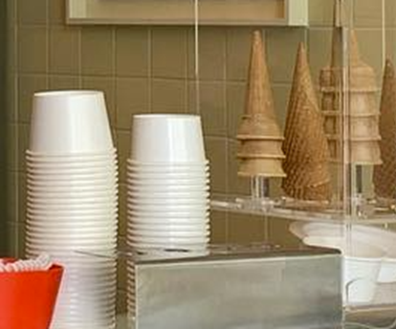
Which would you prefer?
Cup or cone?

Slide 4
Explore
Cone or Cup?

Slide 5
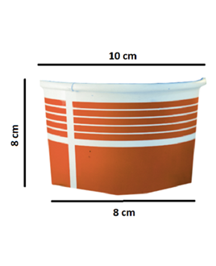
What do you notice? What do you wonder?
Cup or cone?

Slide 6
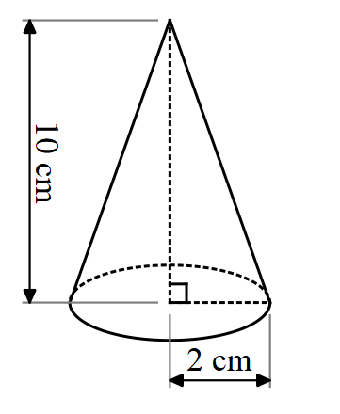
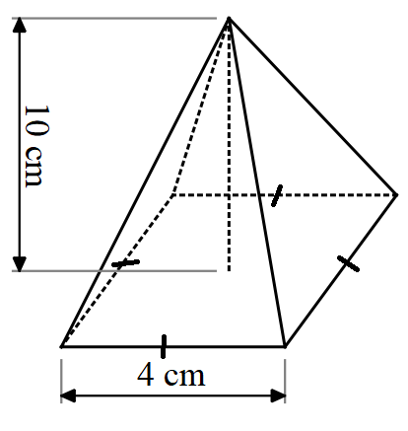
Notice and wonder
Cup or cone?
What do you notice and wonder about the cone and pyramid?

Slide 7
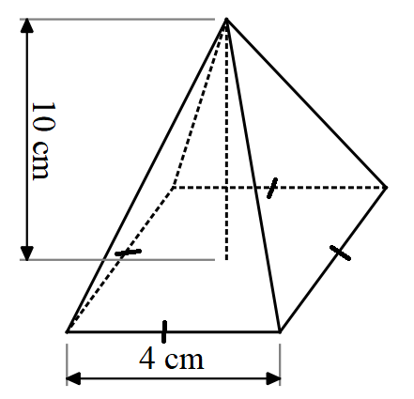
Review
Volume of a pyramid
$$V=\frac{1}{3}×A×h$$
$$=\frac{1}{3}×4×4×10$$
$$=53.33333…$$
$$=53.3 cm^{3}$$

Slide 8
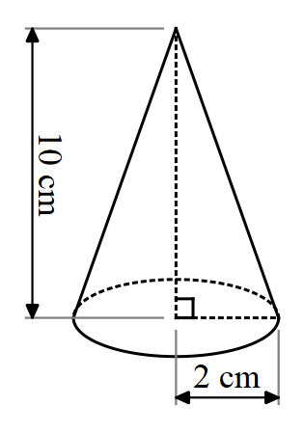
Worked example 1
Volume of a cone
$$V=\frac{1}{3}Ah$$
$$V=\frac{1}{3}πr^{2}h$$
$$V=\frac{1}{3}×π×2^{2}×10$$
$$V=41.88790…$$
$$V=41.9 cm^{3}$$
How is this formula different to the one used for a pyramid?
Compare this result to the previous pyramid with the same dimensions. What can be concluded?
Notes:
Highlight to students that for both cones and pyramids the formula is the area x the base x 1/3.

Slide 9
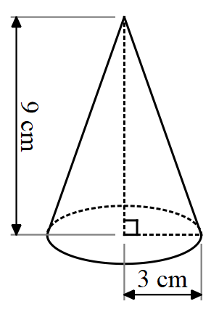
Your turn – example 1
Volume of a cone
Find the volume of the cone using the formula:
$$V=\frac{1}{3}Ah$$
Notes:
Highlight to students that for both cones and pyramids the formula is the area x the base x 1/3.

Slide 10
Your turn – example 1 – solution
Volume of a cone
Find the volume of the cone using the formula:
$$V=\frac{1}{3}Ah$$
$$V=\frac{1}{3}πr^{2}h$$
$$V=\frac{1}{3}×π×3^{2}×9$$
$$V=84.82300…$$
$$V=84.8cm^{2}$$
Notes:
Highlight to students that for both cones and pyramids the formula is the area x the base x 1/3.

Slide 11
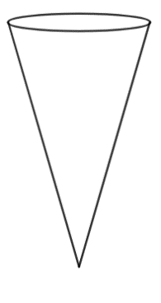
Surface area of a cone – part 1
Net of a cone
What would the net of a cone look like?
Can you draw it?
Notes:
Have students draw the net first.
Then display this GeoGebra link: https://www.geogebra.org/m/knvtp9KK
You can slowly slide the ‘Net’ slider across to demonstrate the net being deconstructed.

Slide 12
Surface area of a cone – part 2
Net of a cone
What would the net of a cone look like?
Can you draw it?
Go to bit.ly/geogebranetofcone to compare your net.
Notes:
Have students draw the net first.
Then display this GeoGebra link: https://www.geogebra.org/m/knvtp9KK
You can slowly slide the ‘Net’ slider across to demonstrate the net being deconstructed.

Slide 13
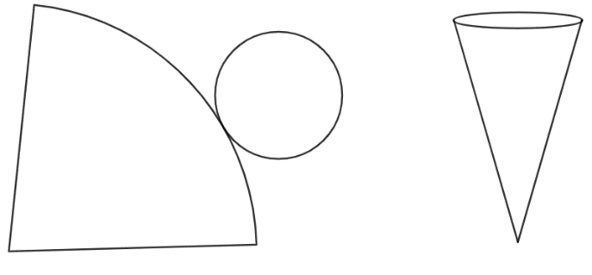
Formula – part 1
Surface area of a cone
What shapes make up the net of a cone?
What formulas could be used to find the surface area of a cone?

Slide 14
Formula – part 2
Surface area of a cone
$$Surface area=πr^{2}+πrl$$

Slide 15
Worked example 2
Surface area of a cone
$$SA=πr^{2}+πrl$$
$$l=\sqrt{{10}^{2}+2^{2}}$$
$l=10.19804$… cm
$$SA=π×2^{2}+π×2×10.198$$
$$SA=76.64255…$$
$$SA=76.6 cm^{2}$$
Which part of the cone is $l$?
What does each part of the calculation represent?

Slide 16
Your turn – example 2
Surface area of a cone – your turn
Find the surface area of the cone, using the formula:
$$SA=πr^{2}+πrl$$

Slide 17
Your turn – example 2 – solution
Surface area of a cone
Find the surface area of the cone, using the formula:
$$SA=πr^{2}+πrl$$
$$l=\sqrt{3^{2}+9^{2}}$$
$$l=9.5cm$$
$$SA=π×3^{2}+π×3×9.5$$
$$SA=117.8cm^{2}$$
What effect has rounding the slant height to 1 decimal place had on the final answer?

Slide 18
Copyright
© State of New South Wales (Department of Education), 2024
The copyright material published in this resource is subject to the Copyright Act 1968 (Cth) and is owned by the NSW Department of Education or, where indicated, by a party other than the NSW Department of Education (third-party material).
Copyright material available in this resource and owned by the NSW Department of Education is licensed under a Creative Commons Attribution 4.0 International (CC BY 4.0) licence.
This licence allows you to share and adapt the material for any purpose, even commercially.
Attribution should be given to © State of New South Wales (Department of Education), 2023.
Material in this resource not available under a Creative Commons licence:
the NSW Department of Education logo, other logos and trademark-protected material
Material owned by a third party that has been reproduced with permission. You will need to obtain permission from the third party to reuse its material.
Links to third-party material and websites
Please note that the provided (reading/viewing material/list/links/texts) are a suggestion only and implies no endorsement, by the New South Wales Department of Education, of any author, publisher, or book title. School principals and teachers are best placed to assess the suitability of resources that would complement the curriculum and reflect the needs and interests of their students.
If you use the links provided in this document to access a third party’s website, you acknowledge that the terms of use, including licence terms set out on the third-party’s website apply to the use which may be made of the materials on that third-party website or where permitted by the Copyright Act 1968 (Cth). The department accepts no responsibility for content on third-party websites.

