Slide 1
Exploring unknowns
Prisms and cylinders

Slide 2
Area
Exploring unknowns

Slide 3
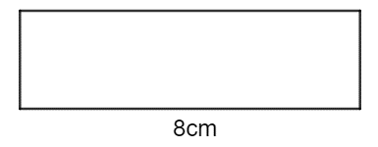
Area – question 1
Exploring unknowns using algebraic techniques
A rectangle has a base length of 8cm and perimeter of 20cm.
Determine the missing dimension of the rectangle.
$$P=l+l+b+b$$
$$20=8+8+x+x$$
$$20=16+2x$$
$$2x=4$$
$$x=2cm$$

Slide 4
Area – question 2
Exploring unknowns using algebraic techniques
A rectangle has a base length of 8cm and area of 20cm².
Determine the missing dimension of the rectangle.
$$A=l×b$$
$$20=8×x$$
$$20=8x$$
$$8x=20$$
$$x=2.5cm$$

Slide 5
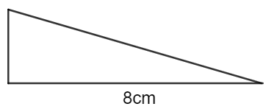
Area – question 3
Exploring unknowns using algebraic techniques
A triangle has a base length of 8cm and area of 20cm².
Determine the missing dimensions of the triangle.
$$A=\frac{1}{2}bh$$
$$20=\frac{1}{2}×8×x$$
$$20=4x$$
$$4x=20$$
$$x=5cm$$

Slide 6
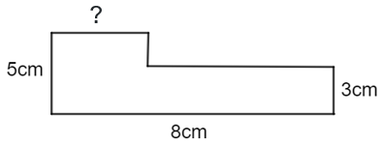
Area – question 4 – method 1
Exploring unknowns using algebraic techniques
A composite shape has measurements as shown below.
Determine the missing dimensions if it is known that the area is 30cm².
$$A=A_{1}+A_{2}$$
$$30=8×3+2×x$$
$$30=24+2x$$
$$6=2x$$
$$2x=6$$
$$x=3cm$$
$$A_{1}$$
$$A_{2}$$
Notes:
Ask students if this could have been solved in a different way?

Slide 7
Area – question 4 – method 2
Exploring unknowns using algebraic techniques
A composite shape has measurements as shown below.
Determine the missing dimensions if it is known that the area is 30cm².
Alternate method
$$A=A_{1}+A_{2}$$
$$30=5×x+3×(8−x)$$
$$30=5x+24−3x$$
$$30=2x+24$$
$$2x=6$$
$$x=3cm$$
$$A_{1}$$
$$A_{2}$$
Notes:
Ask students if this could have been solved in a different way?

Slide 8
Volume
Exploring unknowns

Slide 9
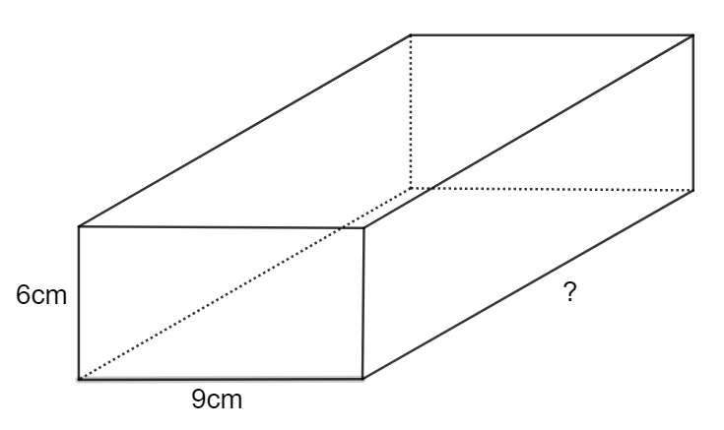
Volume – question 1
Exploring unknowns using algebraic techniques
A rectangular prism has a height of 6cm, a width of 9cm and a volume of 594cm³.
Determine the missing dimension of the prism.
$$V=Ah$$
$$594=6×9×x$$
$$594=54x$$
$$54x=594$$
$$x=11cm$$

Slide 10
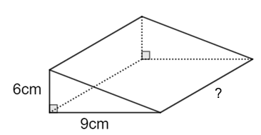
Volume – question 2
Exploring unknowns using algebraic techniques
A triangular prism has a height of 6cm, a width of 9cm and a volume of 594cm³.
Determine the missing dimension of the prism.
$$V=Ah$$
$$594=\frac{1}{2}×6×9×x$$
$$594=27x$$
$$27x=594$$
$$x=22cm$$

Slide 11
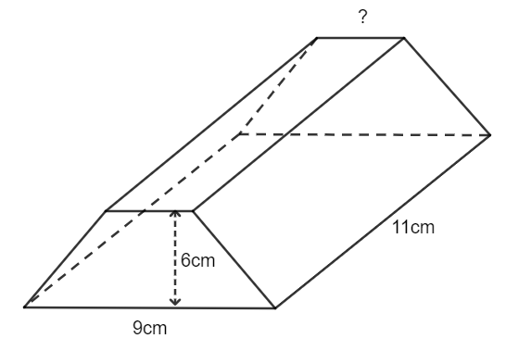
Volume – question 3 – method 1
Exploring unknowns using algebraic techniques
A trapezoidal prism has a height of 6cm, a width of 9cm, a depth of 11cm and a volume of 594cm³.
Determine the missing dimension of the prism.
$$V=Ah$$
$$594=\frac{6}{2}(x+9)×11$$
$$594=3\left(x+9\right)×11$$
$$594=33(x+9)$$
$$594=33x+297$$
$$33x=297$$
$$x=9 cm$$
Notes:
Ask student if anyone solved this in a different way. Or can it be solved in a different way??

Slide 12
Volume – question 3 – method 2
Exploring unknowns using algebraic techniques
A trapezoidal prism has a height of 6cm, a width of 9cm, a depth of 11cm and a volume of 594cm³.
Determine the missing dimension of the prism.
$$V=Ah$$
Alternate method
$$594=3\left(x+9\right)×11$$
$$594=33(x+9)$$
$$18=x+9$$
$$x+9=18$$
$$x=9 cm$$

Slide 13
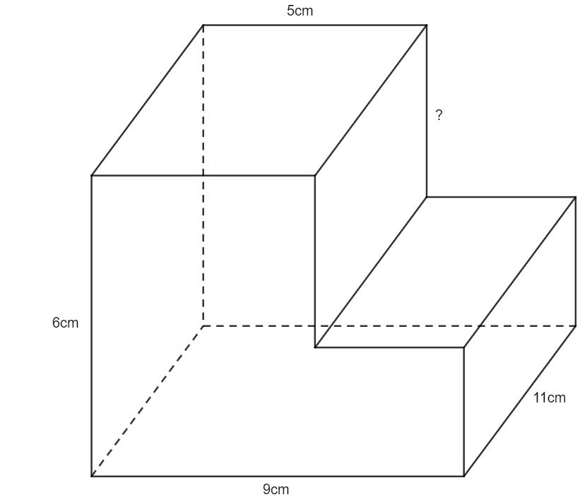
Volume – question 4
Exploring unknowns using algebraic techniques
A composite solid is shown below. It is known that the volume is 462cm³.
Determine the missing dimension of the prism.
$$V=Ah$$
$$V=\left({Area}_{1}+{Area}_{2}\right)×h$$
$$462=\left(x×5+9×(6−x)\right)×11$$
$$462=\left(5x+54−9x\right)×11$$
$$462=\left(54−4x\right)×11$$
$$462=594−44x$$
$$44x=132$$
$$x=3cm$$
$${Area}_{1}$$
$${Area}_{2}$$

Slide 14
Surface area
Exploring unknowns

Slide 15
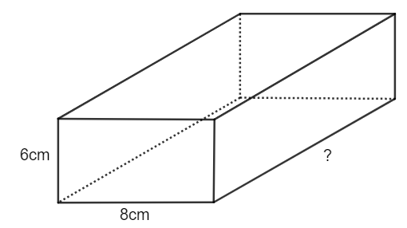
Surface area – question 1
Exploring unknowns using algebraic techniques
A rectangular prism has a height of 6cm, a width of 8cm and a surface area of 390cm².
Determine the missing dimension of the prism.
$$SA=2×front+2×side+2×top$$
$$390=\left(2×6×8\right)+\left(2×6×x\right)+(2×8×x)$$
$$390=96+12x+16x$$
$$390=96+28x$$
$$28x=294$$
$$x=10.5cm$$

Slide 16
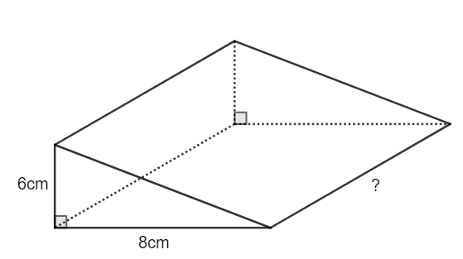
Surface area – question 2
Exploring unknowns using algebraic techniques
A triangular prism has a height of 6cm, a width of 8cm and a surface area of 390cm².
Determine the missing dimension of the prism.
$$SA=2×front+base+back+slope rectangle$$
$$390=\left(2×\frac{1}{2}×6×8\right)+\left(8×x\right)+\left(6×x\right)+(10×x)$$
$$390=48+8x+6x+10x$$
$$390=48+24x$$
$$24x=342$$
$$x=14.25cm$$
Find the hypotenuse
$$h=\sqrt{8^{2}+6^{2}}$$
$$h=\sqrt{100}$$
$$h=10$$

Slide 17
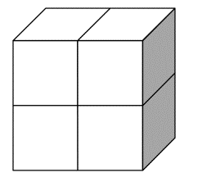
Surface area – question 3
Exploring unknowns using algebraic techniques
Four cubes, each with a surface area of 24cm² are placed together to make a cuboid as shown.
What is the surface area of this cuboid?
One cube has a surface area of 24cm².
$$SA=6×area of one square face$$
$$24=6×x$$
$$x=4cm^{2}$$
Surface area of cuboid.
$$SA=16×area of square face$$
$$SA=16×4$$
$$SA=64cm^{2}$$

Slide 18
Apply
Exploring unknowns

Slide 19
Question 1a
Exploring unknowns using algebraic techniques
Two rectangular prisms hold the same volume. The first rectangular prism has a length of 10cm, a width of 8cm but the height is unknown. The second rectangular prism has a length of 5cm, a width of 8cm but the height is unknown. It is known that the second rectangular prisms height is 2cm more than the height of the first rectangular prism. By constructing an equation, find the height of each of the rectangular prisms.
$${Volume }_{1}={Volume }_{2}$$
$$10×8×x=5×8×(x+2)$$
$$80x=40(x+2)$$
$$80x=40x+80$$
$$40x=80$$
$$x=2$$
The first prism has a height of 2cm and the second prism has a height of 4cm.

Slide 20
Question 1b
Exploring unknowns using algebraic techniques
Two rectangular prisms hold the same volume. The first rectangular prism has a length of 10cm, a width of 8cm but the height is unknown. The second rectangular prism has a length of 5cm, a width of 8cm but the height is unknown. It is known that the second rectangular prisms height is 2cm more than the height of the first rectangular prism. By constructing an equation, find the height of each of the rectangular prisms.
$${Surface area }_{1}={Surface area }_{2}$$
$$\left(2×10×8\right)+\left(2×10×x\right)+\left(2×8×x\right)=\left(2×5×8\right)+\left(2×5×\left(x+2\right)\right)+\left(2×8×\left(x+2\right)\right)$$
$$160+20x=80+10\left(x+2\right)+16(x+2)$$
$$160+20x=80+10x+20+16x+36$$
$$160+20x=136+26x$$
$$6x=24$$
$$x=4$$

Slide 21
Question 2 – money tin problem
Exploring unknowns using algebraic techniques
A company must create 1000 cylindrical money tins from a sheet of tin-coated steel that has dimensions 14m by 15m. If the diameter of the money tin must be 18cm, calculate the height that each money tin will be, in terms of $π$, by firstly rearranging the equation for the surface area of a cylinder such that $h$ is the subject.
$$SA=2πr^{2}+2πrh$$
$$SA−2πr^{2}=2πrh$$
$$2πrh=SA−2πr^{2}$$
$$h=\frac{SA−2πr^{2}}{2πr}$$
The surface area of one money tin
$$=\frac{1400cm×1500cm}{1000}$$
$$=\frac{2 100 000 cm^{2}}{1000}$$
$$=2100cm^{2}$$
$$h=\frac{SA−2πr^{2}}{2πr}$$
$$h=\frac{2100−2π×9^{2}}{2π×9}$$
$$h=\frac{2100−162π}{18π}$$

Slide 22
Copyright
© State of New South Wales (Department of Education), 2024
The copyright material published in this resource is subject to the Copyright Act 1968 (Cth) and is owned by the NSW Department of Education or, where indicated, by a party other than the NSW Department of Education (third-party material).
Copyright material available in this resource and owned by the NSW Department of Education is licensed under a Creative Commons Attribution 4.0 International (CC BY 4.0) licence.
This licence allows you to share and adapt the material for any purpose, even commercially.
Attribution should be given to © State of New South Wales (Department of Education), 2023.
Material in this resource not available under a Creative Commons licence:
the NSW Department of Education logo, other logos and trademark-protected material
Material owned by a third party that has been reproduced with permission. You will need to obtain permission from the third party to reuse its material.
Links to third-party material and websites
Please note that the provided (reading/viewing material/list/links/texts) are a suggestion only and implies no endorsement, by the New South Wales Department of Education, of any author, publisher, or book title. School principals and teachers are best placed to assess the suitability of resources that would complement the curriculum and reflect the needs and interests of their students.
If you use the links provided in this document to access a third party’s website, you acknowledge that the terms of use, including licence terms set out on the third-party’s website apply to the use which may be made of the materials on that third-party website or where permitted by the Copyright Act 1968 (Cth). The department accepts no responsibility for content on third-party websites.

