Slide 1
A shopping plan
Explicit teaching

Slide 2
A shopping plan (1)
Launch
Ivy bakes a muesli bar slice on Monday morning and takes $\frac{1}{12}$ of the slice to work with her each weekday. By next Wednesday night, she has $\frac{1}{3}$ of the slice left. How many more $\frac{1}{12}$ pieces can she make?

Slide 3
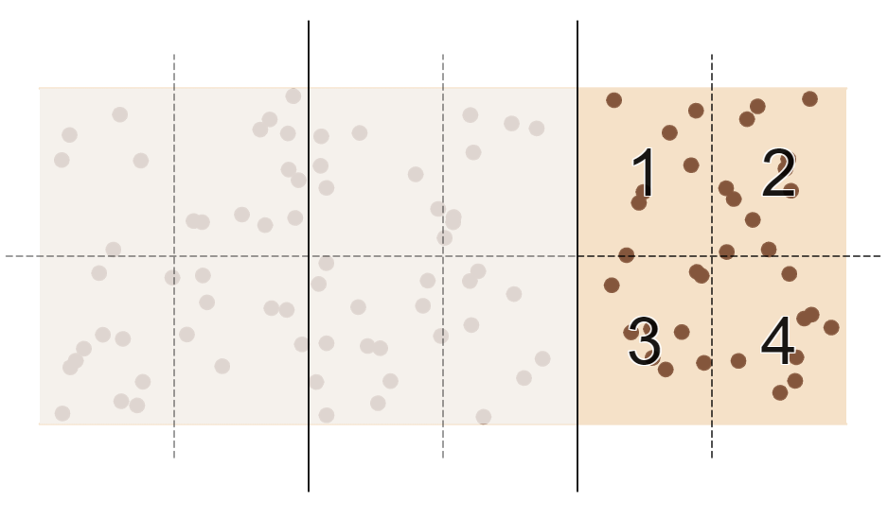
A shopping plan (2)
Launch – solution
Ivy bakes a muesli bar slice on Monday morning and takes $\frac{1}{12}$ of the slice to work with her each weekday. By next Wednesday night, she has $\frac{1}{3}$ of the slice left. How many more $\frac{1}{12}$ pieces can she make? 4 pieces.

Slide 4
A shopping plan (3)
Launch – reflection
Finding how many $\frac{1}{12}$ we can make from $\frac{1}{3}$ is the same as $\frac{1}{3}÷\frac{1}{12}$.
If $\frac{1}{3}÷\frac{1}{12}=4$, what might $\frac{1}{5}÷\frac{1}{15}$ be equal to?

Slide 5
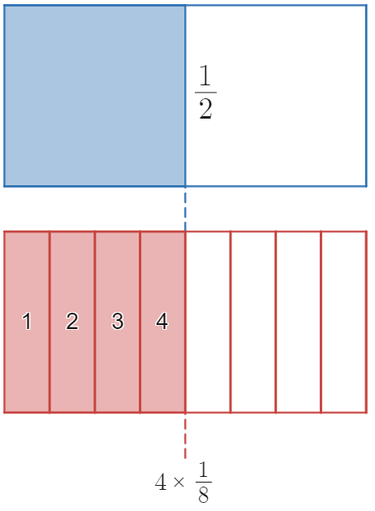
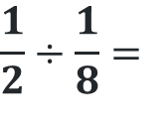
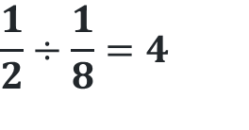
A shopping plan (4)
Dividing fractions – example 1
$$\frac{1}{2}÷\frac{1}{8}=$$
$$\frac{1}{2}÷\frac{1}{8}=4$$

Slide 6
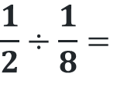
A shopping plan (5)
Dividing fractions – prompts 1
Why don’t we divide one half into 8 pieces?
$$\frac{1}{2}÷\frac{1}{8}=$$
How do we know to count 4 of the ‘eighths’?
$$\frac{1}{2}÷\frac{1}{8}=4$$
What will it mean when the 2 fractions can’t be lined up?

Slide 7
A shopping plan (6)
Your turn – question 1
$$\frac{5}{6}÷\frac{1}{12}=$$

Slide 8
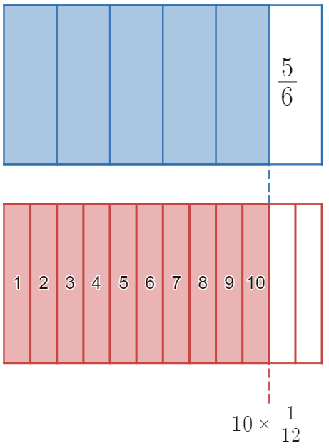
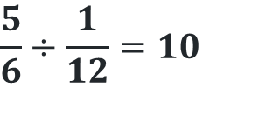
A shopping plan (7)
Your turn – solution 1
$$\frac{5}{6}÷\frac{1}{12}=10$$

Slide 9
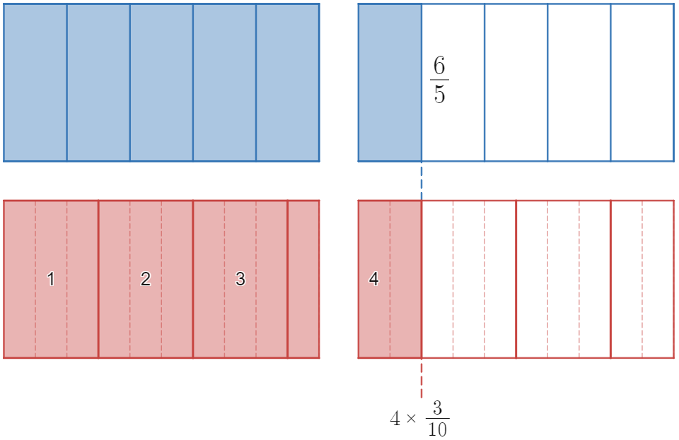
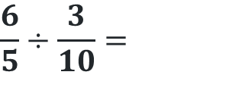
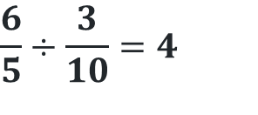
A shopping plan (8)
Dividing fractions – example 2
$$\frac{6}{5}÷\frac{3}{10}=$$
$$\frac{6}{5}÷\frac{3}{10}=4$$

Slide 10
A shopping plan (9)
Dividing fractions – prompts 2
Why is this fraction built using 2 rectangles?
$$\frac{6}{5}÷\frac{3}{10}=$$
Why do we need the dotted lines as well as the full lines?
$$\frac{6}{5}÷\frac{3}{10}=4$$

Slide 11
A shopping plan (10)
Your turn – question 2
$$\frac{5}{3}÷\frac{5}{12}=$$

Slide 12
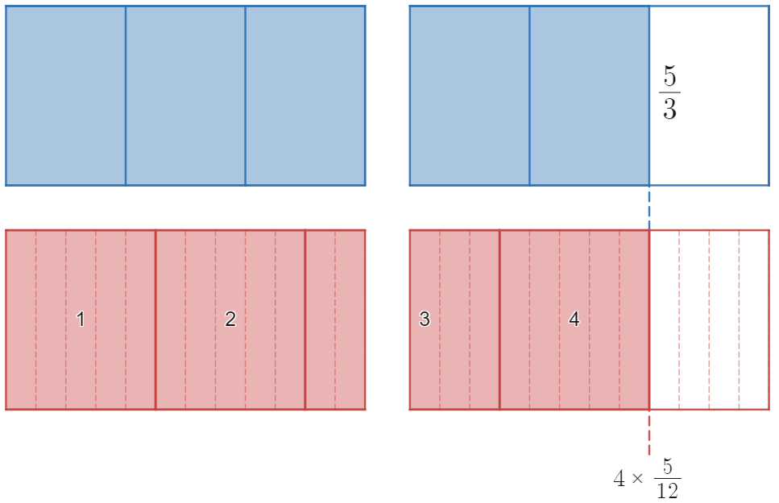
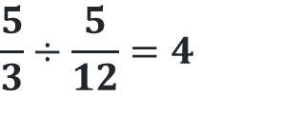
A shopping plan (11)
Your turn – solution 2
$$\frac{5}{3}÷\frac{5}{12}=4$$

Slide 13
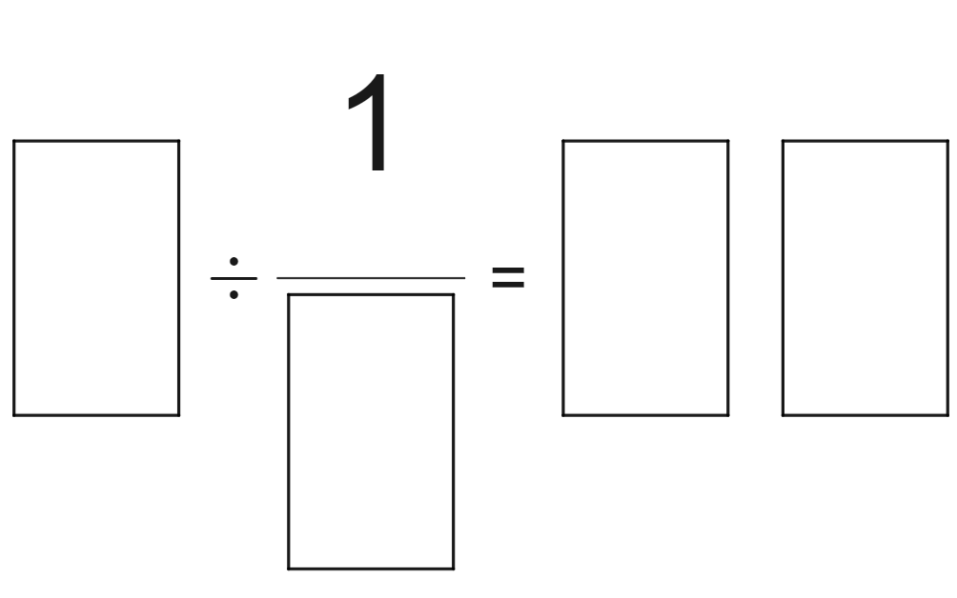
A shopping plan (12)
Open middle problem
$$\text{Use} \text{the} \text{integers} \text{from}\text{ 1 }\text{to}\text{ 9 }\text{at} \text{most} \text{once} \text{to} \text{obatin} \text{the} \text{largest} \text{possible} \text{result}\text{.}$$

Slide 14
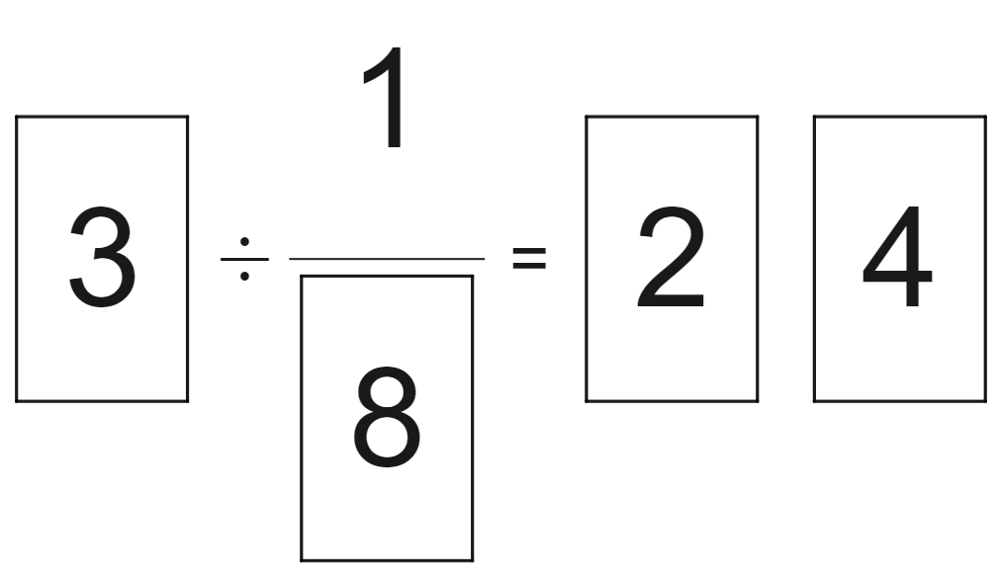
A shopping plan (13)
Open middle problem – possible solution

