Slide 1
A quick guess
Explicit teaching

Slide 2
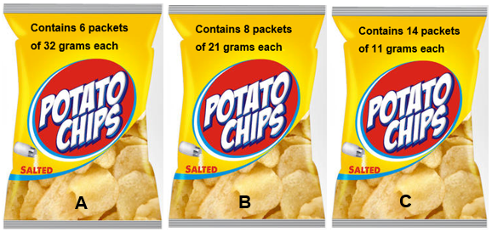
Multi-packs of potato chips
A, B and C are all the same price.
Which multi-pack is the best value?
‘Chips Packaging Mock PSD Template’ by Designbolts is licensed under CC BY-NC-ND 3.0

Slide 3
Would you rather? – part 1
Share a chocolate bar with one friend. | Share a box of chocolates with 9 friends.

Slide 4
Would you rather? – part 2
Win $1000 on your own. | Win $10 000 with 3 friends.

Slide 5
Would you rather? – part 3
Have one regular slice of round cake. | Have $1\frac{1}{2}$ fun size chocolate bars.

Slide 6
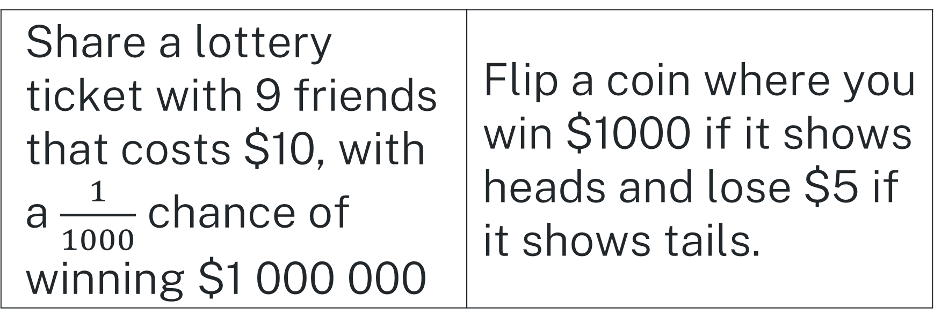
Would you rather? – part 4
Share a lottery ticket with 9 friends that costs $10, with a $\frac{1}{1000}$ chance of winning $1 000 000 | Flip a coin where you win $1000 if it shows heads and lose $5 if it shows tails.

Slide 7
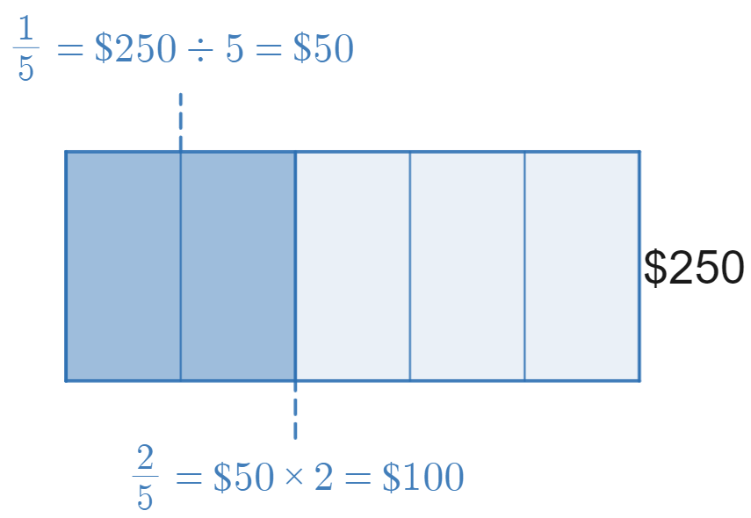
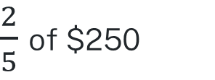
Fractions of quantities
Example 1
$\frac{2}{5}$ of $250
Image created using Desmos and is licensed under the Desmos Terms of Service.
$\frac{2}{5}$ of $250 = $100

Slide 8
Using zero pairs
Example 1
$\frac{2}{5}$ of $250
How do we know to divide by 5?
What does the entire rectangle represent?
What do you know about the remainder of $250?
Image created using Desmos and is licensed under the Desmos Terms of Service.
$\frac{2}{5}$ of $250 = $100

Slide 9
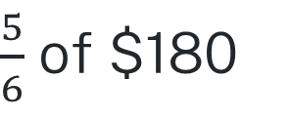
Your turn
Question 1
$\frac{5}{6}$ of $180

Slide 10
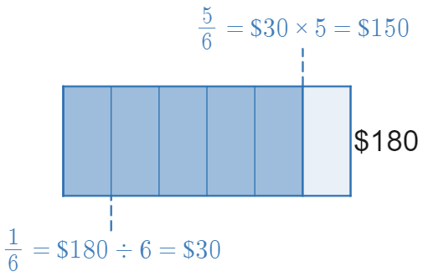
Your turn – solution 1
$\frac{5}{6}$ of $180 = $150
Image created using Desmos and is licensed under the Desmos Terms of Service.

Slide 11
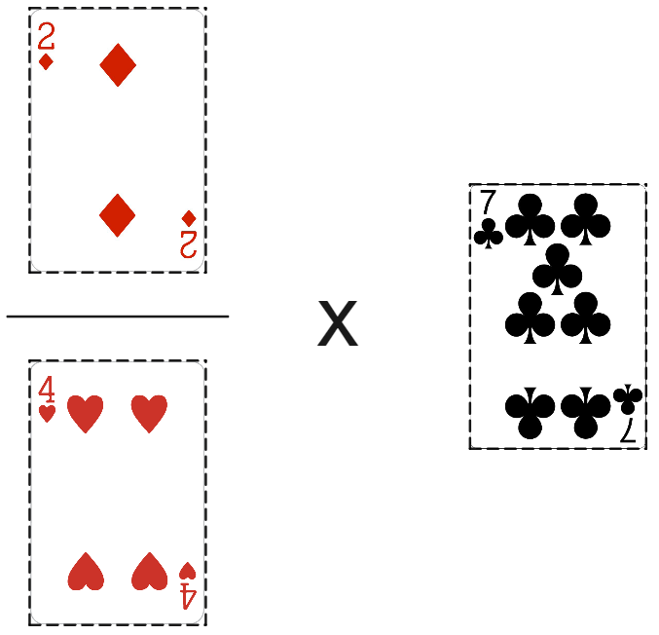
Cardcraft – fraction frenzy
A move with the cards 2, 4 and 7, showing $\frac{2}{4}×7$.
‘Playing Cards PNG Transparent Images’ by Rojal is licensed under CC BY-NC 4.0
Notes:
Game rules:
Keep students in their groups of 3, and hand each group a deck of cards.
On each turn, all players take three cards.
Players are to place these three cards somewhere on their game board to gain obtain the highest possible multiplication.
The player with the highest multiplication wins the round and collects all used cards from that round.
The game ends when all cards are played.
At the end of the game, the player with the most cards wins.

