Slide 1
The magical factor trees
Launch

Slide 2
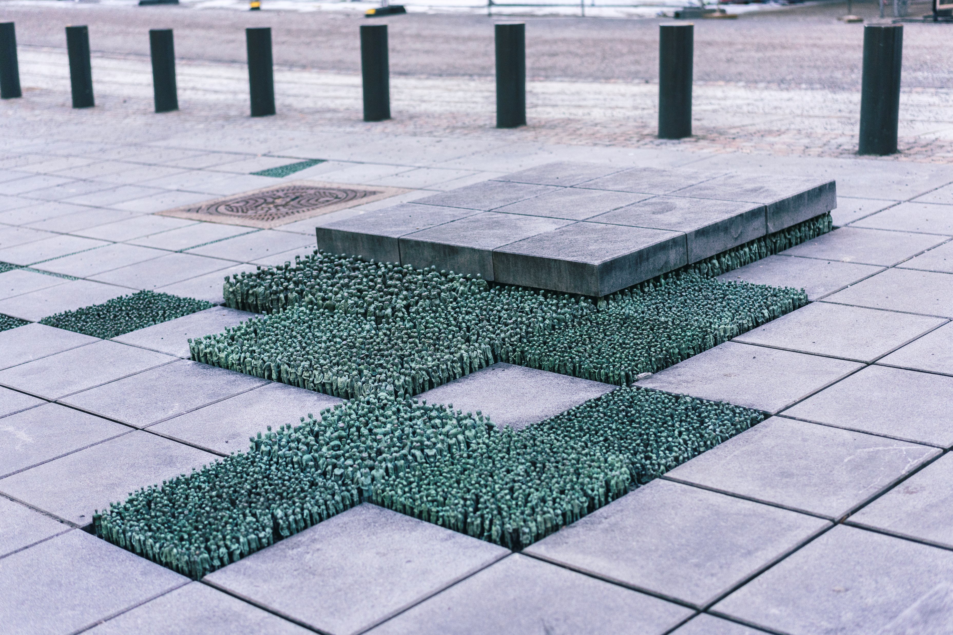
‘Grass roots square’ (1)
By Korean-American artist Do Ho Suh in Oslo, Norway
What do you notice?
What do you wonder?
‘Grass Roots Square by Korean-American artist Do Ho Suh in Oslo, Norway’ by Lorie Shaull licensed under CC BY 2.0.

Slide 3
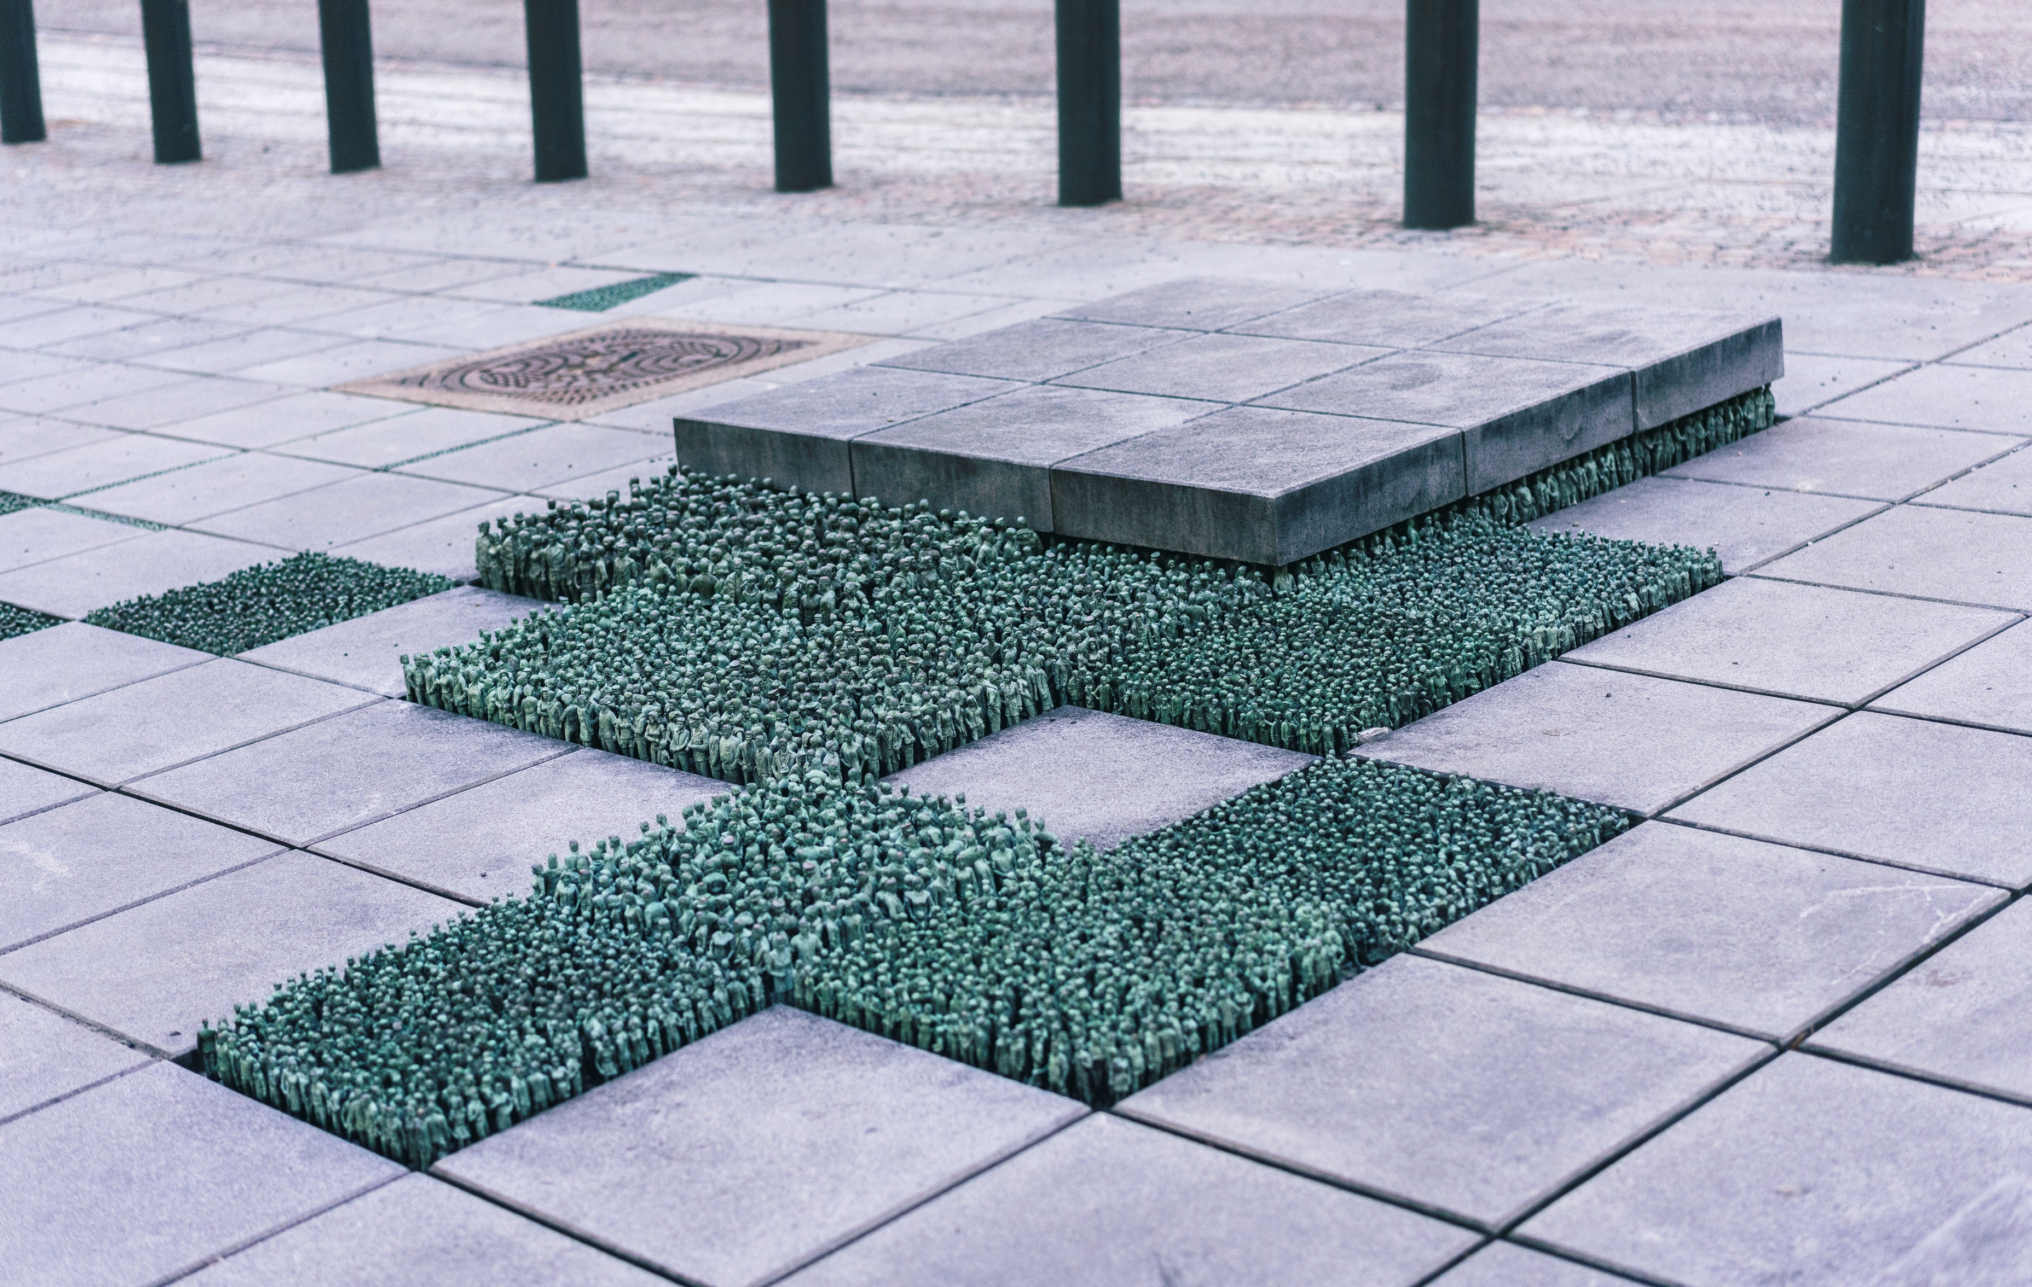
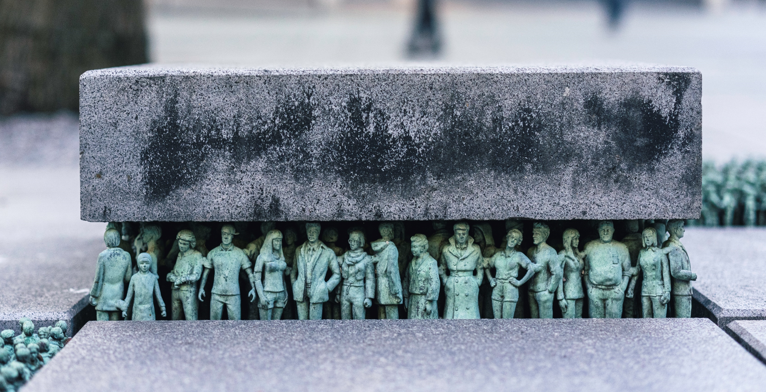
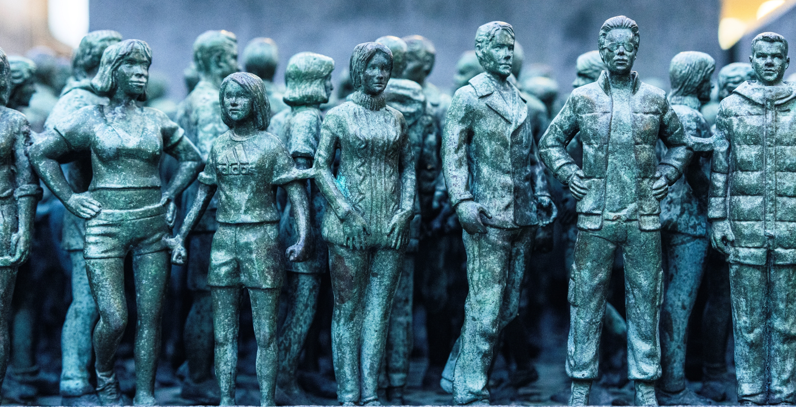
‘Grass roots square’ (2)
By Korean-American artist Do Ho Suh in Oslo, Norway
What do you notice?
What do you wonder?
‘Grass Roots Square by Korean-American artist Do Ho Suh in Oslo, Norway’ by Lorie Shaull licensed under CC BY 2.0.

Slide 4
‘Grass roots square’ scenario
There are 784 students at the school.
How many figurines will be in each row?

Slide 5
Finding the cube root (1)
The magical factor trees
$$\sqrt[3]{64}=4$$

Slide 6
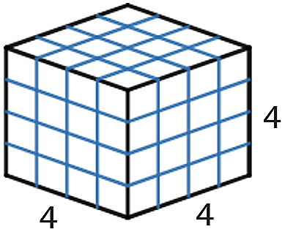
Finding the cube root (2)
The magical factor trees
The volume of the cube is 64 cubic units because
$$4×4×4=64$$
We write:
$$\sqrt[3]{64}=4$$
We say: ‘The cube root of 64 is 4’.

Slide 7
Factor trees (1)
The magical factor trees
Use a factor tree to write the number 72 as a product of its prime factors, in index form.
$$72=2×2×2×3×3$$
$$72=2^{3}×3^{2}$$

Slide 8
Factor trees (2)
The magical factor trees – self explanation prompts
Use a factor tree to write the number 72 as a product of its prime factors, in index form.
What other numbers could we start the factor tree with?
$$72=2×2×2×3×3$$
Why did we write the numbers in this order?
$$72=2^{3}×3^{2}$$
Why did we stop here?

Slide 9
Factor trees: Your turn
The magical factor trees
Use a factor tree to write the number 180 as a product of its prime factors, in index form.

Slide 10
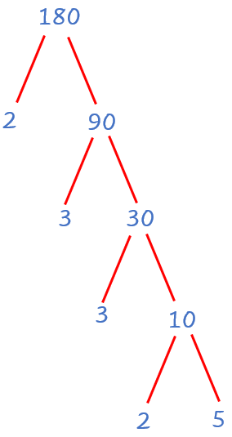
Factor trees: Your turn solution
The magical factor trees
Use a factor tree to write the number 180 as a product of its prime factors, in index form.
$$180=2×2×3×3×5$$
$$180=2^{2}×3^{2}×5$$

Slide 11
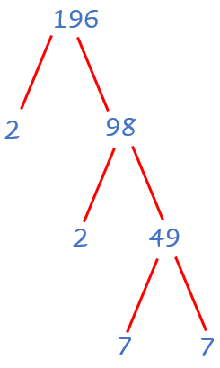
Square roots (1)
The magical factor trees
Use a factor tree to find $\sqrt{196}$.
$$196=2×2×7×7$$
$$196=(2×7)×(2×7)$$
$$196=14×14$$
$$196={14}^{2}$$
$$∴\sqrt{196}=14$$

Slide 12
Square roots (2)
The magical factor trees – self explanation prompts
Use a factor tree to find $\sqrt{196}$.
$$196=2×2×7×7$$
Why have the numbers been grouped?
$$196=(2×7)×(2×7)$$
$$196=14×14$$
Why is this symbol used here?
$$196={14}^{2}$$
$$∴\sqrt{196}=14$$

Slide 13
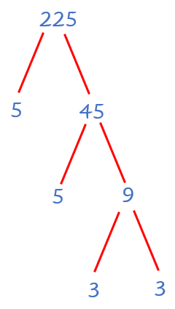
Perfect square: Your turn
The magical factor trees
Use a factor tree to find $\sqrt{225}$.

Slide 14
Perfect square: Your turn solution
The magical factor trees
Use a factor tree to find $\sqrt{225}$.
$$225=3×3×5×5$$
$$225=(3×5)×(3×5)$$
$$225=15×15$$
$$225={15}^{2}$$
$$∴\sqrt{225}=15$$

Slide 15
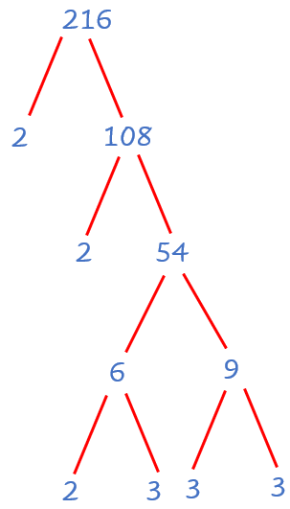
Cubic numbers (1)
The magical factor trees
Use a factor tree to find $\sqrt[3]{216}$.
$$216=2×2×2×3×3×3$$
$$216=(2×3)×(2×3)×(2×3)$$
$$216=6×6×6$$
$$216=6^{3}$$
$$∴\sqrt[3]{216}=6$$

Slide 16
Cubic numbers (2)
The magical factor trees – self explanation prompts
Use a factor tree to find $\sqrt[3]{216}$.
How do we know how to group the factors?
$$216=2×2×2×3×3×3$$
$$216=(2×3)×(2×3)×(2×3)$$
$$216=6×6×6$$
Why does this line tell us what the next line is?
$$216=6^{3}$$
$$∴\sqrt[3]{216}=6$$

Slide 17
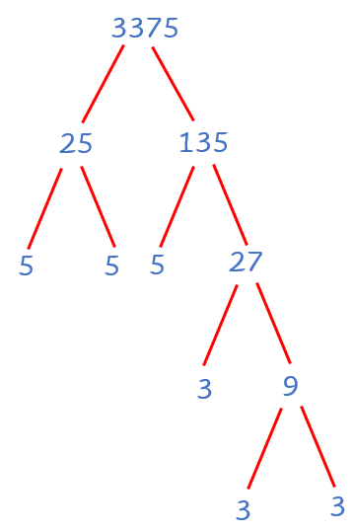
Cubic numbers: Your turn
The magical factor trees
Use a factor tree to find $\sqrt[3]{3375}$.

Slide 18
Cubic numbers: Your turn solution
The magical factor trees
Use a factor tree to find $\sqrt[3]{3375}$.
$$3375=3×3×3×5×5×5$$
$$3375=(3×5)×(3×5)×(3×5)$$
$$3375=15×15×15$$
$$3375={15}^{3}$$
$$∴\sqrt[3]{3375}=15$$

Slide 19
Two truths, one lie
Can you figure out which of the following are true and which one is the lie?
$\sqrt{36}=6$
$\sqrt{36}=\sqrt{16+16+4}=\sqrt{16}+\sqrt{16}+\sqrt{4}$
$\sqrt{36}=\sqrt{4×9}=\sqrt{4}×\sqrt{9}$

Slide 20
Two truths, one lie solution
Did you figure out which of the following are true and which one is the lie?
$\sqrt{36}=6$
$\sqrt{36}=\sqrt{16+16+4}=\sqrt{16}+\sqrt{16}+\sqrt{4}$
$\sqrt{36}=\sqrt{4×9}=\sqrt{4}×\sqrt{9}$

