Slide 1
The ants go marching
Explicit teaching

Slide 2
The ants go marching: Launch
Launch

Slide 3
Arrays and counters
Four counters in 2 different arrays.
How else might you arrange 4 counters to make an array?
Notes:
Encourage students to discuss things they see in common and things that are different between the numbers and the arrays.

Slide 4
The ants go marching: Explore
Explore

Slide 5
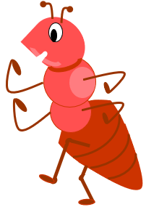
The ants go marching one by one
The little one stops to suck his thumb
Do you know the song?
According to the song, the ants are marching to get out of the rain. Meanwhile, the little one keeps getting up to mischief.
Notes:
Explain to the students that using the theme of the song “The ants go marching” encourages them to visualise a formation of a square array.
The students aren’t required to remember the words to the song.
An age-appropriate version of the song can be viewed on ‘YouTube’ (bit.ly/VideoAntsGoMarching).

Slide 6
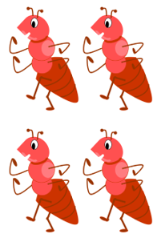
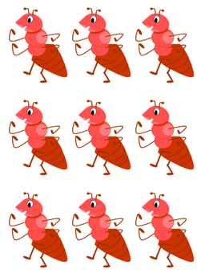
They all go marching
Down, to the ground, to get out, of the rain.
Formation | Number of ants
1 by 1 | 1
2 by 2
3 by 3
4 by 4
5 by 5
6 by 6
7 by 7
8 by 8
9 by 9
10 by 10
Notes:
Students will be able to refer to the arrays from Appendix A to complete the first half of the table.
However, once students reach 6 by 6, they will need to calculate the value.
Encourage students to visualise an array and use their multiplicative strategies to calculate the value.

Slide 7
They all go marching: Solutions
Down, to the ground, to get out, of the rain.
Formation | Number of ants
1 by 1 | 1
2 by 2 | 4
3 by 3 | 9
4 by 4 | 16
5 by 5 | 25
6 by 6 | 36
7 by 7 | 49
8 by 8 | 64
9 by 9 | 81
10 by 10 | 100

Slide 8
Squares
How many squares?
What do you notice?
What do you think?

Slide 9
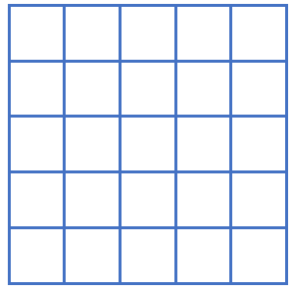
Squaring a number
How many squares?
Jo counted the small squares and said there are 25 squares.
Ari said the area is ‘5 squared’.
5

Slide 10
Cubing a number
Finding the volume of a cube.
Jo tried to count the number of small cubes but found it difficult because many can’t be seen.
What do you know about the volume of the cube?
Ari said there’s an easier way to know that there are 64 cubic units.

Slide 11
The ants go marching: Summarise
Summarise

Slide 12
Squaring (1)
Squaring and cubing
The area of the square is calculated by multiplying the length of the sides:
$$5×5=25$$
We write:
$$5^{2}=25$$
5
We say: ‘5 squared equals 25’.
5

Slide 13
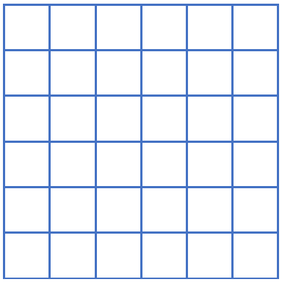
Squaring (2)
Example
The area of the square is:
$$6×6=36$$
We write:
$$6^{2}=36$$
6
We say: ‘6 squared equals 36.’
6

Slide 14
Squaring (3)
Terminology
The area of the square is:
$$6×6=36$$
The number 6 is called the base.
We write:
$$6^{2}=36$$
6
The small number can be called the index, the power or the exponent.
We say: ‘6 squared equals 36.’
6

Slide 15
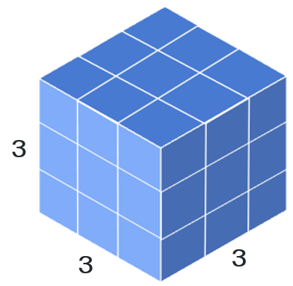
Cubing (1)
Squaring and cubing
The volume of the cube is calculated by multiplying the lengths together:
$$3×3×3=27$$
We write:
$$3^{3}=27$$
We say: ‘3 cubed equals 27’.

Slide 16
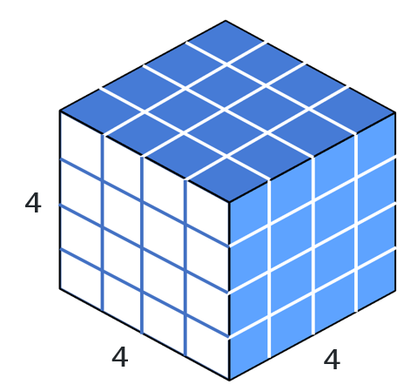
Cubing (2)
Example 2
The volume of the cube is calculated by multiplying the lengths together:
$$4×4×4=64$$
We write:
$$4^{3}=64$$
We say: ‘4 cubed equals 64’.

Slide 17
Cubing (3)
Terminology
The volume of the cube is calculated by multiplying the lengths together:
$$4×4×4=64$$
Why is this called a ‘numerical term’?
We write:
$$4^{3}=64$$
Why can we say, ‘4 cubed’ or ‘4 to the power of 3’?
We say: ‘4 cubed equals 64’.

Slide 18
Bigger Powers
Index notation
Calculation | What we write | What we say
$$7×7$$ | $$7^{2}$$ | Seven squared
$$6×6×6$$ | $$6^{3}$$ | Six cubed
$$2×2×2×2$$ | $$2^{4}$$ | Two to the power of 4
 | $$3^{5}$$ | Three to the power of 5
$$4×4×4×4×4×4$$
Why are only 2 shapes used when talking about powers?

Slide 19
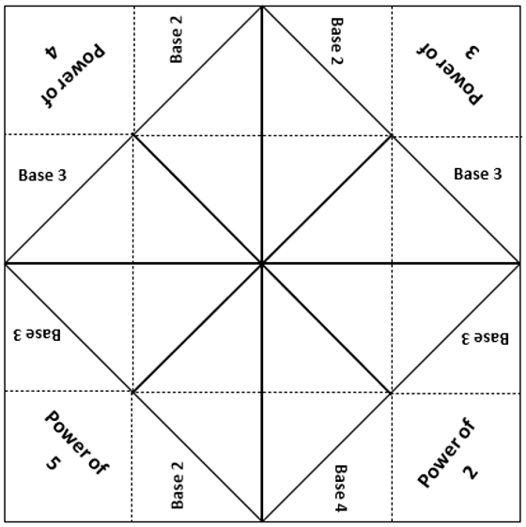
Chatterbox (1)
Powers
Copy the information onto your chatterbox.

Slide 20
Chatterbox (2)
Powers
Complete your chatterbox by filling in the blanks. Use the example as a guide.
Example:
‘3 to the power of 5’
$$3×3×3×3×3=3^{5}$$
243
‘3 to the power of 5’
$$3×3×3×3×3$$
$$=3^{5}$$

Slide 21
The ants go marching: Apply
Apply

Slide 22
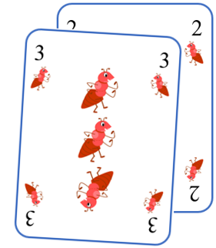
The ants go marching rules
How to play
To start, Player 1 deals 2 cards to each player.
Arrange your cards, using the example as a guide.
Calculate the value of the term and write it on the scorecard.
Replace the cards in the deck.
Player 2 shuffles and deals two cards.
Arrange the cards, record the score and calculate a progressive score.
Repeat for 10 rounds.
The winner is the player with the highest score after 10 rounds.
Example:
The 3 is the base, the 2 is the power, the term is $3^{2}$.

