Slide 1
Area models and divisibility tests
Explicit teaching
NSW Department of Education

Slide 2
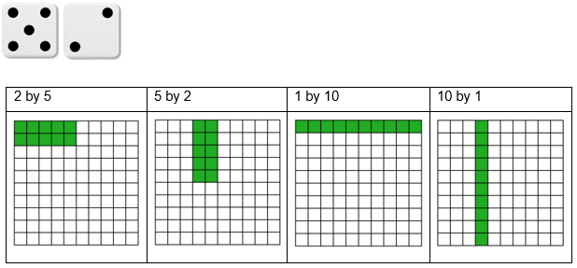
Blockout – an example turn
There are 4 ways to play this turn.
The rectangle can be placed anywhere that it fits.

Slide 3
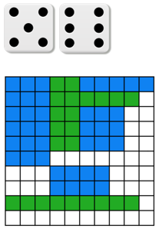
Blockout – an example turn that can’t be played
This turn can’t be played because there is no remaining space that is 5 by 6, 3 by 10 or 2 by 15.

Slide 4
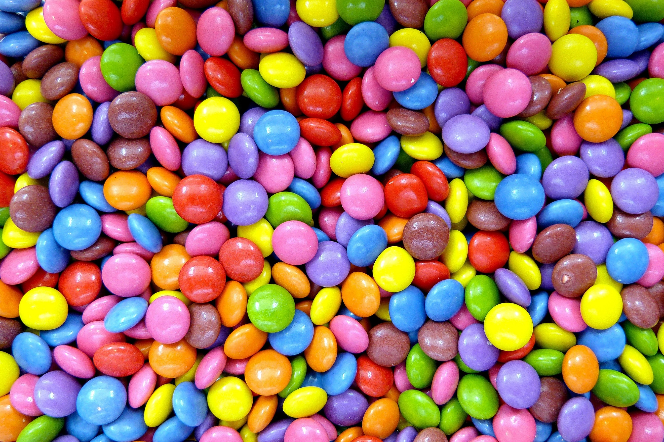
Sharing problem
640-gram bucket of chocolates
708 chocolates in total
Notes:
Problem to read to students
“Michael is having a movie night with his best friend Allen and wants to invite some other friends. He has a 640 gram bucket of tiny coloured chocolate treats to share, but he knows that Allen gets upset if there isn’t enough for everyone to have exactly the same amount. Michael knows the bucket has 708 chocolate treats inside.”

Slide 5
Sharing problem – Think-Pair-Share
Can Michael and Allen share the chocolates equally between the 2 of them? How do you know?
Can Michael invite one more friend and share the chocolates equally among three people? How do you know?
Michael has enough chairs for 10 people, including himself and Allen. What is the largest number of people he can have at the movie night and still share the chocolates equally?

Slide 6
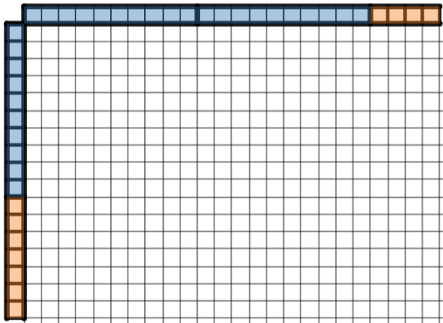
Area model multiplication with base-10 blocks – part 1
Image created using Desmos and is licensed under the Desmos Terms of Service.

Slide 7
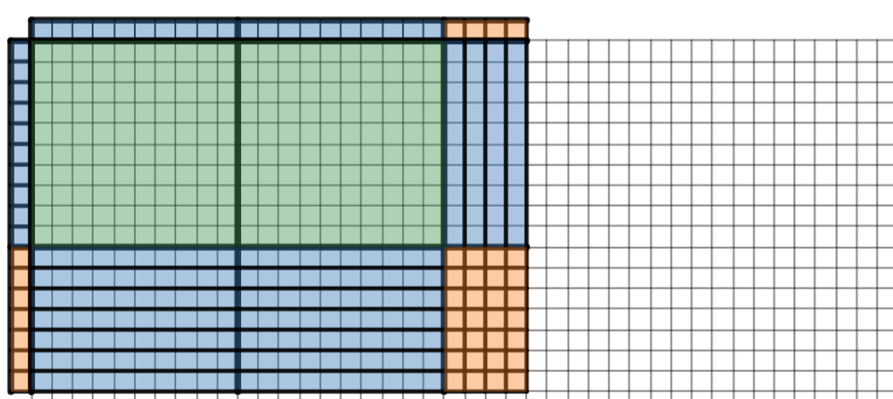
Area model multiplication with base-10 blocks – part 2
$$24×17=2 hundreds+4 tens+14 tens+28 ones$$
$$24×17=408$$
Image created using Desmos and is licensed under the Desmos Terms of Service.

Slide 8
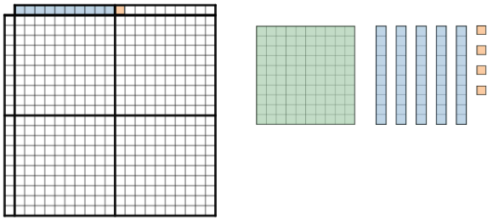
154 divided by 11 – area model
Image created using Desmos and is licensed under the Desmos Terms of Service.

Slide 9
154 divided by 11 – area model solution
Image created using Desmos and is licensed under the Desmos Terms of Service.

Slide 10
154 divided by 11 – self explanation prompts
How many ‘tens’ do we still have to place after this?
How do we know the solution is 14?
Image created using Desmos and is licensed under the Desmos Terms of Service.

