Slide 1
Negative groups of negatives
Explicit teaching
NSW Department of Education

Slide 2
Rolling a dice and drawing a card
This means 3 x 5 or 3 groups of 5.

Slide 3
Rolling a dice and drawing a card – result
3 groups of 5 would look like this with counters.

Slide 4
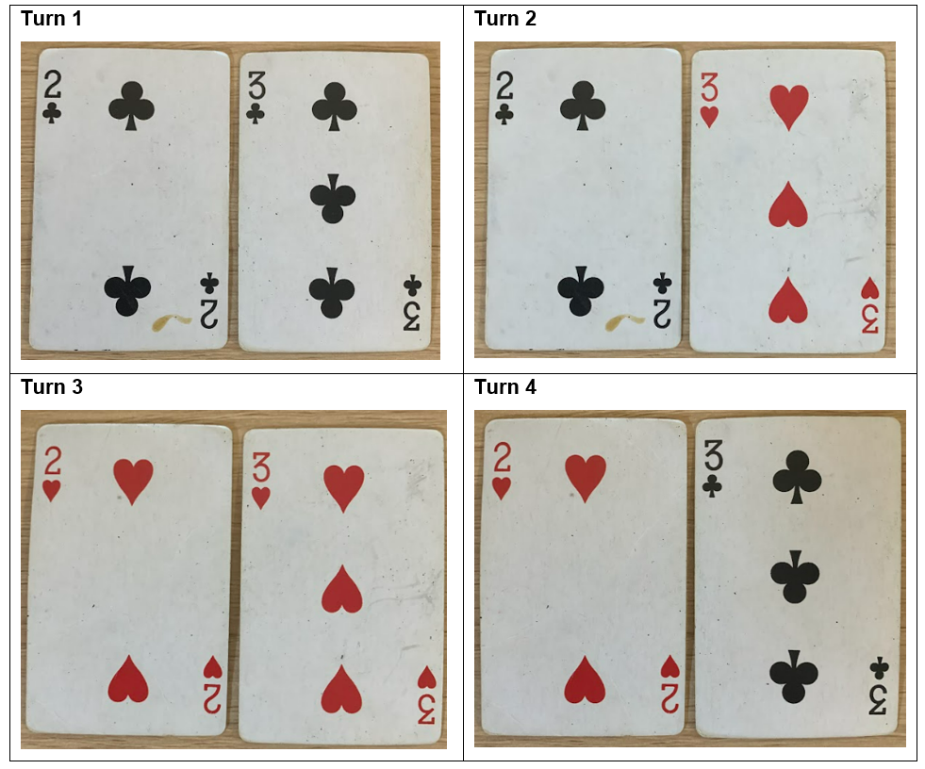
Drawing two cards – result
Each of these will either be 6 or (-6).

Slide 5
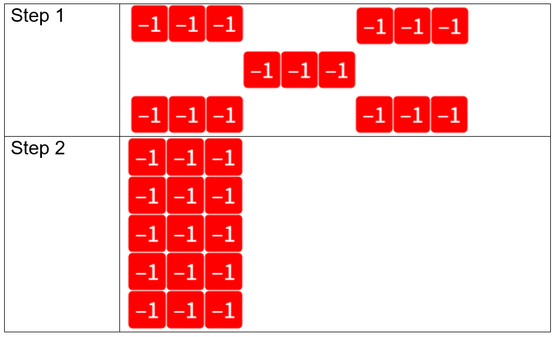
Groups of negatives – example
$$5×\left(−3\right)=$$
$$5×\left(−3\right)=(−15)$$
Notes:
Teacher notes: Step 1 should be seen as 5 groups of 3 negative ‘1’s, or ‘-1’s.
Step 2 should be seen as counting the negative ‘1’s.

Slide 6
Groups of negatives – prompts
$$5×\left(−3\right)=$$
Is there another way to represent this multiplication?
What is the quickest way to count these tiles?
$$5×\left(−3\right)=(−15)$$
Notes:
Teacher notes: Step 1 should be seen as 5 groups of 3 negative ‘1’s, or ‘-1’s.
Step 2 should be seen as counting the negative ‘1’s.

Slide 7
Your turn – question 1
$$2×\left(−6\right)=$$

Slide 8
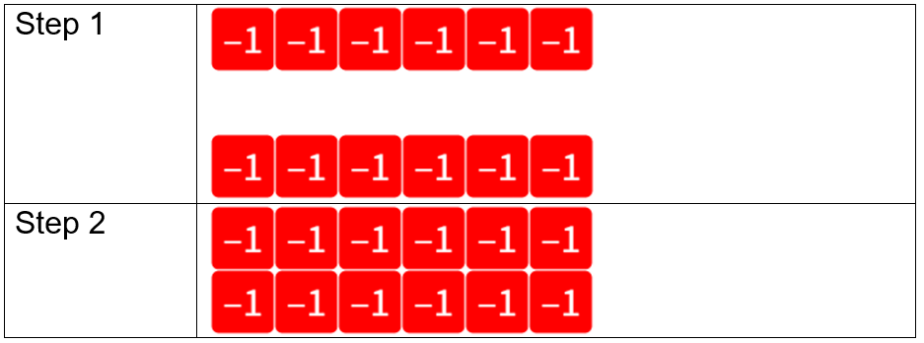
Your turn – solution 1
$$2×\left(−6\right)=(−12)$$
Notes:
Teacher notes: Step 1 should be seen as 2 groups of 6 negative ‘1’s, or ‘-1’s.
Step 2 should be seen as counting the negative ‘1’s.

Slide 9
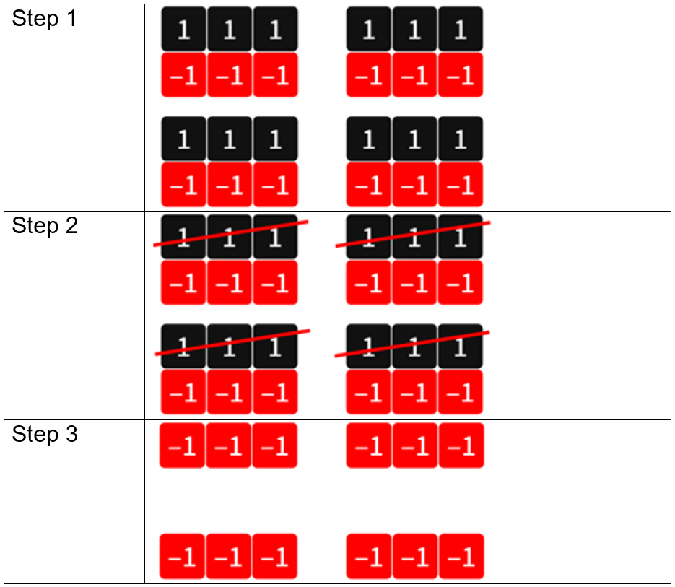
Negative groups – example
$$\left(−4\right)×3=$$
$$\left(−4\right)×3=(−12)$$
Notes:
Teacher notes: Step 1 should be seen as creating 4 groups of 3 zero pairs.
Step 2 should be seen as ‘uncounting’ 4 groups of 3 ‘1’s.
Step 3 should be seen as counting the remaining negative ‘1’s.

Slide 10
Negative groups – prompts
$$\left(−4\right)×3=$$
How many groups are being removed?
Why do we need to start by creating zero pairs?
$$\left(−4\right)×3=(−12)$$
Notes:
Teacher notes: Step 1 should be seen as creating 4 groups of 3 zero pairs.
Step 2 should be seen as ‘uncounting’ 4 groups of 3 ‘1’s.
Step 3 should be seen as counting the remaining negative ‘1’s.

Slide 11
Your turn – question 2
$$\left(−5\right)×4=$$

Slide 12
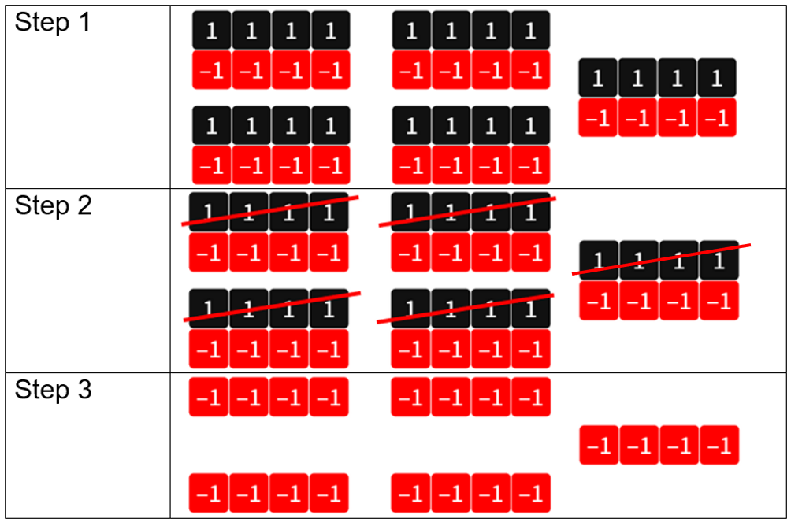
Your turn – solution 2
$$\left(−5\right)×4=(−15)$$
Notes:
Teacher notes: Step 1 should be seen as creating 5 groups of 4 zero pairs.
Step 2 should be seen as ‘uncounting’ 5 groups of 4 ‘1’s.
Step 3 should be seen as counting the remaining negative ‘1’s.

Slide 13
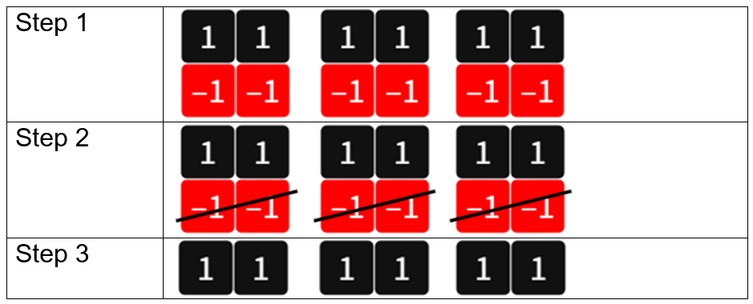
Negative groups of negatives – example
$$\left(−3\right)×\left(−2\right)=$$
$$\left(−3\right)×\left(−2\right)=6$$
Notes:
Teacher notes: Step 1 should be seen as creating 3 groups of 2 zero pairs.
Step 2 should be seen as ‘uncounting’ 3 groups of 2 ‘1’s.
Step 3 should be seen as counting the remaining ‘1’s.

Slide 14
Negative groups of negatives – prompts
$$\left(−3\right)×\left(−2\right)=$$
Why do we need the zero pairs?
Where is the $(−2)$ used?
Where is the $(−3)$ used?
$$\left(−3\right)×\left(−2\right)=6$$
Notes:
Teacher notes: Step 1 should be seen as creating 3 groups of 2 zero pairs.
Step 2 should be seen as ‘uncounting’ 3 groups of 2 ‘1’s.
Step 3 should be seen as counting the remaining ‘1’s.

Slide 15
Your turn – question 3
$$\left(−3\right)×\left(−3\right)=$$

Slide 16
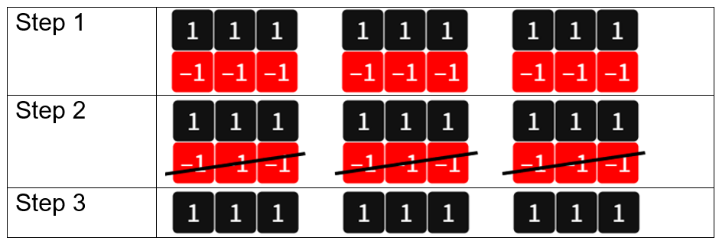
Your turn – solution 3
$$\left(−3\right)×\left(−3\right)=9$$
Notes:
Teacher notes: Step 1 should be seen as creating 3 groups of 3 zero pairs.
Step 2 should be seen as ‘uncounting’ 3 groups of 3‘1’s.
Step 3 should be seen as counting the remaining ‘1’s.

Slide 17
Adding and subtracting integers – part 1
Open middle problem
Use the integers -9 to 9 at most once to fill the empty boxes to create the largest possible answer.

Slide 18
Adding and subtracting integers – part 2
Open middle problem – solution

