Slide 1
How to deal with different denominators
Explicit teaching

Slide 2
Launch – Two truths and a lie
Addition and subtraction of fractions with different denominators
Two of the expressions are true and one is a lie (untrue).
Work in pairs to determine which expression is a lie.
$\frac{1}{2}+\frac{1}{3}<1$
$\frac{1}{4}+\frac{2}{3}>1$
$\frac{1}{5}+\frac{2}{3}<1$

Slide 3
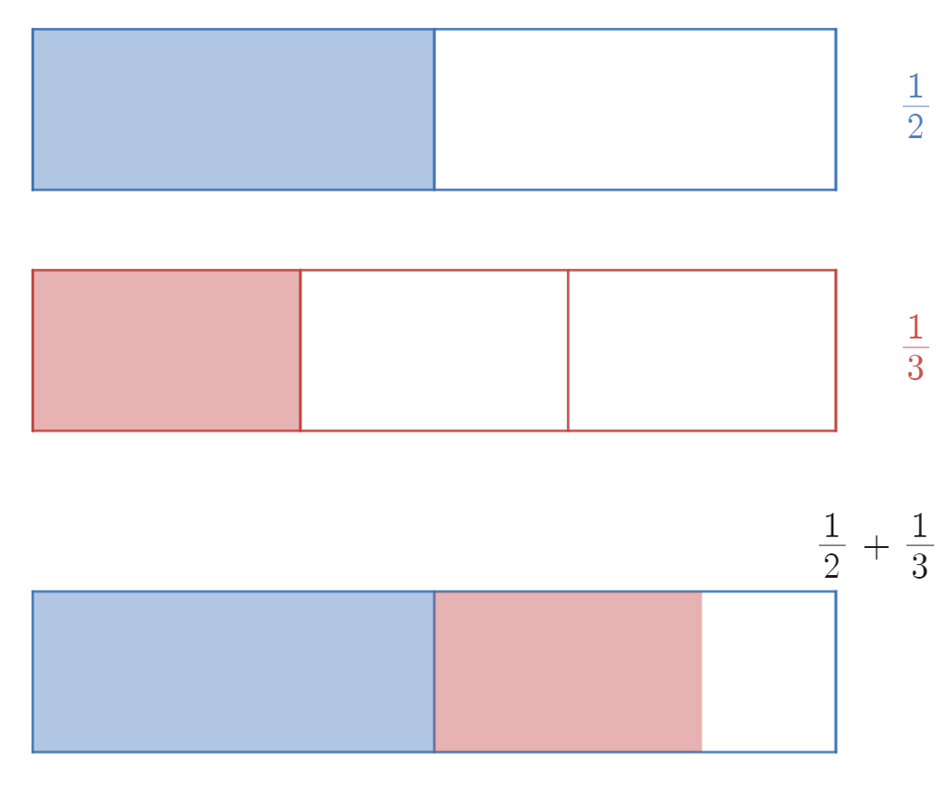
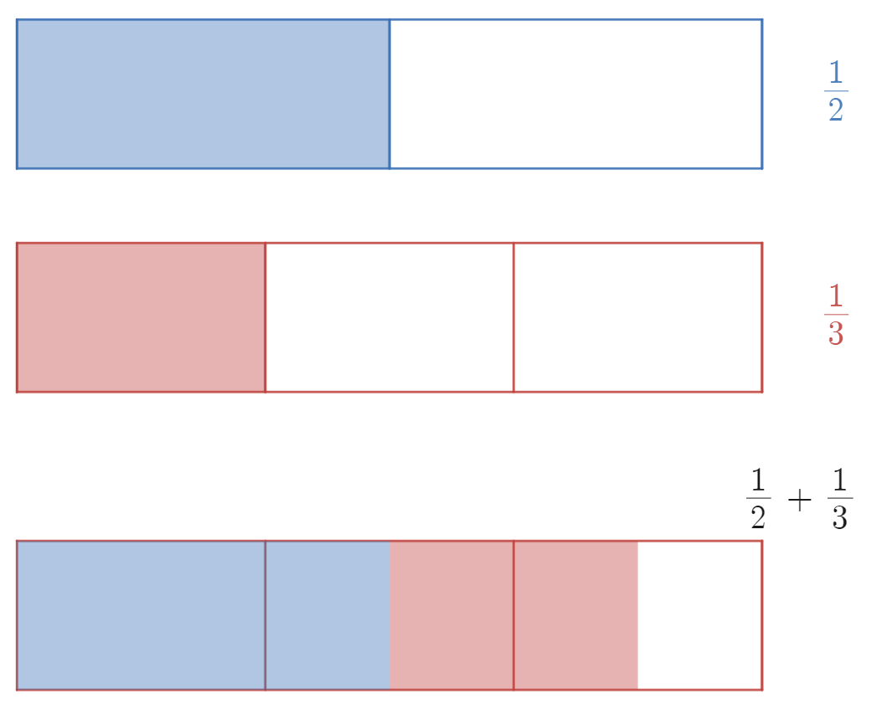
Launch – Two truths and a lie – visual 1
Addition and subtraction of fractions with different denominators
$\frac{1}{2}+\frac{1}{3}<1$
Notes:
Using the bar model from the previous lesson, we can see that regardless of which partition we use, the sum is less than 1.

Slide 4
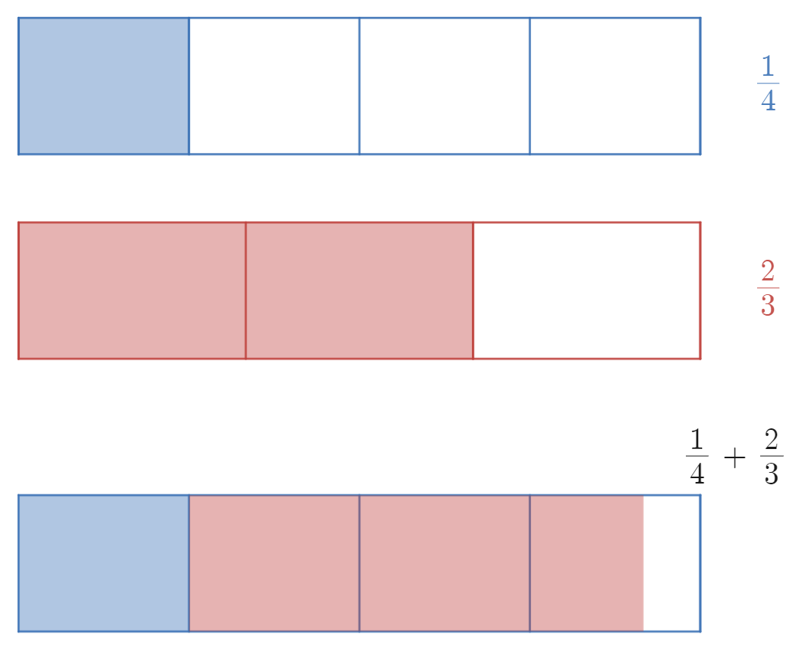
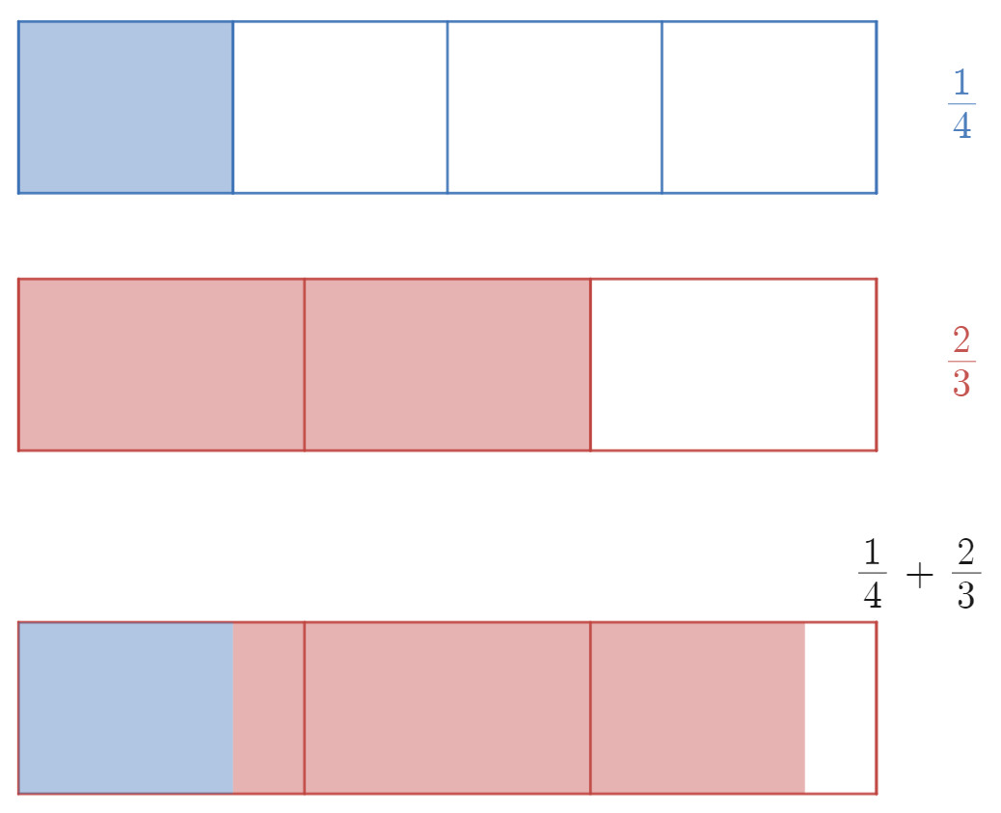
Launch – Two truths and a lie – visual 2
Addition and subtraction of fractions with different denominators
$\frac{1}{4}+\frac{2}{3}>1$
Notes:
Using the bar model from the previous lesson, we can see that regardless of which partition we use, the sum is less than 1, and the inequality is incorrect(a lie).

Slide 5
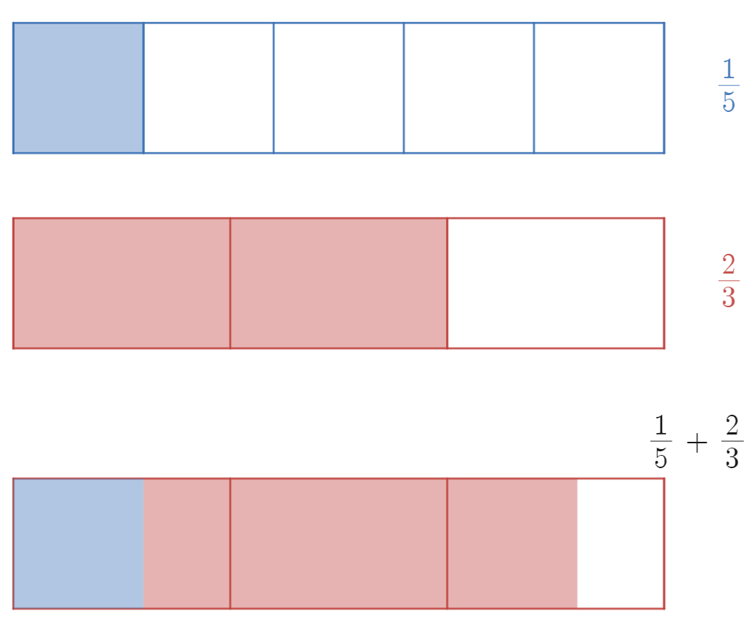
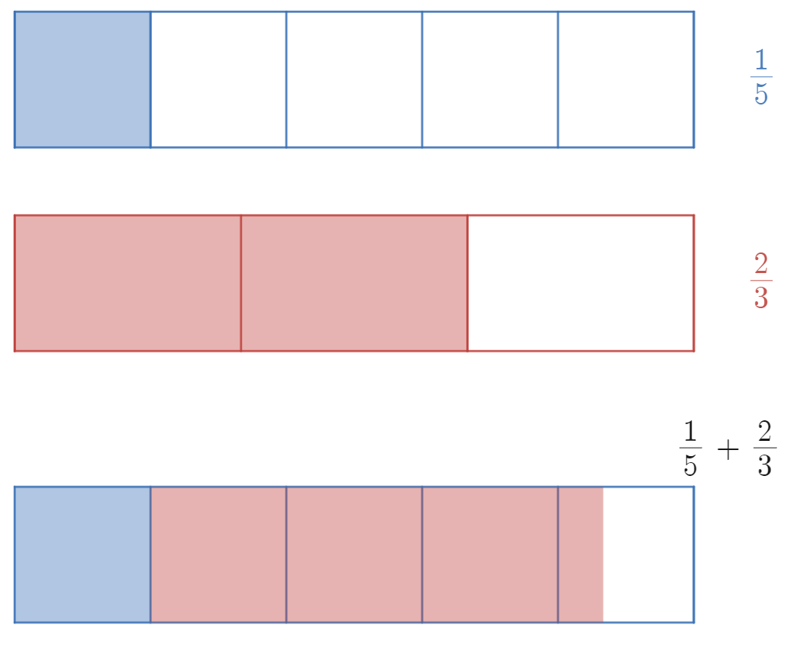
Launch - Two truths and a lie – visual 3
Addition and subtraction of fractions with different denominators
$\frac{1}{5}+\frac{2}{3}<1$
Notes:
Using the bar model from the previous lesson, we can see that regardless of which partition we use, the sum is less than 1.

Slide 6

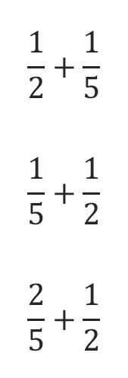
Explore
Addition and subtraction of fractions with different denominators
$$\frac{2}{5}+\frac{1}{3}$$
$$\frac{2}{5}−\frac{1}{3}$$
$$\frac{5}{6}−\frac{3}{5}$$
Represent each fraction in the Desmos graph: bit.ly/additionoffractions
Find equivalent fractions with the lowest common denominator.
Write the original sum and the equivalent sum in their notes.
$$\frac{1}{2}+\frac{1}{5}$$
$$\frac{1}{5}+\frac{1}{2}$$
$$\frac{2}{5}+\frac{1}{2}$$
Notes:
Using this Desmos graph: bit.ly/additionoffractions

Slide 7

Summarise – example 1
Addition and subtraction of fractions with different denominators
Calculate $\frac{1}{3}+\frac{1}{4}$
Multiples of 3: 3, 6, 9, 12, 15, 18, …
Multiples of 4: 4, 8, 12, …
$$\frac{1}{3}+\frac{1}{4}=\frac{4}{12}+\frac{3}{12}$$
$$=\frac{7}{12}$$
Notes:
7/12 is the sum of 1/3 and ¼. And is in its simplest form.
You could verify this using the Desmos graph.

Slide 8
Summarise – self-explanation prompts 1
Addition and subtraction of fractions with different denominators
Calculate $\frac{1}{3}+\frac{1}{4}$
Multiples of 3: 3, 6, 9, 12, 15, 18, …
Multiples of 4: 4, 8, 12, …
$$\frac{1}{3}+\frac{1}{4}=\frac{4}{12}+\frac{3}{12}$$
$$=\frac{7}{12}$$
What would change if the expression was $\frac{1}{4}+\frac{1}{3}?$
Why is it helpful to list out the multiples of 3 and 4?
Notes:
7/12 is the sum of 1/3 and ¼. And is in its simplest form.
You could verify this using the Desmos graph.

Slide 9
Summarise – your turn 1
Addition and subtraction of fractions with different denominators
Calculate $\frac{1}{3}+\frac{1}{7}$

Slide 10
Summarise – your turn 1 – solution
Addition and subtraction of fractions with different denominators
Calculate $\frac{1}{3}+\frac{1}{7}$
$$\frac{1}{3}+\frac{1}{7}=\frac{7}{21}+\frac{3}{21}$$
$$=\frac{10}{21}$$

Slide 11
Summarise – example 2
Addition and subtraction of fractions with different denominators
Calculate $\frac{1}{3}−\frac{1}{4}$
$$\frac{1}{3}−\frac{1}{4}=\frac{4}{12}−\frac{3}{12}$$
$$=\frac{1}{12}$$
Notes:
The point of this example is to emphasise that subtraction works exactly like addition. Students simply subtract the how many (numerators) once the how much (denominators) are the same.

Slide 12
Summarise – self-explanation prompts 2
Addition and subtraction of fractions with different denominators
Calculate $\frac{1}{3}−\frac{1}{4}$
$$\frac{1}{3}−\frac{1}{4}=\frac{4}{12}−\frac{3}{12}$$
$$=\frac{1}{12}$$
What do we do differently when we subtract?
Notes:
The point of this example is to emphasise that subtraction works exactly like addition. Students simply subtract the how many (numerators) once the how much (denominators) are the same.

Slide 13
Summarise – your turn 2
Addition and subtraction of fractions with different denominators
Calculate $\frac{1}{3}−\frac{1}{7}$

Slide 14
Summarise – your turn 2 – solution
Addition and subtraction of fractions with different denominators
Calculate $\frac{1}{3}−\frac{1}{7}$
$$\frac{1}{3}−\frac{1}{7}=\frac{7}{21}−\frac{3}{21}$$
$$=\frac{4}{21}$$

Slide 15
Summarise – example 3
Addition and subtraction of fractions with different denominators
Calculate $\frac{2}{3}+\frac{3}{4}$
$$\frac{2}{3}+\frac{3}{4}=\frac{8}{12}+\frac{9}{12}$$
$$=\frac{17}{12} \\ =1\frac{5}{12}$$

Slide 16

Summarise – self-explanation prompts 3
Addition and subtraction of fractions with different denominators
How is this expression the same/different to example 1: $$\frac{1}{3}+\frac{1}{4}$$
Calculate $\frac{2}{3}+\frac{3}{4}$
$$\frac{2}{3}+\frac{3}{4}=\frac{8}{12}+\frac{9}{12}$$
$$=\frac{17}{12} \\ =1\frac{5}{12}$$
How would you add $1\frac{2}{3}+\frac{3}{4}$?

Slide 17
Summarise – your turn 3
Addition and subtraction of fractions with different denominators
Calculate $\frac{2}{5}+\frac{3}{7}$

Slide 18
Summarise – your turn 3 – solution
Addition and subtraction of fractions with different denominators
Calculate $\frac{2}{5}+\frac{3}{7}$
$$\frac{2}{5}+\frac{3}{7}=\frac{14}{35}+\frac{15}{35}$$
$$=\frac{29}{35}$$

Slide 19
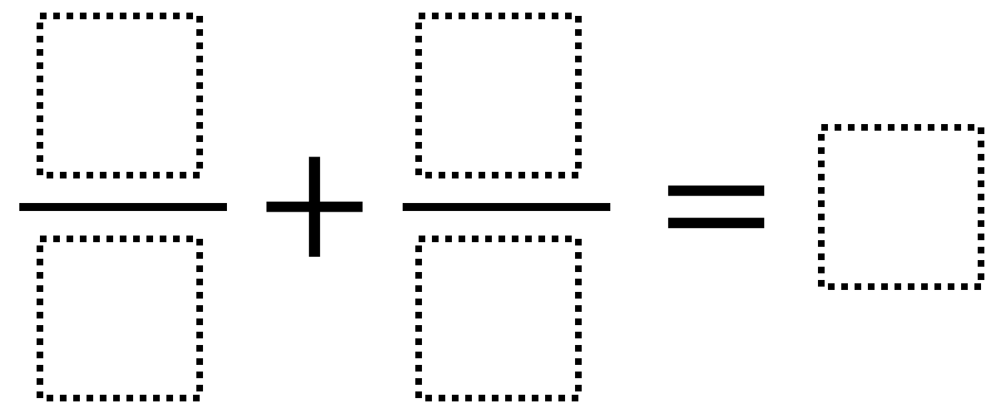
Apply – Open Middle problem
Addition and subtraction of fractions with different denominators
Directions
Using the digits 1 to 9 at most one time each, fill in the boxes to make a true statement.
Notes:
https://www.openmiddle.com/adding-fractions-6/
There are many answers. Here are three possibilities:
$\frac{8}{2}+\frac{9}{3}=7$ $\frac{3}{1}+\frac{4}{2}=5$ $\frac{2}{4}+\frac{3}{6}=1$

