Slide 1
Same same
Explicit teaching

Slide 2
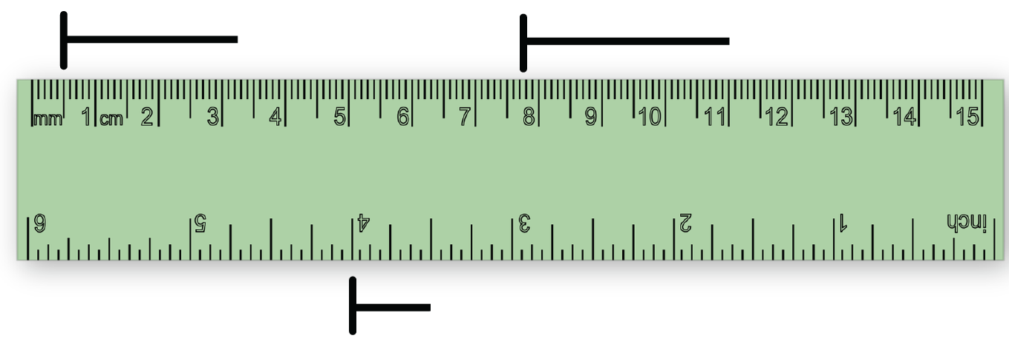
Launch
Which nail is closest to $3\frac{1}{4}$ cm in length?
A
B
C

Slide 3
Explore – example 1
Representing numbers
How would you represent $3 × 2$?
Notes:
This example is about making explicit that the three is the quantity (how many) and the 2 is the size (how much). This is to remind students that multiplication is repeated addition. Then when considering a fraction like 3 fifths, the same skill applies, and they should remember that 3 is a quantity and fifths is the size.
Ask students: How would you say 3 x 2? (Students should be encouraged to read this as 3 twos, where 3 is how many and two is how much)
How would you represent 3 twos on a number line? Where would you start from?
Refer to the previous lesson in which students developed vector notation to use with directed numbers on a number line. Encourage students to show quantities using vector notation.

Slide 4
Explore – self-explanation prompts 1
Representing numbers
How would you represent $3 × 2$?
What is 3 x 2 equal to?
How might you represent 3 x (-2)?
Notes:
This example is about making explicit that the three is the quantity (how many) and the 2 is the size (how much). This is to remind students that multiplication is repeated addition. Then when considering a fraction like 3 fifths, the same skill applies and they should remember that 3 is a quantity and fifths is the size.
How would you say 3 x 2? (Students should be encouraged to read this as 3 twos, where 3 is how many and two is how much)
How would you show 3 twos on a number line? Where would you start from?
Refer to the previous lesson in which students developed vector notation to use with directed numbers on a number line. Encourage students to show quantities using vector notation.

Slide 5
Explore – your turn 1
Representing numbers
How would you represent $2 × 5$?

Slide 6
Explore – your turn 1 – solution
Representing numbers
How would you represent 2 x 5?
Notes:
Students should read this as 2 fives

Slide 7
Explore – example 2
Representing fractions
How would you represent $\frac{2}{5}+\frac{1}{5}$?

Slide 8
Explore – self-explanation prompts 2
Representing fractions
How would you represent $\frac{2}{5}+\frac{1}{5}$?
How would you say this value?
Why is the number line split into 5?

Slide 9
Explore – your turn 2
Representing fractions
How would you represent $\frac{2}{6}+\frac{1}{6}$ ?
Notes:
What is 2/6 + 1/6 the same as?
3/6 which is the same as 1/2

Slide 10
Explore – your turn 2 – solution
Representing fractions
How would you represent $\frac{2}{6}+\frac{1}{6}$ ?
Notes:
What is 2/6 + 1/6 the same as?
3/6 which is the same as 1/2

Slide 11
Explore – example 3
Representing fractions
How would you represent $\frac{3}{5}−\frac{1}{5}$ ?
Notes:
Where do we end up? 3/5 – 1/5 = 2/5
Where the red and blue arrows overlap is a zero pair, meaning they cancel each other out.

Slide 12
Explore – self-explanation prompts 3
Representing fractions
How would you represent $\frac{3}{5}−\frac{1}{5}$ ?
How does the red vector change our answer?
What if the expression was $−\frac{1}{5}+\frac{3}{5}$ ?
Notes:
Where do we end up? 3/5 – 1/5 = 2/5
Where the red and blue arrows overlap is a zero pair, meaning they cancel each other out.

Slide 13
Explore – your turn 3
Representing fractions
How would you represent $\frac{4}{6}−\frac{1}{6}$ ?
Notes:
Where do we end up? 4/6 – 1/6 = 3/6 (which is the same as ½)
Where the red and blue arrows overlap is a zero pair, meaning they cancel each other out.

Slide 14
Explore – your turn 3 – solution
Representing fractions
How would you represent $\frac{4}{6}−\frac{1}{6}$ ?
Notes:
Where do we end up? 4/6 – 1/6 = 3/6 (which is the same as ½)
Where the red and blue arrows overlap is a zero pair, meaning they cancel each other out.

Slide 15
Summarise
Notes to your future selves
$\frac{1}{5}+\frac{2}{5}$
$\frac{2}{5}−\frac{1}{5}$
$\frac{1}{5}−\frac{2}{5}$
$1\frac{1}{5}+\frac{2}{5}$

Slide 16
Apply
Complementary events
The probability of rolling a six on a six-sided die is $\frac{1}{6}$.
The probability of being born on a weekday is $\frac{5}{7}$.
The probability of rolling an even number on a six-sided die is $\frac{3}{6}$.

Slide 17
Apply (1)
Complementary events
The probability of rolling a six on a six-sided die is $\frac{1}{6}$.
Probability of rolling a six
Probability of not rolling a six

Slide 18
Apply (2)
Complementary events
The probability of rolling an even number on a six-sided die is $\frac{3}{6}$.
Probability of rolling an even number
Probability of not rolling an even number

Slide 19
Apply (3)
Complementary events
The probability of being born on a weekday is $\frac{5}{7}$.
Probability of not being born on a weekday
Probability of being born on a weekday

