Slide 1
Bonuses and penalties
Explicit teaching

Slide 2
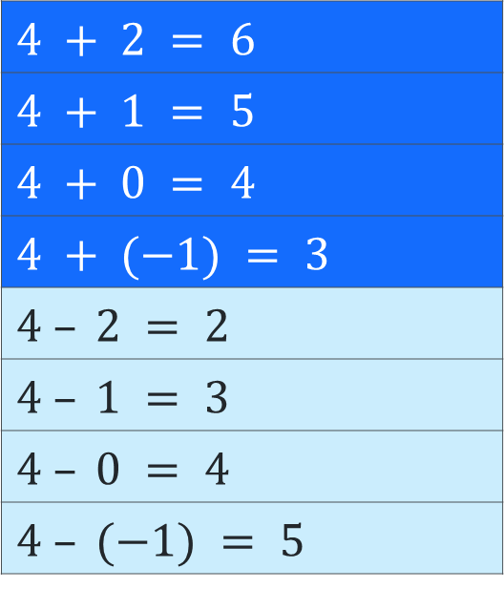
What do you notice? What do you wonder?
Launch
$$4 + 2 = 6$$
$$4 + 1 = 5$$
$$4 + 0 = 4$$
$$4 + (−1) = 3$$
$$4 – 2 = 2$$
$$4 – 1 = 3$$
$$4 – 0 = 4$$
$$4 – (−1) = 5$$

Slide 3
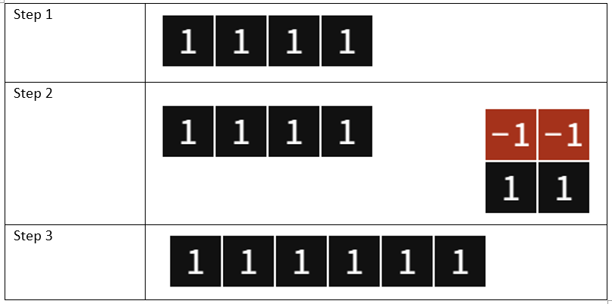
Adding and subtracting integers (1)
Using zero pairs – example 2
$$4 – (−2) =$$
$$4 – (−2) = 6$$

Slide 4
Adding and subtracting integers (2)
Using zero pairs – self explanation prompts
Why were these two blocks added?
$$4 – (−2) =$$
If we are subtracting, why do we get a bigger answer?
Where did the red blocks go?
$$4 – (−2) = 6$$

Slide 5
Adding and subtracting integers (3)
Your turn – question 2
$$6 – (−3) =$$

Slide 6
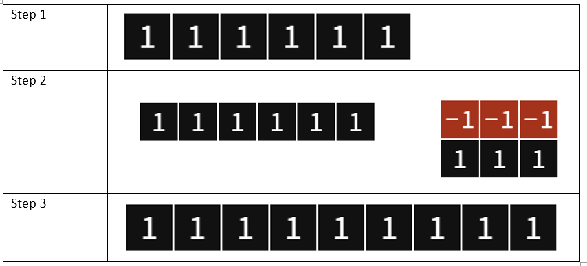
Adding and subtracting integers (4)
Your turn – solution 2
$$6 – (−3) =$$
$$6 – (−3) = 9$$

Slide 7
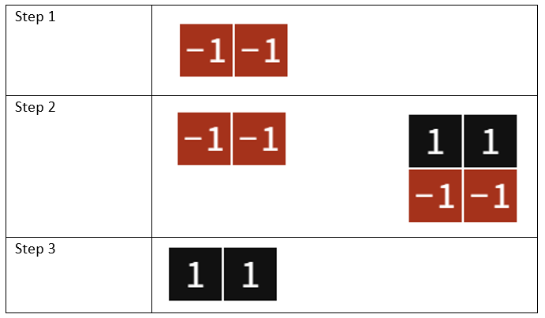
Adding and subtracting integers (5)
Using zero pairs – example 1
$$(−2) – (−4) =$$
$$(−2) – (−4) = 2$$

Slide 8
Adding and subtracting integers (6)
Using zero pairs – example 1
Why did we need to add zero pairs in this case?
$$(−2) – (−4) =$$
Why did we only add 2 zero pairs?
Where did the red blocks go?
$$(−2) – (−4) = 2$$

Slide 9
Adding and subtracting integers (7)
Your turn – question 1
$$(−3) – (−6) =$$

Slide 10
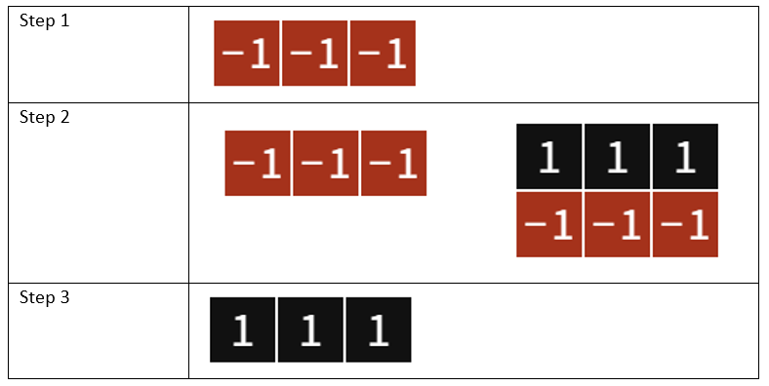
Adding and subtracting integers (8)
Your turn – solution 21
$$(−3) – (−6) =$$
$$(−3) – (−6) = 3$$

